Slide 1
HMM Day 2: Diving into messy data
Ron Togunov, Marie Auger-Méthé

Slide 2
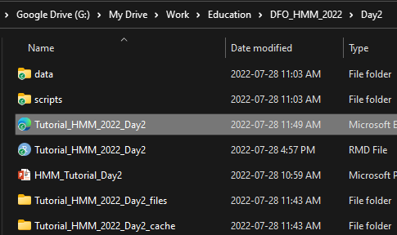
Tutorial setup
Open HTML tutorial for Day 2

Slide 3
Day 2 Objectives:
Working with multiple individuals
Selecting temporal resolution
Handling missing data
Approaches for high accuracy location data
Approaches for data with location error (e.g., ARGOS)
Integrating dive data

Slide 4
Data
Three Narwhals tagged in Tremblay Sound
Fastloc GPS and ARGOS location data
Mean depth data
Temporal resolution:
Fastloc GPS: 10 min
ARGOS: irregular
Depth data: 75 s

Slide 5
1. Working with multiple individuals
Provide statistical information and biological relevance
Requires special considerations when coding
group_by(ID) %>% summarise(…)
ifelse(ID == lead(ID), …, NA)
tracks_list <- split(tracks_df, tracks_df$ID)
lapply(list, FUN)
mapply(FUN, list_1, list_2, SIMPLIFY = F)

Slide 6
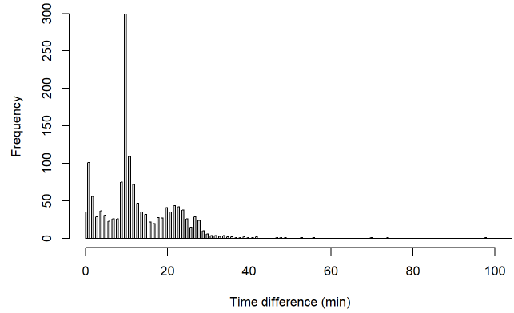
2. Selecting temporal resolution
Depends on data and study question
higher resolution isn’t always best
Visual assessment
Calculating proportion of missing data
Custom function p_na()

Slide 7
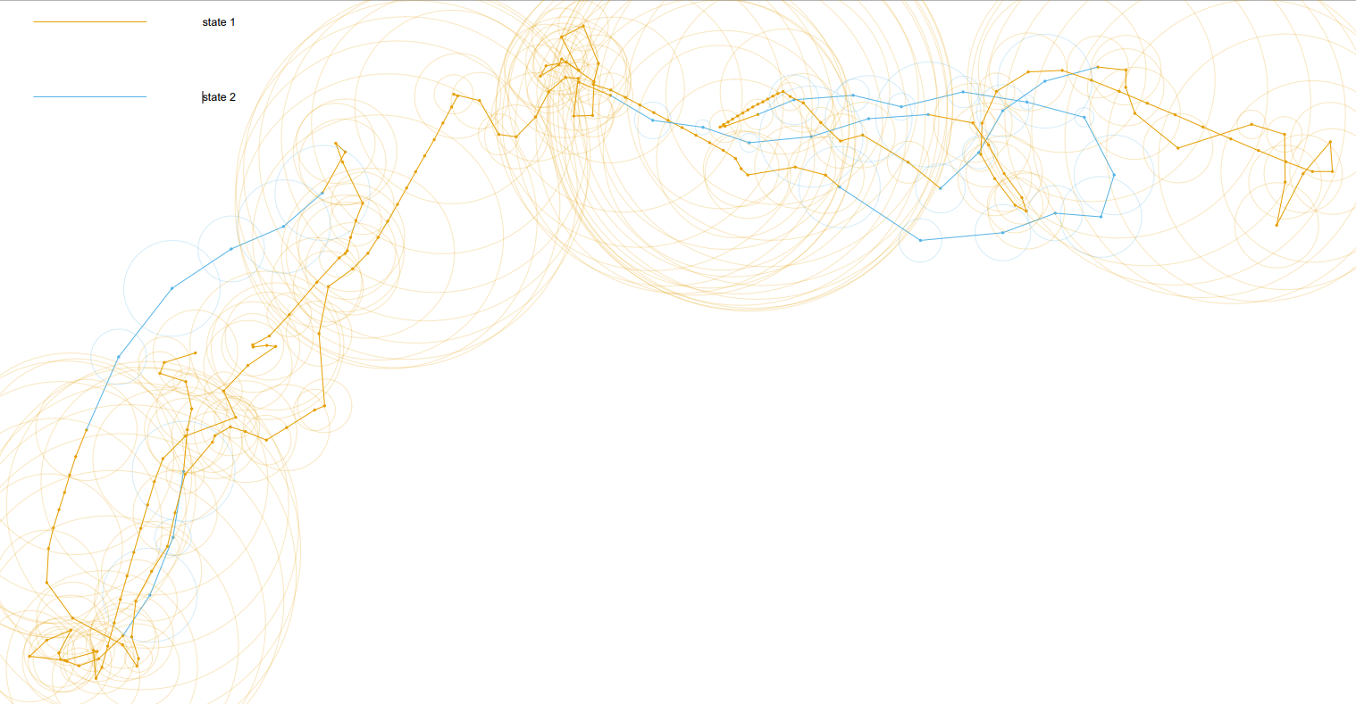
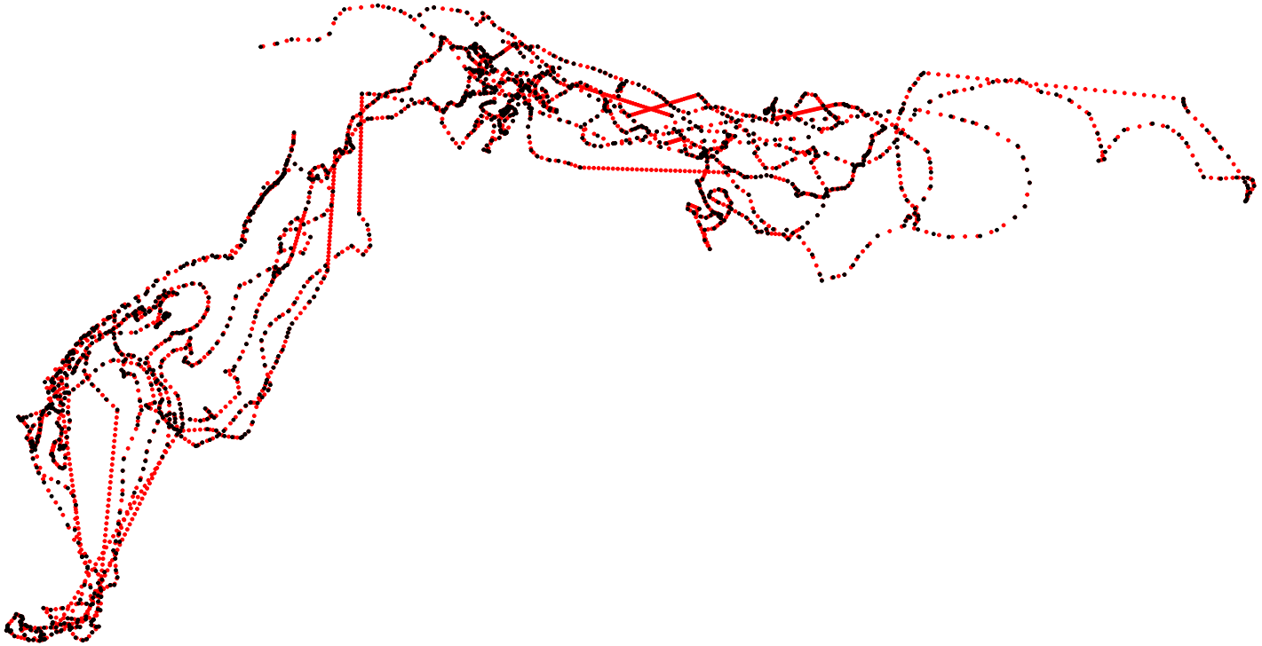
3. Handling missing data
Interpolation
Linear interpolation
Statistical interpolation
Multiple imputation
Voiding data gaps
Path segmentation

Slide 8
Multiple imputation
When location data are temporally-irregular or subject to measurement error
Fit a CTCRW to the tracks
Can accommodate location error
Simulate temporally-regular realizations of the crawl model
Fit HMM to each simulation
Pool inferences across the HMMs
Step 1: crawlWrap Steps 2 & 3: MIfitHMM Step 4: Mipool

Slide 9
4. Integrating dive data
Calculate dive metrics using diveMove package:
Create TDR class using createTDR
Calibrate TDR data using calibrateDepth
Calculate dive statistics using diveStats
Combine data streams with different resolutions
Summarise dive stats using dplyr:: summarise

Slide 10
4. Integrating dive data – Cont.
Selecting data streams
Minimal missing data
Evidence of multi-modality
Some autocorrelation
Minimal co-linearity
Fitting HMM with several data streams
Fit simple models to each data stream separately
Get starting paramiters from simpler models using getPar
Fit with fitHMM

