Slide 1
HMM Day 2: Diving into messy data
Ron Togunov, Marie Auger-Méthé

Slide 2
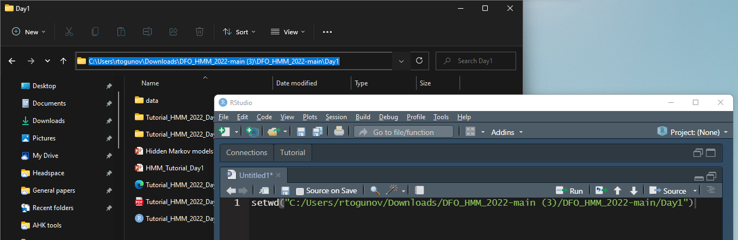
Tutorial setup
Open R and set the working directory to the “Day2” folder

Slide 3
Tutorial setup
Open R and set the working directory to the “Day2” folder

Slide 4
Day 2 Objectives:
Working with multiple individuals
Selecting temporal resolution
Handling missing data
Approaches for high accuracy location data
Approaches for data with location error (e.g., ARGOS)
Integrating dive data

Slide 5
Data
Three Narwhals tagged in Tremblay Sound
Fastloc GPS and ARGOS location data
Mean depth data
Temporal resolution:
Fastloc GPS: 10 min
ARGOS: irregular
Depth data: 75 s

Slide 6
1. Working with multiple individuals
Provide statistical information and biological relevance
Requires special considerations when coding
group_by(ID) %>% summarise(…)
ifelse(ID == lead(ID), …, NA)
tracks_list <- split(tracks_df, tracks_df$ID)
lapply(list, FUN)
mapply(FUN, list_1, list_2, SIMPLIFY = F)

Slide 7
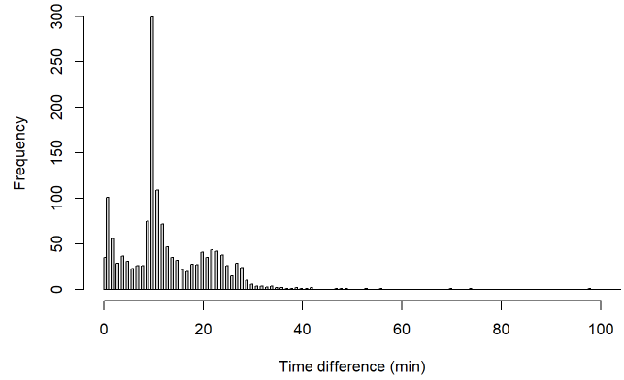
2. Selecting temporal resolution
Depends on data and study question
higher resolution isn’t always best
Visual assessment
Calculating proportion of missing data
Custom function p_na()

Slide 8
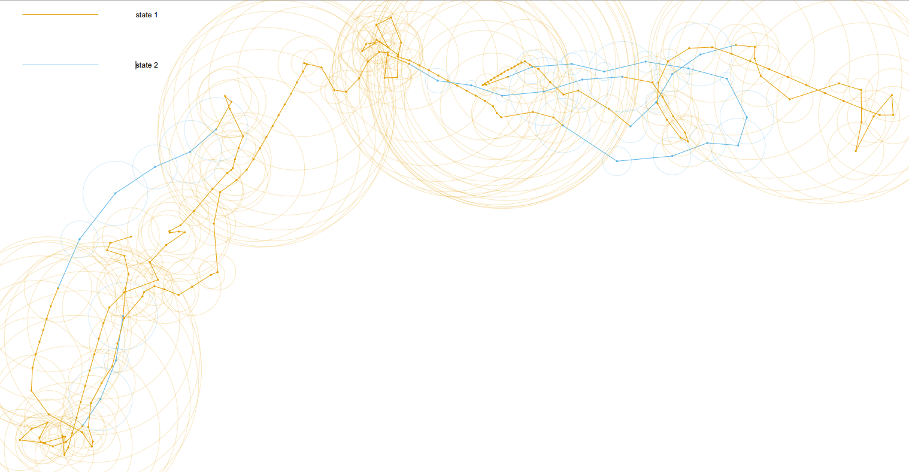
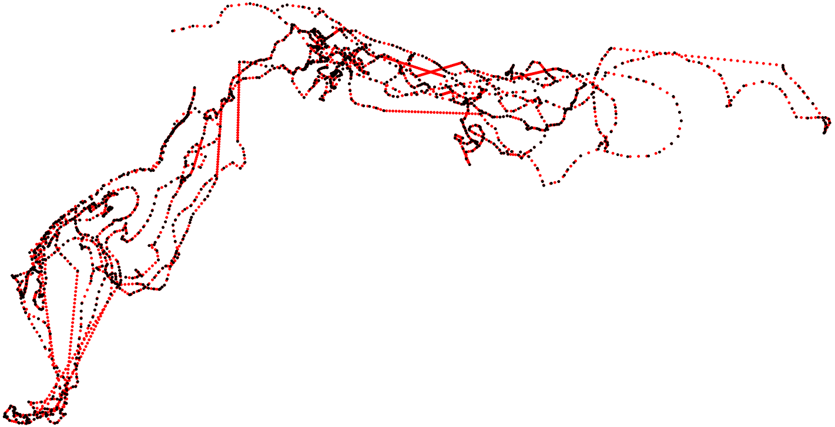
3. Handling missing data
Interpolation
Linear interpolation
Statistical interpolation
Multiple imputation
Voiding data gaps
Path segmentation

Slide 9
Multiple imputation
When location data are temporally-irregular or subject to measurement error
Fit a CTCRW to the tracks
Can accommodate location error
Simulate temporally-regular realizations of the crawl model
Fit HMM to each simulation
Pool inferences across the HMMs
Step 1: crawlWrap Steps 2 & 3: MIfitHMM Step 4: Mipool

Slide 10
4. Integrating dive data
Calculate dive metrics using diveMove package:
Create TDR class using createTDR
Calibrate TDR data using calibrateDepth
Calculate dive statistics using diveStats
Combine data streams with different resolutions
Summarise dive stats using dplyr:: summarise
Add Plot of dive label with different dive metrics

Slide 11
4. Integrating dive data – Cont.
Selecting data streams
Minimal missing data
Evidence of multi-modality
Some autocorrelation
Minimal co-linearity
Fitting HMM with several data streams
Fit simple models to each data stream separately
Get starting parameters from simpler models using getPar
Fit with fitHMM

Slide 12
5. Covs to emission prob
Turn angle.

