Slide 1
HMM Tutorial Day 1 Basics with momentuHMM
Ron Togunov, Marie Auger-Méthé

Slide 2
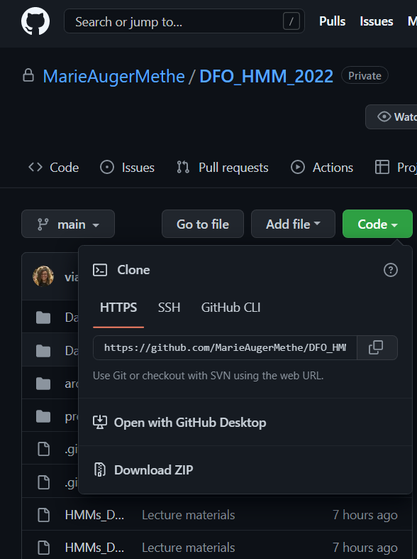
Tutorial setup
Download workshop ZIP

Slide 3
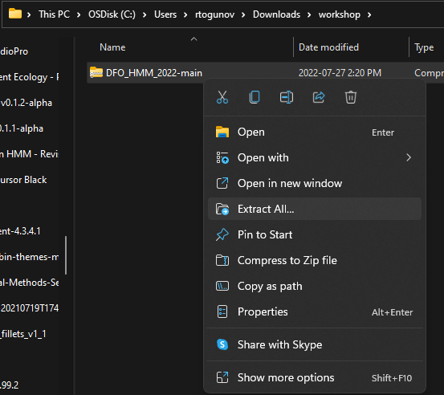
Tutorial setup
Download workshop ZIP
Unzip workshop file

Slide 4
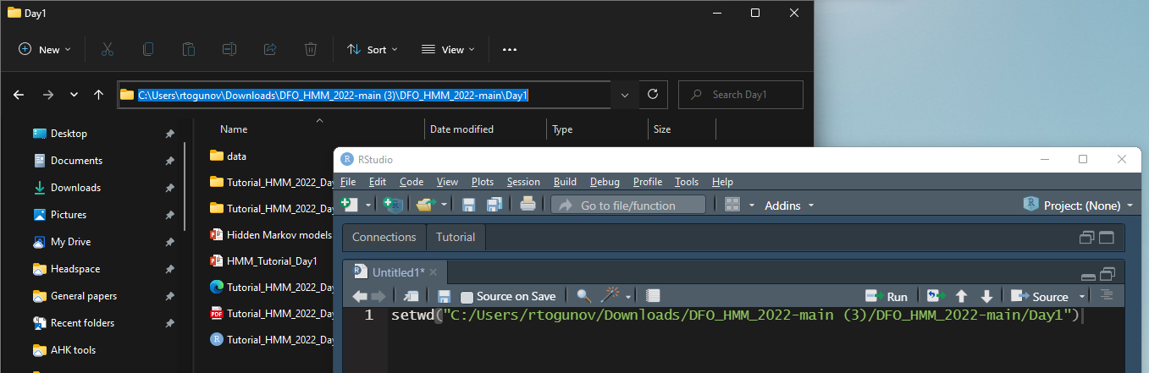
Tutorial setup
Download workshop ZIP
Unzip workshop file
Open R and set the working directory to the “Day1” folder

Slide 5
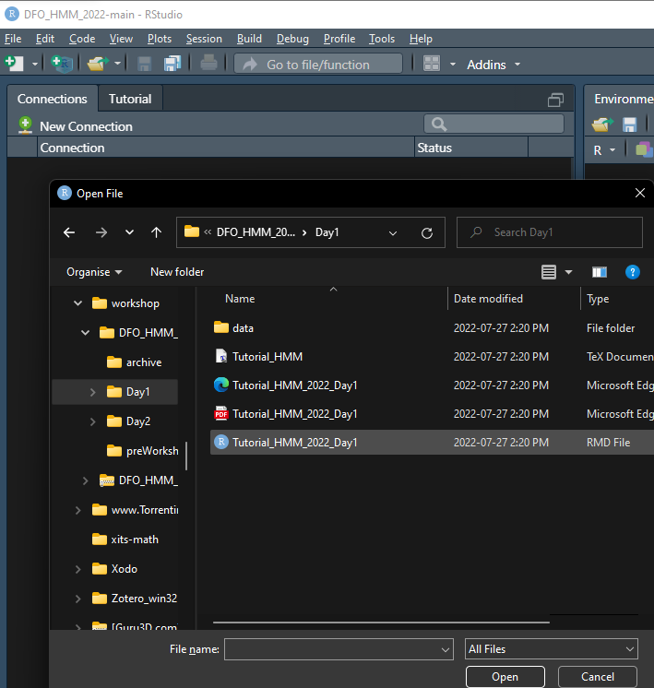
Tutorial setup
Download workshop ZIP
Unzip workshop file
Open R and set the working directory to the “Day1” folder
Follow along with the Day 1 HTML tutorial

Slide 6
Day 1 Objectives
Fit basic HMM to GPS data from grey seal
Introduction fitting models with momentuHMM
Assessing model fit and quality
Integrating and interpreting covariates on state probability
Integrate covariate on emission probability
Examine effect of different temporal resolutions for track data

Slide 7
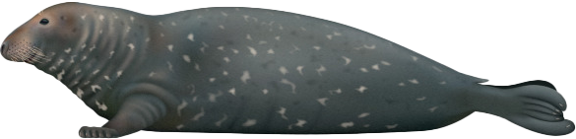
1. Grey seal data
Fastloc GPS data from grey seals
High spatial accuracy
~ 60 min temporal resolution
Few missing locations
Summarised into two data streams: step length, turning angle

Slide 8
2. Fitting HMM with momentuHMM
Package by Brett McClintock and Théo Michelot, based on moveHMM
Key functions
prepData – prepare tracking data for fitting HMM
Extract environmental data
Calculate step length and turning angle
Calculate circular covariates (e.g., angle relative to ocean currents)
fitHMM – Define HMM structure and fit it to model
Number of states
Distribution associated with each state
Starting parameters
Covariates

Slide 9
prepData(data, type = "LL", coordNames = c("lon", "lat"))
Minimum arguments:
Data (e.g., data = sealreg)
Type - coordinate reference system (“UTM” if not lat/long)
coordNames - names of coordinate columns (if not c(“x”, “y”))
Optional arguments:
covNames – names of covariates (fills in missing data with nearest value)
spatialCovs – raster object from which to extract covariate data
angleCovs – name of angular covariate for which to calculate the relative angle (e.g., turn angle relative to wind

Slide 10
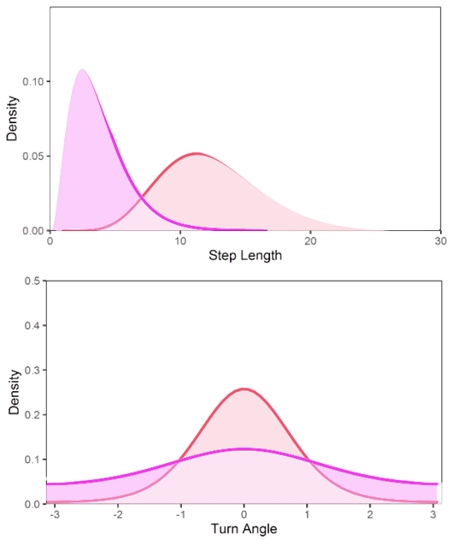
fitHMM(data, …)
Minimum arguments:
nbState – number of behavioural states
Dist – named list distribution associated with each data stream
E.g., gamma for step length and von Mises for turning angle
dist=list(step="gamma", angle="vm")
Par0 – named list initial parameters for data optimisation
E.g., step length l ~ gamma(μ_{i},σ_{i}), define μ and σ for each state
Par0 = list(step=c(mu0, sigma0), angle=kappa0)
Par0 = list(step=c(c(200,500), c(100,250)), angle=c(0.5,0.8))
ϕ
l

Slide 11

fitHMM(data, …)
Optional arguments:
Formula – effects of covariates on transition probability
E.g., formula= ~bathy
estAngleMean – Whether to estimate mean turning angle (default=F)
circularAngleMean – Whether to use a circular-circular distribution for turn angle (use if examining bias relative to multiple factors or if expect non-linear relationship; default = circular-linear)
stateNames – names associated with each behavioural state
retryFits – number of times to attempt to fit the model
DM, workBounds, betaCons, fixPar, …

Slide 12
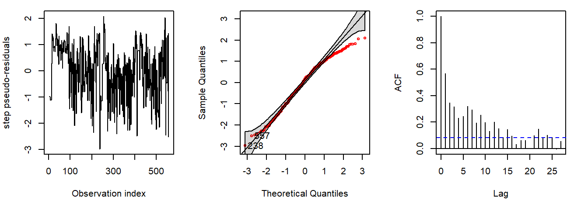
3. Assessing model fit and quality
Review estimated parameters and likelihood
Examine Pseudo-residuals using plotPR
Simulate tracks using simData
Check confidence intervals using CIreal

Slide 13
4. Transition probability covariates
Examine effect of environmental covariate on behaviour probability
Model transition probabilities as function of covariate using Formula argument in fitHMM
Examine relationship using plot and plotStationary

Slide 14
5. Emission probability covariates
Examine effect of covariates on emission probabilities
Model data stream parameters as function of covariate using DM argument in fitHMM
Examine relationship using plot

Slide 15
6. Effect of temporal resolution
Examine effect of interpolating track to different resolutions (e.g., 1, 4, or 8 hours)
Effect on:
Estimated parameters
Predicted states
Model fit

