Slide 1
HMM Tutorial Day 1 Basics with momentuHMM
Ron Togunov, Marie Auger-Méthé

Slide 2
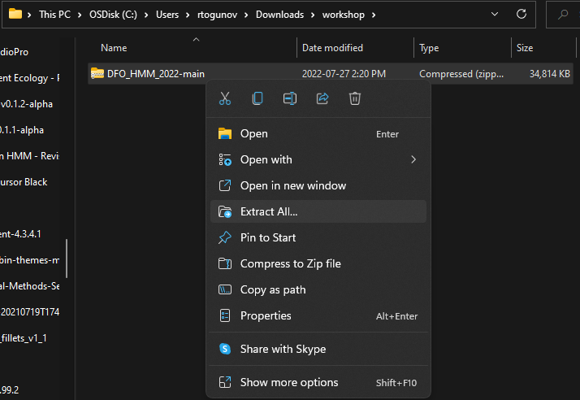
Tutorial setup
Unzip workshop file

Slide 3
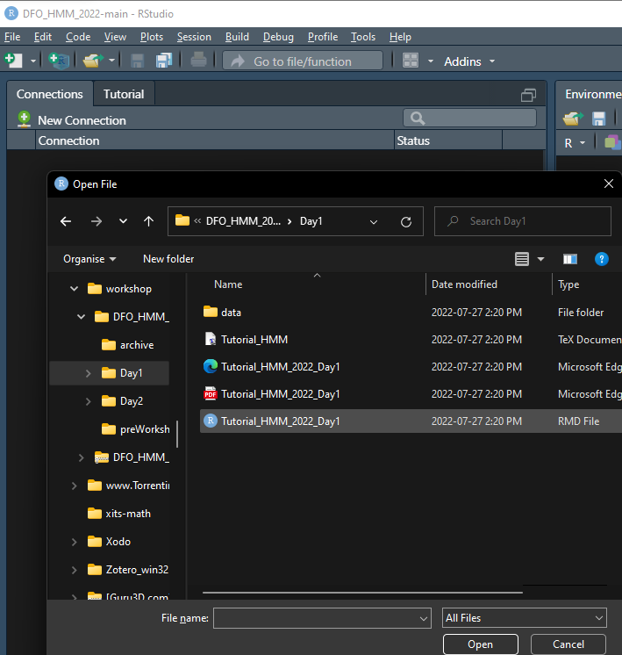
Tutorial setup
Unzip workshop file
In HTML of tutorial for Day 1

Slide 4

Tutorial setup
Unzip workshop file
In R, open tutorial for Day 1
Set workind directory with: setwd(“Day1/”)

Slide 5
Day 1 Objectives
Introduction to momentuHMM
Fit basic HMM to GPS data from grey seal
Assessing model fit and quality
Troubleshooting failed models
Simulating tracks from fit HMMs
Integrating covariates on transition probability

Slide 6
momentuHMM
Package by Brett McClintock and Théo Michelot, based on moveHMM
Key functions:
prepData: prepare data
fitHMM: fit HMM
Viterbi: decode most likely state sequence

Slide 7
Data
Fastloc GPS data from grey seals
High spatial accuracy
~ 60 min temporal resolution
Few missing locations
Summarised into two data streams: step length, turning angle

Slide 8
prepData
prepData(sealreg, type = "LL", coordNames = c("lon", "lat"))
Type: coordinate reference system (lat/long or projected in m)
coordNames: names of coordinate columns

Slide 9
fitHMM
nbState: number of behavioural states
dist: named list distribution associated with each data stream
E.g., gamma for step length and von Mises for turning angle
E.g., dist=list(step="gamma", angle="vm")
Par0: named list initial parameters for data optimisation
E.g., step length ~ gamma(μ_{i},σ_{i}) , define μ and σ for each state
Par0 = list(step=c(mu0, sigma0), angle=kappa0)
Formula: effects of covariates on the transition probability
E.g., formula= ~bathy

