Slide 1
GIS in R Lecture 1
Marie Auger-Méthé
Ocean Tracking Network
Dalhousie University

Slide 2
What is GIS?
Geographical Information System (GIS):
Store and analyse spatial data
Set of tools to handle data referenced to Earth, e.g. tools to:
Store
Retrieve
Transform
Visualise

Slide 3
GIS in R
R can be used to:
Analyse spatial data, including:
retrieve, transform, and statistical analyses
Visualise spatial data
R doesn’t have a storage capacity per say
No equivalent of Arc Catalogue or GIS database
But can somewhat handle this with proper R practices, including using R Studio projects

Slide 4
What is spatial data?
Spatial data is referenced with respect to their location on Earth
For this you need as set of information, e.g.:
Longitude (º) with respect to prime meridian (e.g., Greenwich)
Latitude with respect to the equator
Earth shape model (e.g., WGS84).

Slide 5
A spherical Earth on a flat map

Slide 7
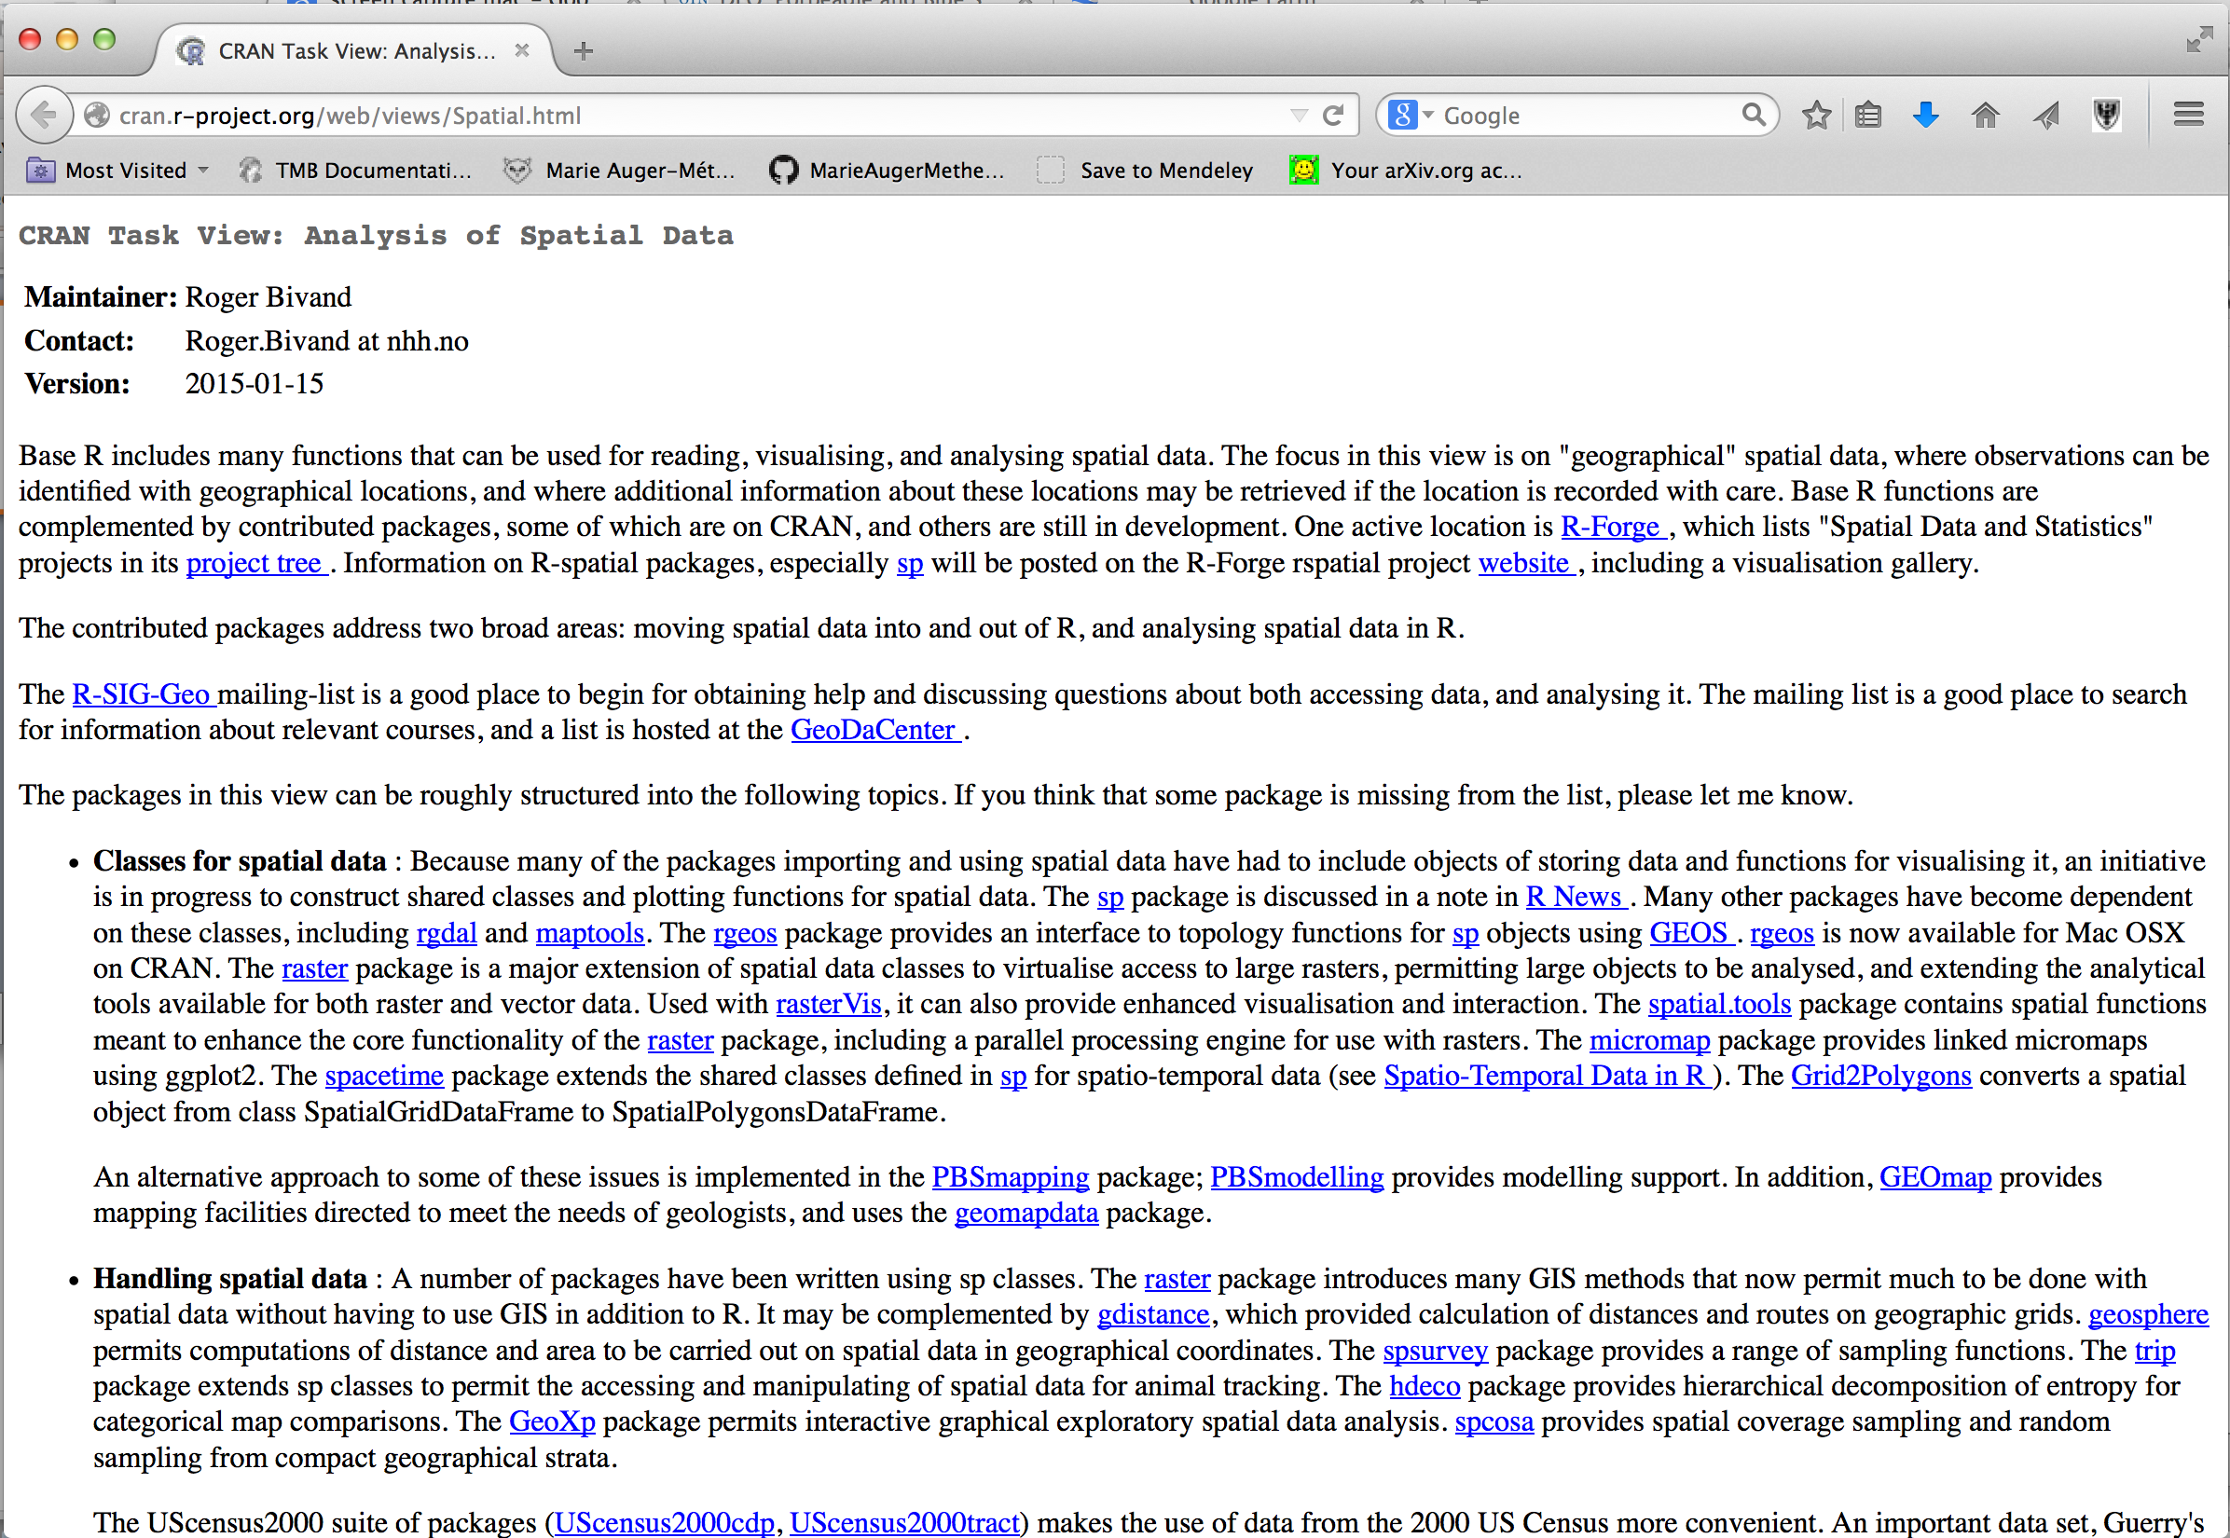
Where to get info: CRAN spatial task view

Slide 8
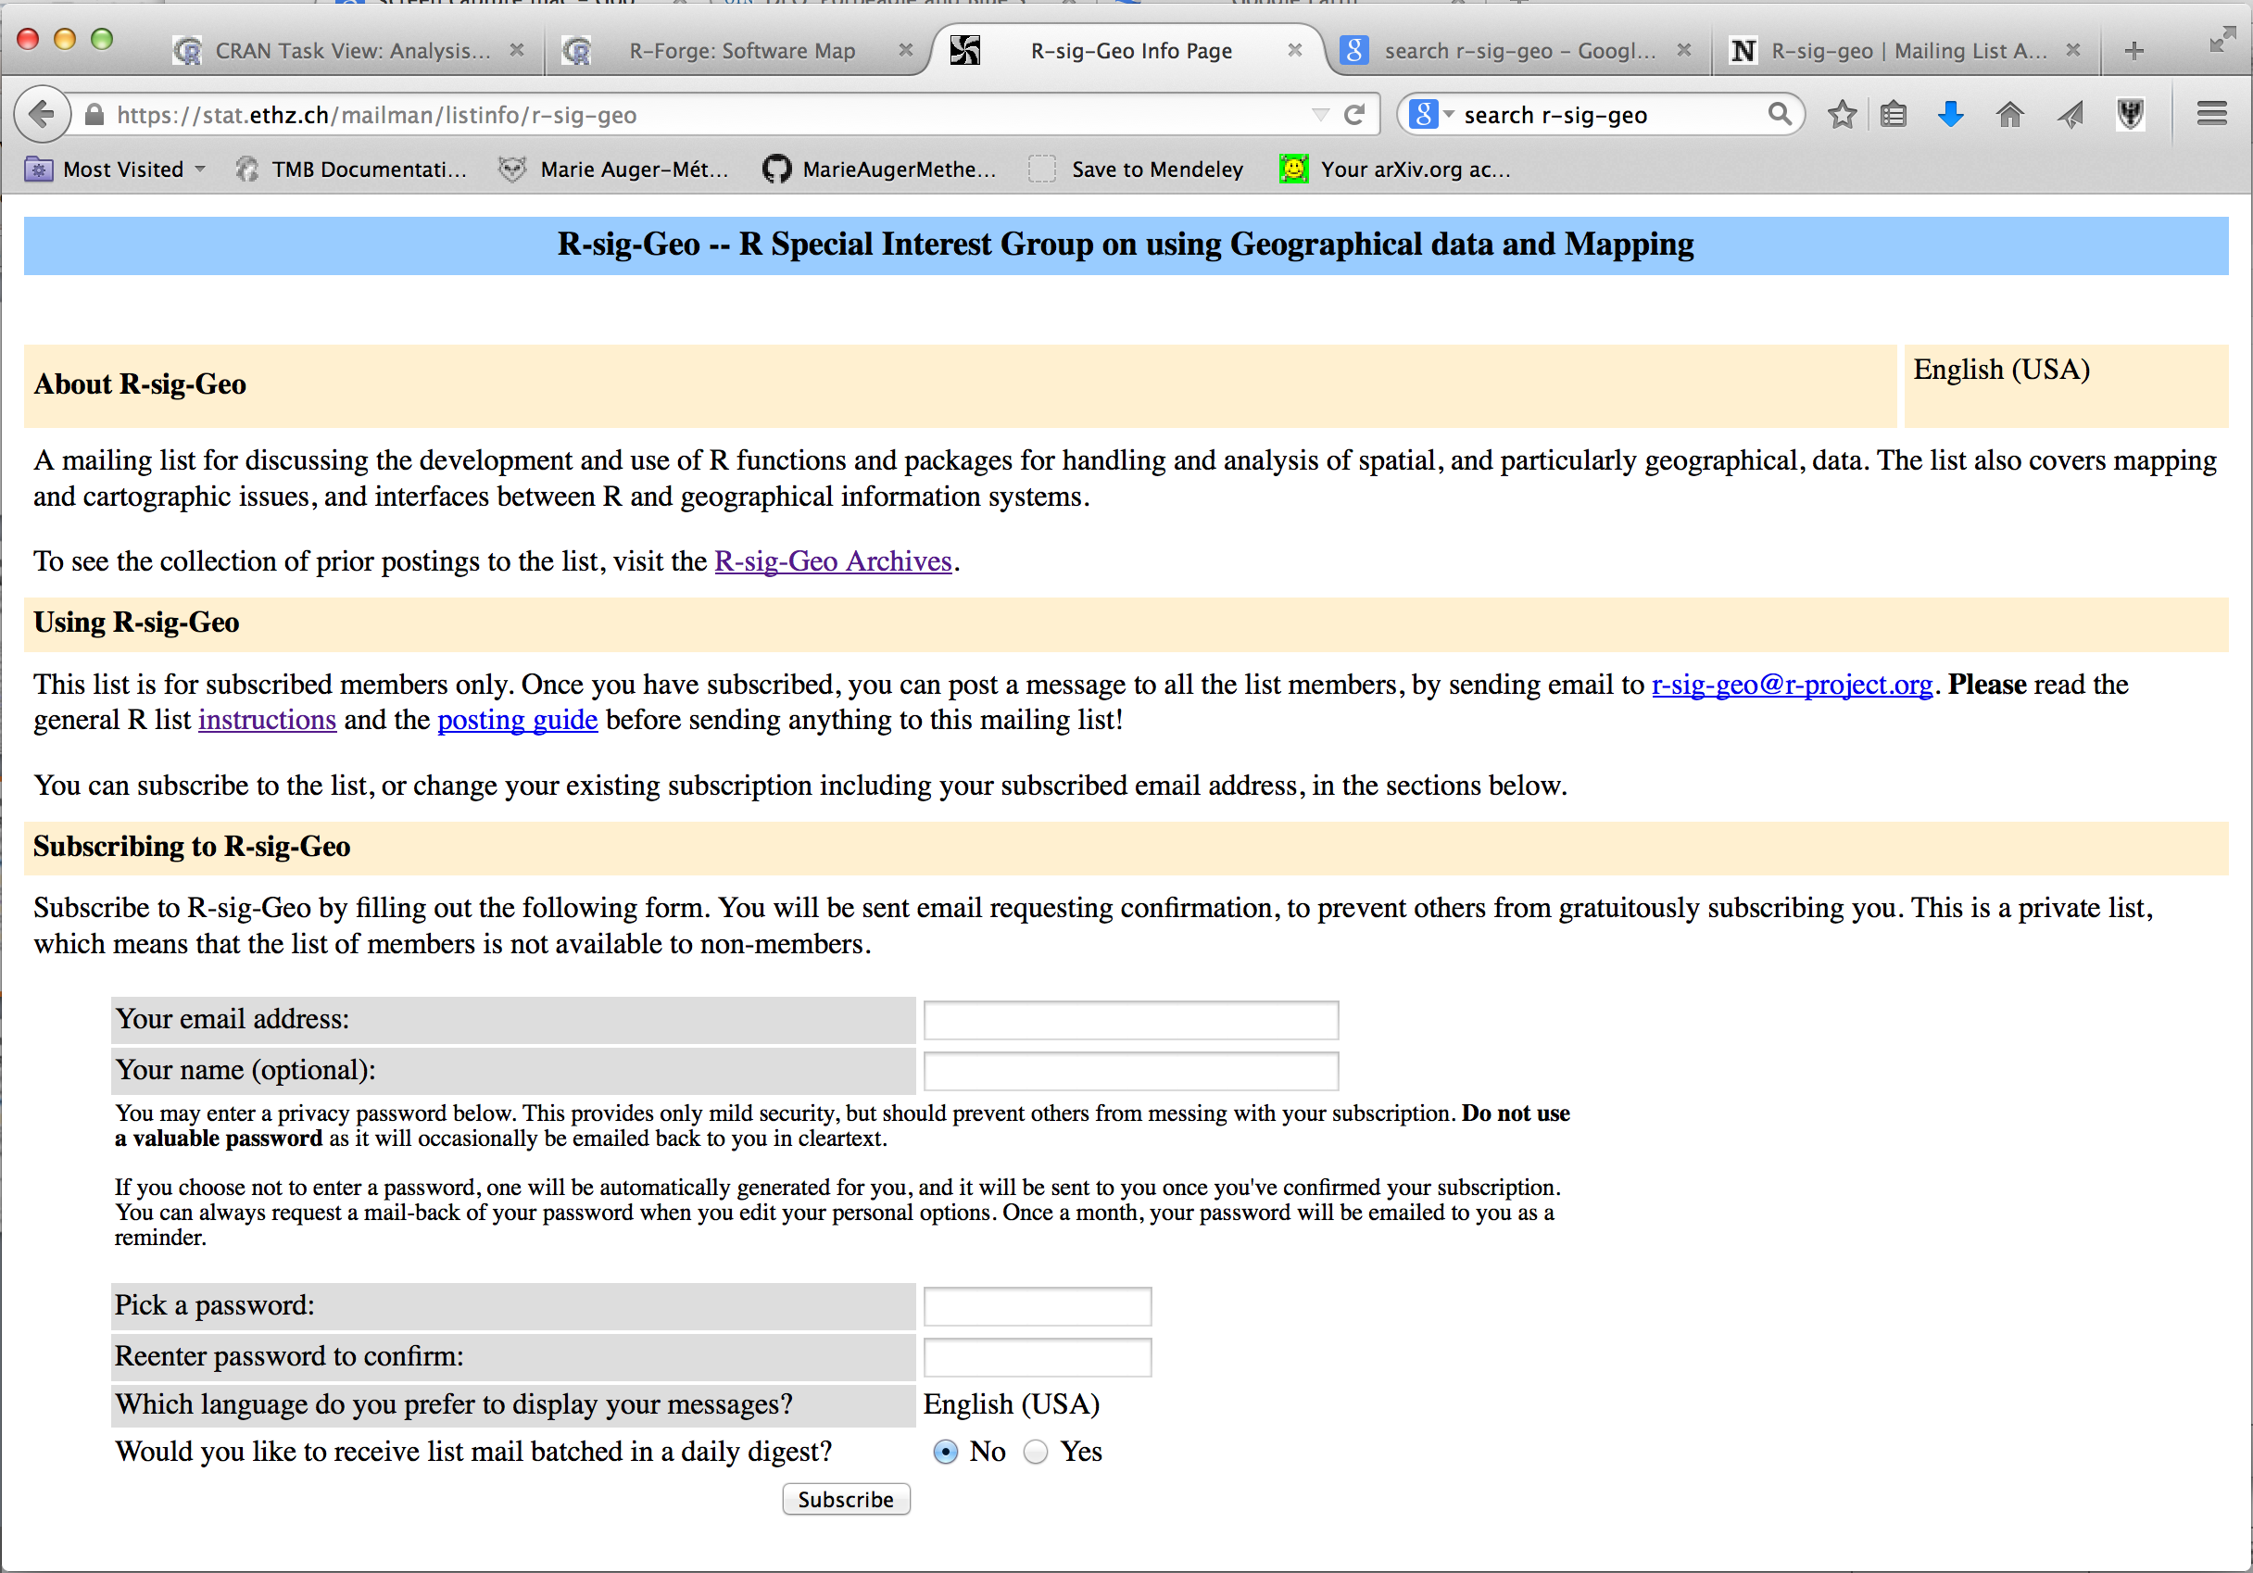
Where to get info: R-Sig-Geo mailing list

Slide 9
Where to get info: R-Sig-Geo mailing list

Slide 10
Where to get info: R-Sig-Geo mailing list

Slide 11
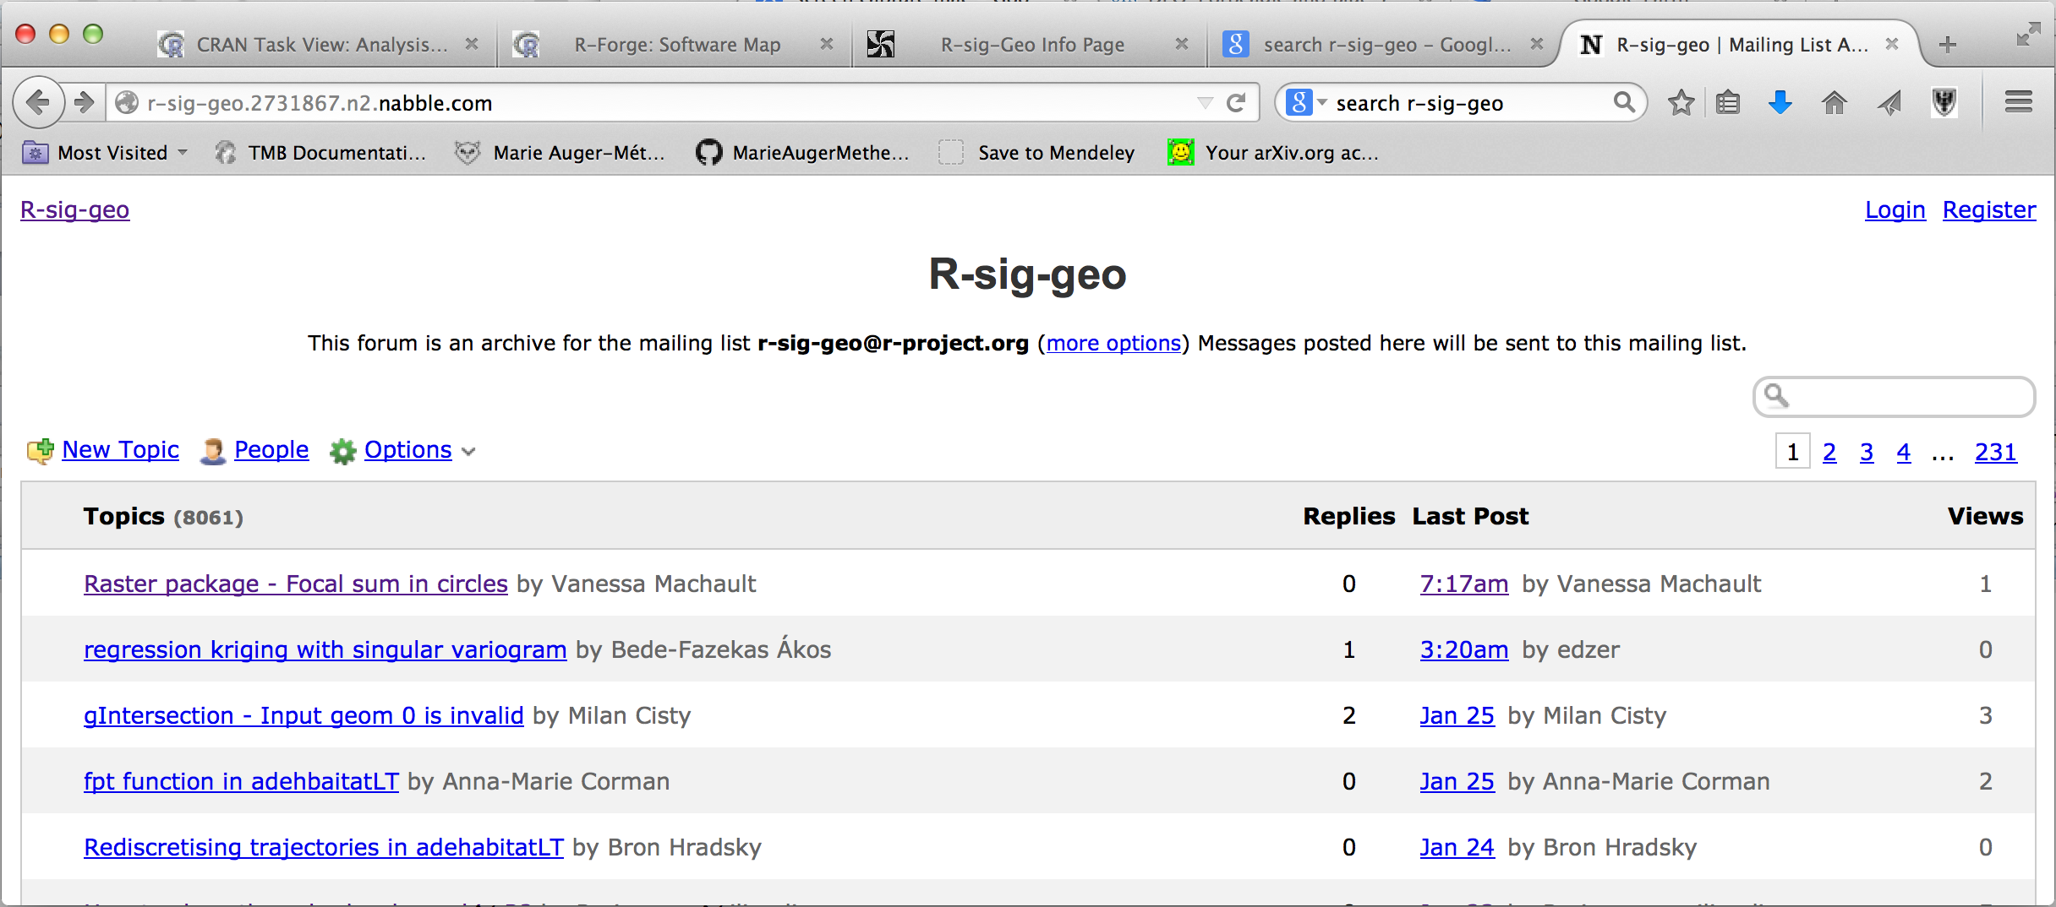
Where to get info: R-Sig-Geo mailing list

Slide 12
Where to get info: R-Sig-Geo mailing list

Slide 13
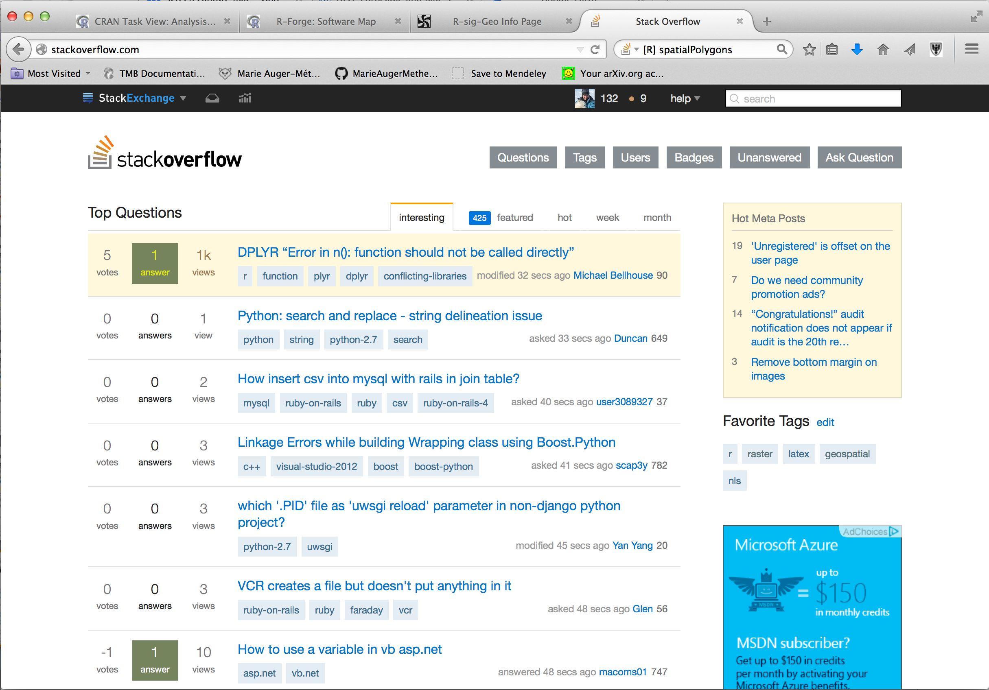
Where to get info: stackoverflow

Slide 14
Where to get info: stackoverflow

Slide 15
Where to get info: stackoverflow

Slide 16
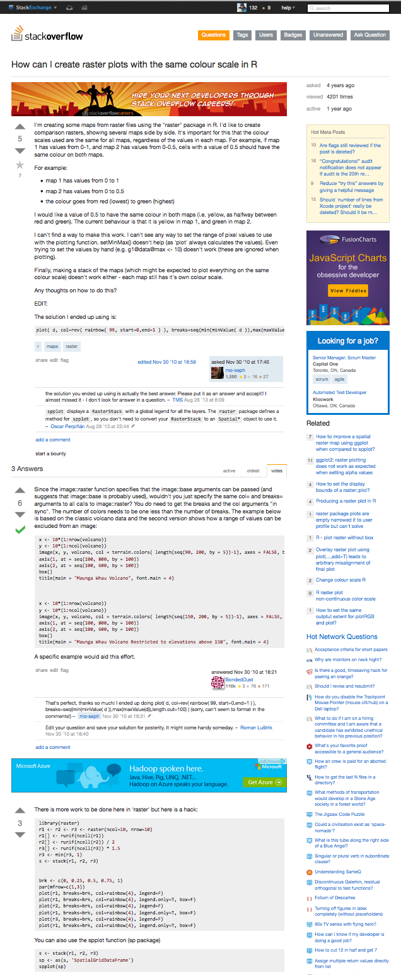
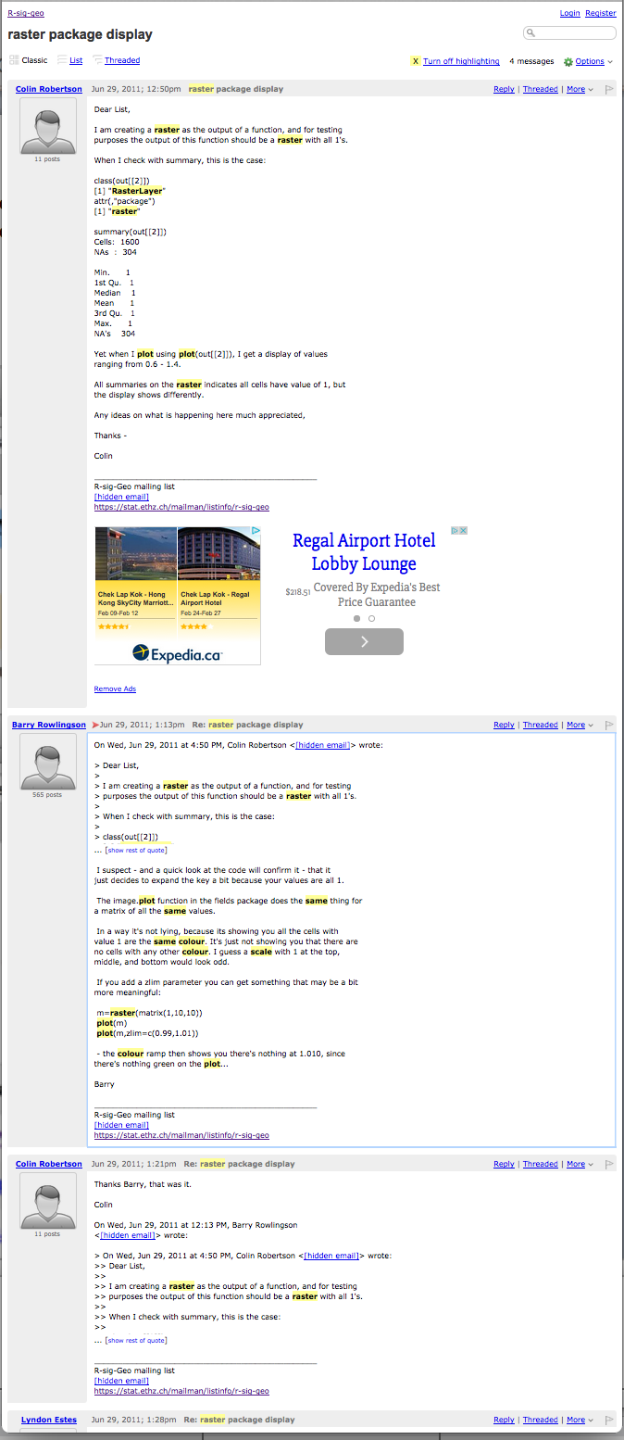
Where to get info: stackoverflow
Question
Question
Best answer
Best answer

Slide 17
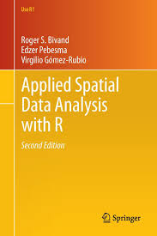
Where to get info: Bivand et al. (2013) Book
Online version available through
Dalhousie’s library
Mainly for vector data (not much on rasters)

