Slide 1
GIS in R Lecture 1
Marie Auger-Méthé
Ocean Tracking Network
Dalhousie University

Slide 2
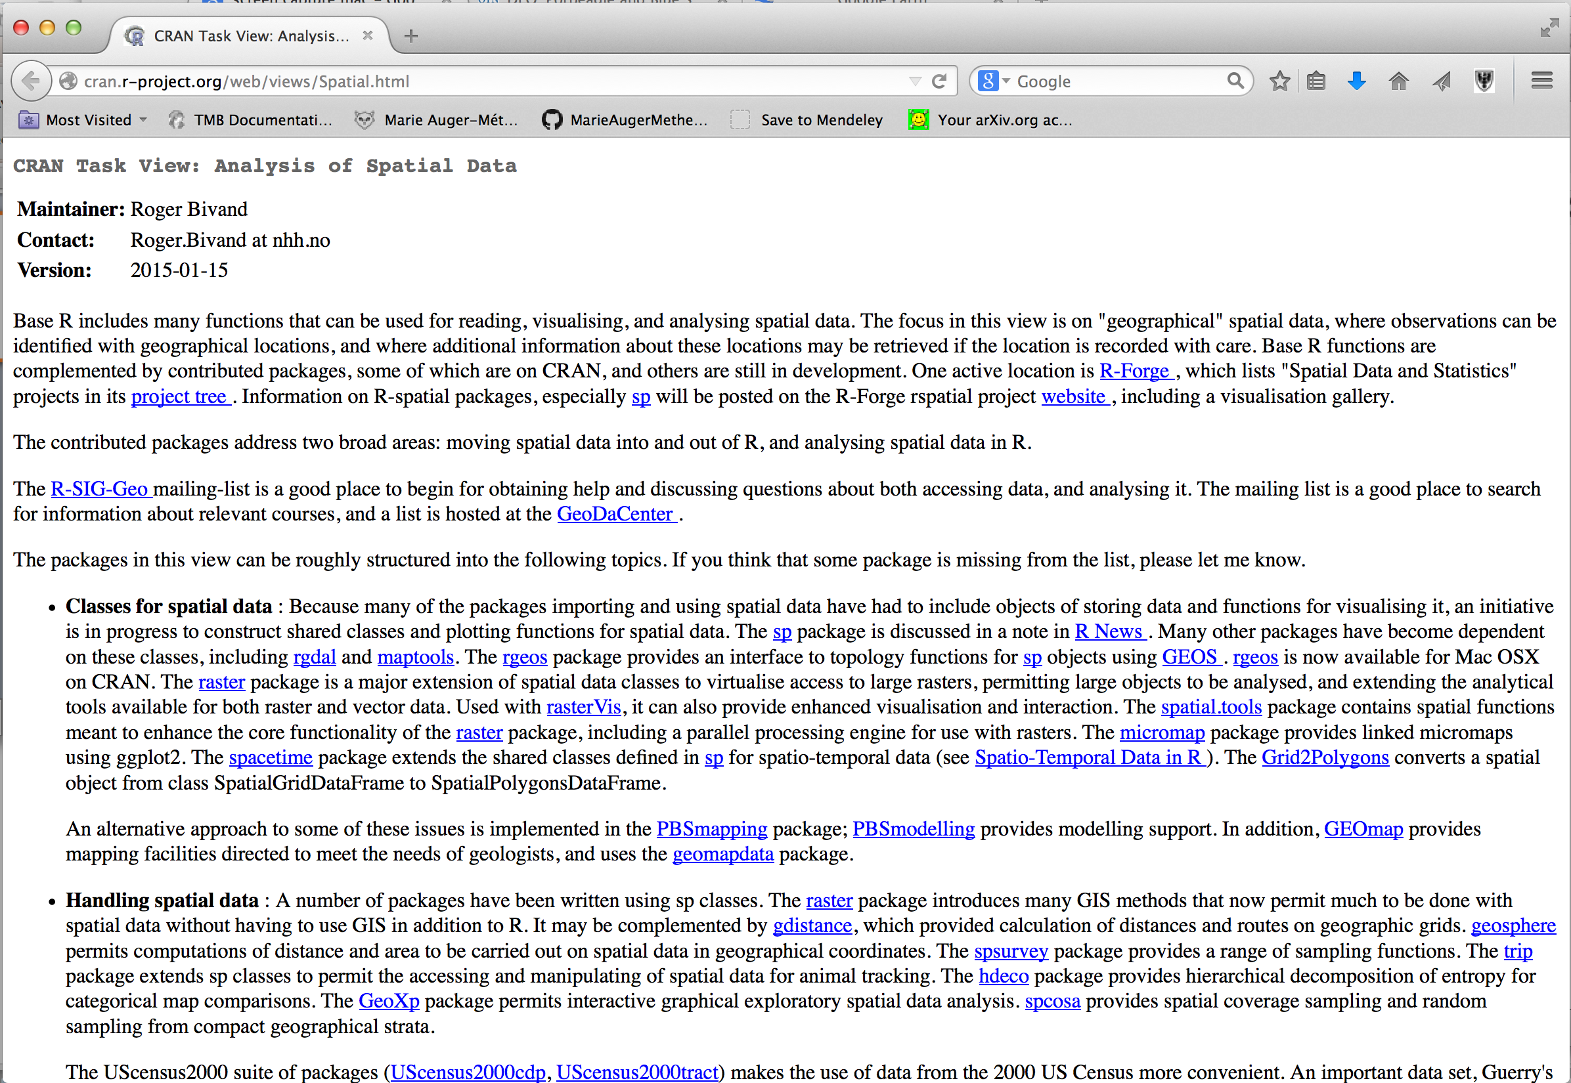
Where to get info: CRAN spatial task view

Slide 3
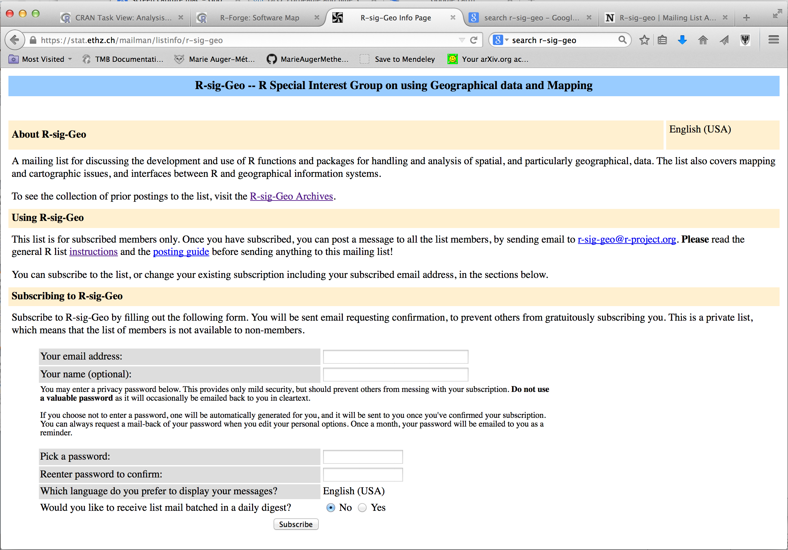
Where to get info: R-Sig-Geo mailing list

Slide 4
Where to get info: R-Sig-Geo mailing list

Slide 5
Where to get info: R-Sig-Geo mailing list

Slide 6
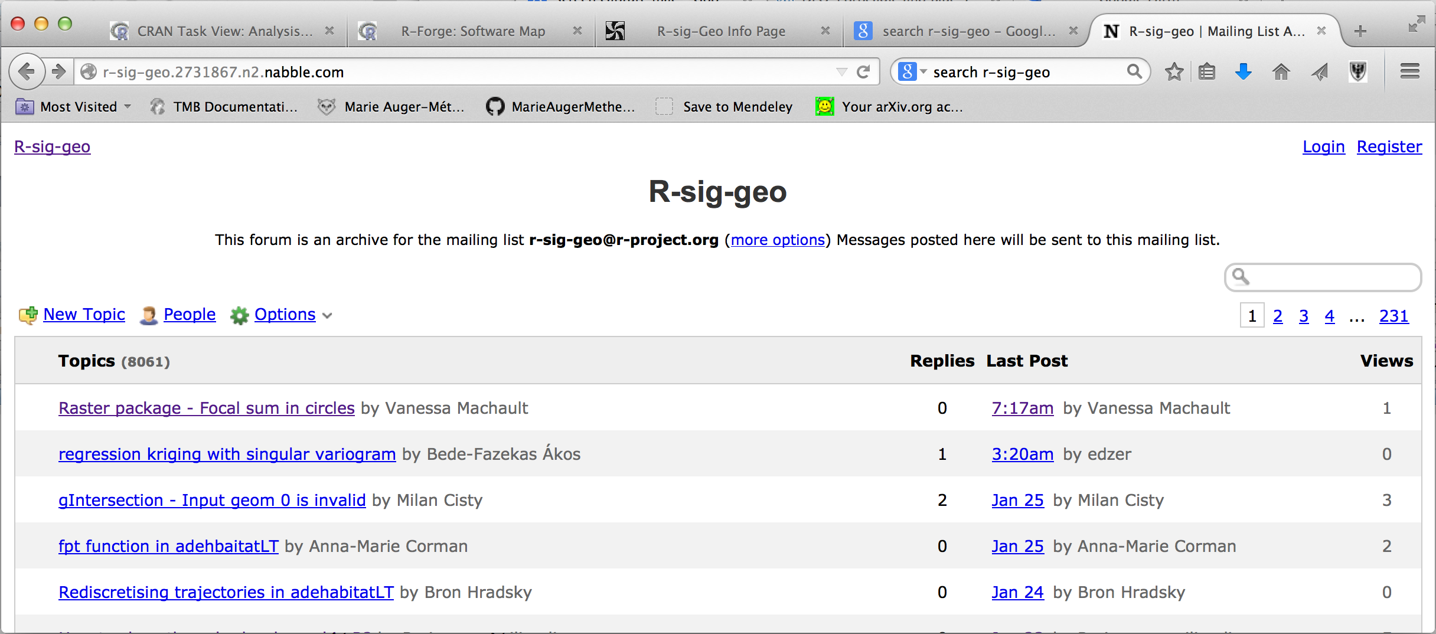
Where to get info: R-Sig-Geo mailing list

Slide 7
Where to get info: R-Sig-Geo mailing list

Slide 8
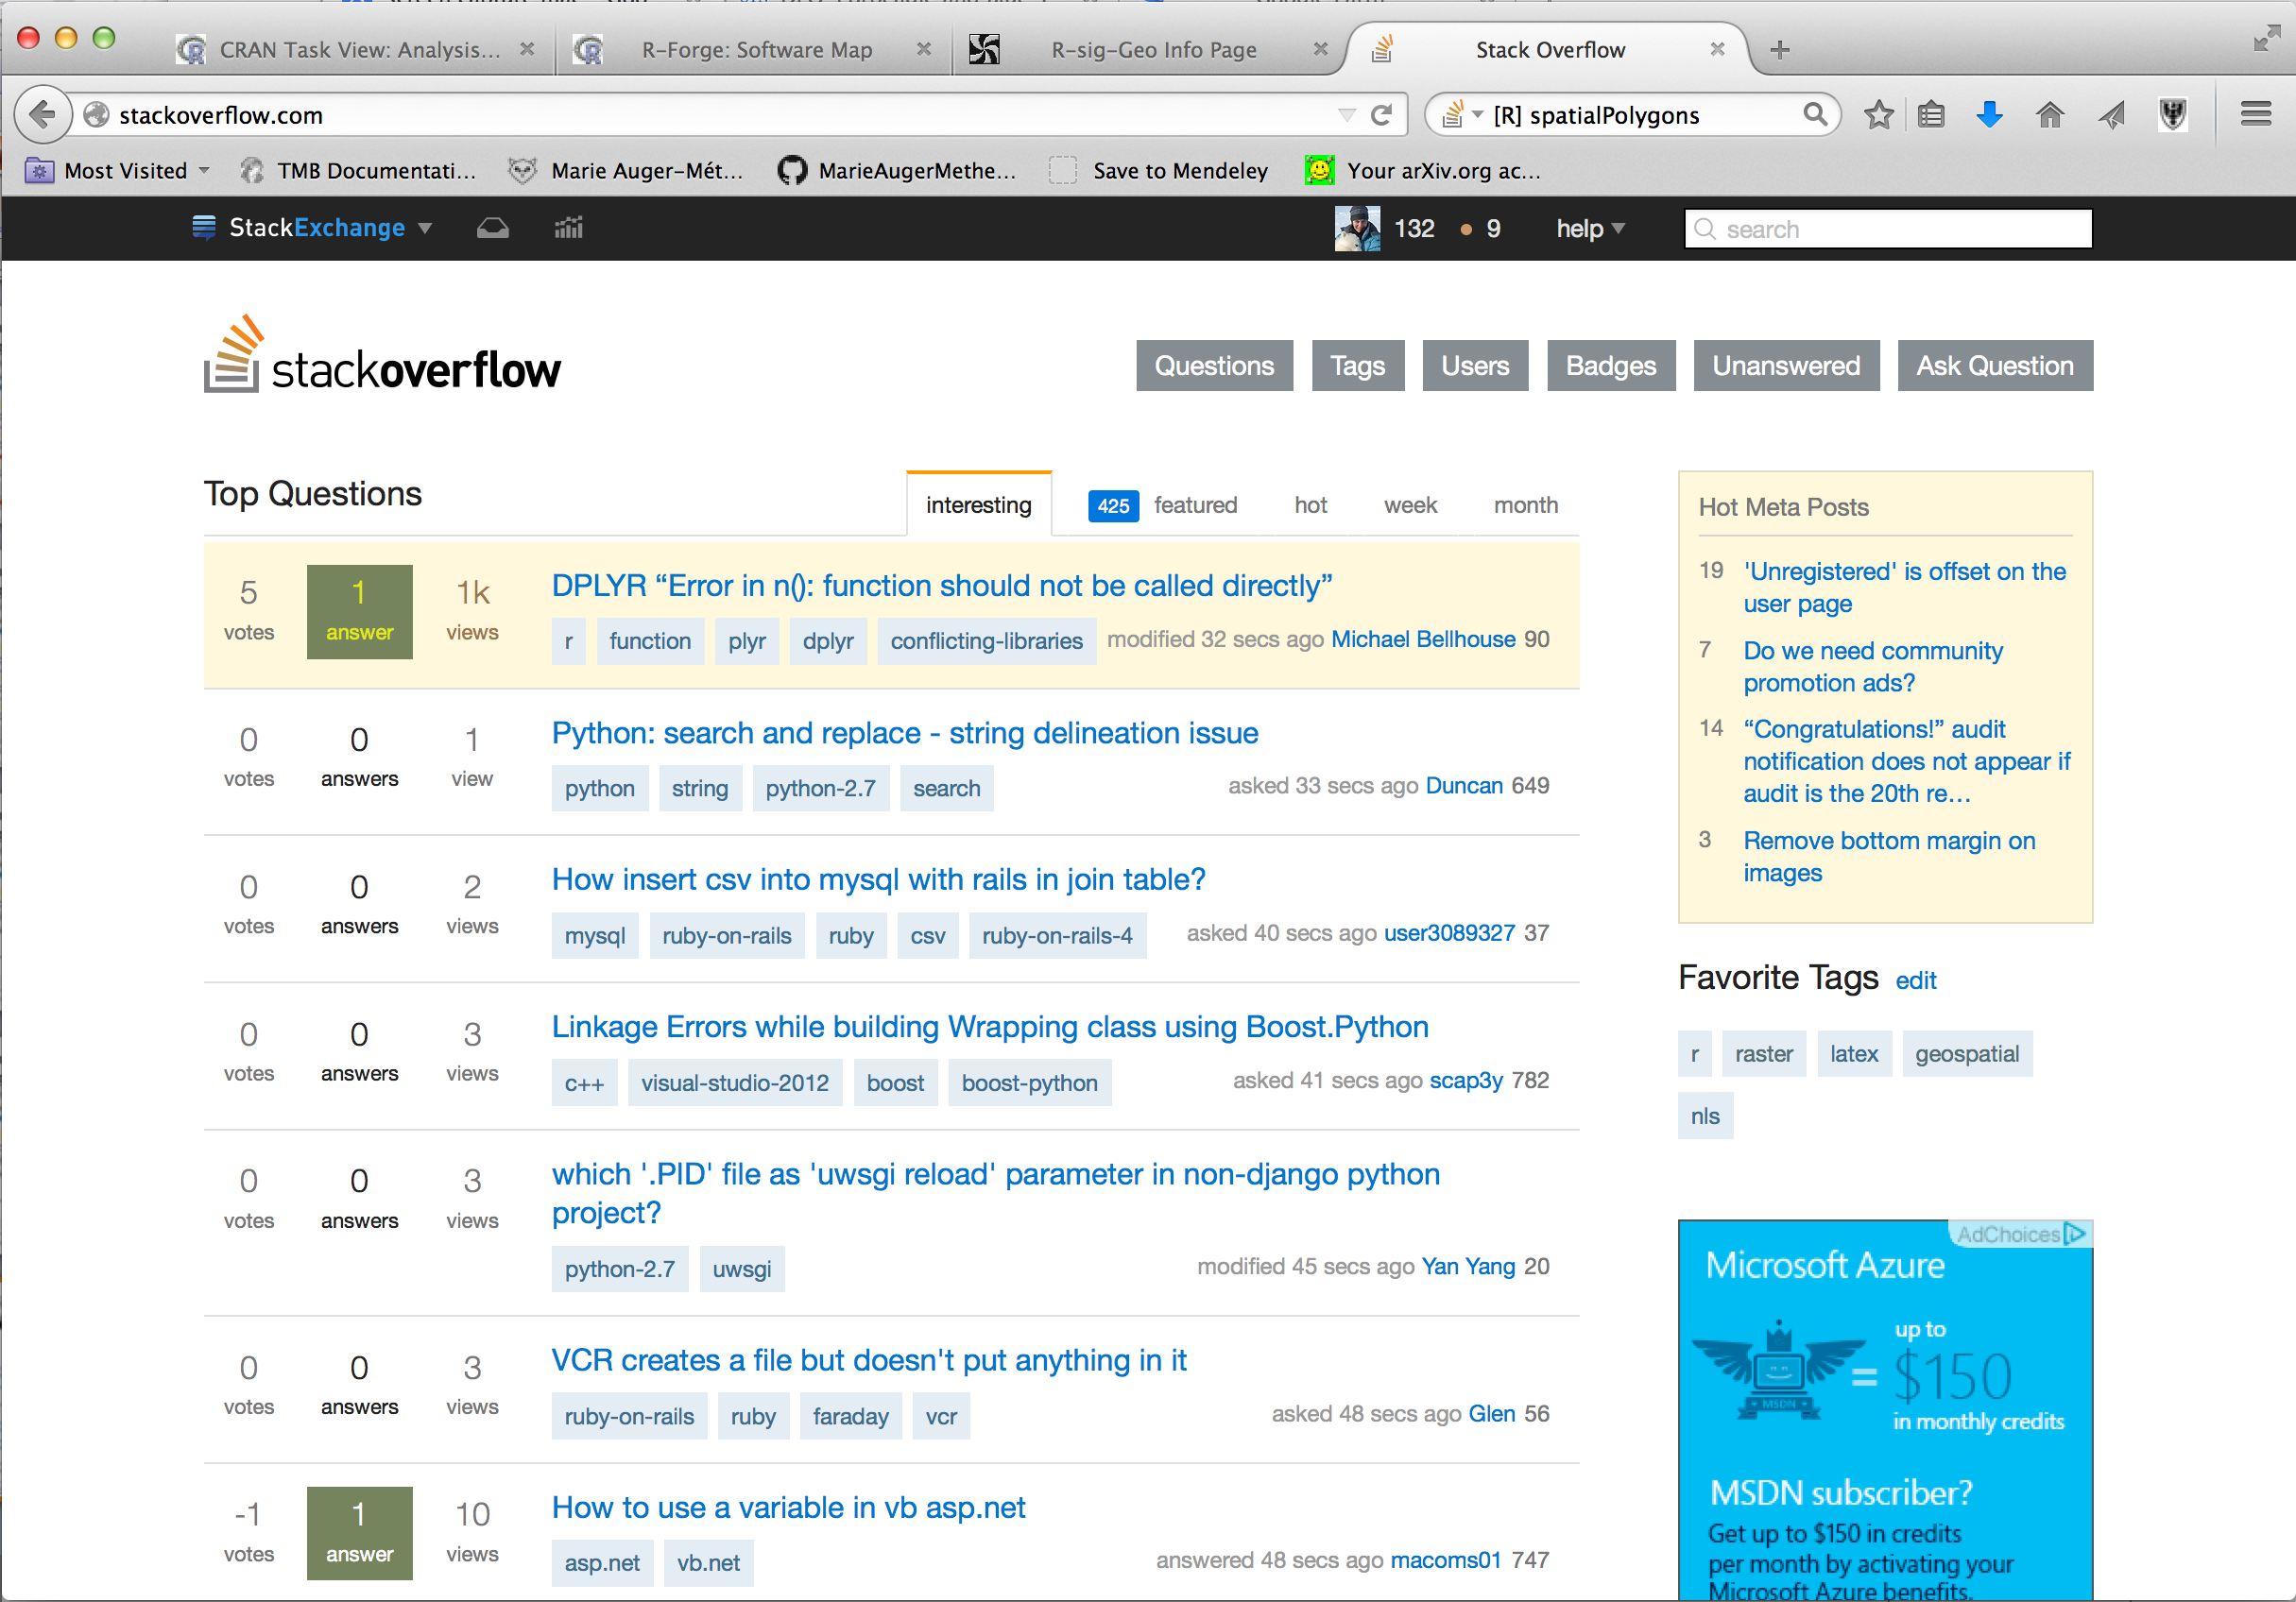
Where to get info: stackoverflow

Slide 9
Where to get info: stackoverflow

Slide 10
Where to get info: stackoverflow

Slide 11
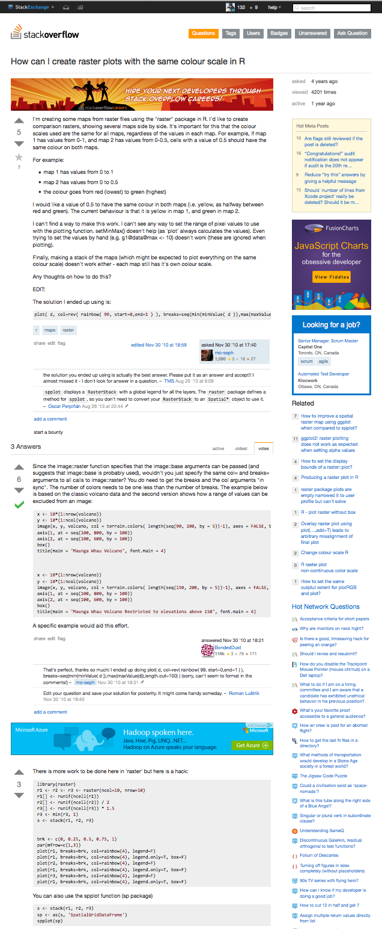
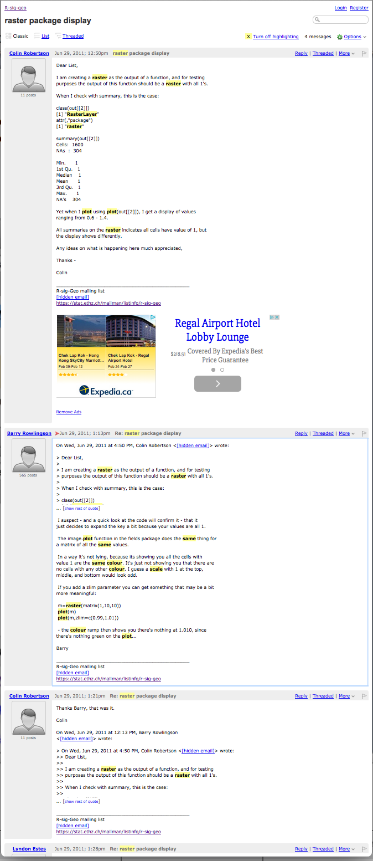
Where to get info: stackoverflow
Question
Question
Best answer
Best answer

