Slide 1

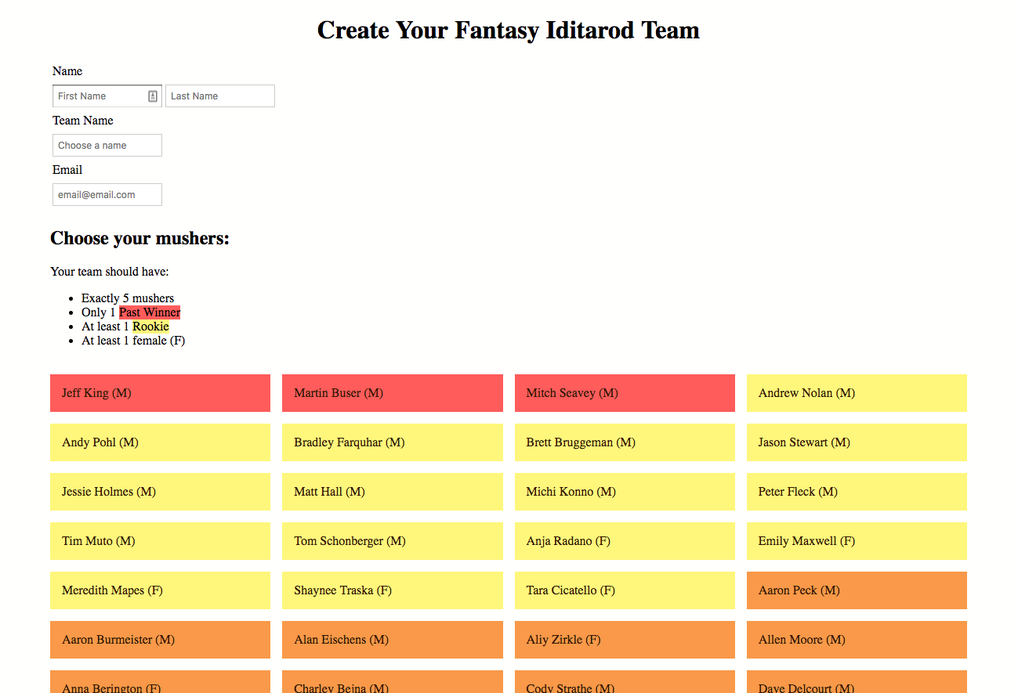
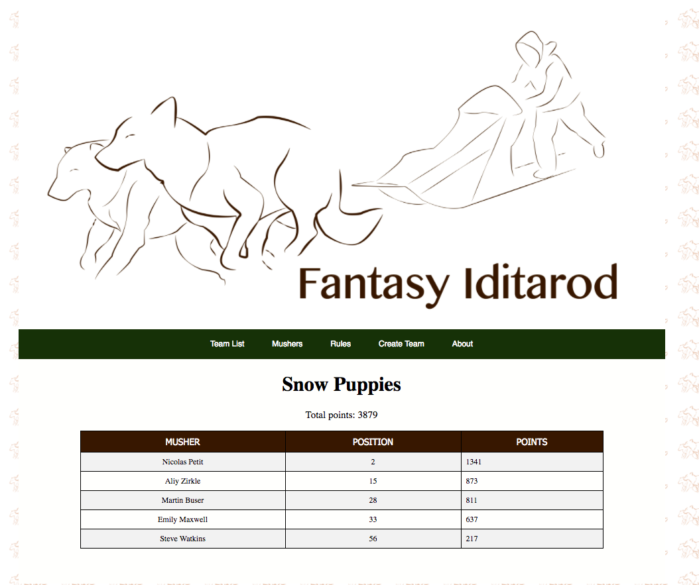
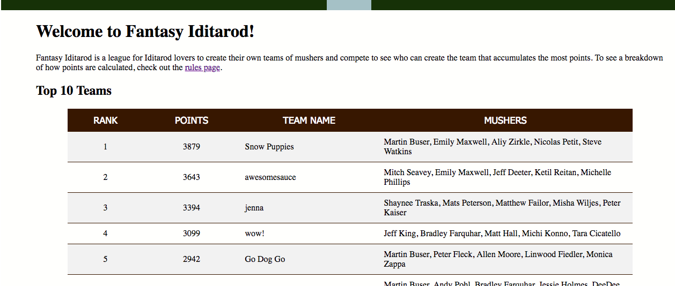
Fantasy-Iditarod.com Fantasy League For Dog Sled Enthusiasts Alexis Cross, Marie Dolleman, Jenna Pfingsten
About Fantasy-Iditarod
Fantasy-Iditarod is a fantasy league for the official Iditarod race. One of the creators, (Jenna) had a fantasy Iditarod league with friends in high school and decided to share her experience with the internet. On Fantasy-Iditarod, a user can chose five mushers which must include one woman, one rookie and at most one past winner. Each user gets their own url based on their username with the status of each of their mushers and their scores as well as the over all score of the team.
Frontend: HTML and CSS
HTML and CSS are used to build the things viewers will see on the website. HTML creates the elements and CSS styles the website via an external stylesheet.
Frontend: JavaScript
The main function of JavaScript and jQuery in Fantasy Iditarod is to communicate with the server without refreshing the page. This is done with jQuery’s AJAX method to do things like verify teams before they’re created, check if a team name is available, and create a team of mushers in our database. JavaScript is also used to dynamically impact the user experience. By inserting text and icons based on the validity of the form input, users can easily see if their team is valid or not. And changing the color of the musher buttons as a user picks their team allows them to easily see the makeup of their team.
What is the Iditarod?
The Iditarod, also known as the “The Last Great Race,” is a sled dog race from Anchorage, Alaska, to Nome, Alaska. The race consists of mushers and a team of sled dogs racing over 950 miles across the Alaskan wilderness for around 8-15 days. The race began in 1973 to commemorate Alaska’s historical dog sled teams, which were a primary mode of transportation until the 1960s.
The Data
The official Iditarod posts around 800 public logs at http://iditarod.com/race/2018/logs/. Within each log is a snapshot of the race, complete with all mushers status data at the time the of the snapshot. For every year, within each log each musher gets a row stating their speed, latest checkpoint, bib number, how many dogs they still have in the race and a few more columns pertaining to the official race rules. For our simulation, we chose to run the 2018 Iditarod, where we simulate the entire two week race in two hours.
Python
In order to calculate scores, display mushers, and simulate our Iditarod race, we needed data from the official Iditarod website. After consulting with the allowed data usage from iditarod.com, we decided to scrape data from the log entries using Python. We chose the libraries Request and BeautifulSoup to get and clean our data. We then initialized objects that calculated scores (capitalizing on Python’s number crunching efficiency), kept track of checkpoints, and the number of dogs a musher had in order to update the database in one easy call.
Our Simulation
For dead day, we’re simulating how our website will work over the racing season. Every five minutes, we’ll be scraping data from a log in order to be kind to the official Iditarod website. The log numbers that are scraped are based on the total number of logs.
Backend: PHP
PHP runs the backend of Fantasy Iditarod, communicating with our database and server. PHP is used to make queries to our database to get all data on mushers and teams, which is used on almost every page. These types of queries include getting the name, points, and mushers for each team (on Home and Team List pages); musher data (on Mushers page); and the names of all mushers, organized by gender and race status (Create Team page). We also used PHP to validate teams before adding them to the database. This includes validating that the team abides by the rules for number and type of mushers. This is all done via a JavaScript AJAX call in order to access data client-side without refreshing the page.
Backend: SQL Databases
Our database contains three tables holding information about the mushers, the mushers’ stats, and the teams. We are using PHPMyAdmin to manage the database. Our stats table is updated consistently during the race with Python to keep track of the points each musher has earned and where they are in the race. The teams table collects the contact information and the ID’s of the mushers that the user created when they submit a valid team form. The mushers table stores information on the mushers like ID’s, names, gender, and whether they are rookies or past winners. This information helps us validate the forms that users submit.
Special thanks to professors Rieck, Manley and Urness for answering questions as well as the official Iditarod website for letting us use their data.

