Slide 1

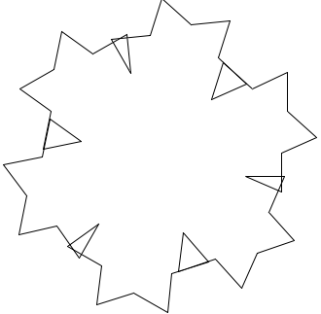
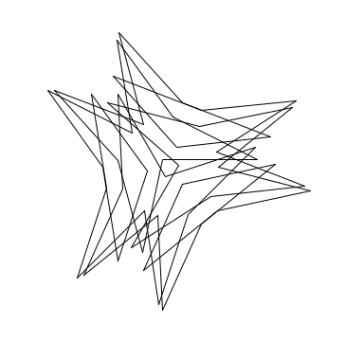
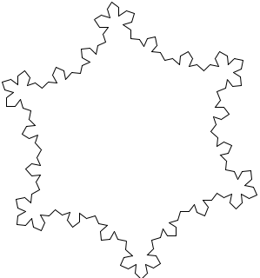
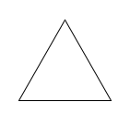
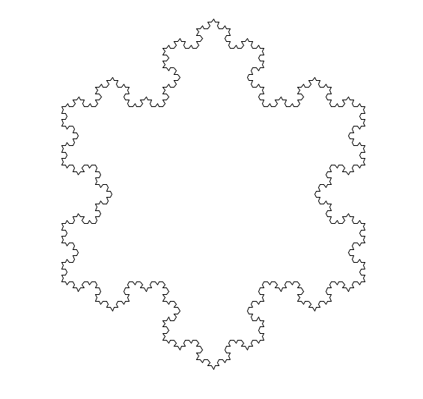
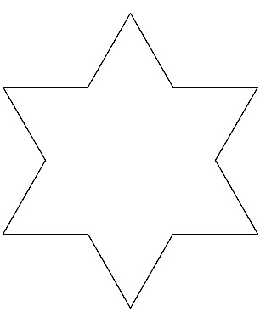
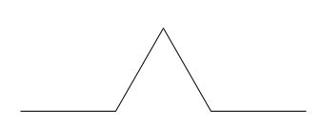
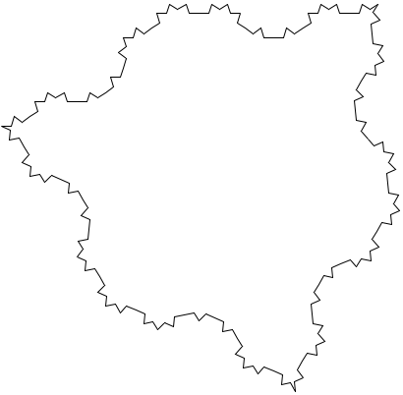
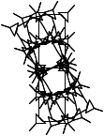
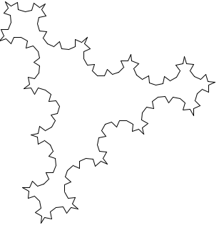
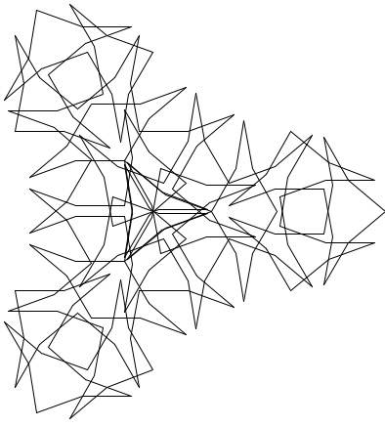

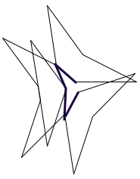

Combining L-Systems Grammar with Fine Arts to Produce Mathematical Objects – NEEDS NEW TITLE Marie Dolleman and Chris Porter Department of Mathematics and Computer Science
The Project
To create self-similar fractals using on Lindenmayer Systems and turtle graphics. Basing the rules and initial internal and external angles within the fractals on the carbon emissions data set from eight different countries over years 1960-2014, and discovering possible insights the data itself from the final visualization. Then upon fractal creation, present findings in such a way as to draw in viewers from various backgrounds and disciplines, namely those with mathematical, scientific and studio art training utilizing the AxiDraw robot to realize the drawing component of the project.
Research Questions
Can fractals represent carbon emission data?
Will the visual qualities of the fractal indicate properties of the original data?
Will the dimension of the fractal relate to the original data?
Motivation
Many artistically inclined people can absorb details, information, and symbolism from artworks over a period of hours, however they can find it difficult to take that kind of time and attention to detail to a simplistic line graph presenting data. If we truly want to inspire viewers dive into the details of data, why not present it in such a way as to spark their curiosity and interest?
Sample Of The Data:
The Koch Snowflake
Starts with an equilateral triangle of three symbols:
“acaca” – Move forward, turn right 120º, move forward, turn right 120º, move forward
Replacement piece is to replace every “a” with “ababa”
Meaning instead of going straight, go straight, then turn left 60º, go straight, right 120º, go straight, turn left 60º, go straight again
Findings
Initial Shape
4th Iteration
of the Koch Snowflake
1st Iteration
United States of America
Australia
Netherlands
Generator
The Created Procedure
Began with three rules and three letters of the Koch Snowflake
Straight, small degree and large degree – a,b,c respectively
Small and large degrees were chosen based on the coefficient of the line of best fit for that country
The some rules I developed while researching:
For every “a” replace with “abacaba”
For every “b” replace with “E”
For every “c” replace with “F”
Example:
“abacaba” becomes “abacabaEabacabaFabacabaEabacaba”
Patterns repeated on every straight edge, with initial equilateral triangle also taken into account
Unlike the Koch Snowflake, a third of the angles within the fractals changed with every iteration
The loss of equiangular angles inside the fractal meant appending the Koch Snowflakes rules for the fractal to complete its shape
Malaysia and Costa Rica
Tunisia
Bhutan
Uganda
Conclusions
Fractals made in this way aren’t useful tools to visualize the numerical quality of data
Fractals are a visually stimulating way to explore visualizing data for the purpose of human involvement (opposed to numerical value)
Data presented in an artistic way presents an opening for important discussion about the data itself and why its important to study the numeric value.
What is a fractal?
A fractal is an infinitely repeating pattern, such that the pattern, or portion thereof, can be infinitely magnified and still recognizable
Self-similarity
Also called fractal recursion
Parts of the of the fractal resemble the whole
Has Fractal Dimension
“The quantitative measure of self-similarity and scaling”
About L-Systems
Created by Hungarian Biologist, Aristid Lindenmayer
Initially used for purpose of studying plant growth
As branches grow and split they create a fractal
Cellular level
Physical level0
A grammar using symbols and substituting (or rewriting strings to transform a single symbol to many for the purpose of creating self-similar fractals
The Basic Rules
Every component of a drawing as a symbol to represent an action in string format
Actions include move forward a certain number of units and turn left or right by specified degrees
The string of actions is formed with rules, for every “a” found in the action string, replace “a” with “ababa”
First iteration:
“ababababababababa”
Commonly implemented with recursion, can depend on the fractal
Creates a self-similar fractal with every iteration. The edge pieces of a fractal are substituted with the generator
Example: Australia
Bibliography
Special thanks to Phillip Chen and Ben Gardner for the use of their facilities, robot, supplies and guidance in the creation of the final artworks
Bassingthwaighte, James B., et al. Fractal physiology. Oxford University Press, 1994.
Prusinkiewicz, Przemyslaw, and Aristrid Lindenmayer. The algorithmic beauty of plants. Springer-Verlag, 1996.
Mandelbrot, Benoit B. The fractal geometry of nature. Freeman, 1983.
Kaye, Brian Howard. A random walk through fractal dimensions. 1st ed., VCH, 1994.
“CO2 emissions (Metric tons per capita).” CO2 emissions (Metric tons per capita) | Data, The World Bank, data.worldbank.org/indicator/EN.ATM.CO2E.PC.
Pickover, Clifford A. Fractal horizons: the future uses of fractals. 1st ed., St. Martins Press, 1996.

