Slide 1

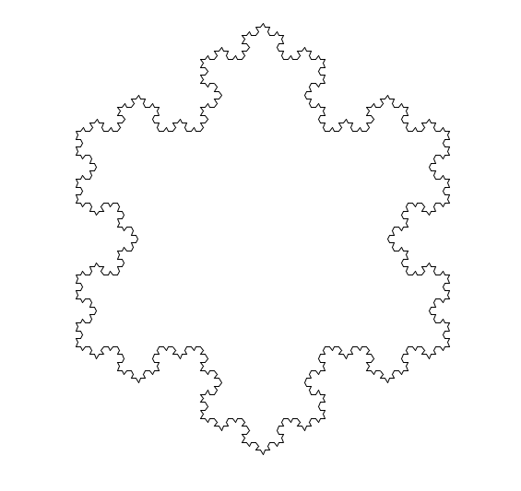
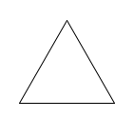
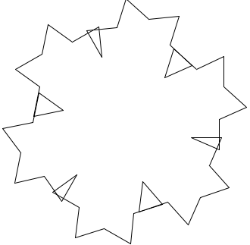
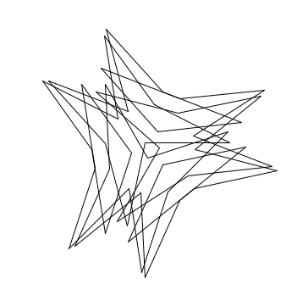
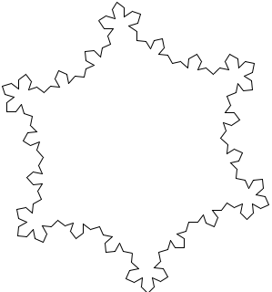
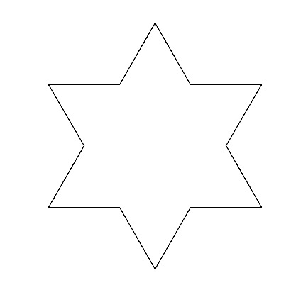
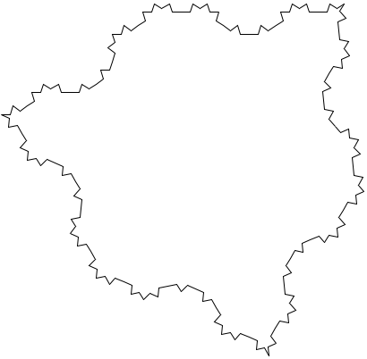
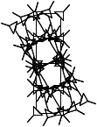
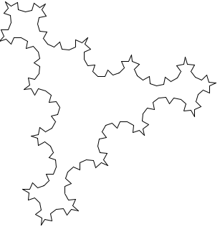
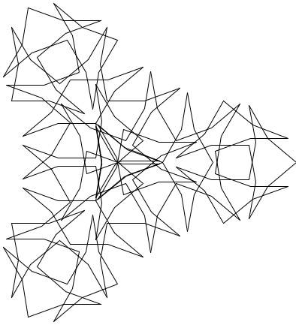
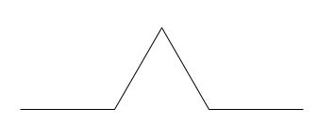

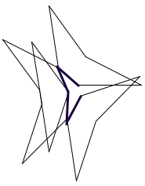

Combining L-Systems Grammar with Fine Arts to Produce Mathematical Objects
About L-Systems
Created by Hungarian Biologist, Aristid Lindenmayer
Initially used for purpose of studying plant growth
As branches grow and split they create a fractal
Cellular level
Physical level
A grammar using symbols and substitutions (or rewriting) to transform a single symbol to many for the purpose of creating self-similar fractals
L-systems commonly implemented using recursion
The Koch Curve
Creations
4th Iteration
of the Koch Snowflake
United States of America
Australia
Netherlands
1nd Iteration
Malaysia and Costa Rica
Tunisia
Bhutan
Uganda
Basic Rules
For every “a” found in the string, replace “a” with “ababa”
First iteration:
“ababababababababa”
Koch Snowflake uses three letters:
“a”, “b”, “c”
Straight line, 60 and 120 degree turns
Commonly implemented with recursion, can depend on the fractal
Creates a self-similar fractal
For every iteration, the terminal pieces of a fractal is replaced with the initial step transformation
The Project
Conclusions / Findings
Fractals made in this way aren’t useful tools to visualize the numerical quality of data
Fractals are a visually stimulating way to explore visualizing data for the purpose of human involvement (opposed to numerical value)
Data presented in an artistic way presents an opening for important discussion about the data itself and why its important to study the numeric value.
Created Rules
Began with three rules and three letters of the Koch Curve
Straight, small degree and large degree – a,b,c respectively
Small and large degrees were chosen based on the coefficient of the line of best fit for that country
The some rules I developed while researching:
For every “a” replace with “abacaba”
For every “b” replace with “E”
For every “c” replace with “F”
Example:
“abacaba” becomes “abacabaEabacabaFabacabaEabacaba”
Example
Bibliography
Special thanks to Phillip Chen and Ben Gardner for the use of their facilities, robot, supplies and guidance in the creation of the final artworks
Bassingthwaighte, James B., et al. Fractal physiology. Oxford University Press, 1994.
Prusinkiewicz, Przemyslaw, and Aristrid Lindenmayer. The algorithmic beauty of plants. Springer-Verlag, 1996.
“CO2 emissions (Metric tons per capita).” CO2 emissions (Metric tons per capita) | Data, The World Bank, data.worldbank.org/indicator/EN.ATM.CO2E.PC.

Slide 2
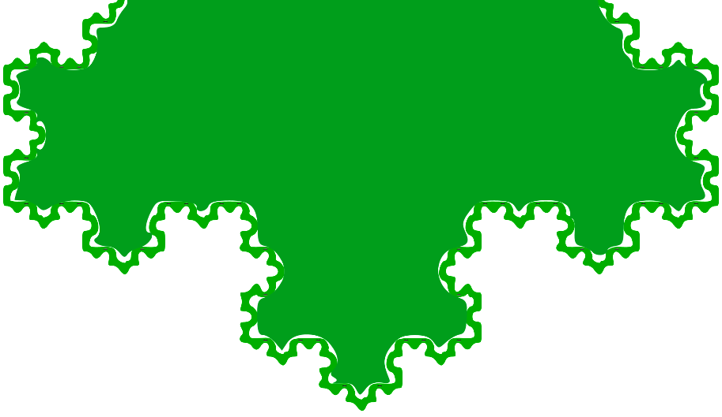
Alternate Visualizations
Because line graphs aren’t as interesting to non-scientists
Marie Dolleman and Chris Porter

Slide 3
The Project and Motivations
Can fractals relate back to the original data?
Sometimes data is boring
Find a new way to represent data to the general public in a new way, but also mathematically accurate

Slide 4
About L-Systems
Created by Hungarian Biologist, Aristid Lindenmayer
Initially used for purpose of studying plant growth
As branches grow and split they create a fractal
Cellular level
Physical level
A grammar using symbols and substitutions (or rewriting) to transform a single symbol to many for the purpose of creating self-similar fractals
L-systems commonly implemented using recursion

Slide 5
Anatomy of a Fractal
What is a fractal?
Repeating pattern
A fractal is an infinitely repeating pattern, such that the pattern can be seen infinitely magnified upon
Scaling
Any measurements of a fractal depend on the scale of which they’re measured
Self-similarity
Also called fractal recursion
Parts of the of the fractal resemble the whole
Fractal Dimension
“The quantitative measure of self-similarity and scaling”
Notes:
Factorization – grey book
N – Grey Book

Slide 6
The Koch Curve
1st Iteration
4th Iteration
Length based on factorization value

Slide 7
Anatomy of a Fractal
For the Koch curve, the factorization is 3
Because the triangle formed is equilateral,
X = R₂
F = R₂ + X + R₂ = 3(R₂)
Resizing to fill the plane
R₁ = R₂ * F/N
F is the factorization
N is the number of sides replacing a side
Koch curve usually drawn by reducing ¾ of side length
Alternate Approach
Python Turtle graphics rejected decimal length
Instead of scaling down, take an aerial view
Reduced the number of calculations
R₁
R₂
R₂
R₂
R₂
x

Slide 8
L-Systems Rules to Turtle Commands
Every element has a unique symbol
In the triangle:
-The straight line is “a”
-The 60 degree turn is “b”
The encoding for a triangle:
“ababa”
For every “a” found in the string, replace “a” with “ababa”
First iteration:
“ababababababababa”
Koch Snowflake uses three letters:
“a”, “b”, “c”
Straight line, 60 and 120 degree turns
Commonly implemented with recursion, can depend on the fractal
Creates a self-similar fractal
For every iteration, the terminal pieces of a fractal is replaced with the initial step transformation

Slide 9
The Data

Slide 10
Transformed Rules
Began with three rules and three letters of the Koch Curve
Straight, small degree and large degree – a,b,c respectively
Small and large degrees were chosen based on the coefficient of the line of best fit for that country
The some rules I developed while researching:
For every “a” replace with “abacaba”
For every “b” replace with “E”
For every “c” replace with “F”
Example:
“abacaba” becomes “abacabaEabacabaFabacabaEabacaba”
Patterns repeated on every straight edge, with initial 60 degree triangle angles also taken into account
Unlike the Koch curve, a third of the angles within the fractals changed with every iteration
The loss of equiangular angles inside the fractal meant appending the Koch Curves rules for the fractal to complete its shape

Slide 11

Generated Curves - Australia

Slide 12
Conclusion – The Fractals
United States of America
Australia
Netherlands
Malaysia and Costa Rica
Tunisia
Bhutan
Uganda

Slide 13
Conclusion - Why is this Important?
Fractals made in this way aren’t useful tools to visualize the numerical quality of data
Fractals are a visually stimulating way to explore visualizing data for the purpose of human involvement (opposed to numerical value)
Data presented in an artistic way presents an opening for important discussion about the data itself and why its important to study the numeric value.

Slide 14
Acknowledgements and Bibliography
Special thanks to Phillip Chen and Ben Gardner for the use of their facilities, robot, supplies and guidance in the creation of the final artworks
Bassingthwaighte, James B., et al. Fractal physiology. Oxford University Press, 1994.
Prusinkiewicz, Przemyslaw, and Aristrid Lindenmayer. The algorithmic beauty of plants. Springer-Verlag, 1996.
“CO2 emissions (Metric tons per capita).” CO2 emissions (Metric tons per capita) | Data, The World Bank, data.worldbank.org/indicator/EN.ATM.CO2E.PC.

