Slide 1
Experimental Statistics I
Live Session Unit 6
June 13-14, 2016

Slide 2
Housekeeping Notes Midterm
The midterm will cover Units 1–6 only
There are some practice problems in Unit 7
Answers are there as well
Try to do these in the next few weeks so you can ask questions about them in tutoring sessions
These will not be collected. Their sole purpose is to help you prepare for the midterm.
I will “hand-out” (email or post) the midterm on Friday, July 1st and it will be due by 11:59pm Central time on Wednesday, July 6th.
There will be no class on July 4th and 5th

Slide 3
Housekeeping Notes
Because Unit 7 is practice problems for the midterm, you will be moving on to Unit 8 this next week.
You should do the practice problems in Unit 7 sometime!
There is a calendar with all due dates for the next several weeks (past the midterm) posted on the wall
Please comment there if you have any questions!
By looking ahead for which Quiz is due next, you can figure out which asynchronous material you should be covering at the time.
e.g. Quiz 8 is due next week, meaning you should be watching the material for Unit 8 this coming week.

Slide 4
Some Questions From Unit 6
Most common questions that are not answered by the later example.

Slide 5
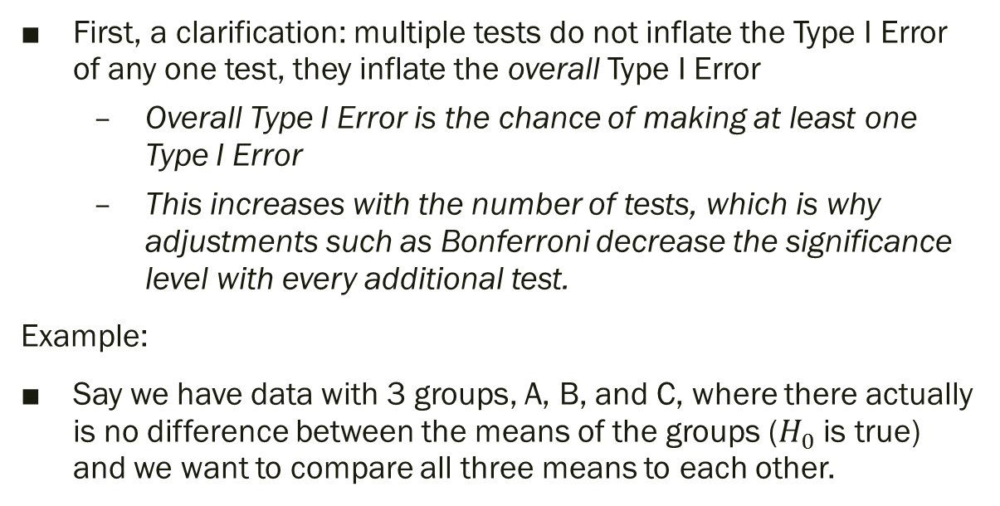
Why does doing multiple tests inflate Type I Error?
First, a clarification: multiple tests do not inflate the Type I Error of any one test, they inflate the overall Type I Error
Overall Type I Error is the chance of making at least one Type I Error
This increases with the number of tests, which is why adjustments such as Bonferroni decrease the significance level with every additional test.
Example:
Say we have data with 3 groups, A, B, and C, where there actually is no difference between the means of the groups ($H_{0}$ is true) and we want to compare all three means to each other.

Slide 6
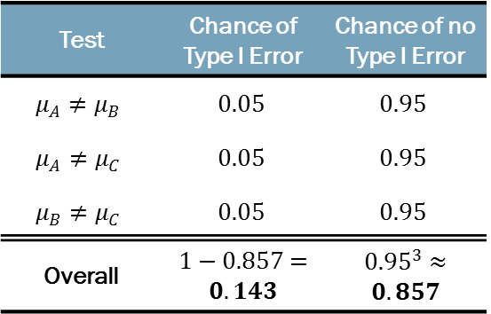
Why does doing multiple tests inflate Type I Error?
Test | Chance of Type I Error | Chance of no Type I Error
$$μ_{A}≠μ_{B}$$ | $$0.05$$ | $$0.95$$
$$μ_{A}≠μ_{C}$$ | $$0.05$$ | $$0.95$$
$$μ_{B}≠μ_{C}$$ | $$0.05$$ | $$0.95$$
Overall | $1−0.857=$ $0.143$ | ${0.95}^{3}≈$ $0.857$
Even though each test has only a Type I Error rate of 0.05, the 3 tests together have a Type I Error rate of 0.143.
Doing 3 tests at the 0.05 level means there is a 14.3% chance we will reject at least one null hypothesis, even if all the nulls are true.
If we have 4 groups, we will need 6 comparisons, giving a 26.3% chance of making at least 1 Type I Error. And so on.
Note: this assumes the tests are independent, but them being dependent will not give us much better results.

Slide 7
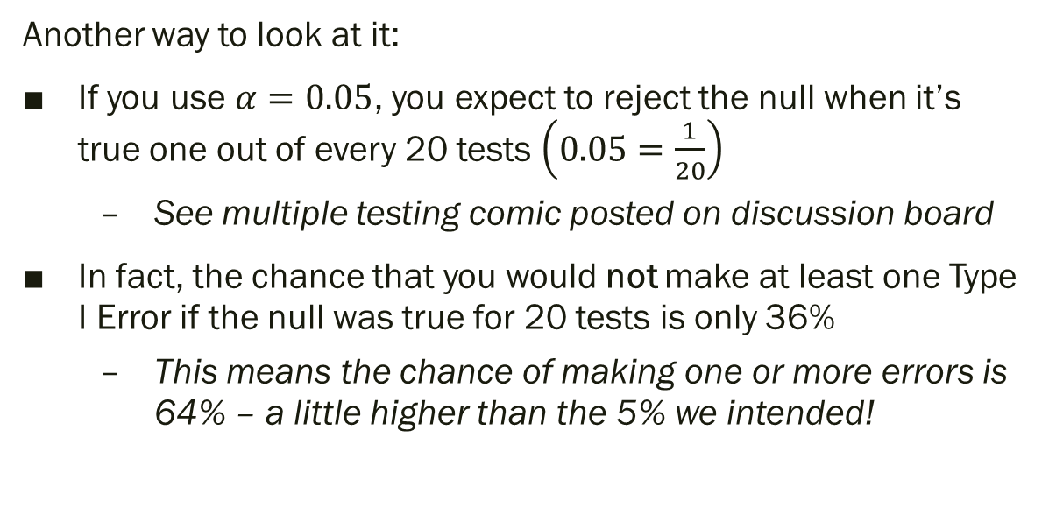
Why does doing multiple tests inflate Type I Error?
Another way to look at it:
If you use $α=0.05$, you expect to reject the null when it’s true one out of every 20 tests $\left(0.05=\frac{1}{20}\right)$
See multiple testing comic posted on discussion board
In fact, the chance that you would not make at least one Type I Error if the null was true for 20 tests is only 36%
This means the chance of making one or more errors is 64% – a little higher than the 5% we intended!

Slide 8
Why does doing multiple tests inflate Type I Error?
To fix this we can either:
Adjust the significance/confidence level
Example: Bonferroni
Adjust the test statistic
Example: Tukey’s HSD
Note: in the MEANS statement of PROC GLM, SAS always “adjusts it back,” so
any p-values it gives you can be compared with 0.05
the confidence intervals are “simultaneous” meaning that as a group they have a 95% confidence level

Slide 9
Walk Through of EXAMPLE in SAS
Spock Conspiracy Trial – Multiple Comparisons

Slide 10
Example: Spock Conspiracy Trial
Introduced on page 117 of Statistical Sleuth (3rd Edition)
Key questions to answer:
Is there evidence that women are underrepresented on Spock’s judge’s venires compared to those of other judges?
Is there any evidence that there are differences in women’s representation in the venires of the other six judges?
Data created by given SAS code (SpockTrial.txt) has 3 variables
PERCENT: percent of women in given venire
JUDGE: judge identification
SPOCKS: identifies whether the judge is Spock’s judge or not
Created to look at reduced model – will ignore this week

Slide 11
What we did last time
Last time we showed that there was a difference in the means of at least two of the judges (or, equivalently, that at least one judge was different than the others)
We also showed that we did not need to assign all the other judges their own mean (i.e. that we could use the reduced model)
However, this doesn’t mean that none of these judges are different from each other, only that there is not much gained by assuming they are ALL different from each other
The new SpockTrial.txt file has all the analyses from last week, plus what we will do this week.

Slide 12
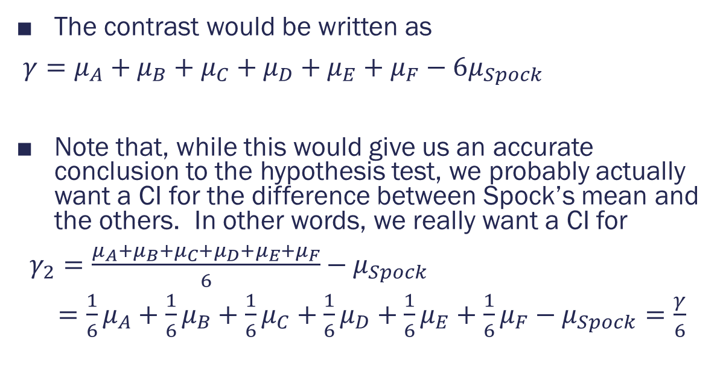
Contrasts
The contrast would be written as
$γ=μ_{A}+μ_{B}+μ_{C}+μ_{D}+μ_{E}+μ_{F}−6μ_{Spock}$
Note that, while this would give us an accurate conclusion to the hypothesis test, we probably actually want a CI for the difference between Spock’s mean and the others. In other words, we really want a CI for
$γ_{2}=\frac{μ_{A}+μ_{B}+μ_{C}+μ_{D}+μ_{E}+μ_{F}}{6}−μ_{Spock}$
$=\frac{1}{6}μ_{A}+\frac{1}{6}μ_{B}+\frac{1}{6}μ_{C}+\frac{1}{6}μ_{D}+\frac{1}{6}μ_{E}+\frac{1}{6}μ_{F}−μ_{Spock}=\frac{γ}{6}$

Slide 13
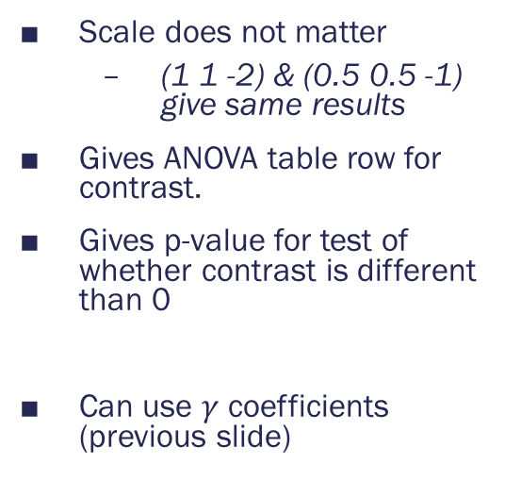
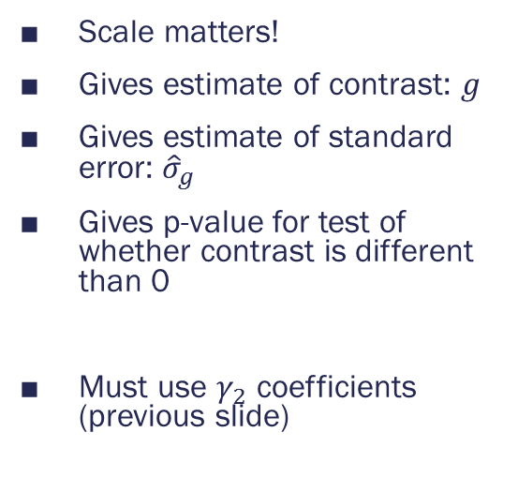
Contrasts
CONTRAST statement
ESTIMATE statement
Scale does not matter
(1 1 -2) & (0.5 0.5 -1) give same results
Gives ANOVA table row for contrast.
Gives p-value for test of whether contrast is different than 0
Can use $γ$ coefficients (previous slide)
Scale matters!
Gives estimate of contrast: $g$
Gives estimate of standard error: ${\hat{σ}}_{g}$
Gives p-value for test of whether contrast is different than 0
Must use $γ_{2}$ coefficients (previous slide)

Slide 14
Contrasts
This will help us answer the question: is Spock’s judge different from the others?
Paste the contents of SpockTrial.txt into SAS and run it.
This will only create the data set.
Look for the line separating the multiple comparisons and run the first PROC below it
This runs ANOVA with a contrast comparing Spock’s Judge’s mean to the other judges’ overall mean.
(See next slide for code and more details)

Slide 15
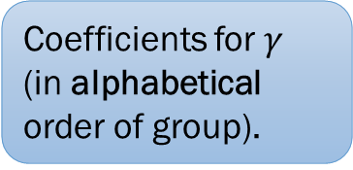
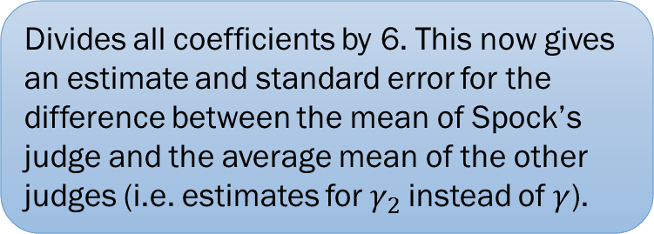
Contrasts
The code we will run:
PROC GLM DATA=SPOCK;
CLASS JUDGE;
MODEL PERCENT=JUDGE;
CONTRAST "Spock's vs. Others" JUDGE 1 1 1 1 1 1 -6;
ESTIMATE "Spock's vs. Others" JUDGE 1 1 1 1 1 1 -6 / divisor = 6;
RUN; QUIT;
Coefficients for $γ$ (in alphabetical order of group).
Divides all coefficients by 6. This now gives an estimate and standard error for the difference between the mean of Spock’s judge and the average mean of the other judges (i.e. estimates for$γ_{2}$ instead of $γ$).

Slide 16
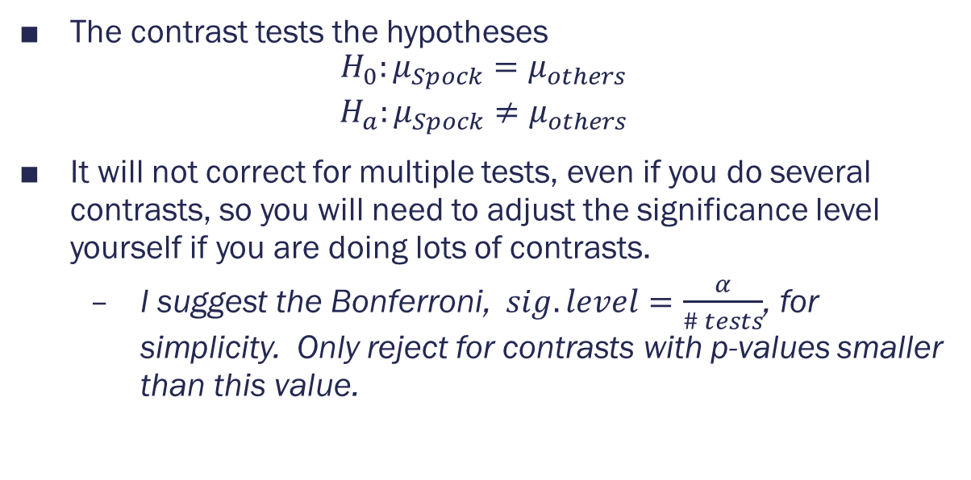
Contrasts
The contrast tests the hypotheses
$$\begin{matrix}H_{0}:μ_{Spock}=μ_{others} \\ H_{a}:μ_{Spock}≠μ_{others}\end{matrix}$$
It will not correct for multiple tests, even if you do several contrasts, so you will need to adjust the significance level yourself if you are doing lots of contrasts.
I suggest the Bonferroni, $sig. level=\frac{α}{\# tests}$, for simplicity. Only reject for contrasts with p-values smaller than this value.

Slide 17

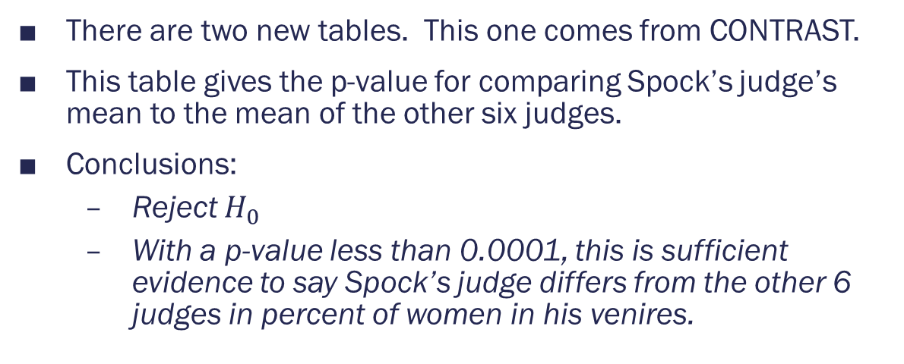
Contrasts
There are two new tables. This one comes from CONTRAST.
This table gives the p-value for comparing Spock’s judge’s mean to the mean of the other six judges.
Conclusions:
Reject $H_{0}$
With a p-value less than 0.0001, this is sufficient evidence to say Spock’s judge differs from the other 6 judges in percent of women in his venires.

Slide 18

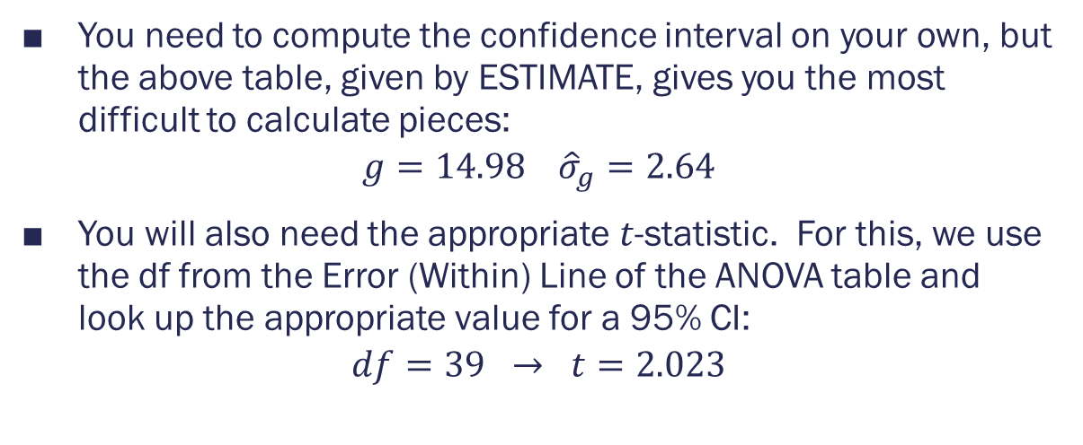
Contrasts
You need to compute the confidence interval on your own, but the above table, given by ESTIMATE, gives you the most difficult to calculate pieces:
$$g=14.98 {\hat{σ}}_{g}=2.64$$
You will also need the appropriate $t$-statistic. For this, we use the df from the Error (Within) Line of the ANOVA table and look up the appropriate value for a 95% CI:
$$df=39 → t=2.023$$

Slide 19
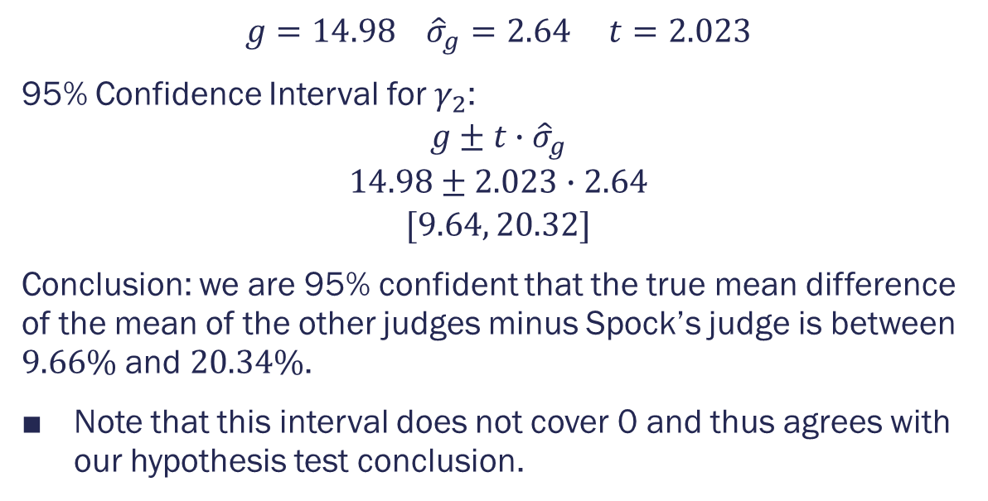
Contrasts
$$g=14.98 {\hat{σ}}_{g}=2.64 t=2.023$$
95% Confidence Interval for $γ_{2}$:
$$g±t∙{\hat{σ}}_{g}$$
$$14.98±2.023∙2.64$$
$$[9.64, 20.32]$$
Conclusion: we are 95% confident that the true mean difference of the mean of the other judges minus Spock’s judge is between $9.66\%$ and $20.34\%$.
Note that this interval does not cover 0 and thus agrees with our hypothesis test conclusion.

Slide 20
Multiple Comparisons: Dunnett’s
Though we wouldn’t necessarily call Spock’s judge a control, we are specifically interested in comparing the other judges to him, so we could argue that Dunnett’s procedure is appropriate.
Note: this will not allow us to answer the second question about how the other judges compare to each other.
PROC GLM DATA=SPOCK;
CLASS JUDGE;
MODEL PERCENT=JUDGE;
MEANS JUDGE /DUNNETT ("Spock's");
RUN; QUIT;
The CI’s in the output are labeled as “simultaneous,” meaning that they are adjusted for the fact that you are doing lots of confidence intervals.

Slide 21
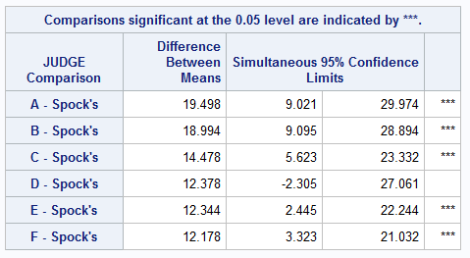
Multiple Comparisons: Dunnett’s
Using this procedure, we see that we have the evidence Spock’s judge is different then every judge except Judge D, for whom we do not have evidence to say has a different mean that Spock’s judge.
As always, be careful with your wording; you don’t want your language to imply you are accepting the null hypothesis for Judge D.

Slide 22
Multiple Comparisons: Tukey’s HSD
Bonferroni or a different comparison can be used here, if you prefer.
PROC GLM DATA=SPOCK;
CLASS JUDGE;
MODEL PERCENT=JUDGE;
MEANS JUDGE / TUKEY LINES;
RUN; QUIT;

Slide 23
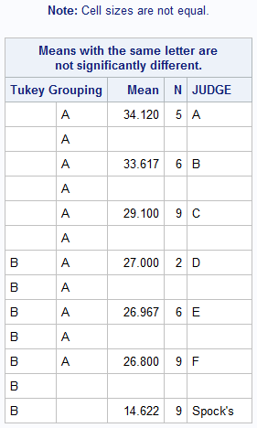
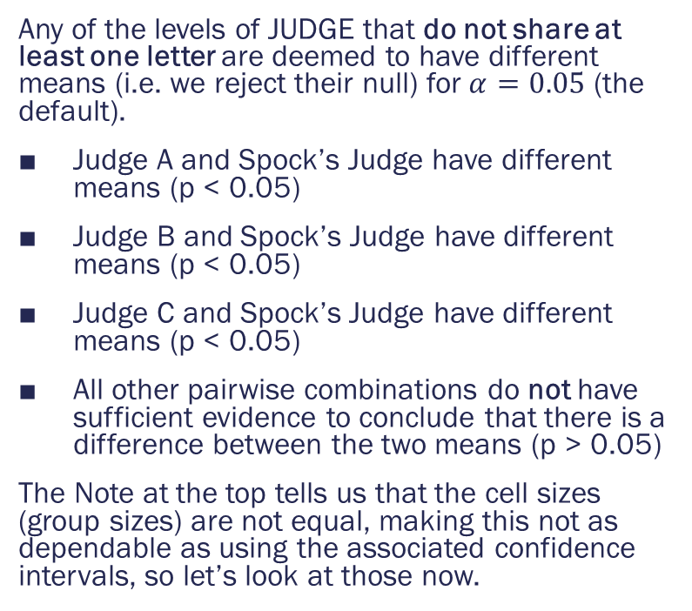
Multiple Comparisons: Tukey’s HSD
Any of the levels of JUDGE that do not share at least one letter are deemed to have different means (i.e. we reject their null) for $α=0.05$ (the default).
Judge A and Spock’s Judge have different means (p < 0.05)
Judge B and Spock’s Judge have different means (p < 0.05)
Judge C and Spock’s Judge have different means (p < 0.05)
All other pairwise combinations do not have sufficient evidence to conclude that there is a difference between the two means (p > 0.05)
The Note at the top tells us that the cell sizes (group sizes) are not equal, making this not as dependable as using the associated confidence intervals, so let’s look at those now.

Slide 24
Multiple Comparisons: Tukey’s HSD
Now replace LINES with CLDIFF (as below) to get confidence intervals instead of the table on the last slide.
You can do both as well, if that’s what you need to make your conclusions.
PROC GLM DATA=SPOCK;
CLASS JUDGE;
MODEL PERCENT=JUDGE;
MEANS JUDGE / TUKEY CLDIFF;
RUN; QUIT;

Slide 25
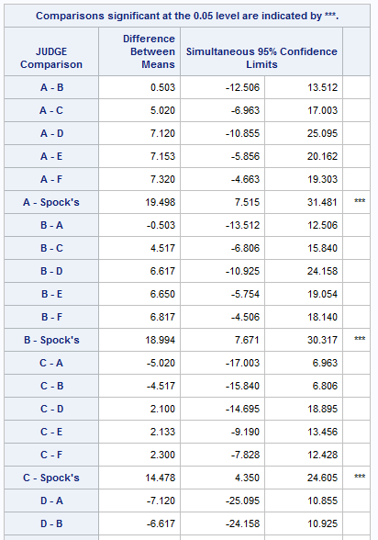
Multiple Comparisons: Tukey’s HSD
This table gives the confidence limits for any pairwise comparisons of means (first 20 shown here). Looking through the full list, we determine that
Spock’s Judge and Judge A have different means.
Spock’s Judge and Judge B have different means.
Spock’s Judge and Judge C have different means.
Spock’s Judge and Judge E have different means.
Spock’s Judge and Judge F have different means.
All other pairwise comparisons do not have sufficient evidence to conclude that they have different means
If the group sizes are all equal, these CIs will give the same results as the previous table (not the case here).

Slide 26
Breakout Sessions
After each question’s slide, I have included a follow-up slide with the answer and an additional question for discussion.
You should:
Spend only a minute or two discussing the original question and trying to come to an agreement on the answer.
If your group can’t agree within that timeframe, move on to the next slide anyway.
Go to the next slide and check your answer.
Discuss the follow-up question and answer it in your group notes.
Note: some of the answers are scrambled from what you saw in the quiz, so you need to look at the actual answers, not just whether you answered a, b, c, or d.

Slide 27
BreakOUT Sessions
Review of Quiz 6

Slide 28
Question 1
Recall the handicap study (case 6.1.1). Is it possible that the applicant’s handicap in the videotape is confounded with the actor’s performance?
No. The script was held constant.
Yes. The actor who played the applicant could be more convincing in some roles than in others.
No. The undergraduates viewing the videos were randomized to view the tapes.
Yes. Only undergraduates from a U.S. university were used to view the videos.

Slide 29
Question 1 Follow-Up
Recall the handicap study (case 6.1.1). Is it possible that the applicant’s handicap in the videotape is confounded with the actor’s performance?
Yes. The actor who played the applicant could be more convincing in some roles than in others.
One way to correct for this is to get different people to play each role, preferably those who actually have the handicap, as they would be unbiased in their portrayal. However, this would likely introduce a new source of bias. What would that be?

Slide 30
Question 2
For the handicap study, who were the subjects?
The job applicants
The interviewers
The videos
The undergraduates

Slide 31
Question 2 Follow-Up
For the handicap study, who were the subjects?
The undergraduates
We are examining the potential bias of the undergraduates; they are the ones having measurements taken on them.
[No follow-up question for this one.]

Slide 32
Question 3
Again for the handicap study, suppose that the researchers wanted to examine the effect of the control group versus each of the other groups (i.e. control vs. crutches, control vs. hard of hearing, etc). What multiple comparison procedure is the most appropriate?
Tukey’s HSD procedure
Scheffe’s procedure
Dunnett’s procedure
The Bonferroni procedure

Slide 33
Question 3 Follow-Up
Again for the handicap study, suppose that the researchers wanted to examine the effect of the control group versus each of the other groups (i.e. control vs. crutches, control vs. hard of hearing, etc). What multiple comparison procedure is the most appropriate?
Dunnett’s procedure
Dunnett’s procedure is designed to control the total Type I Error rate for this exact situation. If we also wanted to examine whether some handicaps produced different results that others, why would Dunnett’s procedure no longer be appropriate?

Slide 34
Question 4
Which of the following is NOT a common fallacy of reasoning from a statistical hypothesis test?
Interpreting a small p-value as evidence against the null hypothesis
Interpreting statistical significance from an observational study as evidence of causation.
Interpreting a large p-value as evidence that the null hypothesis is true.
Interpreting a statistically significant effect as a practically important one

Slide 35
Question 4 Follow-Up
Which of the following is NOT a common fallacy of reasoning from a statistical hypothesis test?
Interpreting a small p-value as evidence against the null hypothesis
[Follow up question on next slide]

Slide 36
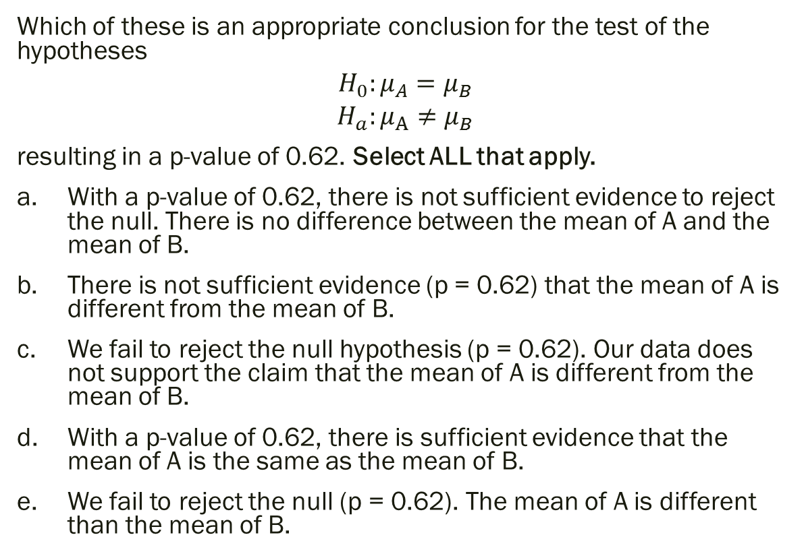
Question 4 Follow-Up
Which of these is an appropriate conclusion for the test of the hypotheses
$$H_{0}:μ_{A}=μ_{B}$$
$$H_{a}:μ_{A}≠μ_{B}$$
resulting in a p-value of 0.62. Select ALL that apply.
With a p-value of 0.62, there is not sufficient evidence to reject the null. There is no difference between the mean of A and the mean of B.
There is not sufficient evidence (p = 0.62) that the mean of A is different from the mean of B.
We fail to reject the null hypothesis (p = 0.62). Our data does not support the claim that the mean of A is different from the mean of B.
With a p-value of 0.62, there is sufficient evidence that the mean of A is the same as the mean of B.
We fail to reject the null (p = 0.62). The mean of A is different than the mean of B.

Slide 37
If you finish reviewing the quiz, go back to the example we did as a class (earlier in this PowerPoint) and discuss any lingering questions you have with the group.
If as a group you still have questions about that example, please put them in the group notes box. I will try to discuss them at the end of class or add additional explanation before posting this presentation.

