Slide 1
Data analytics from a toddler autism dataset
Presented by Marie NAVARRO

Slide 2
Data analytics from a toddler autism dataset
Reminder about autism
Dataset I worked on
Data visualisation
Statistical hypothesis
Project feedback

Slide 3
About autism

Slide 4
Autism Spectrum Disorder (or ASD) is a neurodevelopmental disorder.
The symptoms are multiple and their intensity variable
ASD affects children in:
Communication (language, eye contact, …)
Social interactions (perception and understanding emotions, relationships, …)
Behavior (stereotypical gestures, specifics interests, routines, …)
There is no drug treatment for ASD, but there are educational approaches :
Personalized support for children diagnosed with ASD
Reminder – Dataset – Visualization – Statistical hypothesis - Feedback

Slide 5
My dataset

Slide 6
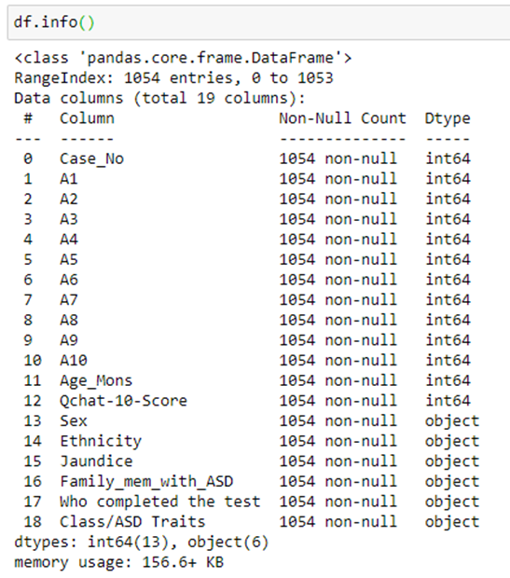
Dataset aubout toddler autism
https://www.kaggle.com/fabdelja/autism-screening-for-toddlers
Developped by Dr Fadi Fayez Thabtah, using a mobile app called ASDTest
behavioural tests, completed by parents and care givers when doubts about a child
Reminder – Dataset – Visualization – Statistical hypothesis - Feedback

Slide 7
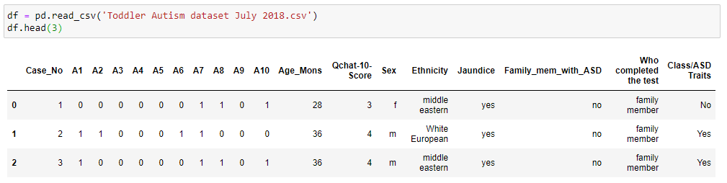
1054 records (one per child), with no missing values !
Answers to 10 test-questions (1 if autistic behavior, 0 if normal)
Various info about children : Age (in month), Sex, Ethnicity, if born with jaundice, if there is a family member with ASD
Other info : who completed the test, the result assigned by the test
I didn’t need to clean the dataset (I only replaced binary values by booleans)
Reminder – Dataset – Visualization – Statistical hypothesis - Feedback

Slide 8
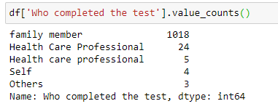
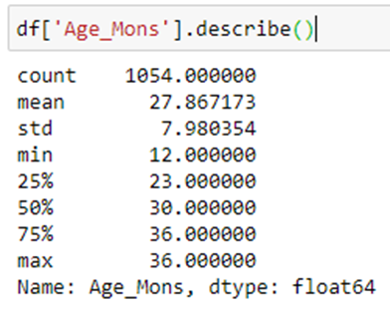
Who completed the ASDtest ?
I choosed to keep the 7 rows completed by ‘self’ and ‘other’ considering:
parents could have shown their kid where to clic
‘Other’ could be a babysitter or a nursery worker
Tested children
I will go back to them in Viz part
Reminder – Dataset – Cleaning – Visualization – Statistical hypothesis - Feedback

Slide 9
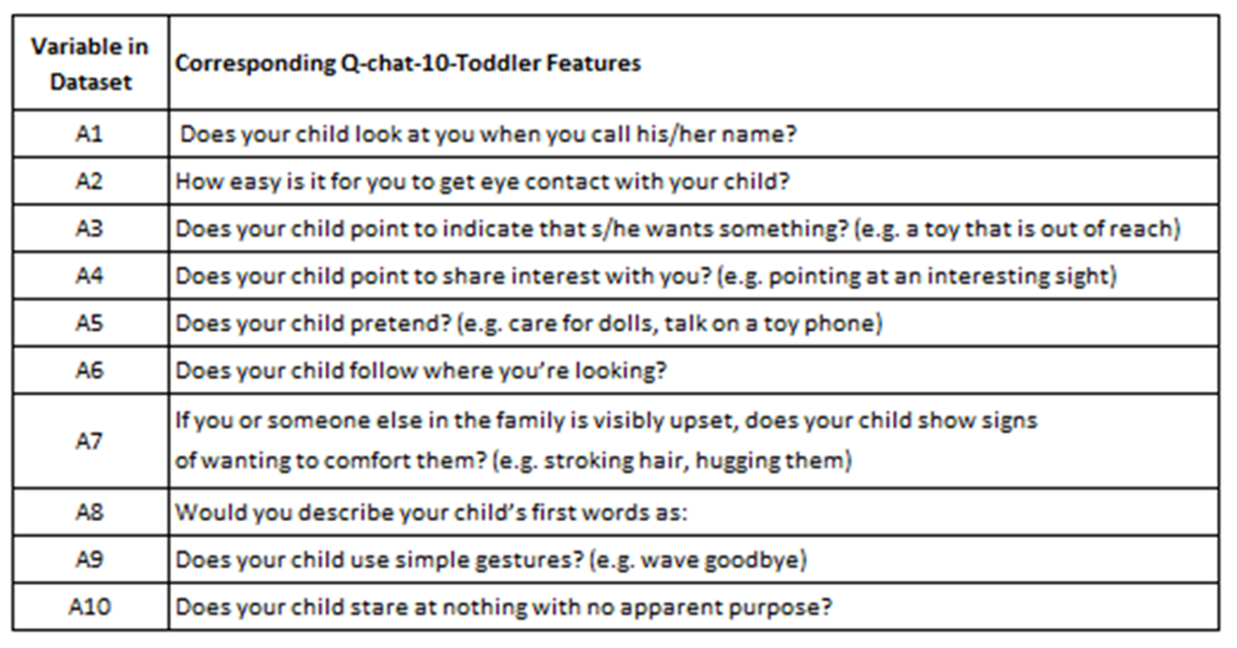
If you are curious, here are the questions :
Reminder – Dataset – Visualization – Statistical hypothesis - Feedback

Slide 10
Data Visualization

Slide 11
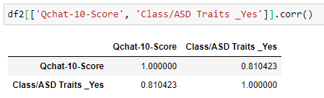
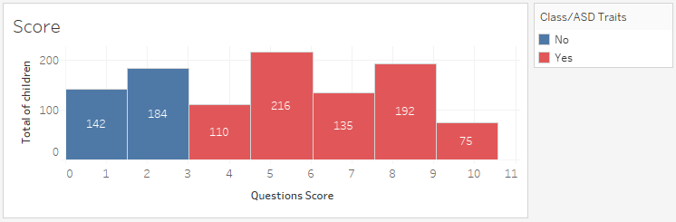
We can observe a strong correlation between the total score and having ASD traits : this is normal, given ASD traits is automatically assigned when the total score is greater than 3.
Reminder – Dataset – Visualization – Statistical hypothesis - Feedback

Slide 12
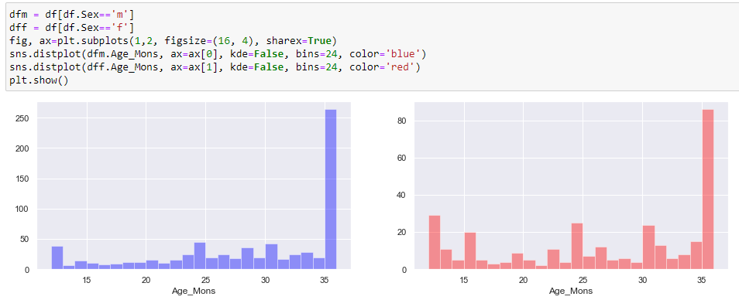
Data visualisation
I work both on Python (Matplotlib, Seaborn) and Tableau
Here we can see with Python that our sample is based on children from 1 to 3 years, with more boys than girls, and children around 3 years are more represented than others (parents are probably less worried before).
Reminder – Dataset – Visualization – Statistical hypothesis - Feedback

Slide 13
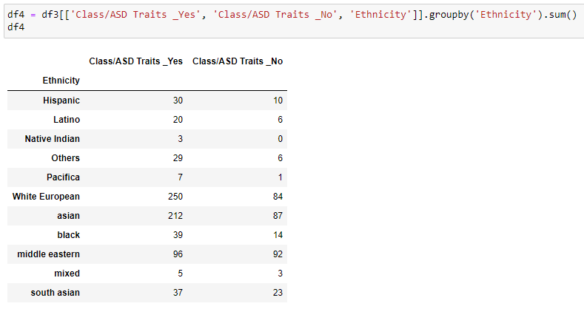
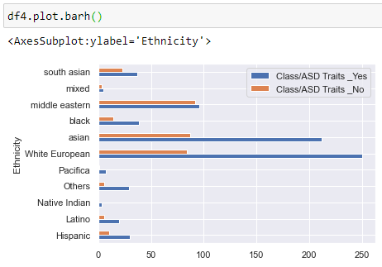
Here we can see the repartition of children which obtained (or not) « ASD traits » result, by ethnicity.
Reminder – Dataset – Visualization – Statistical hypothesis - Feedback

Slide 14
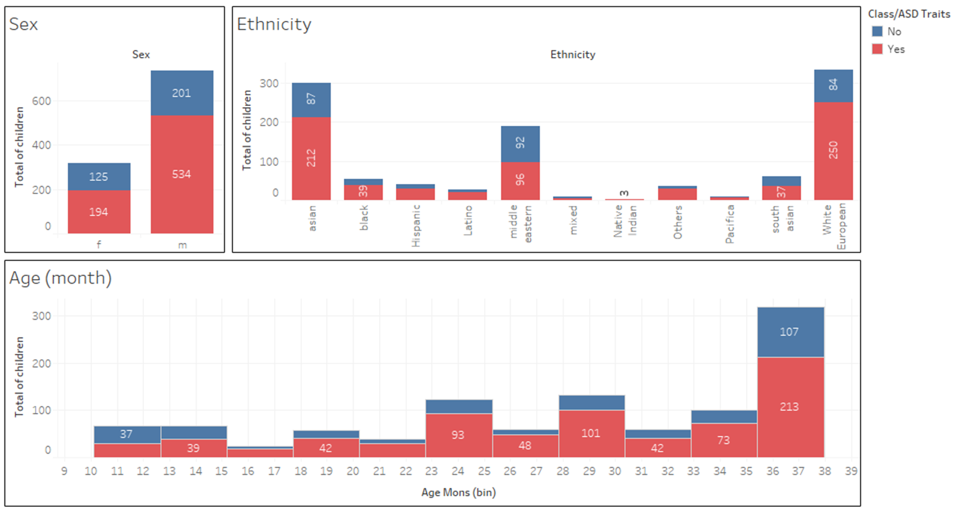
With a dashboard from Tableau, we can see the repartition of tested children by sex, age and ethnicity. We can see that the majority of tested children are considered having autistic traits, according to the apps
Reminder – Dataset – Visualization – Statistical hypothesis - Feedback

Slide 15
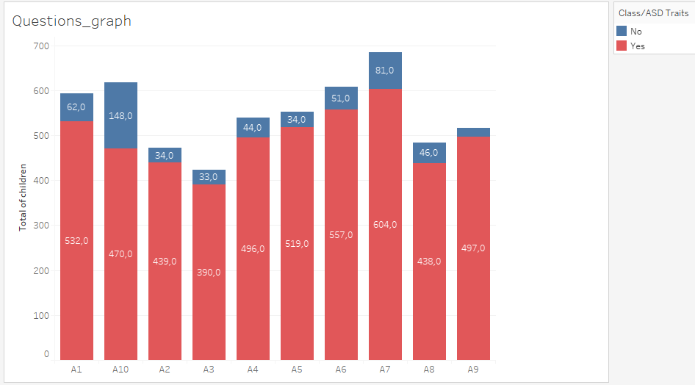
Here we can see the count of positive answers for each questions, the color indicates if tested children were finally considered as having ASD traits or not : the blue part show us it’s possible to answer with the autistic critera but not being considered with ASD at the end of the test.
Reminder – Dataset – Visualization – Statistical hypothesis - Feedback

Slide 16
Statistical hypothesis

Slide 17
Does having a family member with ASD increase the possibility for a child of having ASD traits ?
H0: Those 2 facts are independent
H1: Those 2 facts are not independent
Chi-squared test of independence :
Significant level = 0,05
Using a 2x2 array: degre of freedom = 1
Chi-squared [table](1df, 0,95) = X²t = 3,84
If X²obs > X²t, then H0 will be rejected
Reminder – Dataset – Visualization – Statistical hypothesis - Feedback

Slide 18
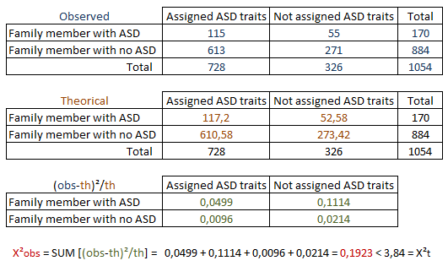
If X²obs > X²t, then H0 would be rejected
X²obs < X²t → then H0 can’t be rejected
We can’t say that being assigned the result « ASD traits » depends on having a family member with ASD.
Reminder – Dataset – Visualization – Statistical hypothesis - Feedback

Slide 19
Project feedback

Slide 20
Challenge: Find a statistical hypothesis
Learnings: Tame tools sush as Matplotlib, Seaborn and Tableau
If I was starting from scratch: Find and work on an dataset about autistics adults
Improvements:
Use Webscrapped data
Do more descriptive statistics
Reminder – Dataset – Visualization – Statistical hypothesis - Feedback

Slide 21
Thank you for your attention !
and thanks to Yani CHELA for working with me to find the dataset
Any Questions ?

