Slide 1
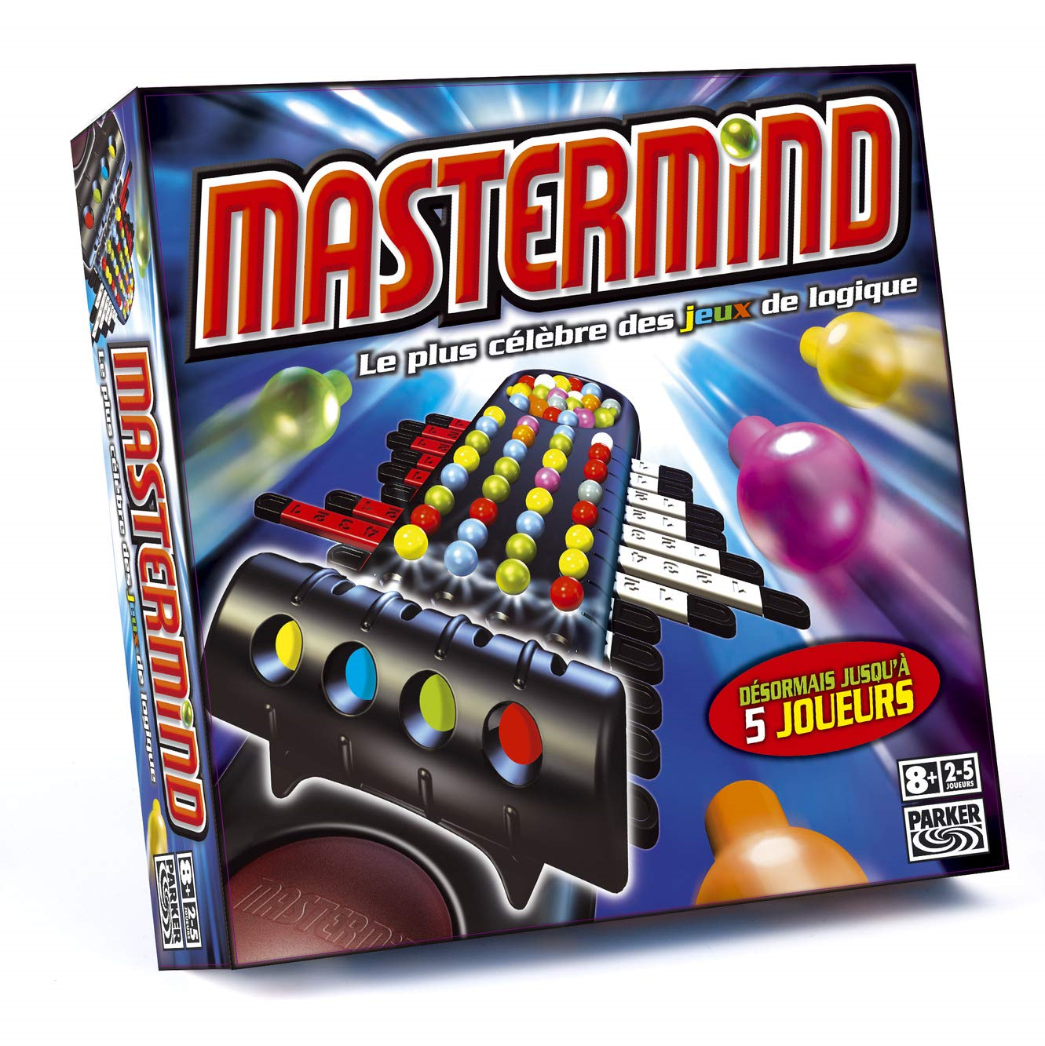
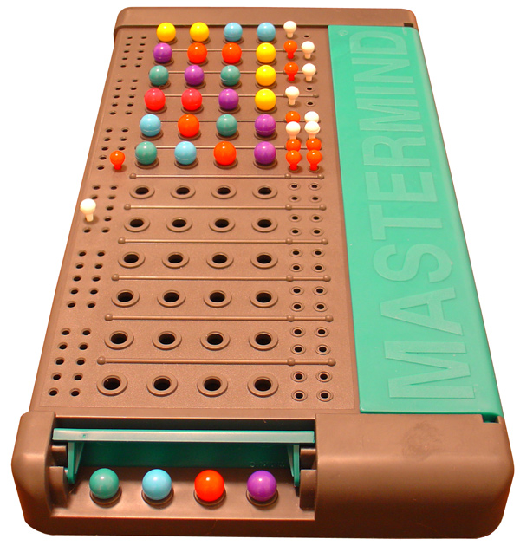
MASTERMIND
By Tatiana MARTINEZ
& Marie NAVARRO

Slide 2
It’s a one player game. The computer generates a random secret code. In the original game, the code is composed by colored balls. In this version, we replaced colors by numbers. As a player, you have to guess in limited rounds what the code is. By default, the game runs with 4 digits (balls), of 4 possible colors (1 to 4) in 12 rounds but in our version, if you find it too easy, you can increase the difficulty by modifying those 3 variables
Presentation of our mastermind game

Slide 3
Challenges:
- Work as a team for the first time (remote organization, share the tasks)
- Coding a game using what we have learned during the week.
The Process:
Sharing our screen, we first planned our project with Trello.
Secondly, we coded getting inspired by existing code, improving it and testing it to obtain our proper game.
Then we pushed it on a shared github repository.
Finally, we worked on this presentation.
Learnings:
- managing a project in a really short time.
- practising a bit more our python programming.

Slide 4
If I were to start from scratch...
we would never have been able to finish this project on time.
Improvements:
We could have
- split the project into more tasks on Trello in order to better balance them.
- improved our code, which is not perfect.
- used Git as it’s made for : with merging branches…
Highlights:
Our mastermind is playable !
We did it instead of remote conditions, thanks to a good communication.

Slide 5
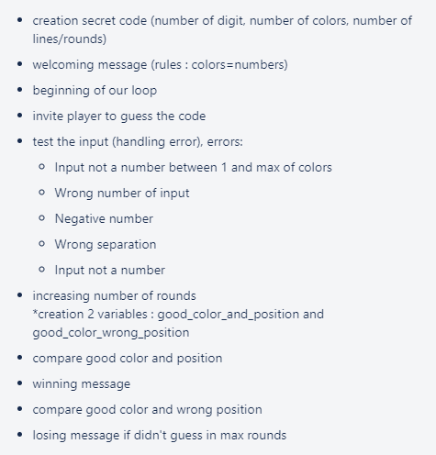
Specifications of our project code :

Slide 6
Now let’s play !

Slide 7
Thanks for your attention !
Any questions ?

