Slide 1

Prediction on hospital readmissions of diabetese patients
Data Analytics bootcamp
August 2020
Presented by Marie NAVARRO
github.com/MarieNav/Prediction_Diabetics_Readmission

Slide 2
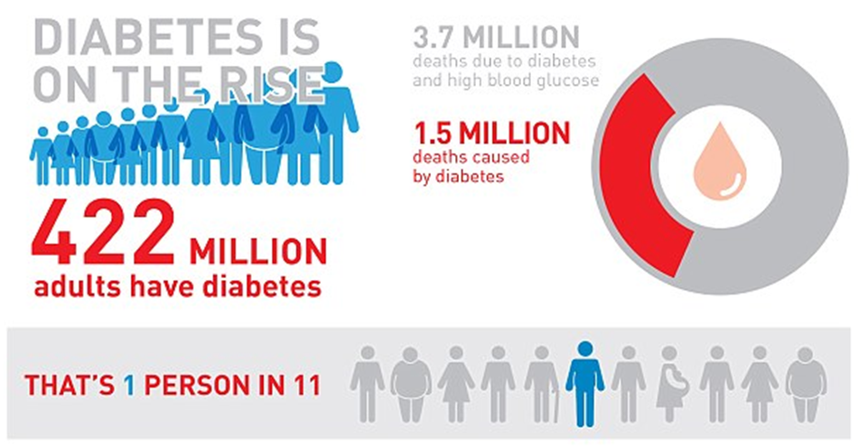
A public health problem

Slide 3
A public money problem
* According to the CNAM (french health insurance treasury) :
a
In 2014, in France, The sum of all reimbursed expenses to diabetic patients amounts to 19 billion euros per year, i.e. 15% of health insurance expenses.
* According to the NCBI (National Center for Biotechnology Information):
a
In 2011, American hospitals spent over $41 billion on diabetic patients who got readmitted within 30 days of discharge.

Slide 4
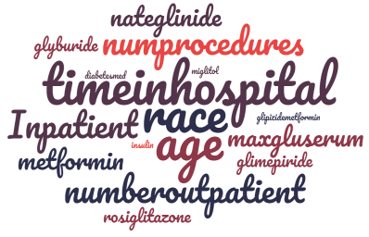
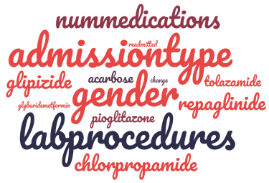
Data Description
A 10-year study (1999-2008) was carried out in 130 US hospitals
registering datas for 101.000 diabetes patients in the Health Facts Database,
including over 50 features representing patient and hospital outcomes,
in order to predict the probability of readmission of diabetic patient.

Slide 5
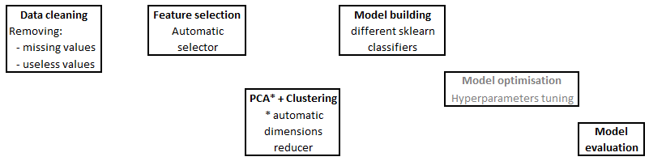
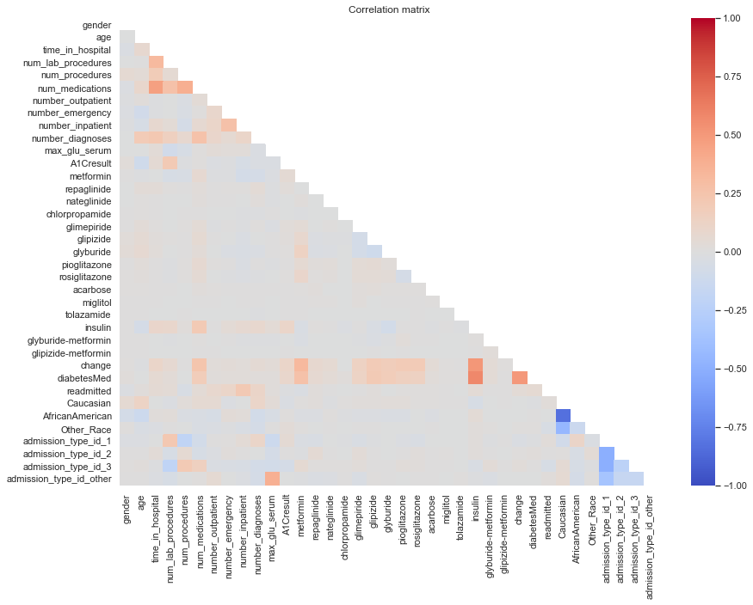
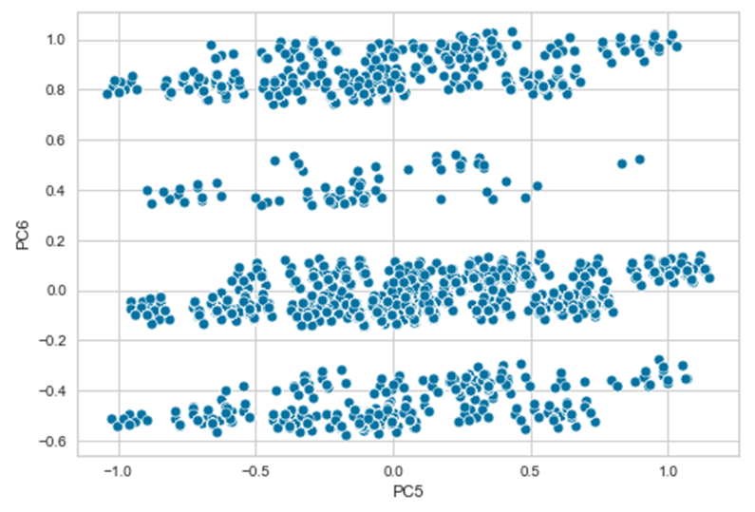
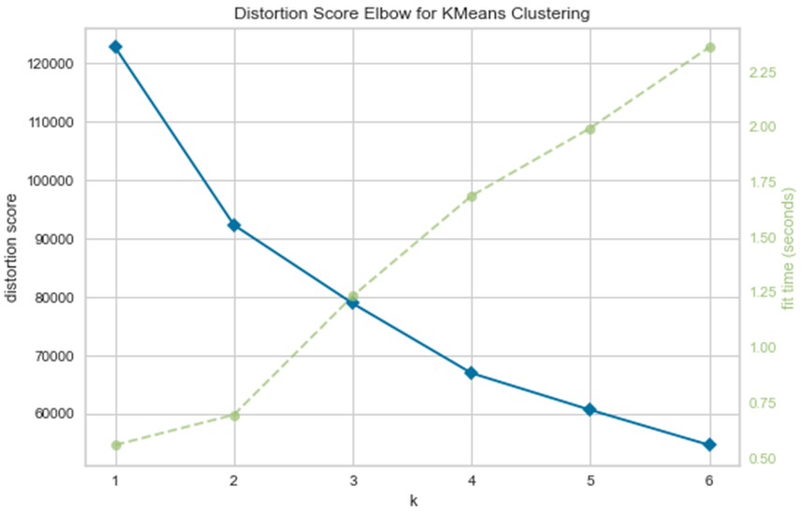
Model building process
Usefull features
Useless features

Slide 6
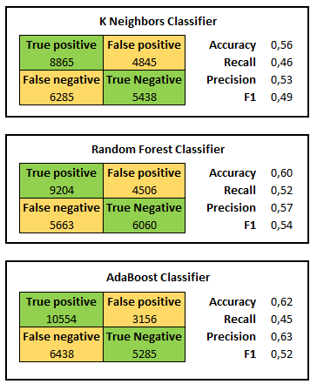
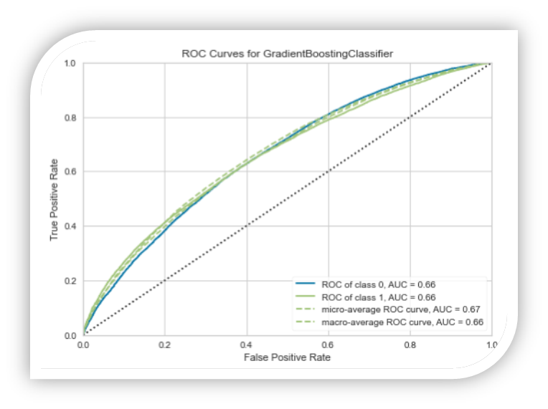
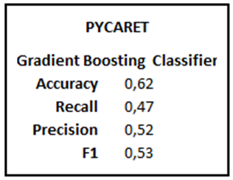
Some prediction models tested
According to Pycaret (a machine learning librairy), the best performing model is obtained using Gradient Boosting Classifier (though it had a poor performance with AUC = 0,66)

Slide 7
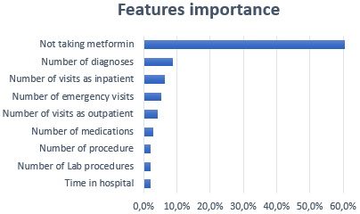
Important features in this prediction model
This study was carried out so that hospitals can adapt their practices in order to reduce the readmission rate. However, we note that, excpet for the Metformin, the important features on which our prediction model is based are not really up to them (or it would be ethically questionable)
a
Hospitals have been advised to work not only on inpatient treatment but also on continued care after discharge.

Slide 8
Thank you for your attention !

