Slide 1
Statistical analysis with linear regression Energy used by house appliances
Presented by Marie NAVARRO

Slide 2
Statistical analysis with linear regression Energy used by house appliances
Dataset presentation
Statistical analysis
Project feedback

Slide 3
MY DATASET

Slide 4
Appliances energy prediction Data Set
My dataset contains 29 columns :
- date time: year-month-day hour:minute:second
- Appliances: energy use (in Wh)
- lights: energy use of light fixtures in the house (in Wh)
- T1 to T9: Temperature in different rooms (in Celsius)
- RH_1 to RH_9: Humidity in different rooms (in %)
- RV1& RV2: 2 random variables
merged from Chievres weather station:
- T_out: Temperature outside (in Celsius)
- Pressure (in mm Hg)
- RH_out: Humidity outside (in %)
- Wind speed (in m/s)
- Visibility (in km)
- Tdewpoint (in Celsius)
It also contains:
- 19735 rows : 1 entry every 10min during 4,5 months
- No missing values → No need to clean, just manipulations
Data Visualization - Statistical Analysis - Feedback

Slide 5
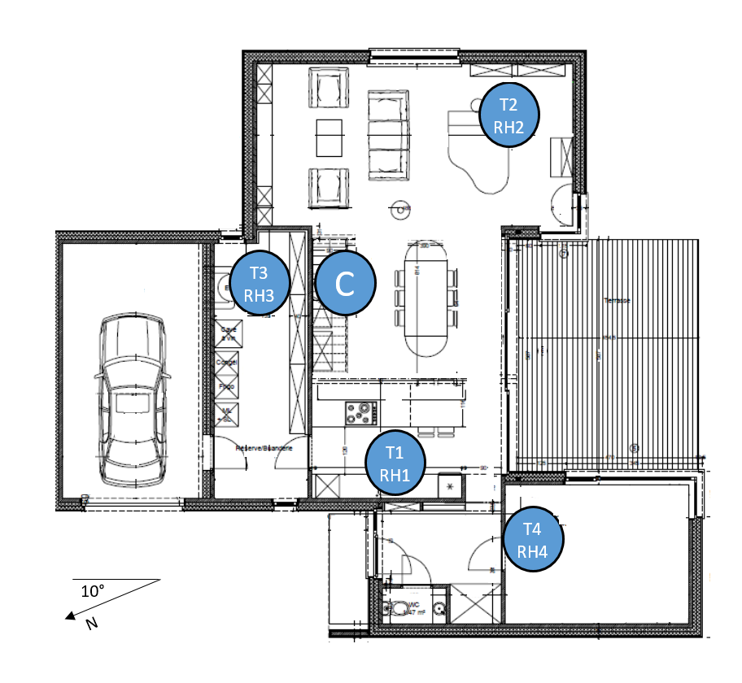
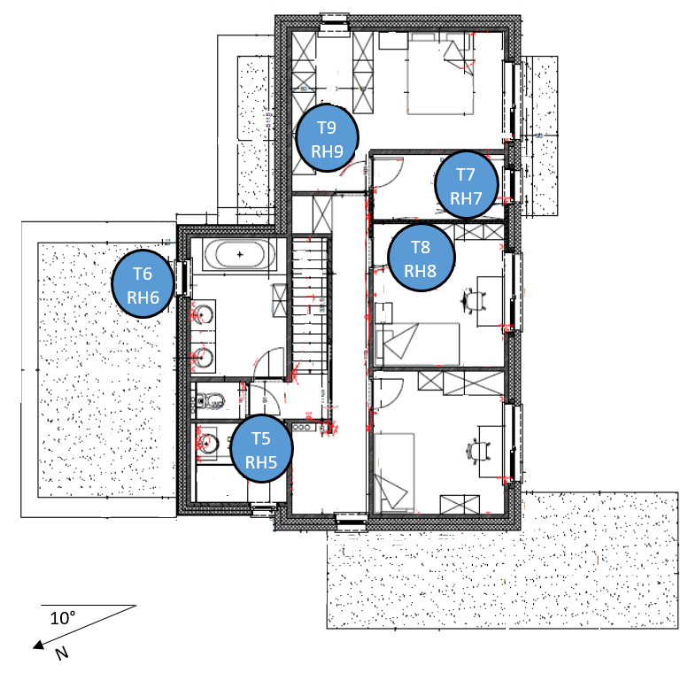
First floor :
1_Kitchen
2_Living room
3_Laundry room
4_Office room
Second floor :
5_Bathroom
6_Outside
7_Ironing room
8_Teenager room
9_Parents room

Slide 6
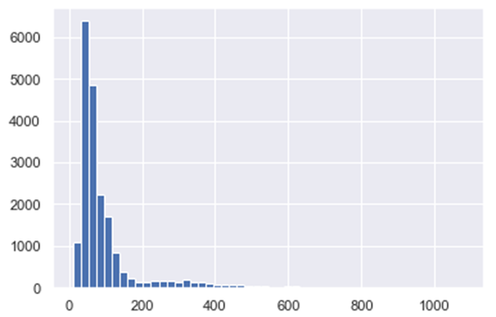
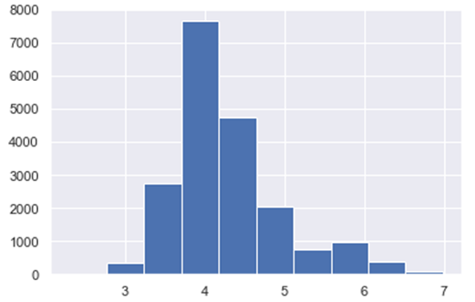
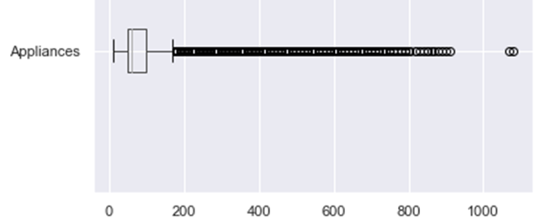
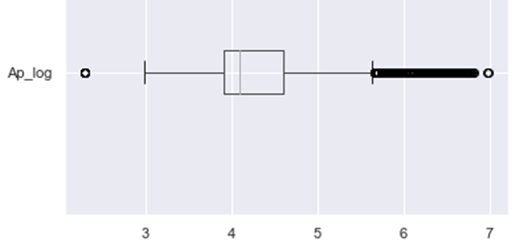
Data manipulation
Drop the 2 random variables columns
Turn date column into datetime to create a new columns :
* Weekend (0 : weekday / 1 : weekend)
Turn Appliances column (logarythm distribution) into an other one, normally distributed
Data Visualization - Statistical Analysis - Feedback

Slide 7
Data manipulation
Keep the lights column (logarythm distribution) because of too many 0
Create new columns for both T°C and %H :
INSIDE (mean of all inside sensors)
DIFFERENCE between inside and outside (absolute value)
DIRECTION of the sign of previous differences (1 : in > out / 0 : in < out)
TDP (1 if outside temperature is under dew point, else 0)
Difference between all the inside rooms next door.
Let’s see my code !
Data Visualization - Statistical Analysis - Feedback

Slide 8
STATISTICAL ANALYSIS

Slide 9
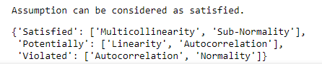
How I processed
I’ve droped date column (considered as an object)
I’ve droped T°C and %H columns clearly correlated
I’ve used statsmodel librairy to do an OLS regression, and P-HACKING
Problem : My R-Squared value is 0,287 which is bad…
I did a bit of P-HACKING, I’ve checked if assumptions were satisfied
I’ve droped columns wich still represented a multi-collinearity problem
I stopped with a R-Squared = 0,227 and assumptions satisfied:
Let’s see
my code!
Data Visualization - Statistical Analysis - Feedback

Slide 10
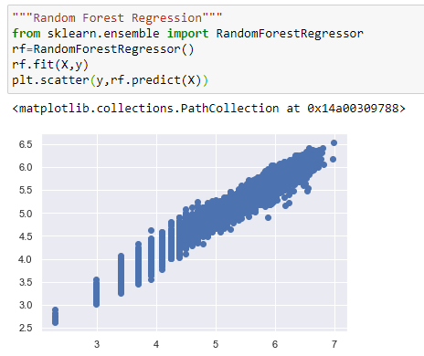
If my model were good, we could have conclude:
Appliances consumption depends of parameters as:
Lights turned on or off
Temperature set inside
We it’s week-end or not
As my model was not good, building a regression didn’t make sense, but let’s see what it would have looked like:

Slide 11
Project feedback

Slide 12
Challenge: figuring out what to do with my data
Learnings: use tools like statsmodel
If I was starting from scratch:
I would have search harder, a dataset with more cooperative values
Improvements:
get a better R-squared
work on regression after finiding a good model
Link: github.com/MarieNav/Statistical-Analysis_Appliances-Energy
Data Visualization - Statistical Analysis - Feedback

Slide 13
Thank you for your attention !
Any Questions ?

