Slide 1
Statistical analysis with classification Edibility of a mushroom given its caracteristics
Presented by Marie NAVARRO

Slide 2
Statistical analysis with classification Edibility of a mushroom given its caracteristics
Dataset presentation
d
Statistical analysis
Features selection
Model training
a
Project feedback

Slide 3
MY DATASET

Slide 4
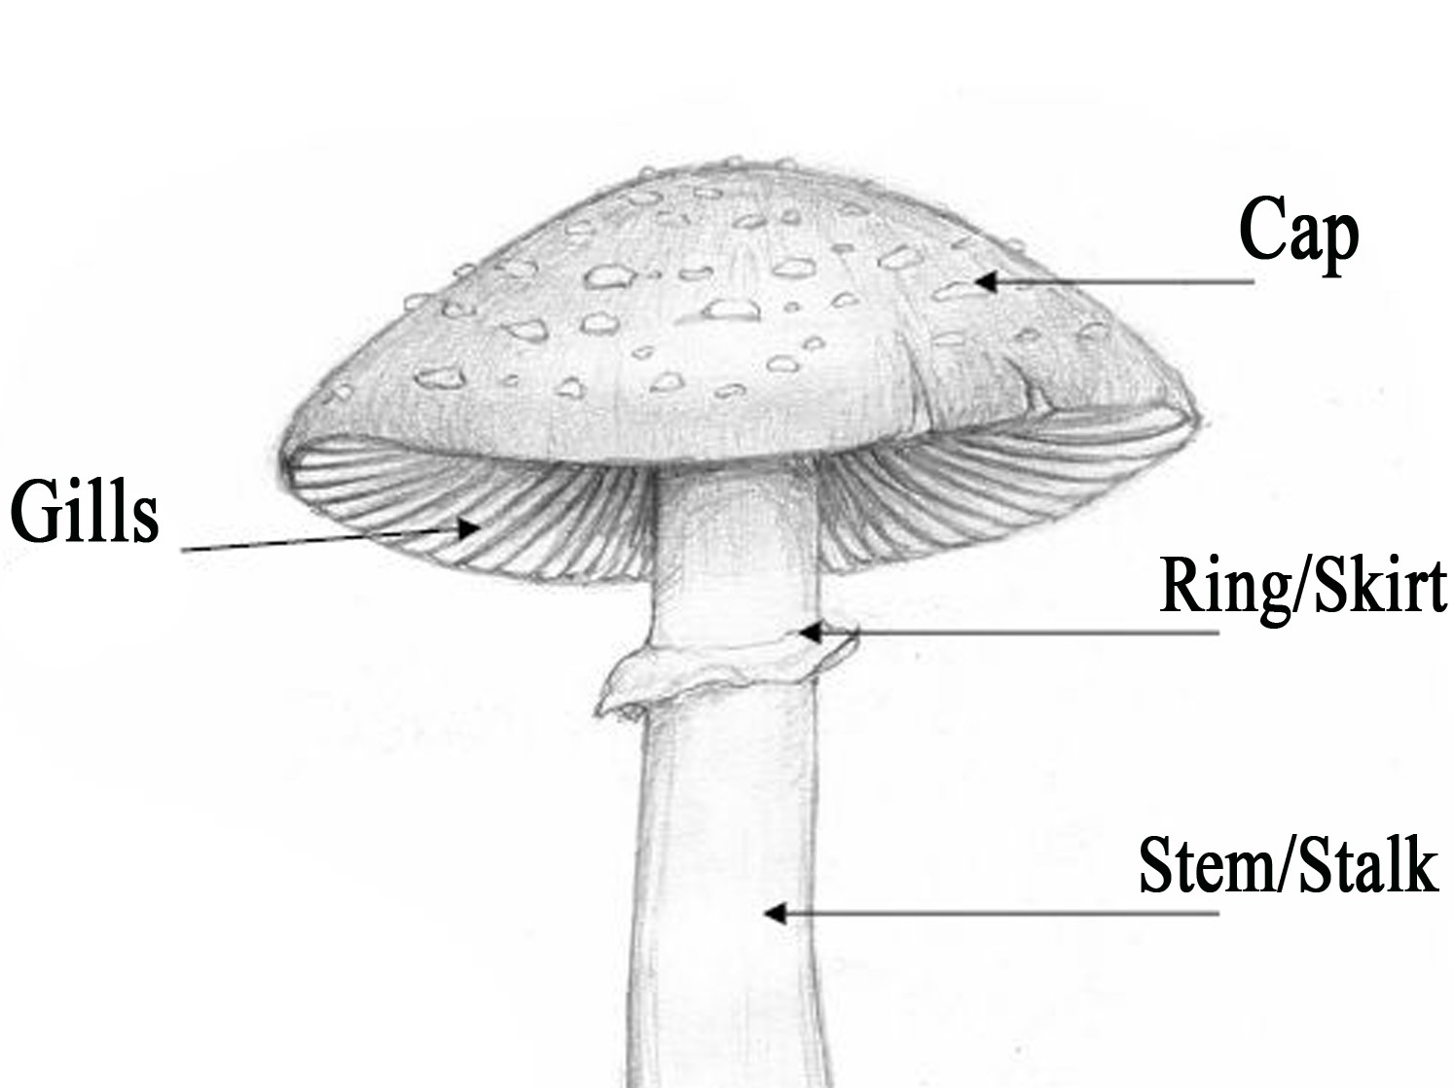
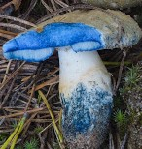
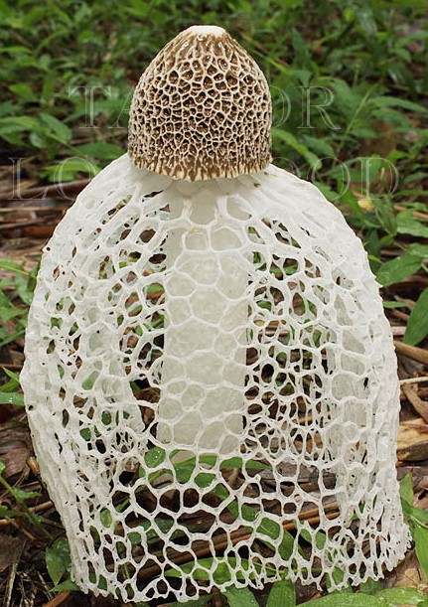
Mushroom Dataset
My dataset contains 23 categorical columns :
- If it’s edible or poisonous
- 3 about its cap (shape, surface, color)
- If it bruises or not
- Its odor
- 4 about its gills (attachement, spacing, size, color)
- 6 about its stalk (shape, root, surface*, color*)
- 2 about its veil (type and color)
- 2 about its ring (number, type)
- Its spore-print-color
- its population
- Its habitat
And 8124 rows (one per murshroom)
* Above and bellow ring
Veil
Bruising

Slide 5
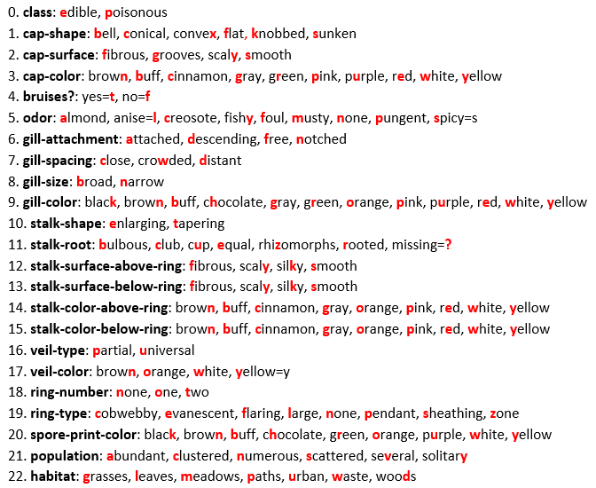
Mushroom Dataset

Slide 6
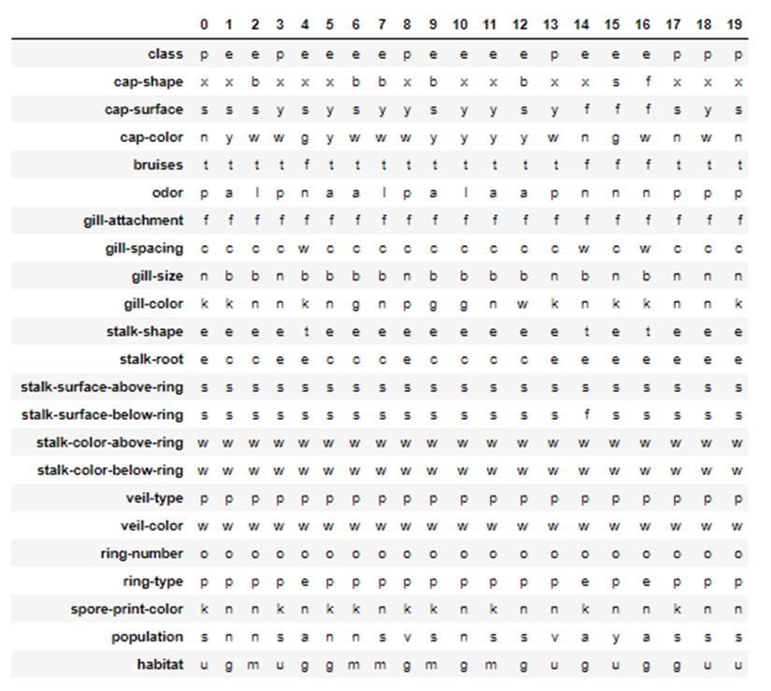
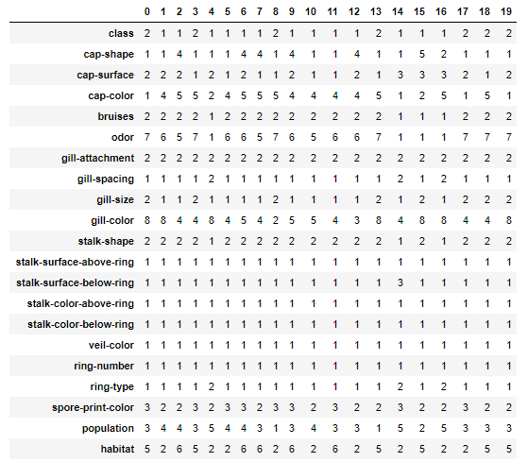
Data manipulation
Drop 2 columns : * « stalk-root » because of 30% missing values
* « veil-type » because 100% partial / 0% universal
bd
Map every columns into numbers :

Slide 7
STATISTICAL ANALYSIS

Slide 8
Feature selection
Constraint : categorical features & categorical respone
Filter : According to the Chi-Squared test, the columns ‘cap-color’ and ‘gill-attachment’ could not be considered for model training.
Wrappers : According to Sequential Forward Selection method, the columns 'cap-color', 'bruises', 'odor', 'gill-spacing', 'gill-size', 'stalk-surface-above-ring', 'ring-type' & 'population’ are the best for building a model.
Let’s see my code !

Slide 9
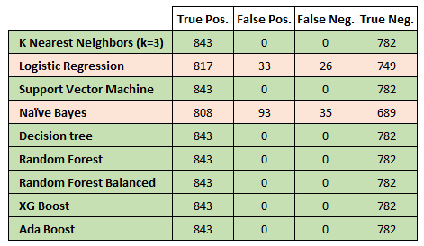
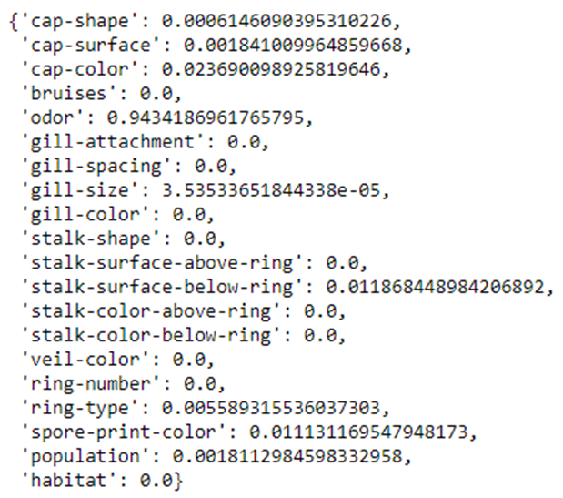
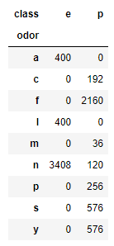
Model training
Let’s see my code !

Slide 10
Project feedback

Slide 11
Challenge: Manage categorical features
Learnings: Practice Sklearn and modeling
If I was starting from scratch: Use a dataset with numerical and categorical features, for more challenge !
Improvements:
Do more descriptive stats
Play with my tests, adjusting the hyperparameters
Link: github.com/MarieNav/Statistical-Analysis_Mushroom-Classification

Slide 12
Thank you for your attention !
Any Questions ?

