Slide 1

SENTIMENT ANALYSIS
ON CHATGPT REDDIT POSTS
WEB AND SOCIAL NETWORKS SEARCH AND ANALYSIS
PROJECT
BY: MARIE E. BASSIL 503962

Slide 2

CONTENT
01
OBJECTIVE
02
DATA COLLECTION
03
EDA
04
DATA PREPROCESSING
05
NETWORK ANALYSIS
06
CONTENT ANALYSIS
07
COMPARISON/RESULTS

Slide 3
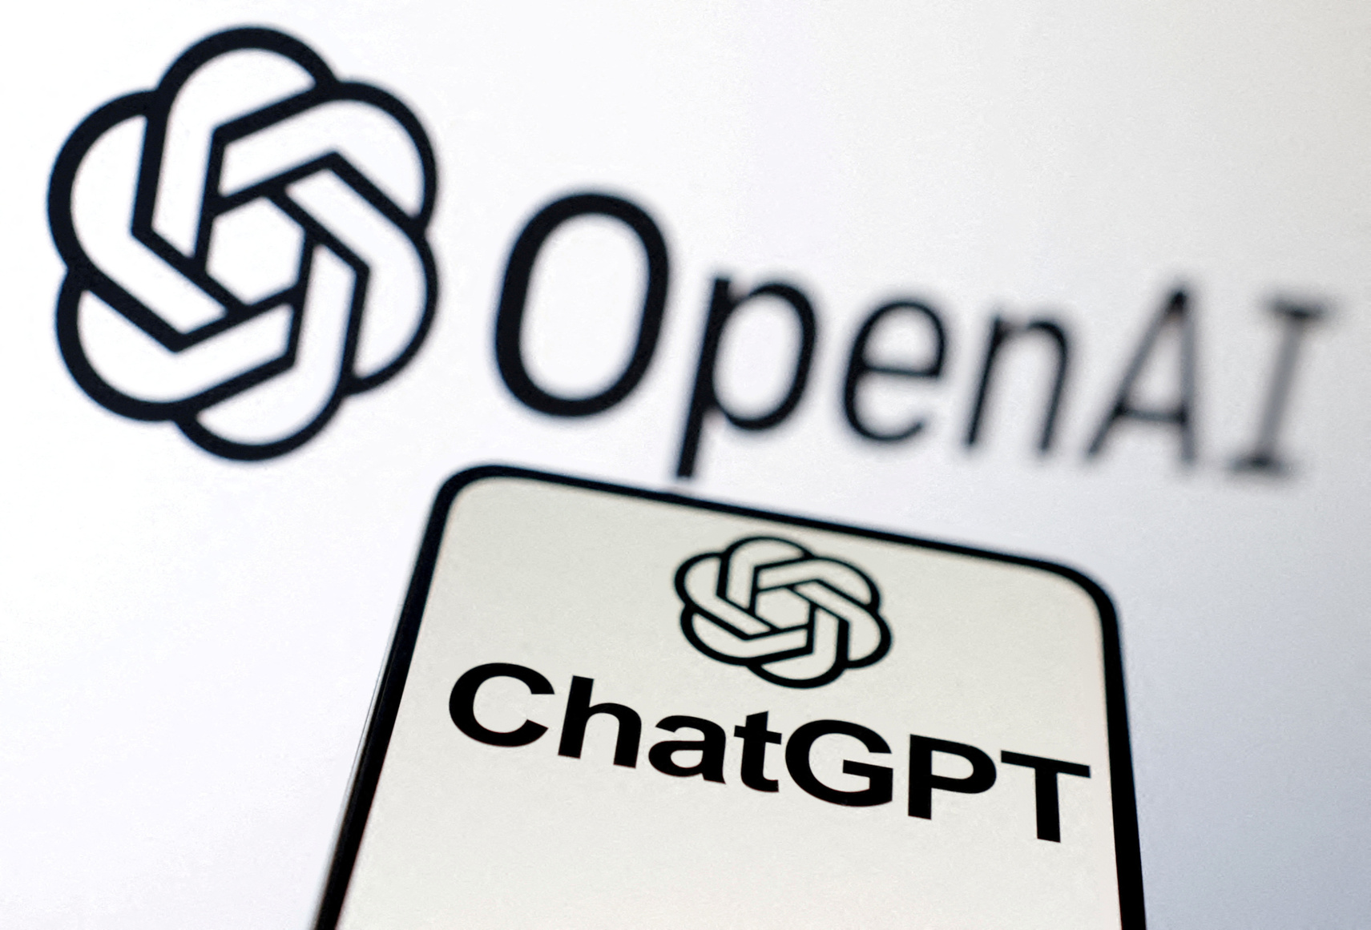



OBJECTIVE
The primary objective of this project is to analyze the sentiment of Reddit posts related to ChatGPT to gain a deeper understanding of public opinion.
By examining user-generated content, this analysis aims to uncover how users perceive ChatGPT especially after its increased popularity.

Slide 4





DATA
DATA SCRAPING
EDA
DATA PREPROCESSING
Utilization of the Reddit API to scrape posts from various subreddits. This involved querying Reddit for posts that mentioned specific keywords in their title or content.
Performing EDA to uncover patterns, anomalies, and insights, aiding in better data understanding and informed decision-making.
Cleaning, transforming, and prepareing the raw data for analysis, to ensure accuracy and enhancing the performance of analytical models.

Slide 5



DATA SCRAPING
SCRAPING DATA
Utilized the Reddit API to scrape posts from various subreddits using PRAW (python reddit api wrapper).
Subreddits Scraped: OpenAI, ChatGPT, artificial, machinelearning.
Keywords Used: ChatGPT, OpenAI GPT-3, GPT-3, GPT-4, OpenAI, AI chatbot, language model, natural language processing, AI assistant, conversational AI.
DATASET
The dataset contains the following columns: 'author', 'comments', 'date', 'id', 'num_comments', 'score', 'subreddit', 'upvote_ratio', 'text', ‘title],
Since some reddit posts don't have a selftext, I have combined the title and the text together into one column and considering that column as my target.
--> combined_text

Slide 6
EXPLORATORY DATA ANALYSIS

Slide 7

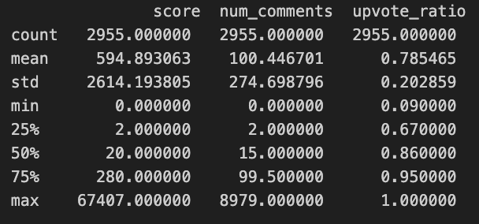

SUMMARY STATITICS
Score: Average scoreindicating some highly popular posts.
Number of Comments: On average, posts have ~100 comments, ranging from 0 to 8979, with a median of 15, showing varied engagement.
Upvote Ratio: Most posts having a positive reception (median 0.86) and a range from 0.09 to 1.0.
Variation: High standard deviations in scores (2614.2) and comments (274.7) indicate significant variability in post popularity and engagement.

Slide 8
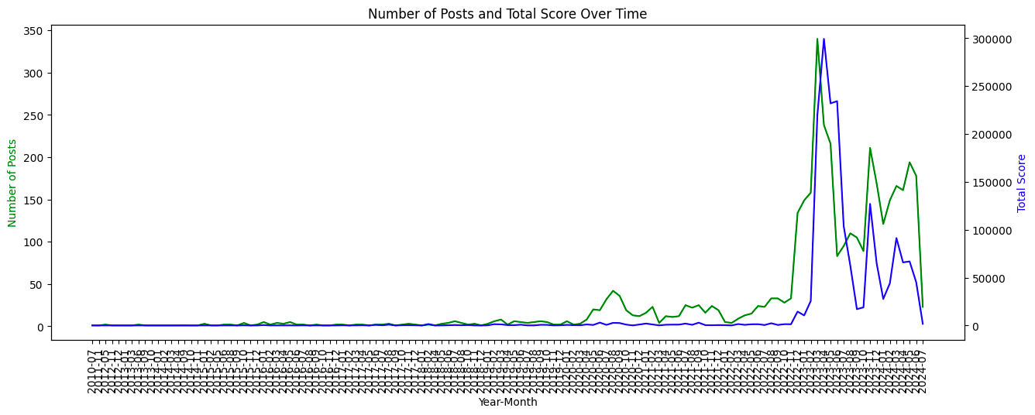

There are clear peaks in the number of posts and total scores, suggesting periods of heightened interest or activity related to ChatGPT and AI topics.
Certain months show a significant spike in both the number of posts and the total score, indicating viral or highly engaging discussions.

Slide 9

IN ADDITION
The following EDA were done:
AT WHAT TIME THE HIGHEST POSTING ACTIVITY ABOUT CHATGPT OCCURS --> WEDNESDAY TO FRIDAY, 5PM TO 7PM
TO IDENTIFY THE AUTHORS/POSTS THAT ARE HIGHLY ACTIVE AND ARE LIKELY TO PLAY A ROLE IN DRIVING DISCUSSIONS.
CHECK WHICH SUBREDDIT HAS THE HIGHEST ENGAGEMENT AND REASONATES WELL WITH THE COMMUNITY --> CHATGPT
POST ANALYSIS PER HOUR/DAY
AUTHOR/POSTS ANALYSIS
ENGAGEMENT BY SUBREDDIT

Slide 10
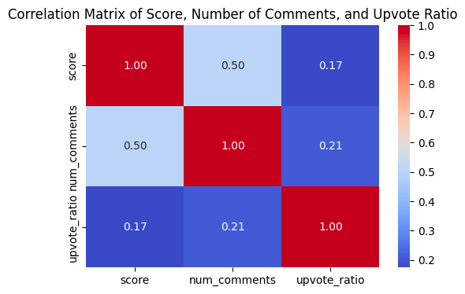
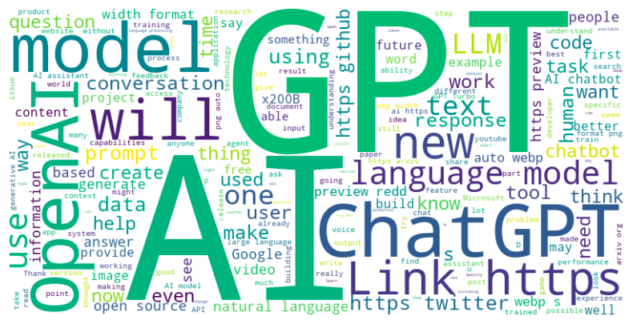
The moderate correlation between score and the number of comments suggests that higher-scoring posts are likely to generate more discussion. However, the weak correlations involving the upvote ratio indicate that while positive reception (high upvote ratio) contributes to scores and comments, other factors also play significant roles in driving engagement.
WORD CLOUD:

Slide 11
DATA PREPROCESSING
Lowercasing, removing newlines,..
Text Cleaning (fixing spaces, removing numbers, removing stop words, punctuation..)
Handling negations by adding a hyphen
Tokenisation
Lemmatization
Features Exctraction

Slide 12
NETWORK ANALYSIS
COMMENTS EXTRACTION
Extracted comments for each Reddit post and identified the relationship between authors and commenters.
To understand the interaction dynamics within Reddit discussions about ChatGPT by analyzing that relationship.
DATASET
The full dataset of the relationships was a total of 136046 rows
It was reduced to 11000 rows for the purpose of the network analysis,

Slide 13
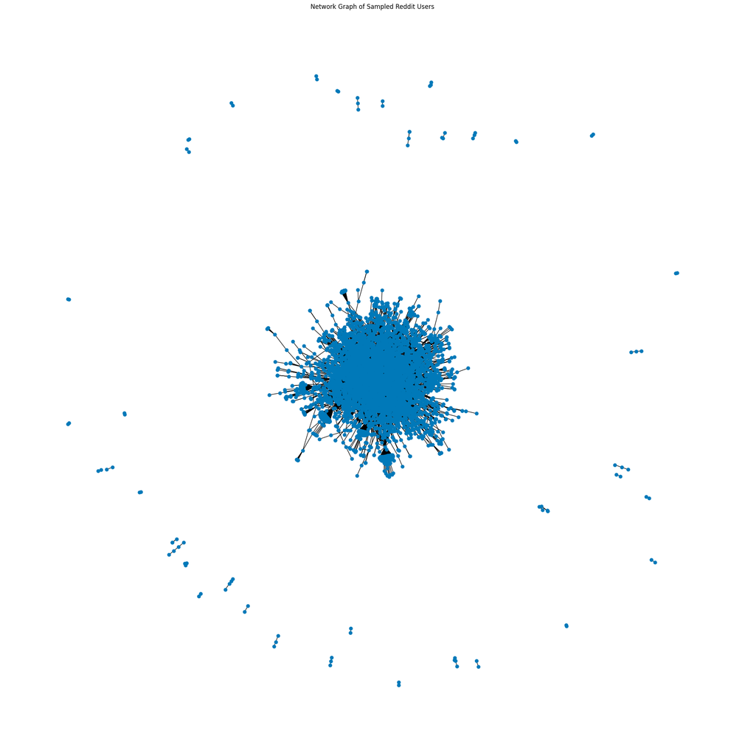
GRAPH
The graph is a dense central cluster of nodes with many interconnections. This suggests that there is a core group of users who frequently interact with each other.

Slide 14
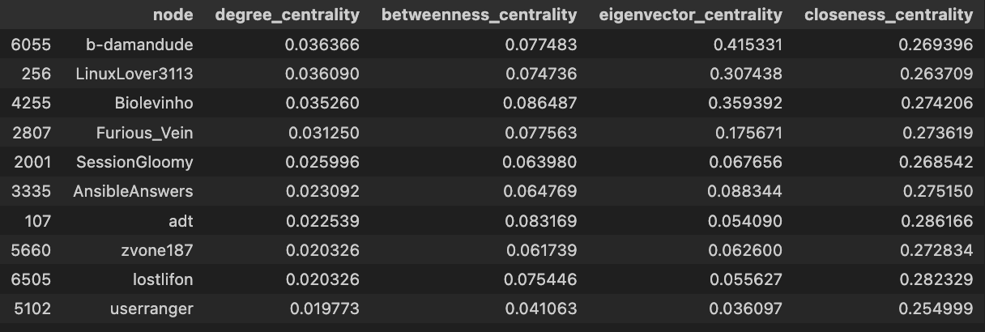
MEASURES OF CENTRALITY
Degree Centrality: Measures the number of direct connections a node has.
Betweenness Centrality: Quantifies the number of times a node acts as a bridge along the shortest path between two other nodes.
Eigenvector Centrality: Measures a node's influence based on the quality of its connections, giving higher scores to nodes connected to other high-scoring nodes.
Closeness Centrality: Indicates how close a node is to all other nodes in the network, based on the average shortest path length.

Slide 15
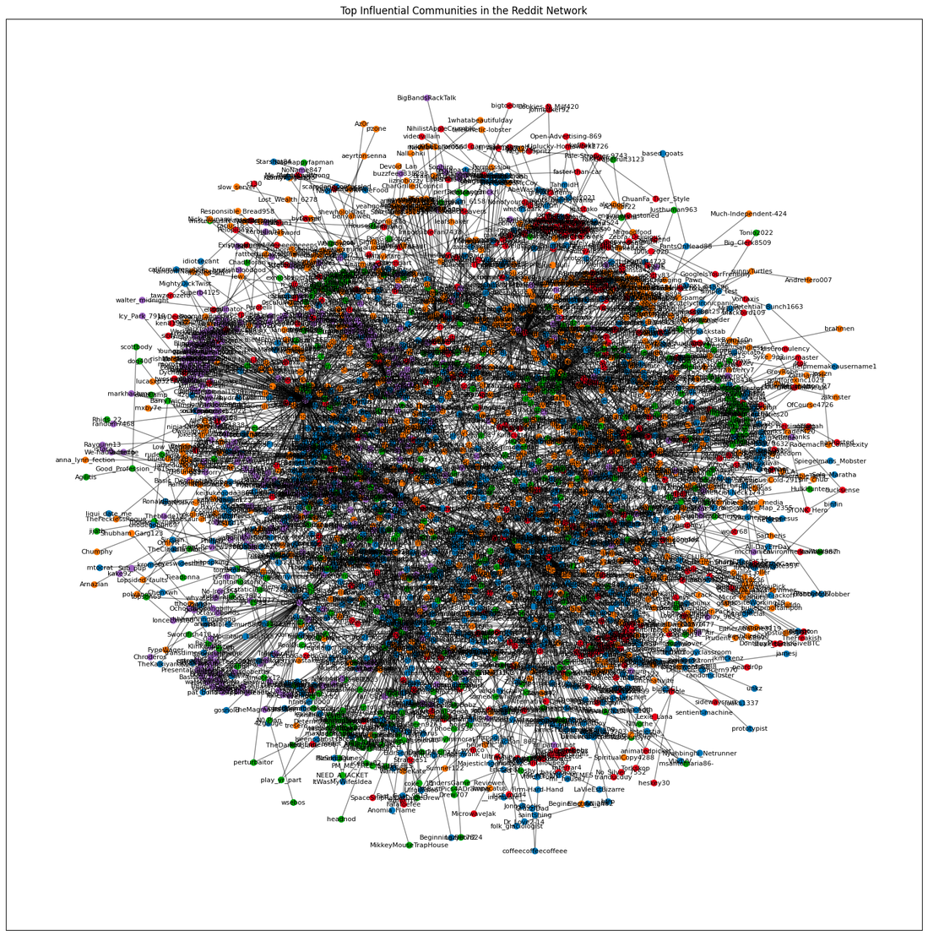
COMMUNITY DETECTION
The central part of the network is densely connected, indicating a high level of interaction among the nodes. This area likely represents the most influential communities, where members are actively engaging with each other.

Slide 16
CONTENT ANALYSIS
SENTIMENT ANALYSIS
Understand the strengths and limitations of each model and guide us in selecting the most appropriate tool for our sentiment analysis needs.
The VADER sentiment analyzer is designed to analyze the sentiment of social media texts and is effective at capturing the emotional tone conveyed in short text formats.
transformer-based model pre-trained on a large corpus of data, making it highly effective for natural language understanding tasks.
COMPARISON
VADER
ROBERTA

Slide 17
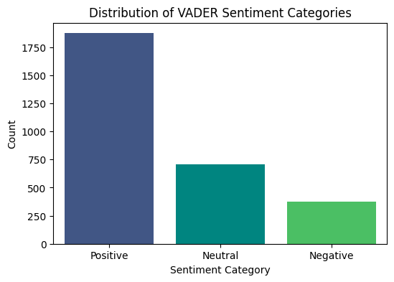

VADER

Slide 18
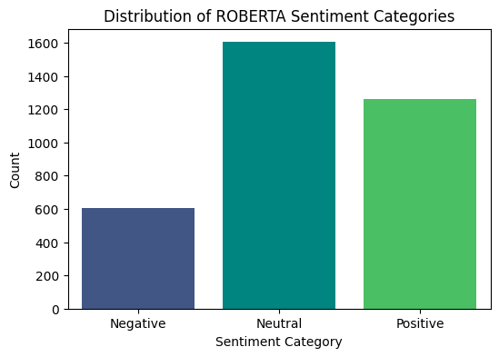
ROBERTA

Slide 19
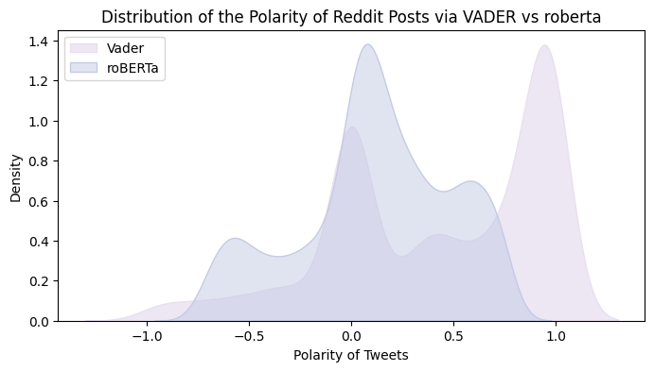
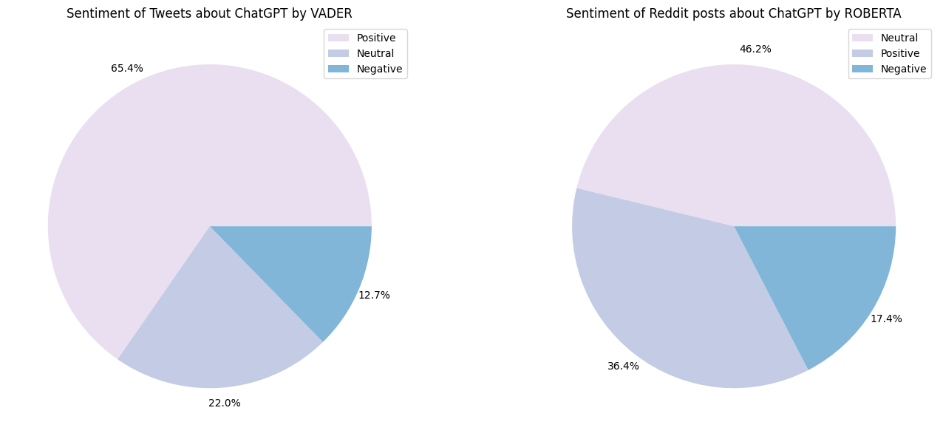
COMPARISON

Slide 20
The analysis of Reddit posts related to ChatGPT reveals several key insights into public sentiment and user engagement. Utilizing both VADER and RoBERTa sentiment analysis models, the study demonstrates that the majority of discussions about ChatGPT are positive, with VADER indicating a higher proportion of positive sentiments (65.4%) compared to RoBERTa (36.4%).
The analysis also highlights the engagement patterns within the Reddit community. Certain users are identified as highly influential based on measures of centrality, suggesting their key roles in driving discussions. Additionally, the ChatGPT subreddit stands out with the highest average scores and comments per post, indicating highly engaging discussions.
Exploratory data analysis reveals significant peaks in activity around late 2022, aligning with the release of ChatGPT, which sparked heightened interest and engagement.
THANK YOU

