Slide 1
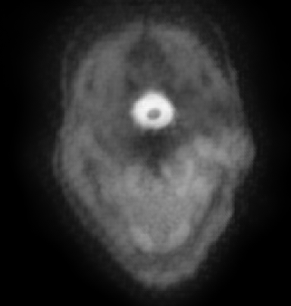
Example ADC

Slide 2
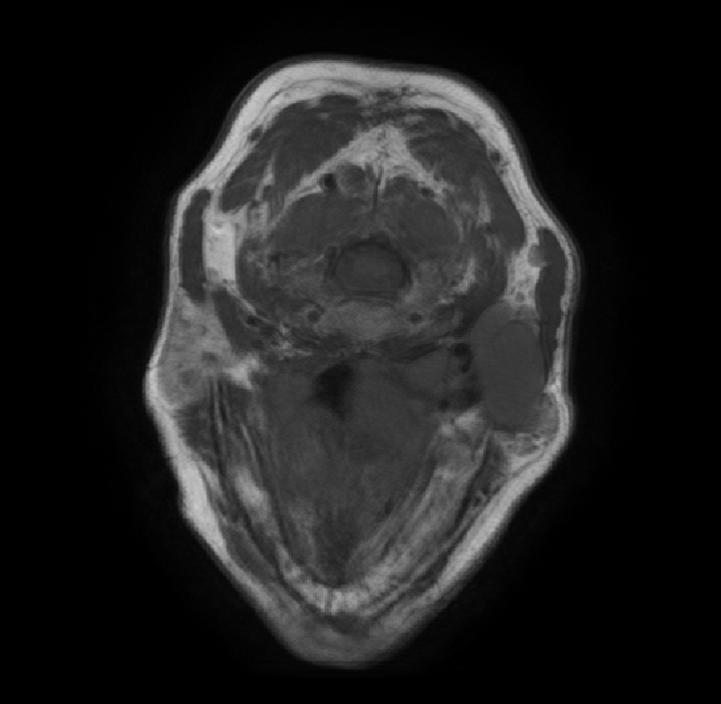
Example T1

Slide 3
Example T1C

Slide 4
Example T2

Slide 5
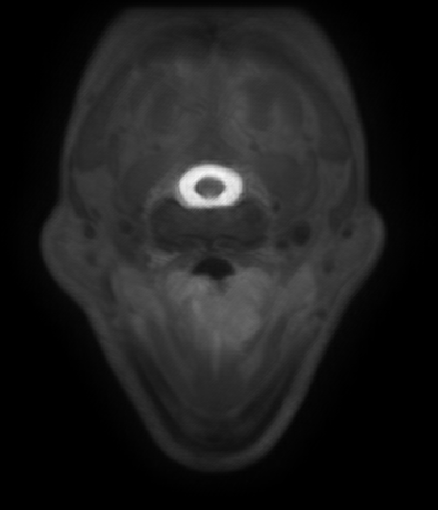
Example STIR

Slide 6
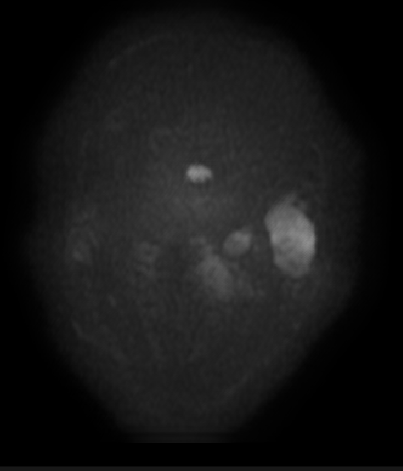
Example DWI

Slide 7
Example ADC

Slide 8
Example T1

Slide 9
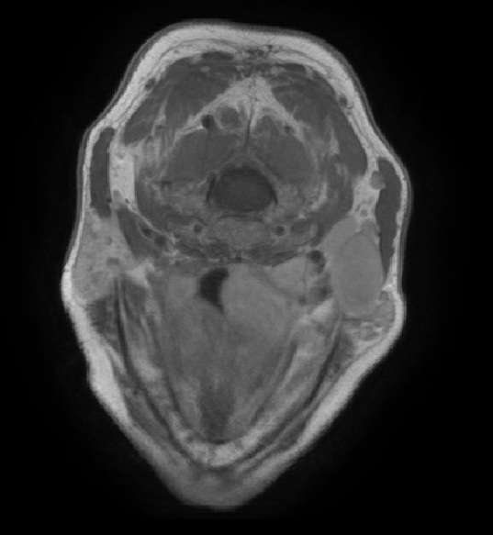
Example T1C

Slide 10
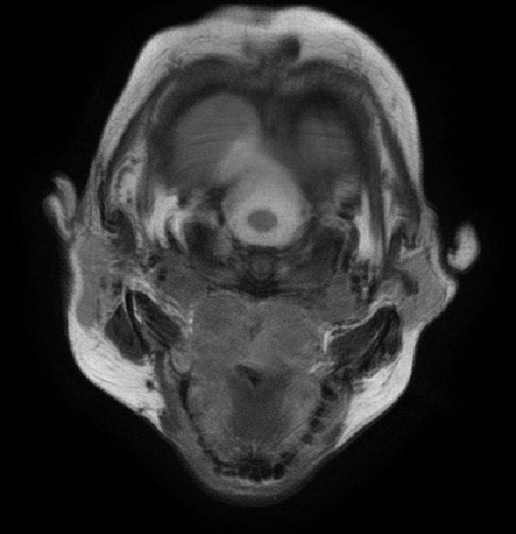
Example T2

Slide 11
Example STIR

Slide 12
Example DWI

Slide 13
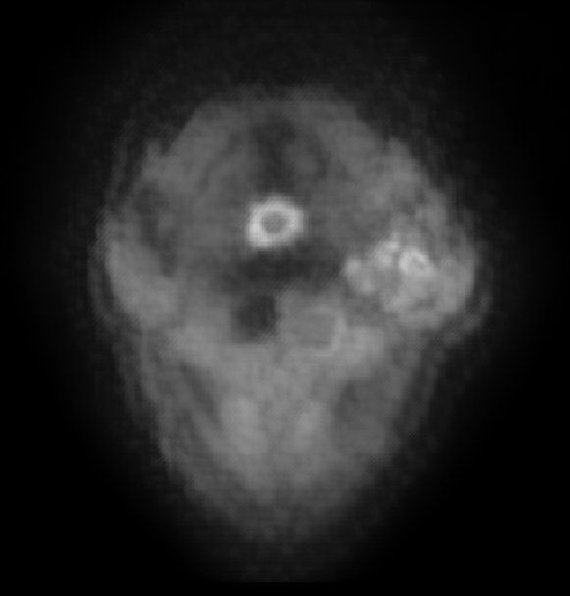
Example ADC

Slide 14
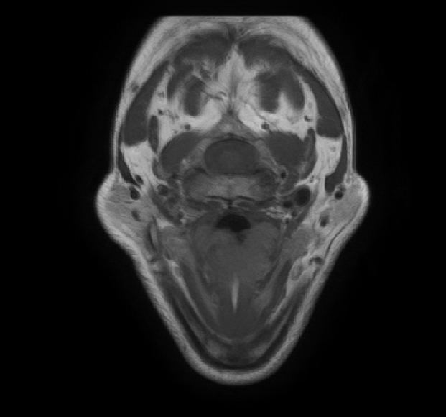
Example T1

Slide 15
Example T1C

Slide 16
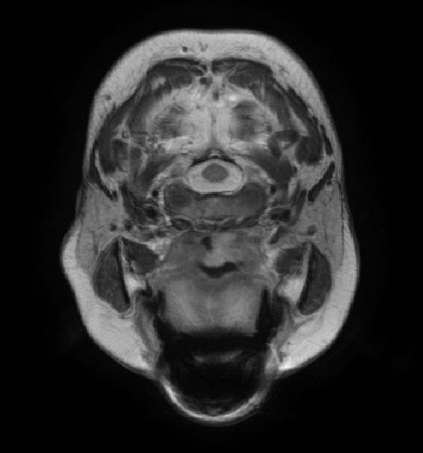
Example T2

Slide 17
Example STIR

Slide 18
Example DWI

Slide 19
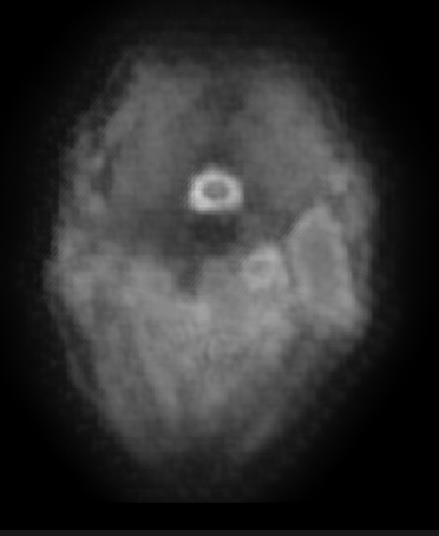
Example ADC

