Slide 1


COSMOS
InterGalactic
Michail Bantouvas
Eleftherios Konstantinidis
Panagiotis Petroulios
Mariel Mesi

Slide 2

INTRODUCTION
Our idea
What we will do
How we will do it

Slide 3
TABLE OF CONTENTS
1. NFT
Images
2. Shuffler
3. Smart Contract
Opensea
Morallis
4. InterGalactic 2D game
Implementation of NFT’s in game

Slide 4
01
NFT

Slide 5
What is NFT
What is NFT
Our NFT images

Slide 6
02
SHUFFLER

Slide 7
SHUFFLER
What is an image shuffler
Shufflers role in NFT creation

Slide 8
03
SMART CONTRACT

Slide 9
SMART CONTRACT
What is a smart contract
Opensea
Morallis

Slide 10
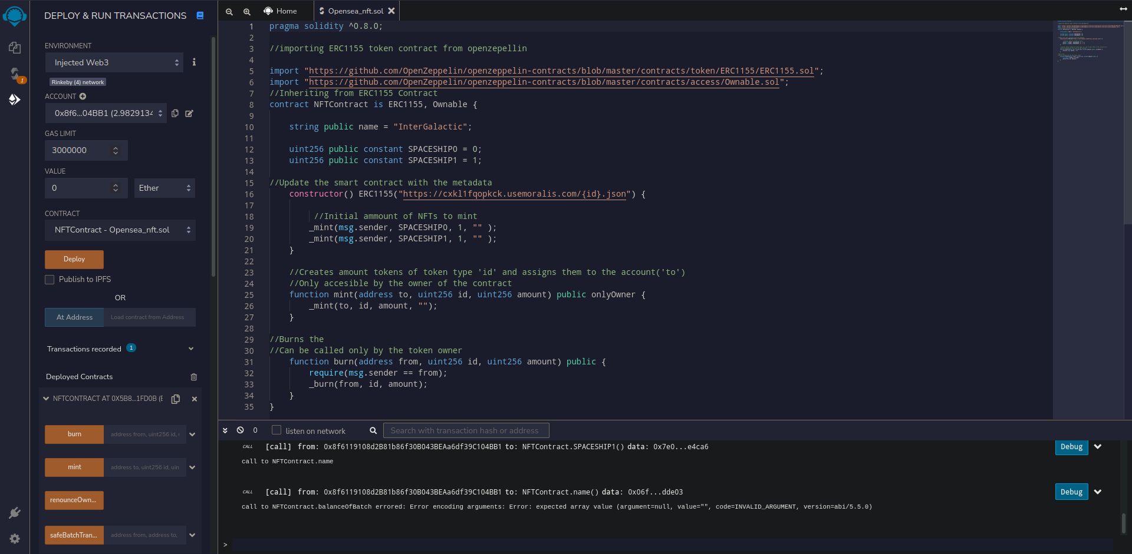
Smart Contract

Slide 11
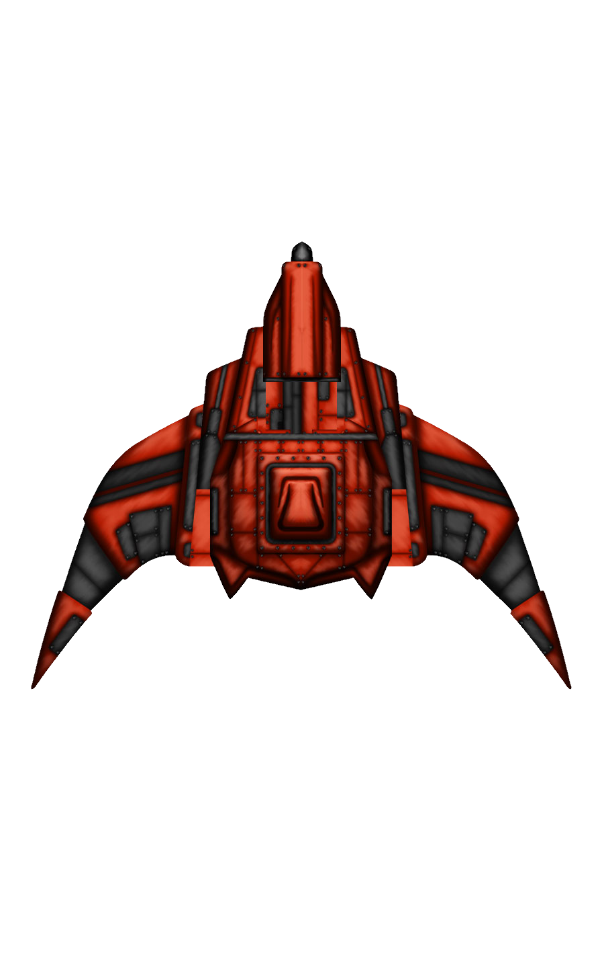
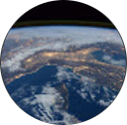
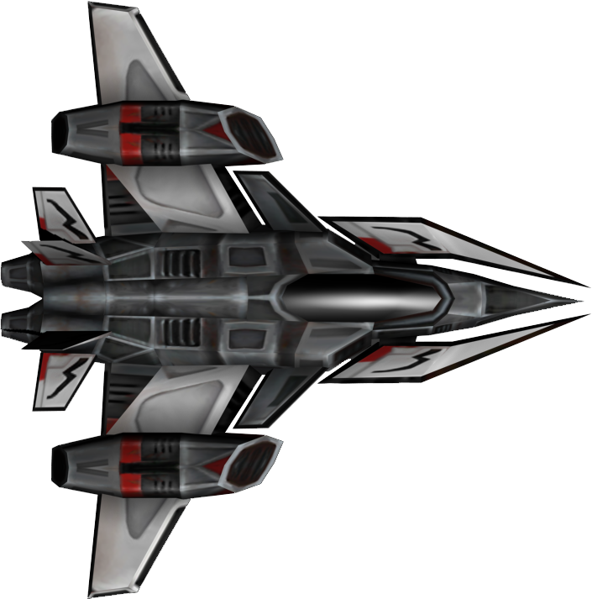
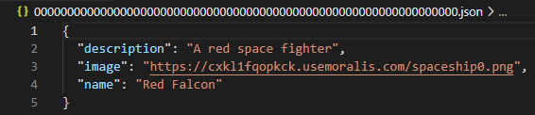
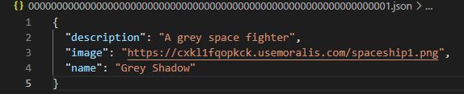
Opensea & Morallis
Player metadata

Slide 12
04
InterGalactic 2D game

Slide 13
The Game
Gameplay
Implementation of our NFT

Slide 14
Thank you for your attention!
Feel free to ask any question!

