Slide 1
Coding

Slide 2


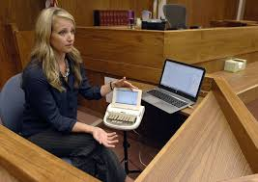
Welcome!
container
Book
form_ container
Service Type
Receive Date
Return Date
Search
section
Services
FM Units
Roger Pen transmits the speaker's voice directly into your ears. Cutting Edge Wireless microphone. Roger Pen features adaptive wireless transmission, fully automated settings, wideband audio Bluetooth for cell phone use, TV connectivity, and an audio input for listening to multimedia. Swiss premium quality product developed by Phonak, the world's leading hearing healthcare company.
CART Reporter
With CART, everything that is said is "captioned" live for deaf and hard of hearing clients. In fact, it can be thought of as captioning for non-broadcast settings, such as classrooms, churches, meetings, and conferences.

