Slide 1
Coding

Slide 2

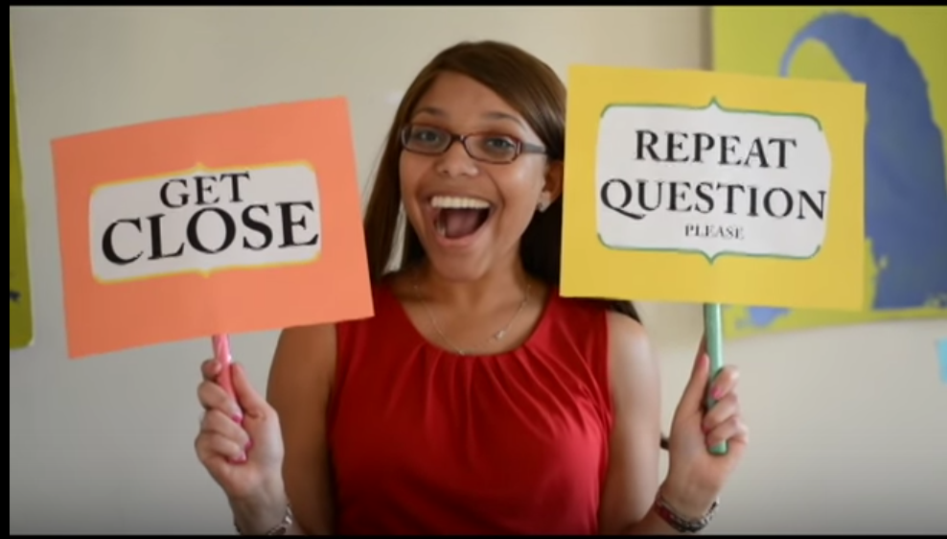
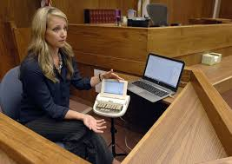
Welcome!
container
Book
form_ container
Service Type
Receive Date
Return Date
Search
section
Services
FM Units
Roger Pen transmits the speaker's voice directly into your ears. Cutting Edge Wireless microphone. Roger Pen features adaptive wireless transmission, fully automated settings, wideband audio Bluetooth for cell phone use, TV connectivity, and an audio input for listening to multimedia. Swiss premium quality product developed by Phonak, the world's leading hearing healthcare company.
CART Reporter
With CART, everything that is said is "captioned" live for deaf and hard of hearing clients. In fact, it can be thought of as captioning for non-broadcast settings, such as classrooms, churches, meetings, and conferences.

Slide 3
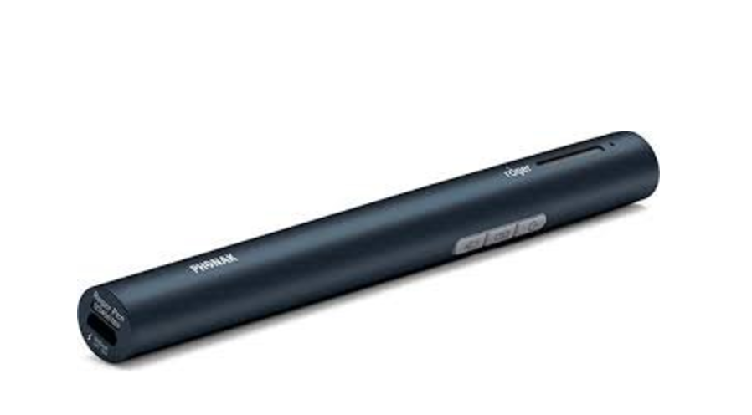
Item is Available!
Roger Pen
Days Requested: 30 Days
Compatible: Naida Q90
Needs: Compilot and Roger X or Roger Battery
8 Hour Battery Life
Outlet rechargeable
Keep Shopping
PROCEED TO CHECKOUT

Slide 4

Cart
Roger Pen
Days Requested: 30 Days
Day Requested: 9/1/2016
End Day: 9/30/2016
Compatible: Naida Q90
Keep Shopping
PROCEED TO CHECKOUT

Slide 5
Checkout
Shipping Information
Eloy Ortega
25 Chamber Street #430
Brooklyn NY 12345
Roger Pen
Days Requested: 30 Days
Day Requested: 9/1/2016
End Day: 9/30/2016
Compatible: Naida Q90
PROCEED TO CHECKOUT

Slide 6
Thank you!
Your order information will be sent in an email shortly!

Slide 7
Sorry, this item is not available during the time you requested.
Try another date or item.
Service Type
Receive Date
Return Date
Search
Services
FM Units
Roger Pen transmits the speaker's voice directly into your ears. Cutting Edge Wireless microphone. Roger Pen features adaptive wireless transmission, fully automated settings, wideband audio Bluetooth for cell phone use, TV connectivity, and an audio input for listening to multimedia. Swiss premium quality product developed by Phonak, the world's leading hearing healthcare company.
CART Reporter
With CART, everything that is said is "captioned" live for deaf and hard of hearing clients. In fact, it can be thought of as captioning for non-broadcast settings, such as classrooms, churches, meetings, and conferences.

Slide 8
Sign In
Register
Email
Password
Sign In

Slide 9
Register
Sign In
Email
Password
First Name
Last Name
Address
City
State
Zip Code
Sign In Register

