Slide 1
ERTMS Solutions
…the Fast Track to ERTMS
ERTMSFormalSpecs workshop
17/18th December 2012
  Stanislas Pinte

Slide 2

Wifi:
SSID: Phidani-Guest
Password: 3225220663

Slide 3
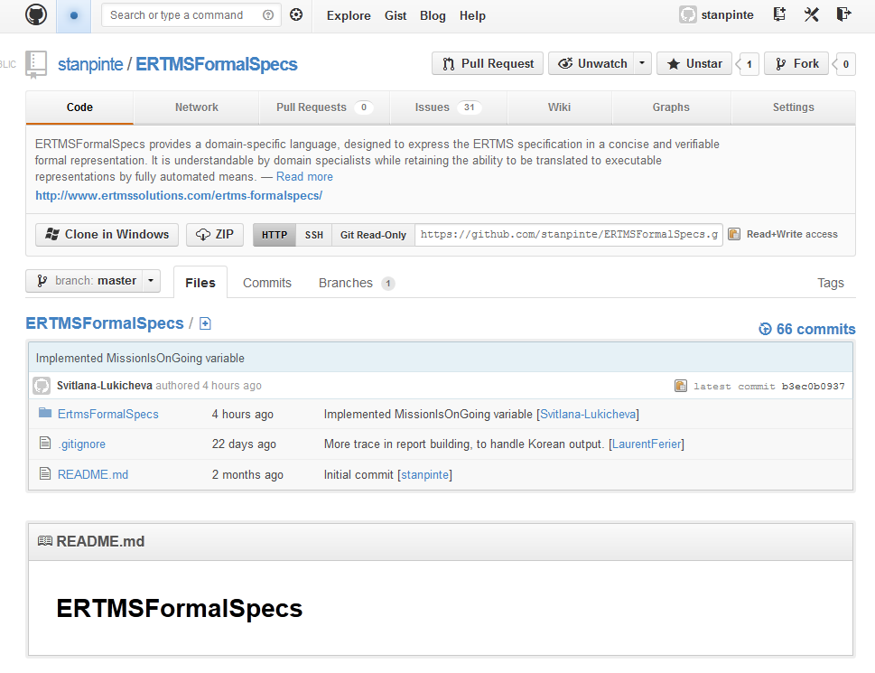
https://github.com/stanpinte/ERTMSFormalSpecs/

Slide 4
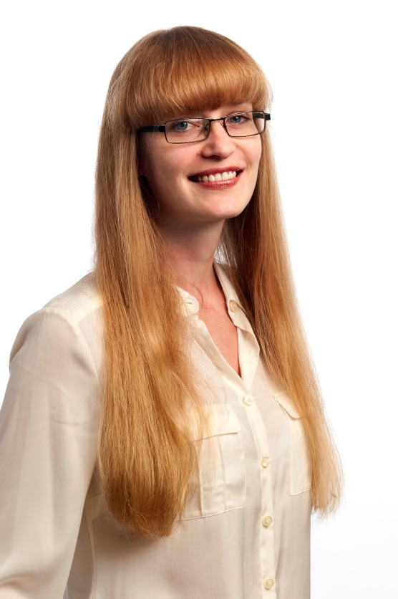
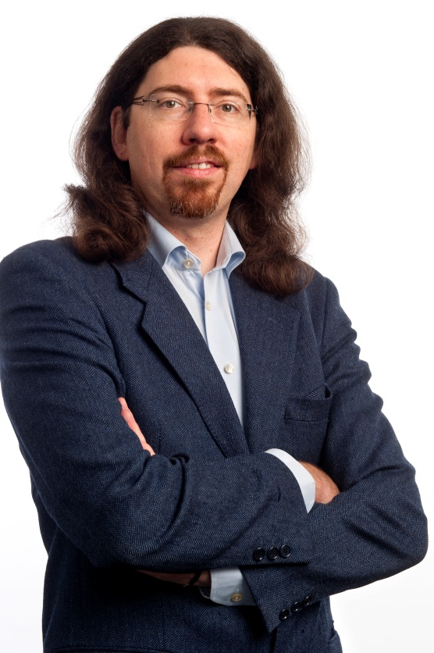

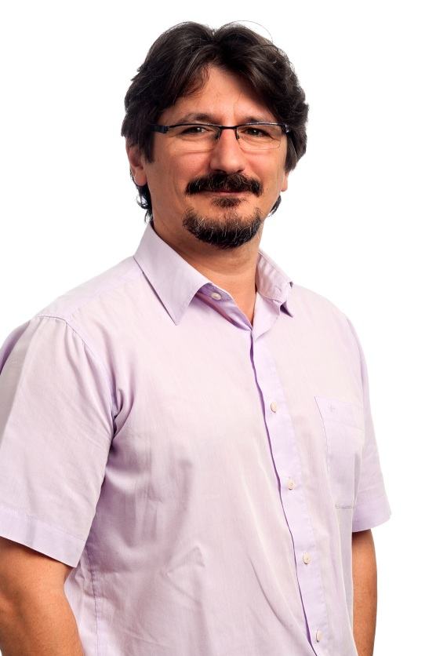
The ERTMSFormalSpecs team

Slide 5




The ERTMSFormalSpecs team

Slide 6
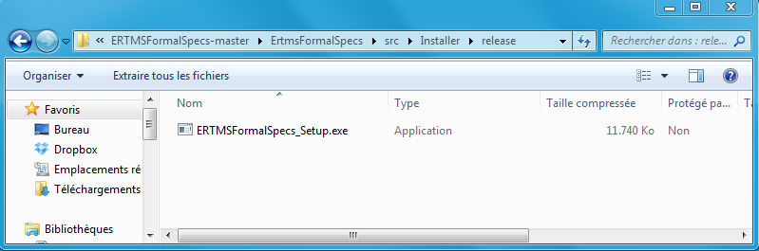
To start modelling S026 yourself
Download installer or sources from Github
  https://github.com/stanpinte/ERTMSFormalSpecs
  https://dl.dropbox.com/u/86354232/ERTMSFormalSpecs_Setup_0.9.exe
Execute the installer in src/Installer/release
Click on the EFS Workbench shortcut
Pick a requirement and … go

Slide 7
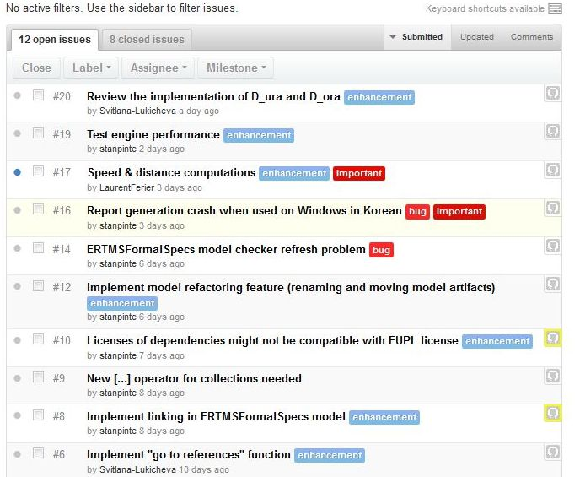
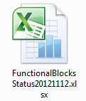
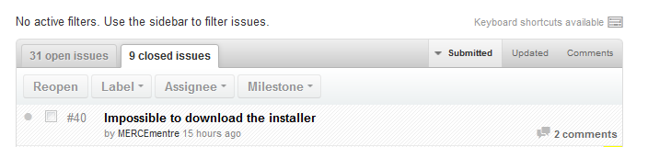
Pick a requirement…and go!

Slide 8
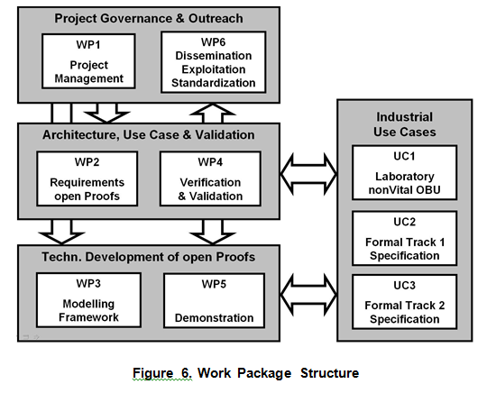
OpenETCS project

Slide 9
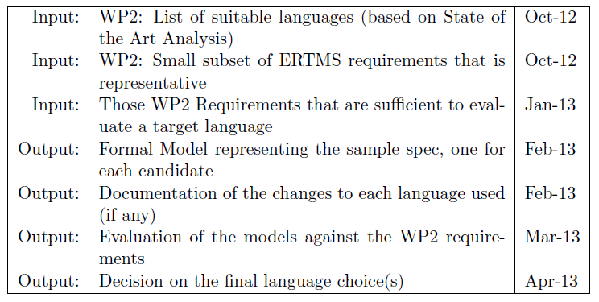
OpenETCS project – WP3a
https://github.com/openETCS/toolchain/blob/master/DescriptionOfWork/ToolchainDescriptionOfWork.pdf

Slide 10
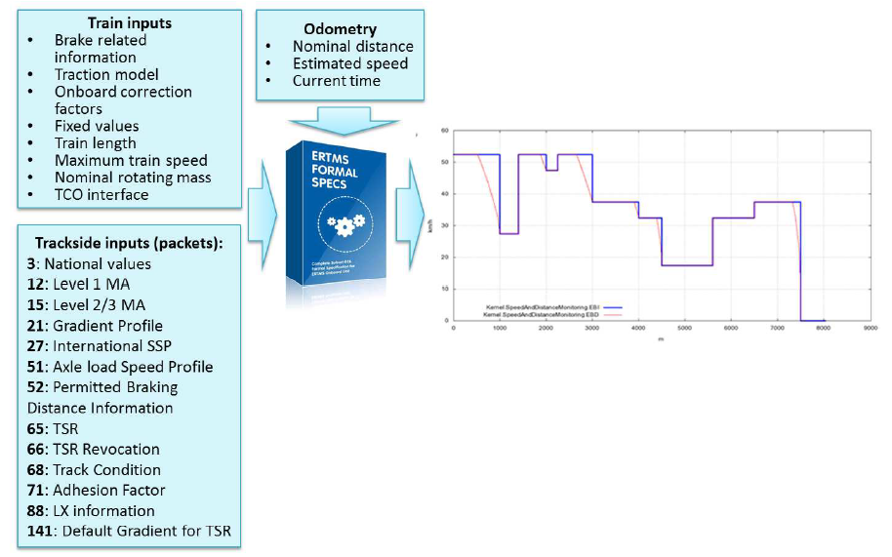
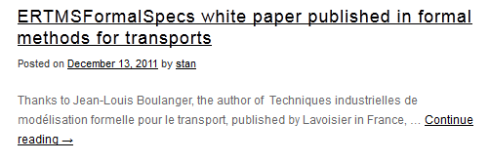
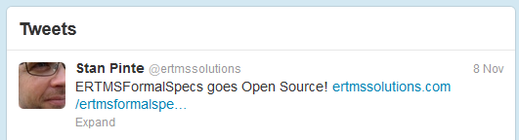
Beyond OpenETCS
RFF
ERA
ERTMS User Group
INFRABEL
SSICF / DVIS

Slide 11
Workshop agenda : day 1
ERTMSFormalSpecs
  Language & Workbench Presentation
  Subset-026 Modelling tutorial

Slide 12


Workshop agenda : day 2
Track 1: model proving track
  Investigate how to add model proving to ERTMSFormalSpecs
    ERTMSFormalSpecs -> B / SCADE / Others ?
    ERTMSFormalSpecs with Safety Properties ?
Track 2: Graphical User Interface (GUI)
  Eclipse ?
  New GUI components ?

Slide 13

EFS Workshop - Plan
Day 1
Day 2
13h30 : Participants presentation
14h00 : EFS Presentation
16h00 : Pause
16h30 : Installation + GIT
17h00 : Tutorial
18h00 : Questions & Answers
19h30 : Let’s party!
8h30 : Coffee/croissant/pain au chocolat
9h00 : Split sessions
  Track 1 : Model proving
  Track 2 : User experience
10h00 : Informal work + coffee break
11h00 : Join session
12h30 : Sandwich - Wrap up
13h30 : End of workshop

Slide 14
After the workshop
ERTMS Solutions ERTMSFormalSpecs support team:
  stan@ertmssolutions.com
  laurent@ertmssolutions.com
  svitlana@ertmssolutions.com

Slide 15
Questions & Answers
ERTMS Solutions
http://www.ertmssolutions.com
info@ertmssolutions.com
+32 2 612 41 70

