Slide 1
Econometric Analysis of Commodity Influence on Stock Indices (2024)
Mariem Briki
Econometrics | Mgr. Arleta Kedra
Submission Date: April 28, 2025

Slide 2
Introduction to the Phenomenon
Stock volatility is a key indicator of market uncertainty and risk.
•Important for investors, analysts, and financial institutions.
Impact of Gold and Oil on S&P 500 and NASDAQ returns.
Research Question: How do Gold and Oil returns impact S&P 500 and NASDAQ returns during 2024?
Hypothesis H0: Gold and Oil returns have no significant impact on S&P 500 and NASDAQ returns.

Slide 3
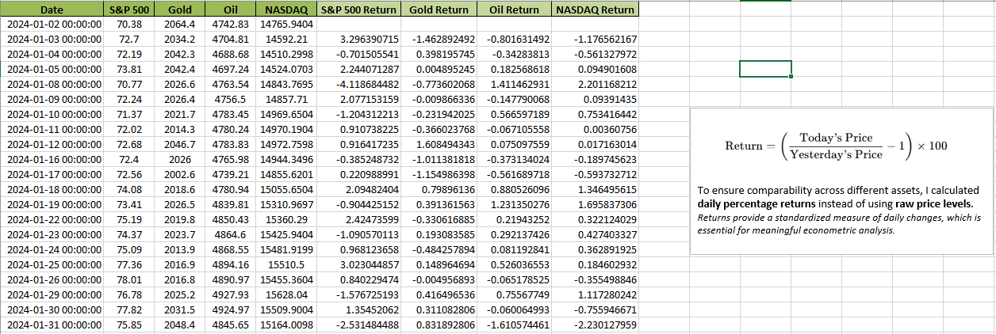
Dataset Description
Source: Kaggle Financial Market Data (2019–2024)
Observations: 250 daily records for 2024.
Variables: S&P 500, NASDAQ, Gold, Oil Returns.
Returns calculated from daily prices.

Slide 4
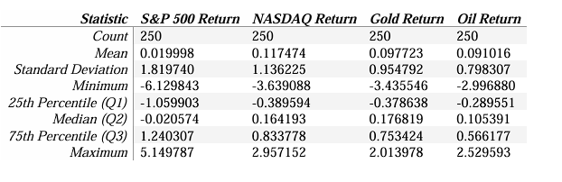
Descriptive Statistics and Visualizations
Mean returns close to zero.
S&P 500 shows highest volatility.
Histograms and time series show return distributions.

Slide 5
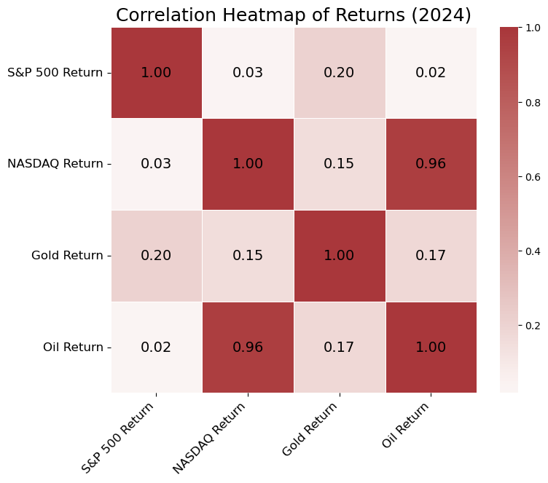
Correlation Heatmap of Returns (2024):
Oil and NASDAQ returns show a very strong positive correlation (≈ 0.96).
S&P 500 returns and Gold returns show a weaker correlation (≈ 0.20).
Indicates differentiated impact of commodities on stock indices.
Motivates further econometric modeling to quantify these effects.

Slide 6
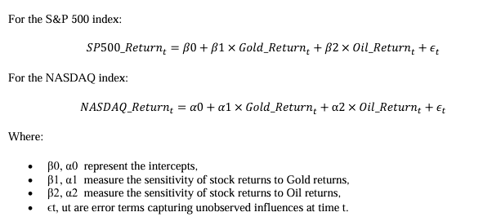
Econometric Models
OLS Regression Models:
S&P 500 Return ~ Gold + Oil Return.
NASDAQ Return ~ Gold + Oil Return.
OLS suitable under classical assumptions.

Slide 7
Model Verification
Linearity Check:
- Residuals vs Fitted plots showed random dispersion around zero without clear patterns.
- Conclusion: Linearity assumption is reasonably satisfied for both models.
Homoskedasticity Check (Breusch-Pagan Test):
- p-values > 0.05 in both models.
- Conclusion: No evidence of heteroskedasticity; residuals have constant variance.
Normality Check (Q-Q Plot and Shapiro-Wilk Test):
- Q-Q plots showed residuals roughly along the 45-degree line.
- Shapiro-Wilk p-values > 0.05 for both models.
- Conclusion: Residuals are approximately normally distributed.
Goodness of Fit Measures:
- S&P 500 Model:
- R²: 0.0418, Adjusted R²: 0.0341, RMSE: 1.7777, AIC: 1003.14, BIC: 1013.70
- NASDAQ Model:
- R²: 0.9183, Adjusted R²: 0.9176, RMSE: 0.3241, AIC: 152.18, BIC: 162.74
- Conclusion: The NASDAQ model fits the data substantially better than the S&P 500 model.
Significance Testing of Parameters:
- S&P 500 Model:
- Gold Return: Significant (p = 0.001)
- Oil Return: Not significant (p = 0.786)
- NASDAQ Model:
- Oil Return: Significant (p < 0.001)
- Gold Return: Not significant (p = 0.345)

Slide 8
Conclusions
- Gold significantly influences S&P 500 returns.
- Oil significantly drives NASDAQ returns.
- NASDAQ model shows excellent fit.
- Limitations: Few predictors, short timeframe.
- Future Work: Add macroeconomic variables, non-linear models.

Slide 9
Thank You
Open for questions.
Refer to Jupyter Notebook and Project Report for full details.

