Slide 1

Electronic Geek Bag
(Shapes and Schematics)
These shapes are Part of the sewable electronics workshop „Electronic Geek Bag“ at the 32c3 congress
For more Information on the Workshop go to:
https://events.ccc.de/congress/2015/wiki/Assembly:Electronic_GeekBag
All workshop material can be found at:
https://github.com/Mariemurasaki/Electronic-Geek-Bag
This work is licensed under the Creative Commons Attribution 4.0 International License. To view a copy of this license, visit http://creativecommons.org/licenses/by/4.0/
Attribution goes to: Marion Uebernickel (https://github.com/Mariemurasaki)

Slide 2
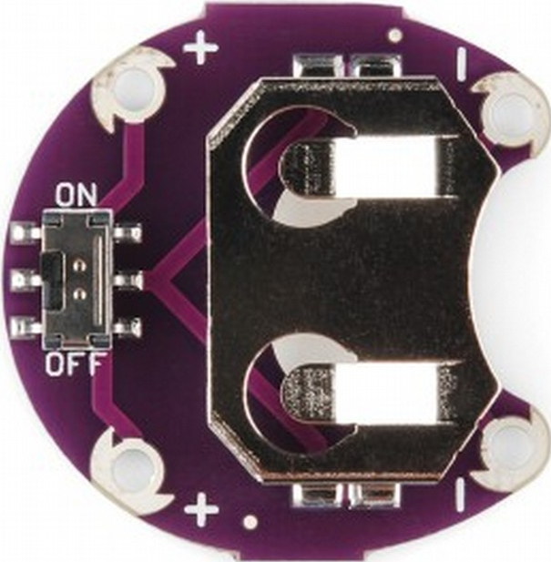
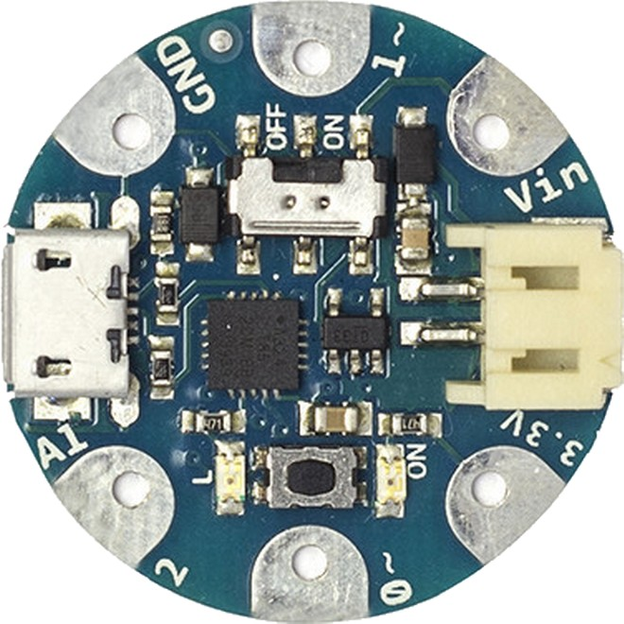
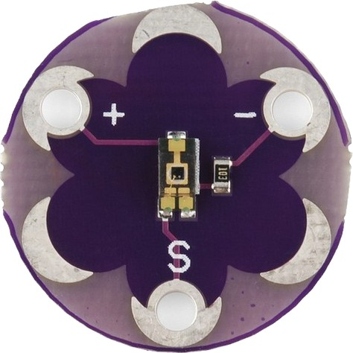
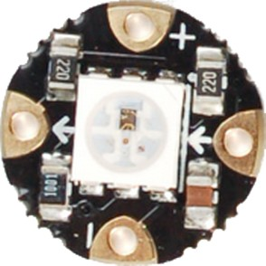
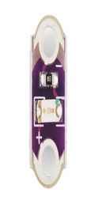
Symbols
Lilypad Battery Holder
0~
Adafruit GEMMA
- mirrored -
(because it's mounted on the inside)
USB
A1/2
3.3V
Batt
GND
1~
Vout
s
Lilypad Light Sensor
Adafruit Neopixel
Lilypad LED

Slide 3
Cat
Smart - RGB
s
A1/2
0~
3.3V
USB
GND
Vout
Batt
1~
Battery

Slide 4
Cat
Smart - Mono
s
A1/2
0~
3.3V
USB
GND
Vout
Batt
1~
Battery

Slide 5
Cat
Easy

Slide 6
Robot
Smart - RGB
s
A1/2
0~
3.3V
USB
GND
Vout
Batt
Battery
1~

Slide 7
Robot
Smart - Mono
s
A1/2
0~
3.3V
Battery
USB
GND
Vout
Batt
1~

Slide 8
Robot
Easy

