Slide 1


2022-2023 Sales Report
Welcome to our comprehensive sales report covering the 2022-2023 fiscal year. This document provides a detailed analysis of our product sales, market trends, and key performance indicators for the Product Design and Buying teams.
by Maria Agudelo

Slide 2
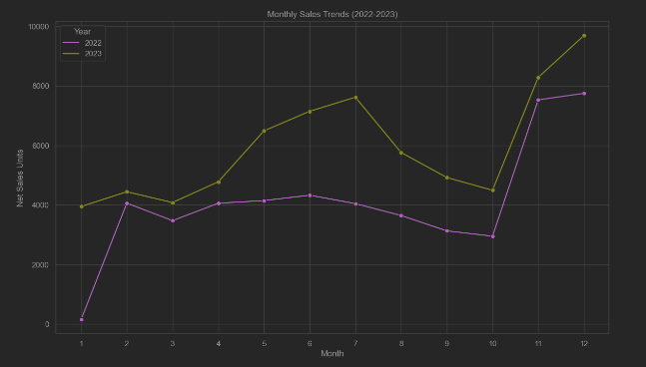
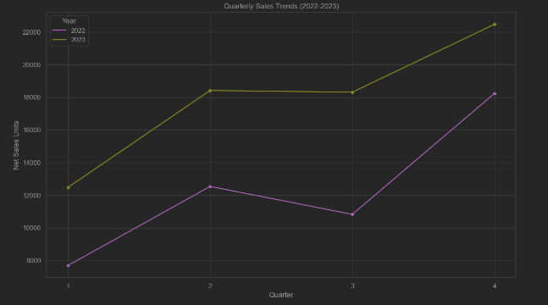
Time-Based Analysis
Our quarterly sales data shows a distinct seasonal pattern, with Q4 being the strongest quarter due to the holiday shopping season. Q2 also sees a significant increase as customers prepare for the summer. Throughout 2023, we saw that our sales increased and that the summer collection was very successful.

Slide 3
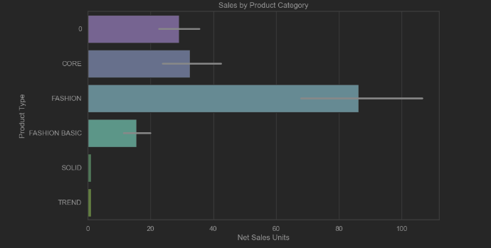
Top-Performing Product Categories
Our Top performing product type was the Fashion category .It outperformed the other categories

Slide 4
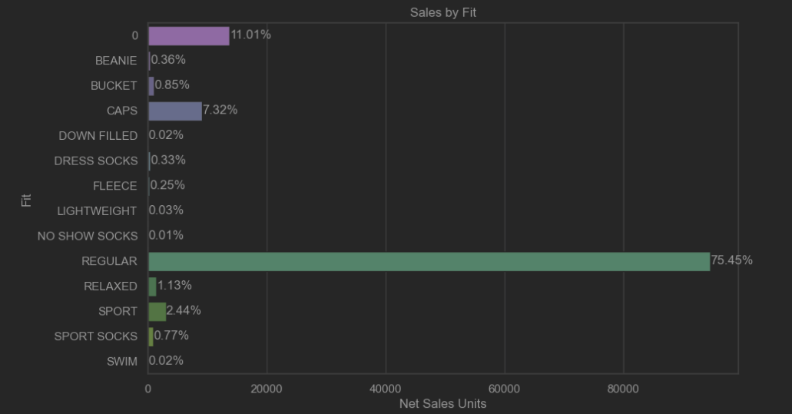
Sales by Fit
Our sales analysis shows that the Regular Fit category continues to be the most popular among customers. Slim Fit garments make up 75.45% of sales,. These insights can help guide our product development and merchandising strategies for the upcoming year.

Slide 5



Sales by Size
Medium
Medium sizes saw the highest overall volume,.
Large
Larger sizes experienced growing demand, reflecting our efforts to expand size inclusivity and cater to a diverse range of body types.
Small
Small sizes were popular, with strong sales in our petite and junior collections. Customers sought comfortable, form-fitting garments.

Slide 6
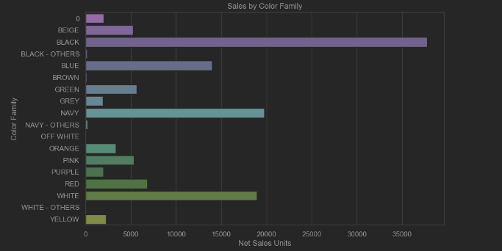
Sales by Color Family
Our data shows that neutral color families, such as blacks, whites, and navy, continue to drive the majority of our sales. These classic shades are a perennial favorite among our customers. However, we're also seeing strong demand for vibrant, saturated colors a - indicating that our customers are looking for a diverse range of options to express their personal style.

Slide 7
Impact of Discounts on Sales
Discount Levels
1
High discounts drive higher sales volumes, but it's important to balance this with profit margins.
Profit Margins
2
Higher discounts generally reduce profit margins but we maintained mostly 1-10% discounts through 2022-23.
Customer Behavior
3
Discount levels impact customer retention and repeat purchase behavior. Understanding this can help tailor discount strategies to improve customer loyalty.

Slide 8
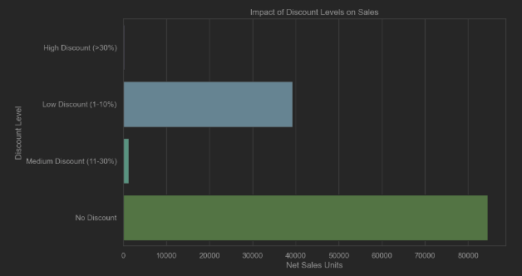
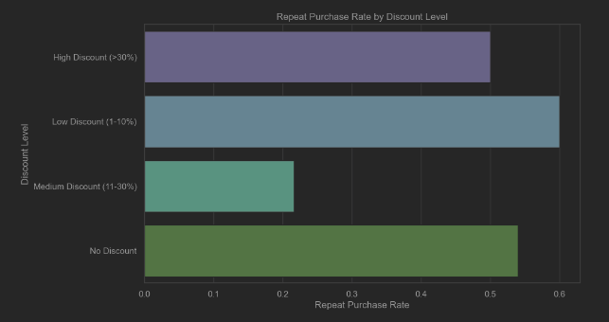
No discounts category was able to drive the majority of our sales but adding a small discount increases the retention rate of our customers

Slide 9

eCommerce vs. Brick and Mortar
Hybrid Approach
eCommerce Advantages
Many successful retailers combine both online and physical stores, leveraging the benefits of each channel to create a seamless omnichannel experience for customers.
Wider product selection, convenient 24/7 access, personalized recommendations, and lower operational costs for retailers.
1
2
3
Brick-and-Mortar Strengths
Tangible shopping experience, immediate product availability, personal interaction with sales staff, and the ability to try on items.

Slide 10
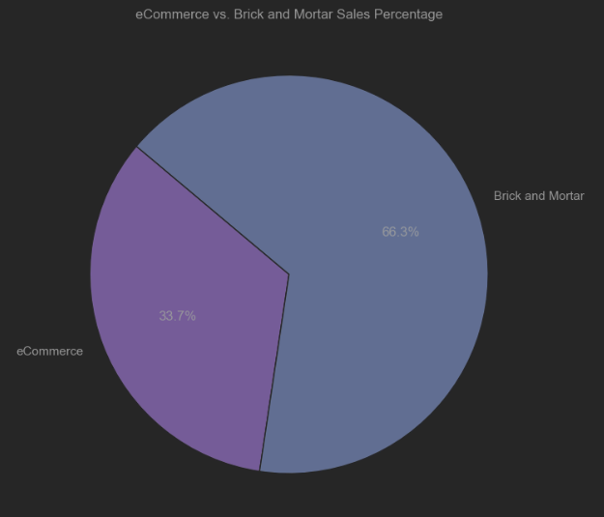
33% of the sales come from eCommerce and 66.3% come from Brick and Mortar

Slide 11




2024 Outlook
Economic Recovery
With the expected gradual recovery of the global economy, we anticipate increased consumer confidence and spending power in 2024.
Emerging Trends
Capitalizing on rising sustainability awareness and the growth of personalized experiences.
Digital Transformation
Enhancing our e-commerce capabilities and capitalizing on the opportunity.

Slide 12




Recommendations
Focus on High-Margin Products
-Focus on high-performing product categories such as Fashion, Core, and Fashion Basic.
Increase inventory for top-performing fits like Regular
Expand eCommerce Presence
Invest in optimizing the online shopping experience to capture more sales from the growing e-commerce market.
Improve Inventory Management
Implement data-driven inventory planning to ensure the right products are available at the right time to meet customer demand.

