Slide 1
Applying NIR and MIR spectroscopy for C and soil property prediction in northern cold-region ecosystems. Which approach works better?

Slide 2
Introduction
Materials and methods
3. Results and discussion
4. Conclusion

Slide 3
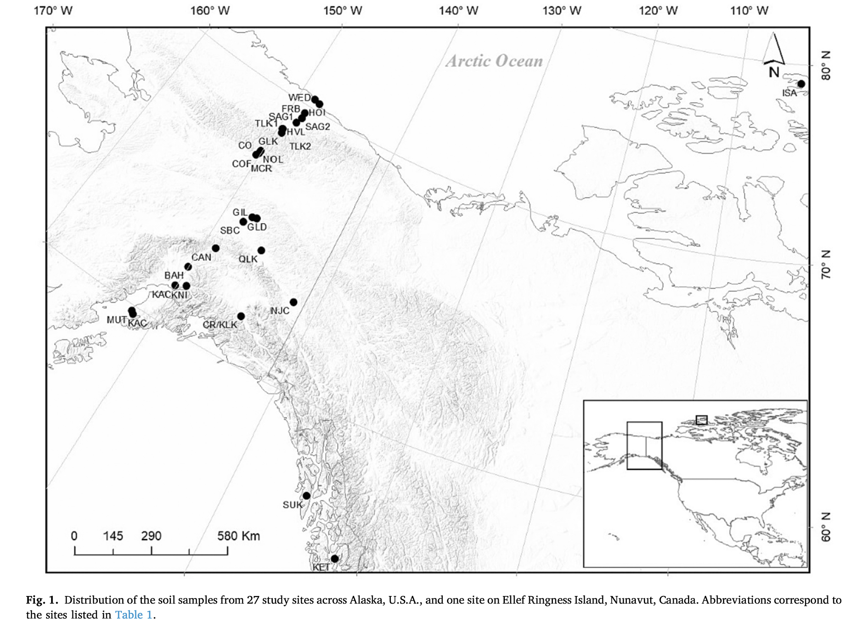
Introduction – Data Collection
Soil samples:
27 sites across Alaska and one
Sampled From 1981 ~ 2008
Total : 119 Samples
Those samples were selected from this archive to provide a wide range of site and soil characteristics for this study.
Notes:
這些地點是由與阿拉斯加大學費爾班克斯分校有關的研究人員在1981年至2008年期間為各種項目進行采樣的。
從這個檔案中選取了119個樣本子集，以提供本研究所需的各種場地和土壤特徵。

Slide 4
Introduction – Data Collection
Soil samples:
From 27 sites across Alaska
Sampled From 1981 ~ 2008
Total : 119 Samples
The same soil samples were used by Matamala et al. (2017)
To evaluate the usefulness of MIR spectroscopy for characterizing the properties of northern cold-region soils.
Matamala, R., Caldero ́n, F.J., Jastrow, J.D., Fan, Z., Hofmann, S.M., Michaelson, G.J., Mishra, U., Ping, C.L., 2017. Influence of site and soil properties on the DRIFT spectra of northern cold-region soils. Geoderma 305, 80–91. https://doi.org/ 10.1016/j.geoderma.2017.05.014.
Notes:
這些土壤樣本也被Matamala等人（2017年）用於評估MIR光譜學對於表徵北方寒冷區土壤特性的有用性。

Slide 5
Introduction-Models
Various machine learning (ML) algorithms are used to build
spectroscopic models:
PLS
SVM
RF
ANN
The most commonly used for predictiong a wide range of soil chemical-physical properties.
(Partial Least Squares)
Because it mitigates problems associated with multi-collinearity and small samples
SVM and RF are considered apporiate approaches, when data contain a large number of predictor variables with :
complex nonlinearities
interactions
Notes:
PLS演算法是最常用於預測各種土壤化學物理性質的方法，因為它緩解了多重共線性和小樣本集所帶來的問題。
d
PLS可以緩解多重共線性和資料少的問題，主要是因為它在建立模型時使用了主成分分析的思想，並且同時考慮了輸入變量和目標變量之間的關係。 PLS通過從輸入變量中提取出主成分或潛在變量，將原始的高度相關的輸入變量轉換成新的低相關的潛在變量。
PLS通常需要進行交叉驗證等模型優化技術
SVM and RF在大量預測變量和複雜非線性交互作用存在的情況下，被認為是適當的分析方法
RF則通過使用多棵決策樹來建立集成模型
人工神經網路（Artificial Neural Network，簡稱ANN）是一種模仿生物神經系統的數學模型，其模型由一大群相互連接的簡單處理元件（神經元）所組成。ANN常用於非線性建模、模式識別、分類、迴歸分析等。

Slide 6
Introduction-NIR and MIR
NIR’s ability to predict chemical has been less documented.
The author hypothesize that :
MIR will be outperform NIR in predicting many soil attributes due to more defined bands in MIR, high heterogeneity in cold region soils resulting from permafrost and cryogenic transformations, and lastly, biogeochemical processes controlled by parent materials from varied depositional environments.
Notes:
NIR文獻報導較少。
MIR在預測許多土壤屬性方面將優於NIR。 由於MIR有更明確的吸收峰、寒區土壤由於永久凍土和低溫形變所導致的高異質性，以及不同沉積環境下母質控制的生物地球化學過程所導致的。

Slide 7
Introduction-Purpose
To document the NIR spectral responses to changes in TOC and environment factors (e.g., parent material, land cover)
To compare the accuracy of NIR vs. MIR spectroscopy for predicting soil properties on a regional scale over a wide range of natural vegetation and diverse soil types.
To investigate the predictive ability of NIR and MIR coupled with PLS and other machine learning algorithms in order to improve performance.
Notes:
1.記錄 NIR 光譜對 TOC 和環境因素（例如母質、土地覆蓋）變化的反應
2.比較 NIR 與 MIR 光譜技術在預測不同自然植被和多樣化土壤類型上的土壤特性時的準確性
3.探討 NIR 和 MIR 與 PLS 和其他機器學習算法相結合，以提高其預測性能。

Slide 8
Materials and methods - Soil physico-chemical analysis
Bulk Density measurements were obtained using the clod method
Soils were air-dried at room temperature and passed through a 2-mm sieve.
Aliquots of each sieved soil were homogenized, finely ground in an oscillating ball- mill
Oven-dried overnight at 65 °C
TOC, TN elemental analyzer
Notes:
Step1 :BD的測量方法使用泥塊法
Step2 :土壤在室溫下經風乾並通過2毫米篩子。
Step3 :每個篩選的土壤樣品均勻混合，在振盪式球磨機(MM200，Retsch，德國Haan)中細磨，
Step4 :然後在65°C的烘箱中烘乾一夜。
TOC和TN的測定是使用元素分析儀

Slide 9
Materials and methods - Near-infrared and mid-infrared spectroscopy
Diffuse reflectance infrared Fourier transform (DRIFT) spectra were obtained from undiluted soil samples in both MIR (4000 to 400 cm-1) and NIR (10,000 to 4000 cm 1) regions.
After:
Ground soil subsamples were dried at 65 °C and further pulverized and mixed by hand with an agate mortar and pestle
Then:
The samples were analyzed in diffuse reflectance with a Digilab FTS 7000 spectrometer.
Notes:
第一個測量：透過擴散反射紅外線傅立葉轉換 (DRIFT) 技術，在中紅外 (MIR，4000 到 400 cm-1) 與近紅外 (NIR，10,000 到 4000 cm-1) 範圍，使用未稀釋的土壤樣本取得光譜。
第二個測量：將土壤樣本烘乾後，並使用瑪瑙研磨杵和研磨杯進一步粉碎和混合後進行分析。再透過光譜儀進行擴散反射測量

Slide 10
Materials and methods - Near-infrared and mid-infrared spectroscopy
Several mathematical pre-treatments were evaluated to reduce baseline variations and/or enhance spectral features.
Savitzky-Golay first and second derivative
standard normal variate (SNV)
multiplicative scatter correction (MSC)
to obtain the lowest root mean square error (RMSE) for cross-validation.
Point: For MIR, the best improvement was reached using Savitzky-Golay with a first derivative and 5 points smoothing pretreatment (Savitzky and Golay, 1964)
Notes:
包括Savitzky-Golay的一階和二階導數 標準正態變量(SNV) 乘法散射校正(MSC)，
以獲得交叉驗證的最低均方根誤差(RMSE)。 對於MIR，使用一階導數和5個點平滑預處理的Savitzky-Golay取得了最佳效果
至於原理方面還不是很清楚，但或許這可以成為之後的參考方法之一
對於NIR，原始光譜被用作輸入變量，因為預處理處理沒有對RMSE提供實質性改進。

Slide 11
Introduction
Materials and methods
3. Results and discussion
4. Conclusion

Slide 12
Introduction
Global warming affects cold Regions
Stimulate soil organic matter mineralization rates
→Increasing greenhouse gas
Permafrost melting
→Affects the type and content of C in the soil
Predict ecosystem responses to future climate and associated greenhouse gas emissions in arctic soils
Notes:
1.刺激寒冷地區的土壤有機物礦化率/增加溫室氣體
2.永凍土融化/影響碳在土壤中的種類與含量
預測生態系統對未來氣候的反應以及北極土壤中相關的溫室氣體排放

Slide 13
Introduction
-Target
1. To document the NIR spectral responses to changes in TOC and environment factors
2. To compare the accuracy of NIR and MIR spectroscopy
3. To investigate the predictive ability of NIR and MIR
→Use machine learning algorithms to improve performance
Notes:
1.記錄 NIR 光譜對 TOC 和環境因素變化的響應
2.比較NIR與MIR光譜的準確性，以在區域範圍內預測各種自然植被和不同土壤型別的土壤特性
3.調查NIR和MIR的預測能力，加上PLS和其他機器學習演算法，以提高效能

Slide 14
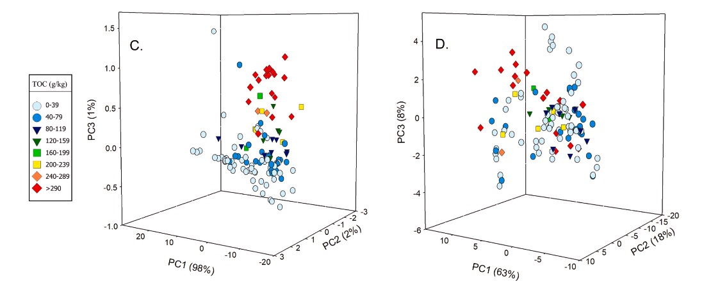
Results and discussion
Description of NIR and MIR spectra
NIR MIR
The ability of NIR to identify TOC content will be better than MIR
Notes:
進行PCA（主成分分析）
評估C不同碳鍵是否對近紅外光譜反射率變化產生影響
1.不同顏色代表不同的有機碳
三種主成分
NIR的部分TOC含量沿著PC1和PC2清晰分佈
NIR識別TOC含量的能力會比MIR好

Slide 15
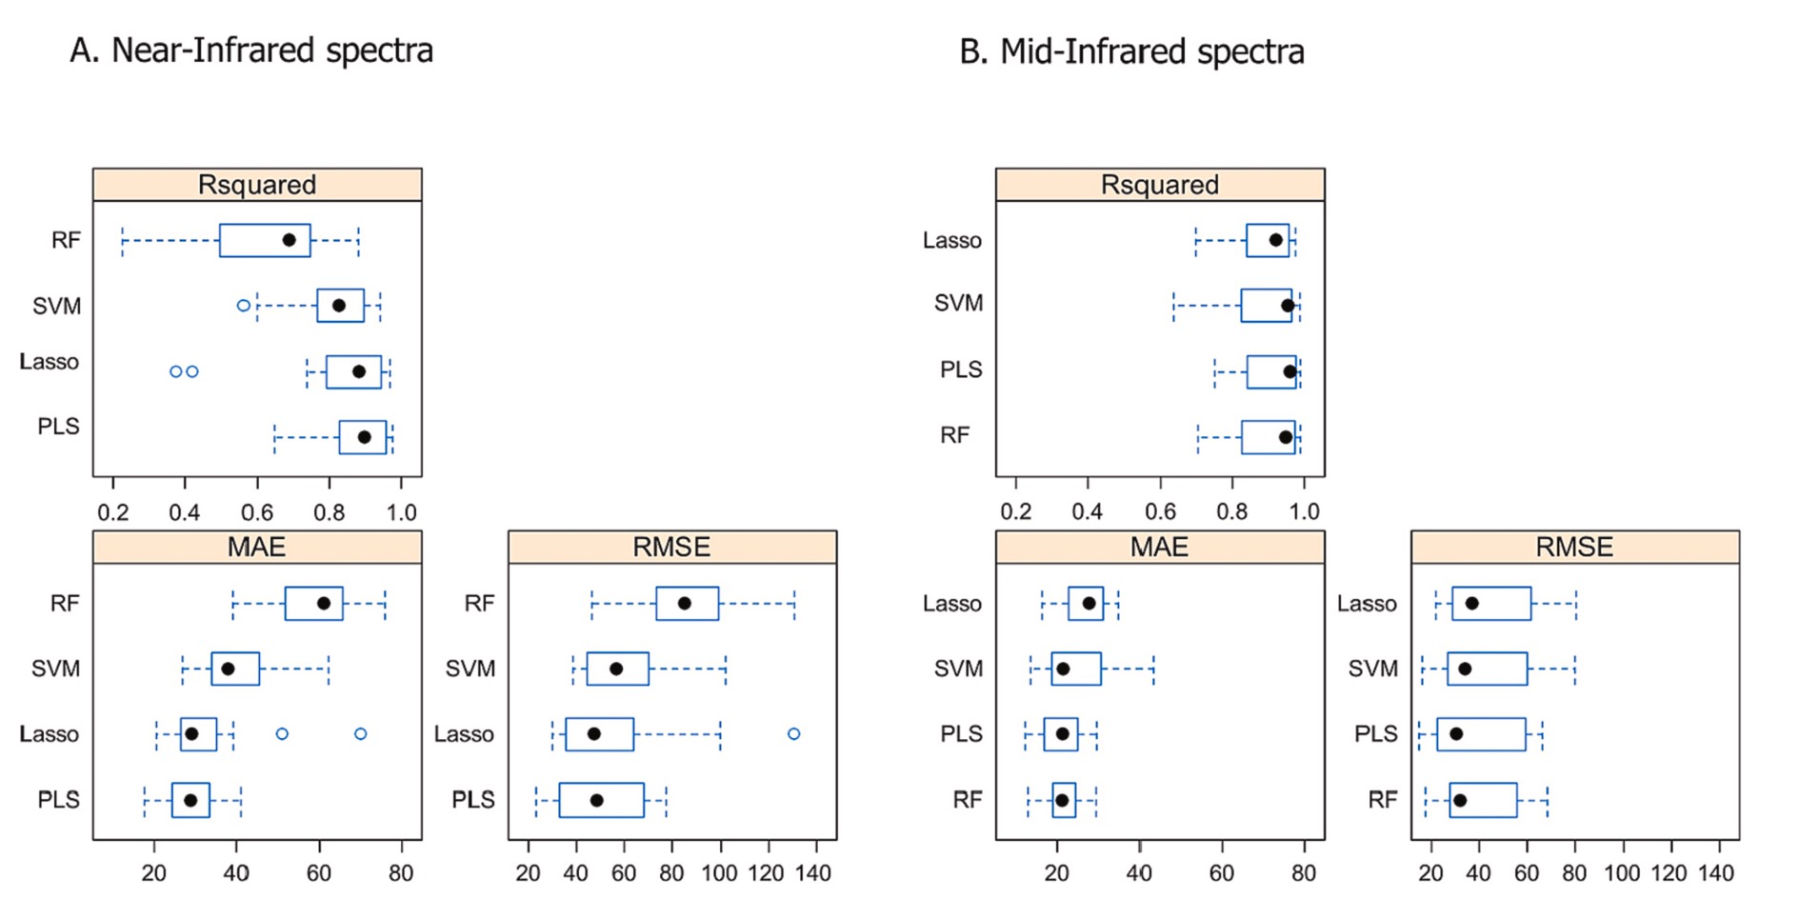
Results and discussion
Application of different algorithms in TOC prediction
MIR is better then NIR
PLS&Lasso are better
then others
Notes:
1.MIR表現比NIR好 更高的Ｒ^2 更低的MAE RMSE
2.Lasso PLS相較於其他兩種模型更為簡單，在處理小量資料的情況下可以避免過度擬和
若要提升轉確率→增加資料量

Slide 16
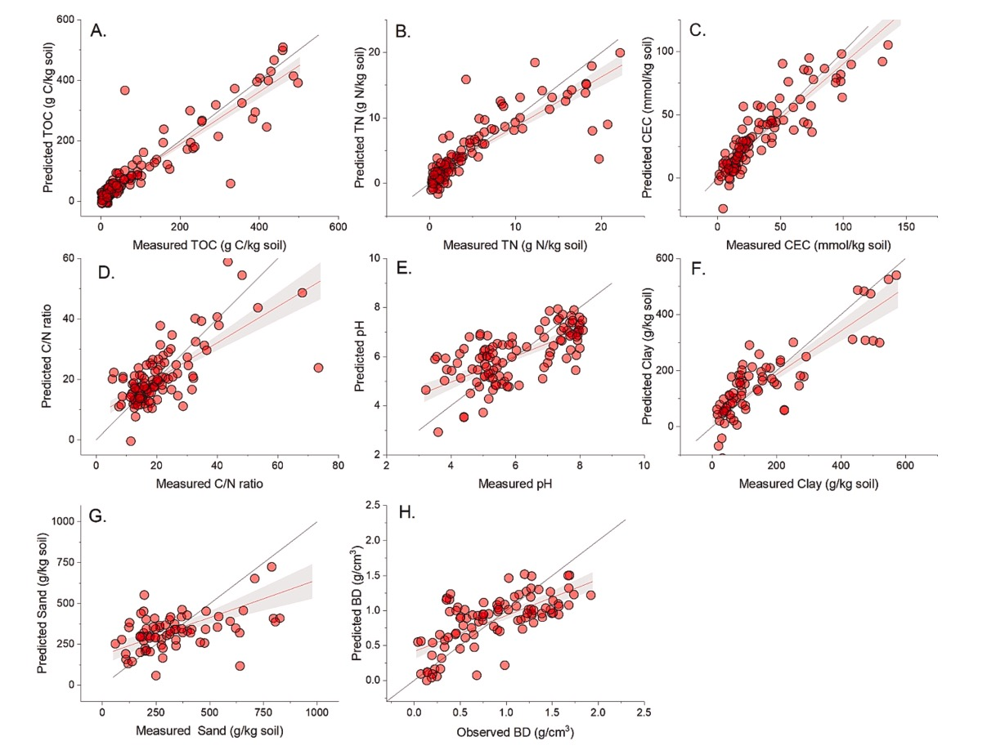
Results and discussion
Underestimate the content of various indicators
Application of different algorithms in TOC prediction
Black line: 1:1 line
Red line: regression line
Red zone: 95% accuracy
Notes:
雖然NIR在區分碳元素含量有顯著的表現，但對於TOC的預測並未比MIR好
低估各項指標的含量

Slide 17
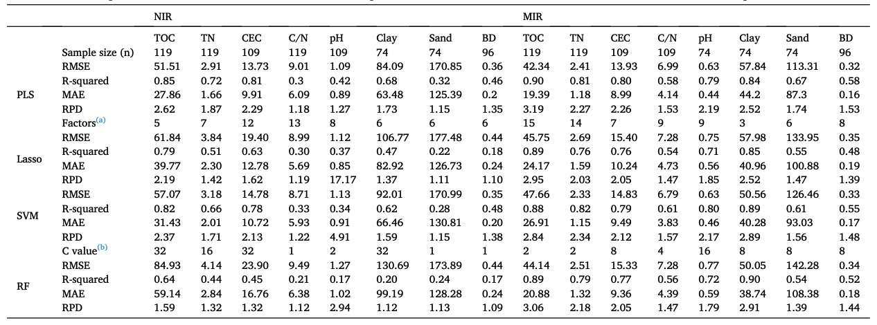
Results and discussion
Prediction of C-related variables by using NIR and MIR
Notes:
專注於PLS預測

Slide 18
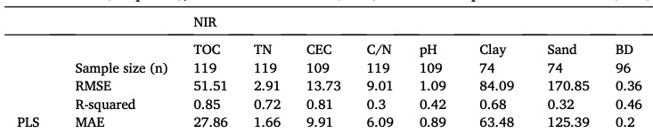
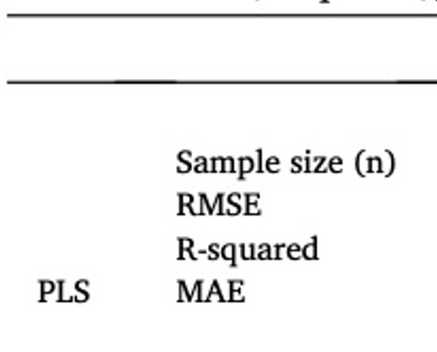
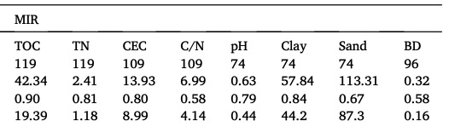
Results and discussion
Prediction of C-related variables by using NIR and MIR
CEC : Cation exchange capacity (mmol/kg soil)
BD : Bluk density
Notes:
CEC:陽離子交換容量(毫莫耳/每公斤土壤) mmol =1/1000mol
BD:體積密度
TOC/CEC表現都不錯
Ph clay MIR比較好
Sand BD都不佳

Slide 19
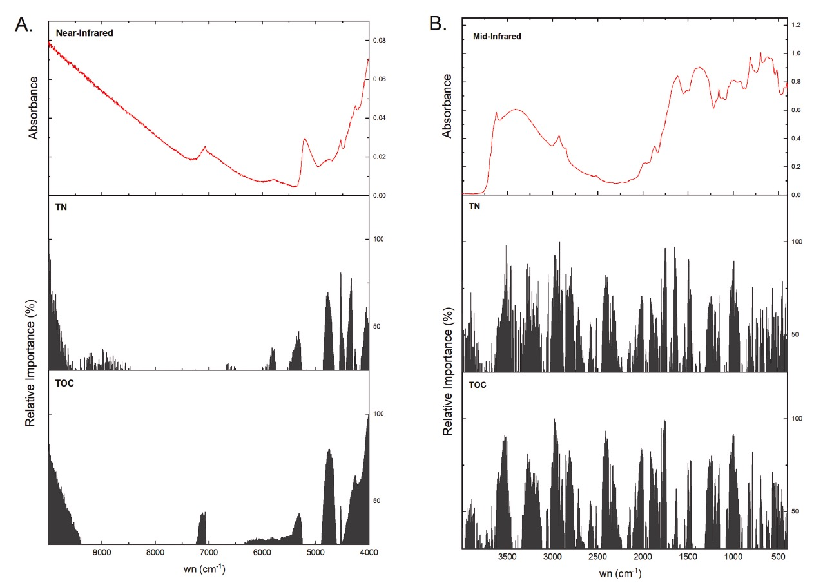
Results and discussion
Variable importance derived from PLS model
NIR MIR
Notes:
來自 PLS 模型的變量重要性
使用偏最小二乘（PLS）模型進行變數選擇，以估計波長對（TOC）（TN）預測的貢獻。 該圖顯示了a）NIR和b）MIR區域中最具影響力的波長的平均光譜和相對貢獻。

Slide 20
Conclusion
MIR spectroscopy works better
2. NIR+PLS is suitable for TOC and TN estimates
MIR → A high-precision alternative tool
NIR → A rapid screening technique
Notes:
2.使用近紅外光譜的PLS模型適用於TOC和TN估計
PLS相較於其他模型較為簡單 ，因為在現場資料收集過程中，樣本必須在沒有光譜預處理的情況下進行掃描
保持轉確幸的同時也降低資料維度
3.MIR :監測北部寒冷氣候地區土壤的潛在和高精度替代工具
NIR :作為一種可靠的快速篩查技術，特別是對於TOC和TN。

