Slide 1

AI Model
Cubist
Random Forest (隨機森林)
Extreme Learning Machine (極限學習機)
Partial Least Square Regression(偏最小平方迴歸)

Slide 2
Cubist - Introduction
Cubist is a tool for generating rule-based predictive models
from data
Rule-based System(規則化系統)
專家系統：將規則以情況、目標、動作來呈現
Rule-based 舉例：
(1) 聽到「付款」=> 提供購買連結
(2) 聽到「交易失敗」=> 提供疑難排除的連結

Slide 3
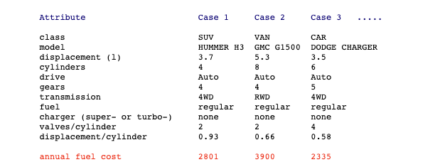
Cubist - Data
屬性
目標
每一筆數據

Slide 4
Cubist – How Cubist works ?
To find how to estimate a case's target value in terms of its attribute values
If a case satisfies all the conditions
Then the linear expression is appropriate for predicting the target value.
building a model containing one or more rules, where each rule is a conjunction of conditions associated with a linear expression.
To relate annual fuel cost to the other information provided for the automobile.

Slide 5
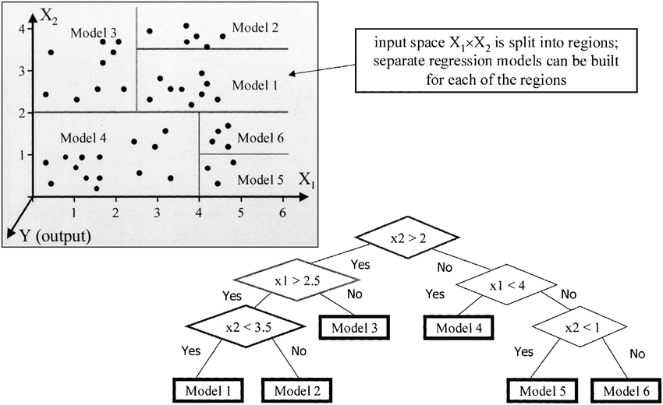
Cubist – How Cubist works ?
A Cubist model thus resembles a piecewise linear model
Cubist can construct multiple models
Example of M5 model tree. Models 1-6 are linear regression models
M5 model tree is a numerical prediction algorithm developed by Quinlan.

Slide 6
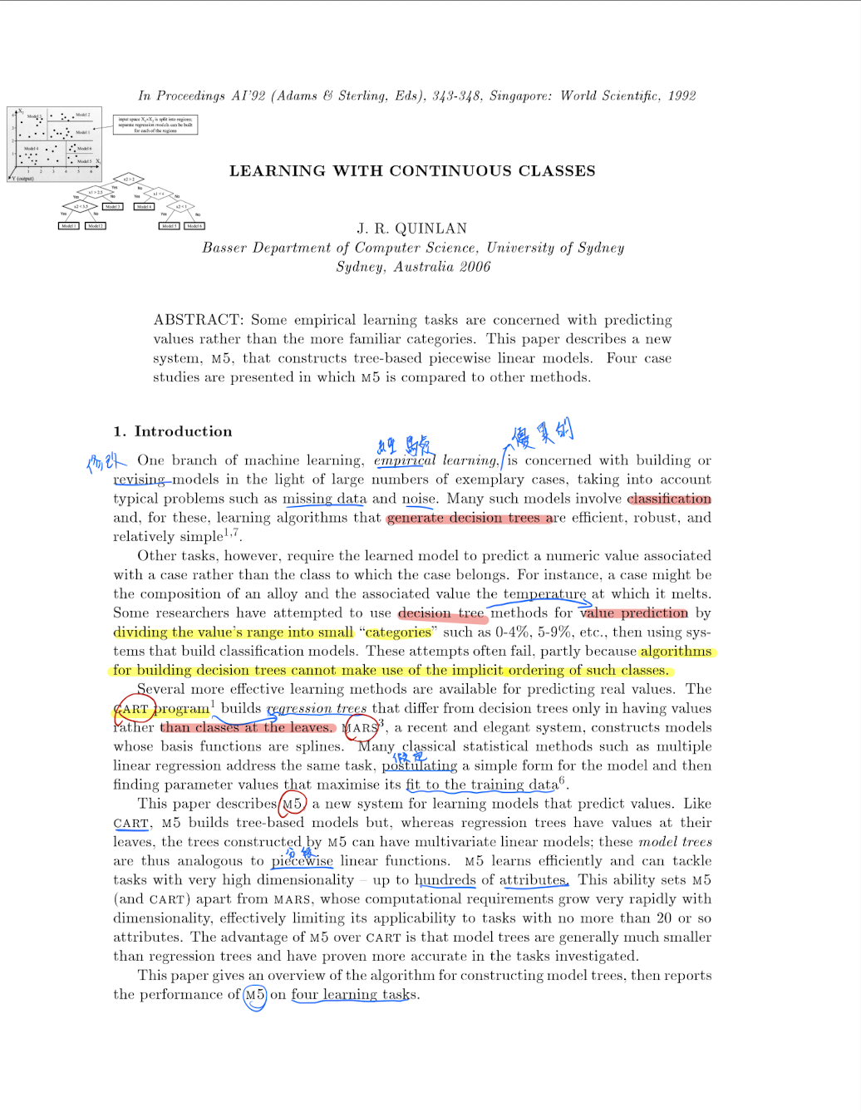
1992-Quinlan AI
Abstract :
M5,that constructs tree-based piecewise linear models

Slide 7
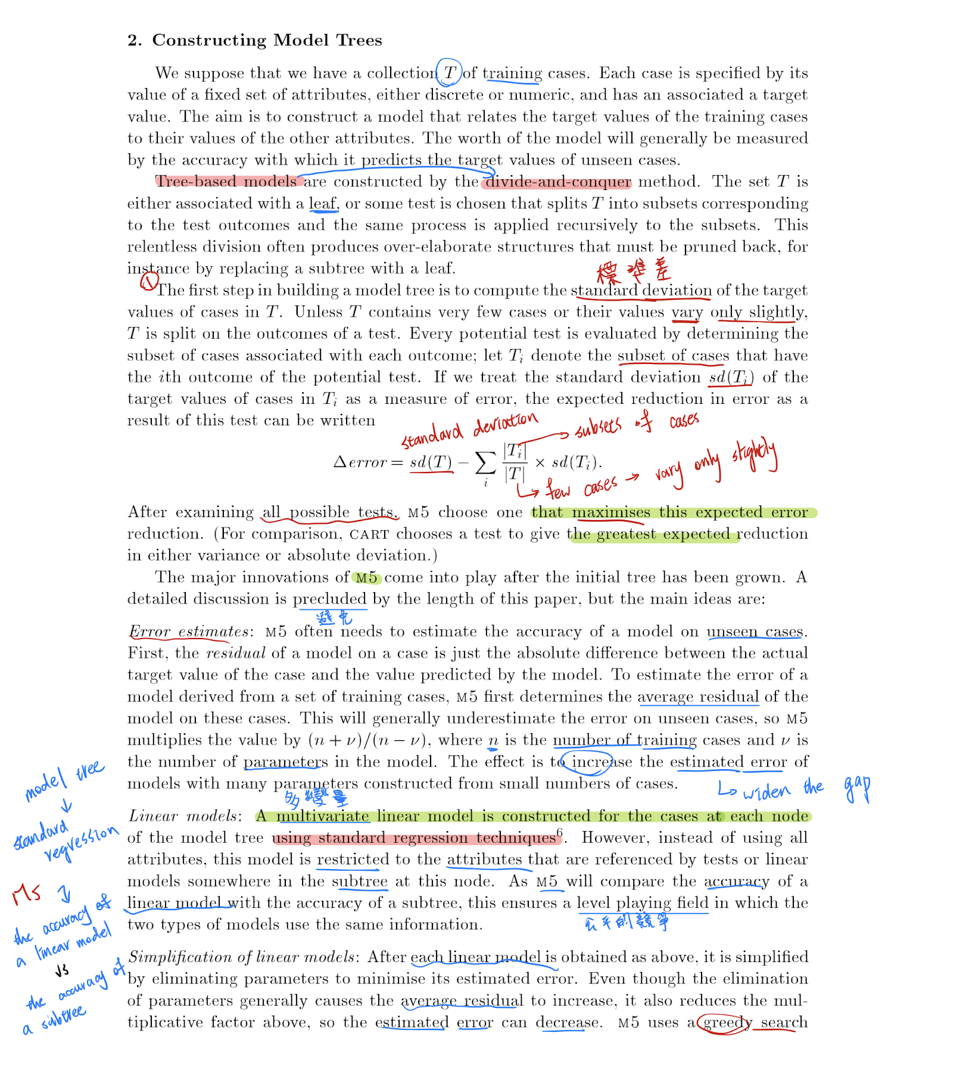
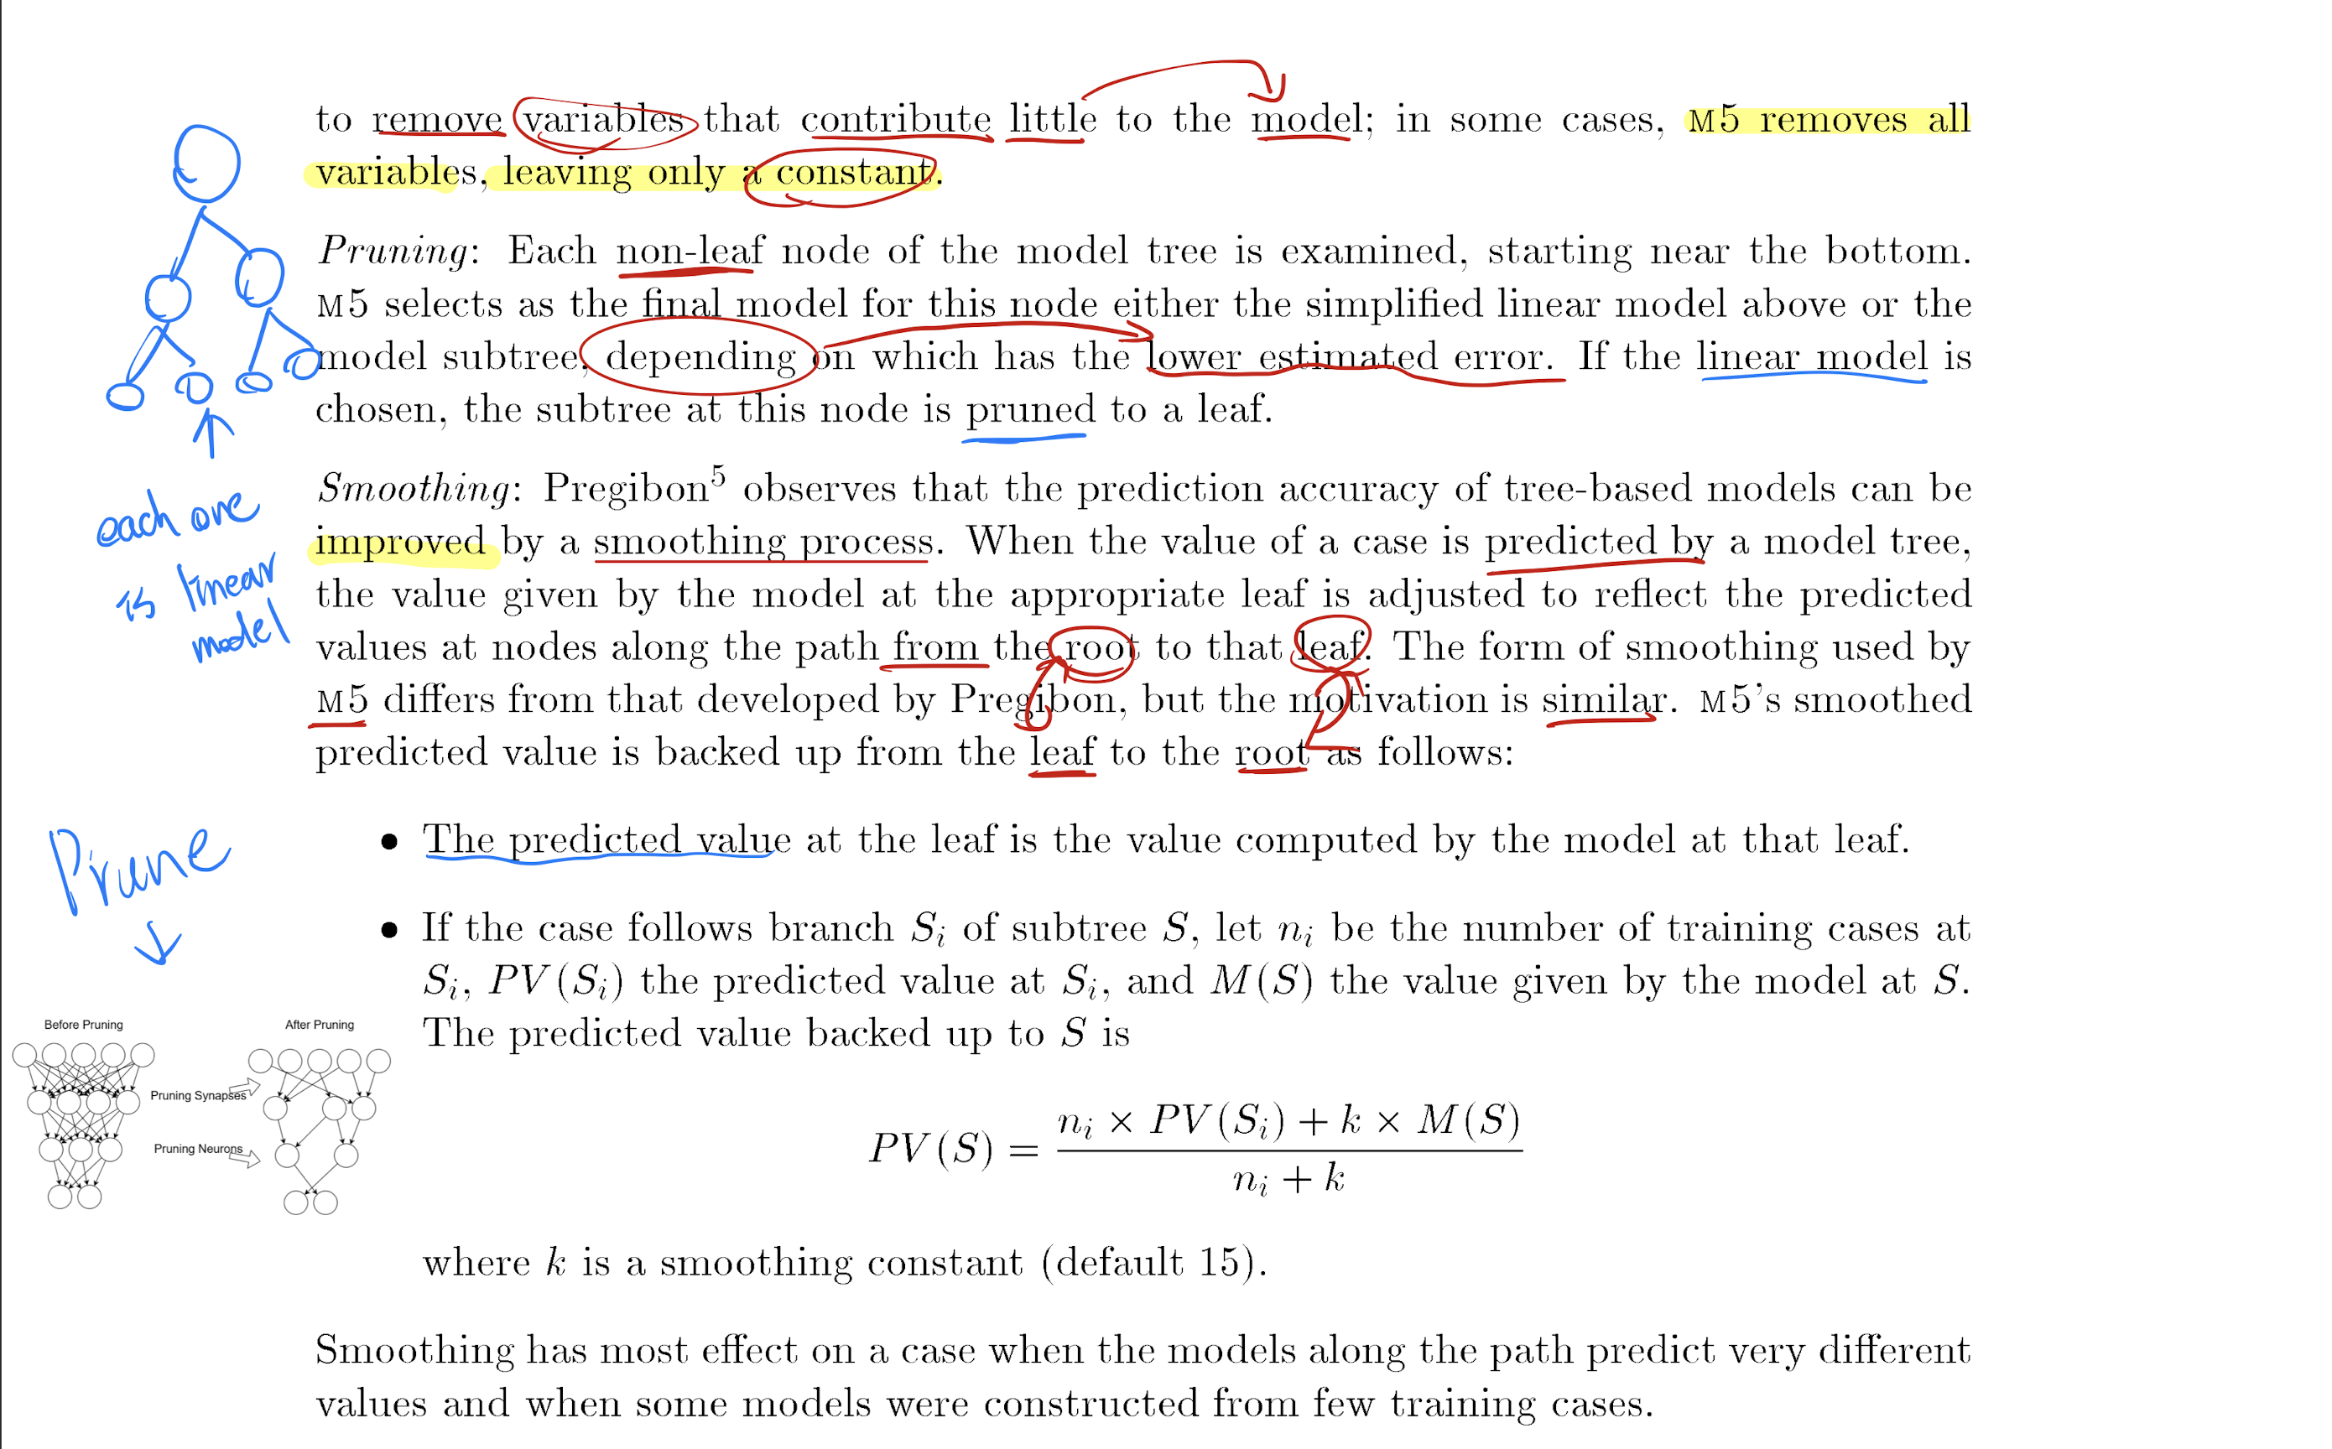
1992-Quinlan AI
Constructing Model Trees:
Error estimates
Linear models
Simplification
Pruning
Smoothing

Slide 8
Cubist – Essential files
Names file : description of the application's attributes.(e.g. soil.names)
Data file : provides information on the training cases that Cubist will use to construct a model.(e.g. soil.data)
Test and cases files : Unseen cases used to test a model. (e.g. soil.cases)

Slide 9
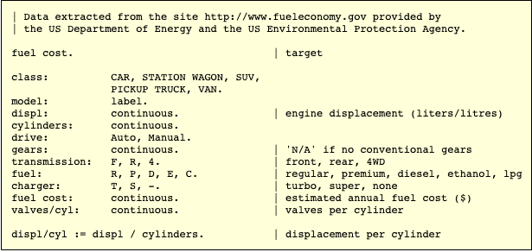
Cubist – Names file
Names file : description of the application's attributes.(e.g. soil.names)

Slide 10

Cubist – Data file
Data file : provides information on the training cases that Cubist will use to construct a model.(e.g. soil.data)

Slide 11
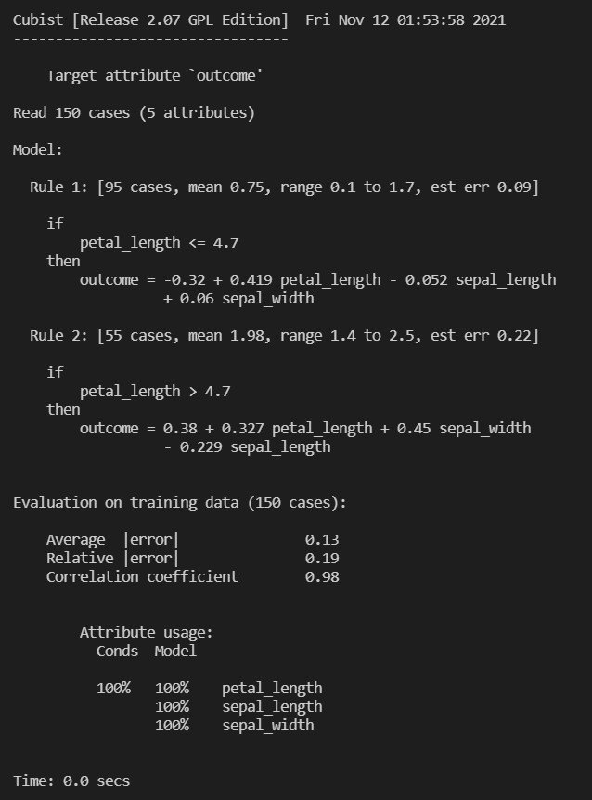
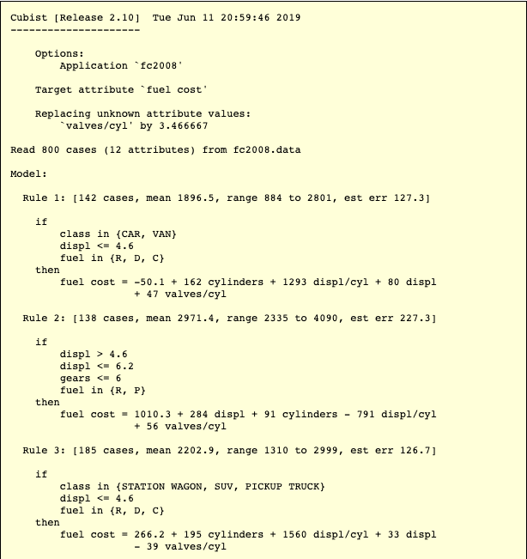
Cubist – Constructing Models
Rules
Linear Expression
Rule-based models

Slide 12
目前的問題
若要使用Github Cubist的模型尚無法進行預測
需要等待資料處理、標記過後才有辦法丟進去預測

Slide 13
Cubist – The outline of the next step for Cubist
根據以上建構模型以後：Training Data
接下來 :
Cases of Cubist
Python package for Cubist regression model

Slide 14
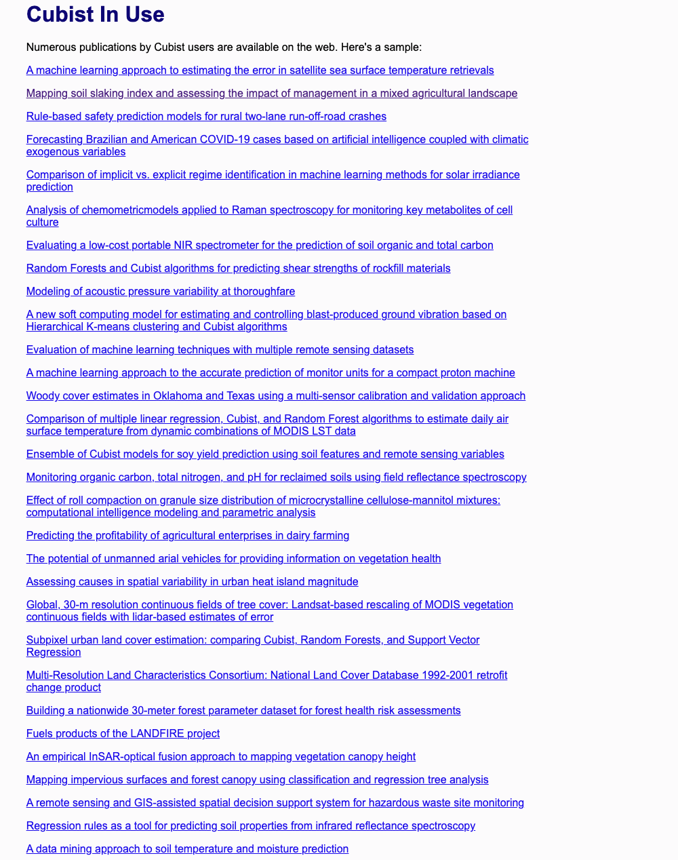
Cubist – The next step for Cubist (1)
Cases of Cubist

Slide 15
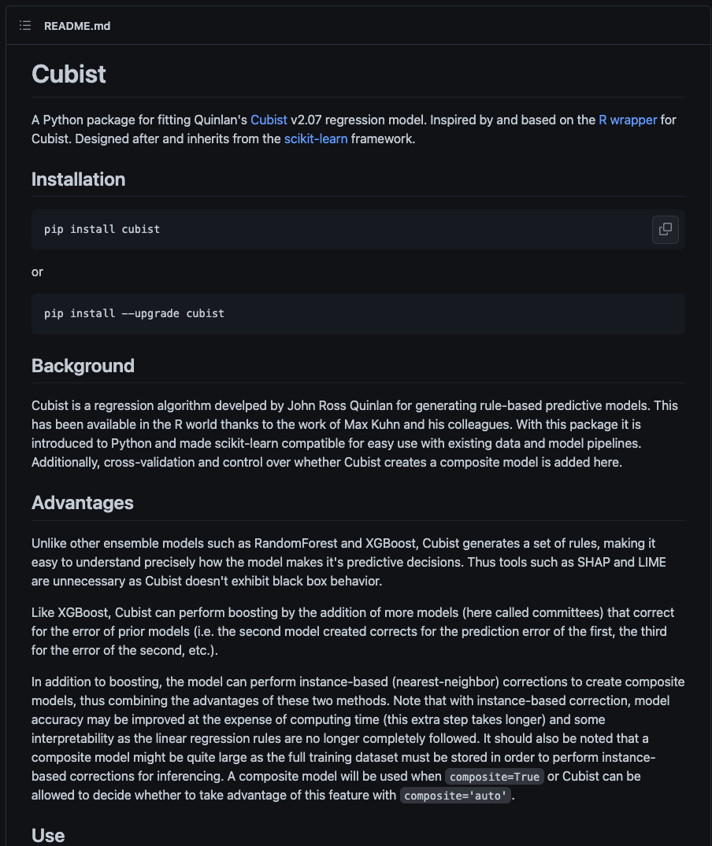
Cubist – The next step for Cubist (2)
Python package for Cubist regression model: Github

Slide 16
Cubist - Reference
Cubist-Github
An Overview of Cubist
Cubist In Use
Example of M5 model tree.
1992-Quinlan-AI.pdf

