Slide 1

Soil spectroscopy with the use of chemometrics, machine learning and pre-processing techniques in soil diagnosis: Recent advancese - A review
Issam Barra
圖書館202
2023/03/21

Slide 2
Contents
1. Abstract
2. Chemometrics/machine learning tools
2.1 Preprocessing tools
2.2 Regression tools
3. Prediction of soil properties
4. Conclusion

Slide 3
1. Abstract
In this context, the present article reviews the recent developments:
Mid and near infrared techniques coupled with chemometrics and machine learning
The preprocessing transformations and variable selection strategies to diagnose soil physical and chemical properties.
Notes:
本文回顧了近紅外和中紅外技術與化學計量學和機器學習工具以及預處理轉換和變量選擇策略相結合的最新發展，以診斷土壤物理和化學性質。

Slide 4
2. Chemometrics/machine learning tools
Chemometrics is a discipline of analytical chemistry:
mathematical
statistical
computer applications
There are two main categories of chemometrics tools
supervised : prediction
unsupervised : generally for data visualization

Slide 5
2.1 Preprocessing tools
Several factors can affect the quality of the infrared spectra :
The particle size of the samples
The variations of the optical path

Slide 6
2.1 Preprocessing tools
Preprocessing tools :
Smoothing : remove the high- frequency noise from samples
mean centering : include an adjustable intercept in multivariate models
derivatives : reduce the drift of the baseline and highlight some parts of the spectral information
normalization : minimize errors presented due to the samples preparation step
standard normal variate : eliminate the effect of uncontrolled variations, viz, instrument optical path
multiplicative scatter correction : mitigate problems arising from scattered light

Slide 7
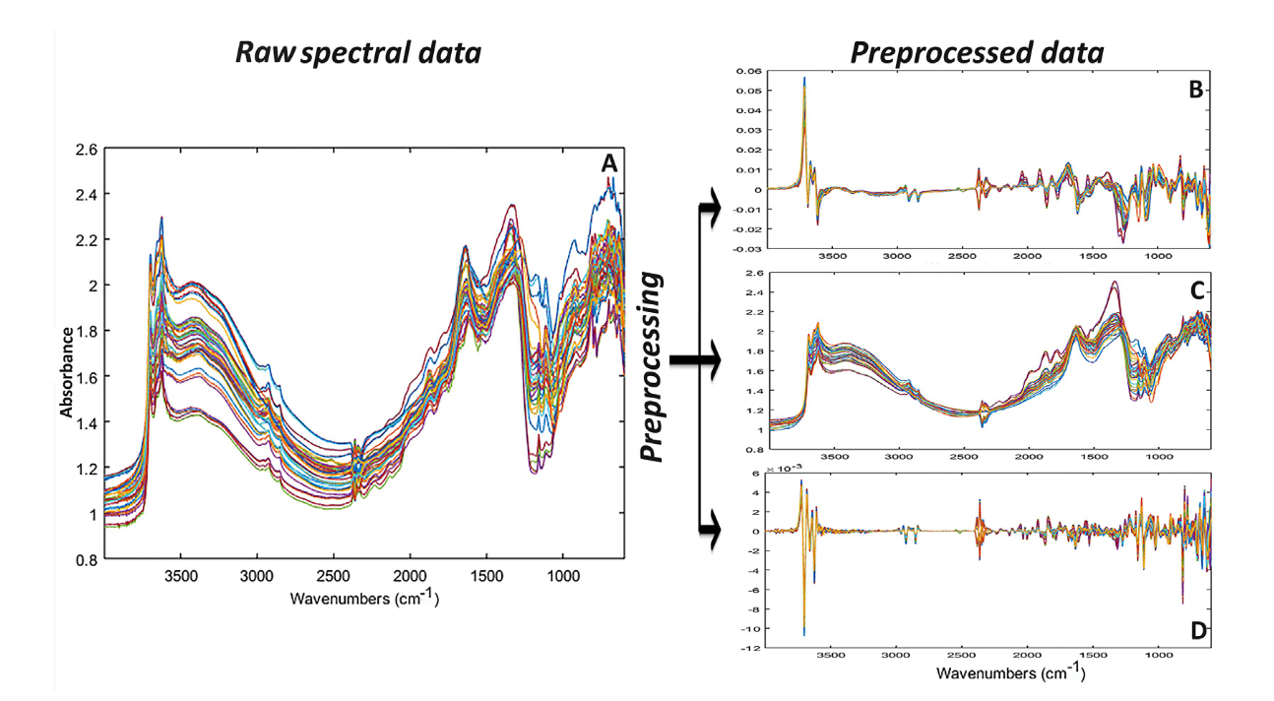
2.1 Preprocessing tools
first derivative
raw spectra
standard normal variate
second derivative

Slide 8
2.2 Regression tools
The commonly applied multivariate calibration tools:
partial least squares regression (PLS): PLS explains the variability in the data by constructing some new composite variables, and then uses these variables for regression modeling.
support vector machine regression (SVMR): Can handle high-dimensional data and non-linear problems
principal component regression (PCR): Used to handle high-dimensional data and multicollinearity problems.
multiple linear regression: Used to explain the linear relationship between a dependent variable and one or more independent variables.

Slide 9
3. Prediction of soil properties
The study concluded :
that machine learning techniques such as RR and ANN combined with Vis-NIR spectral data can provide precise predictions.
A similar study tested the accuracy of combining PLS with NIR and Vis-NIR techniques as a soil multi-nutrient availability index. The coupling of PLS - Vis-NIR proved to be relevant since it accurately predicted plant available P, Ca, Mg and K .
Notes:
研究結論是，機器學習技術，如RR和ANN，結合Vis-NIR光譜數據，可以提供精確的預測。類似的研究[62]測試了將PLS與NIR和Vis-NIR技術結合作為土壤多營養元素可用性指標的準確性。PLS-Vis-NIR的耦合被證明是相關的，因為它可以精確地預測植物可利用的P、Ca、Mg和K.

Slide 10
3. Prediction of soil properties
Based on portable MIR spectroscopy data modeled by machine learning techniques (Random Forest [RF] and PLSR)
Predict TC, TN, CEC, clay, silt and Naex in 458 representative
Australian soil samples.
Notes:
研究結論是，機器學習技術，如RR和ANN，結合Vis-NIR光譜數據，可以提供精確的預測。類似的研究[62]測試了將PLS與NIR和Vis-NIR技術結合作為土壤多營養元素可用性指標的準確性。PLS-Vis-NIR的耦合被證明是相關的，因為它可以精確地預測植物可利用的P、Ca、Mg和K.

Slide 11
3. Prediction of soil properties
The study demonstrated :
DRIFT data could be calibrated to estimate a soil quality index by directly predicting measurable soil parameters
Tested a small portable prototype MIR spectrometer
to collect soil spectra
from two agricultural fields (predominantly organic and mineral soils)
PH、CEC、SOC、Ca、Mg、TN、TP、Fe、Cu、K、Na、
Notes:
研究結論是，機器學習技術，如RR和ANN，結合Vis-NIR光譜數據，可以提供精確的預測。類似的研究[62]測試了將PLS與NIR和Vis-NIR技術結合作為土壤多營養元素可用性指標的準確性。PLS-Vis-NIR的耦合被證明是相關的，因為它可以精確地預測植物可利用的P、Ca、Mg和K.

Slide 12
4. Conclusion
The studies cited in this paper showed :
1. infrared spectroscopy especially in MIR led to predictive models that are able to give reasonable estimations of important key soil health indicators, namely, SOC, pH, sand, clay ... Etc.
Notes:
研究結論是，機器學習技術，如RR和ANN，結合Vis-NIR光譜數據，可以提供精確的預測。類似的研究[62]測試了將PLS與NIR和Vis-NIR技術結合作為土壤多營養元素可用性指標的準確性。PLS-Vis-NIR的耦合被證明是相關的，因為它可以精確地預測植物可利用的P、Ca、Mg和K.

