Slide 1

1a.lv
Marija Sobole

Slide 2
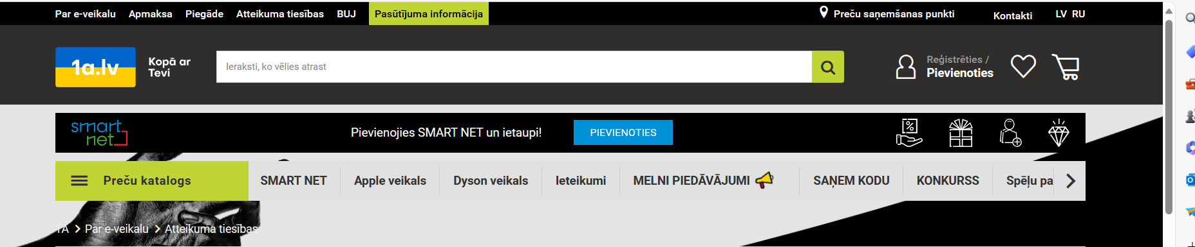
INTUITIVE NAVIGATION:
Product categorization:

Slide 3
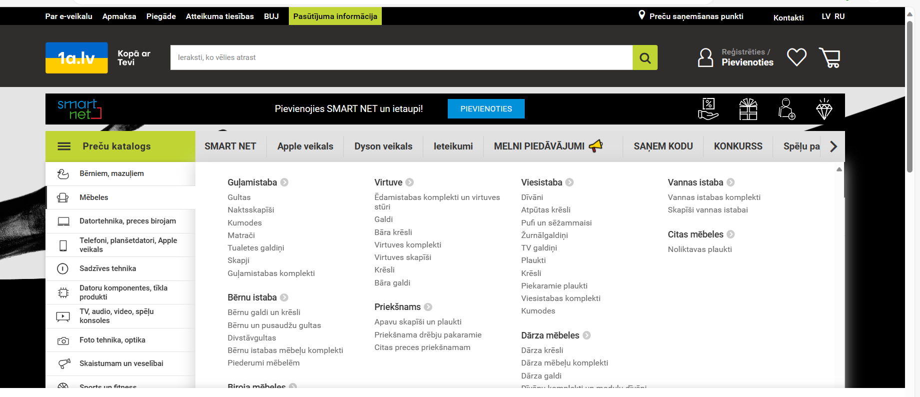
PRODUCT CATEGORIZATION:

Slide 4

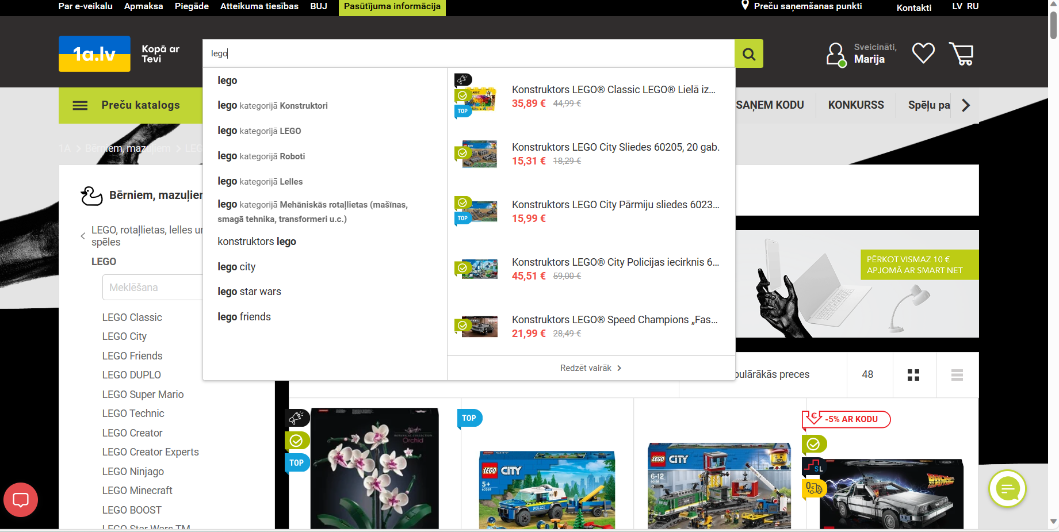
Search:

Slide 5
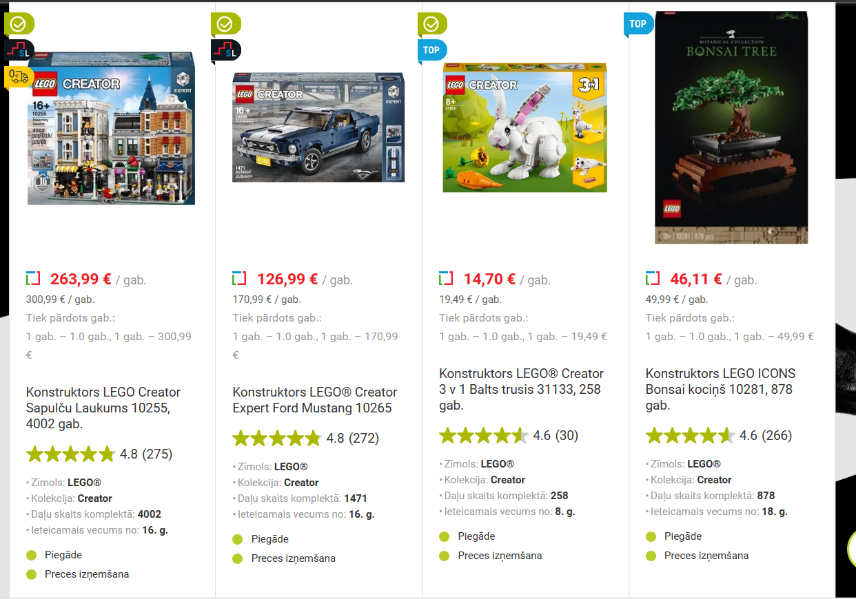
Product Page Design:

Slide 6
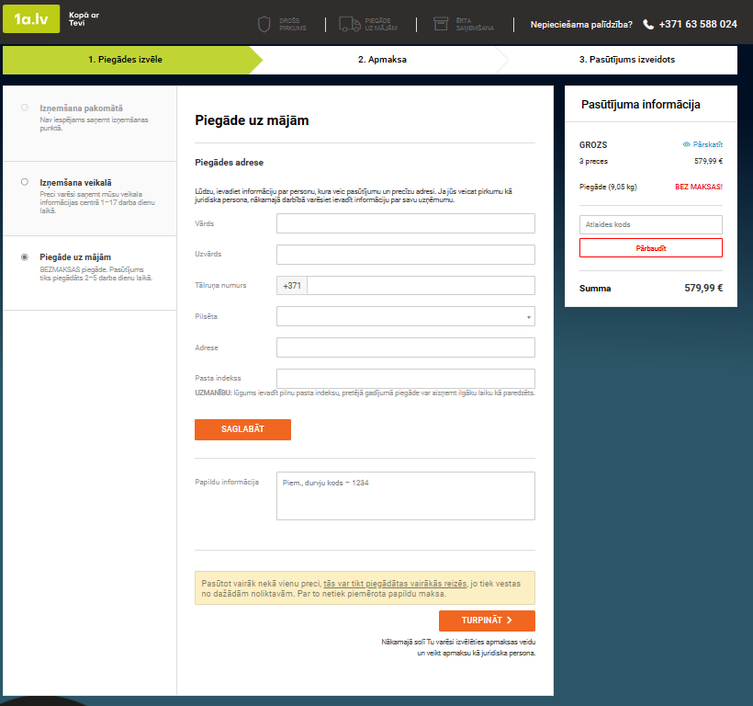
Checkout Process:

Slide 7
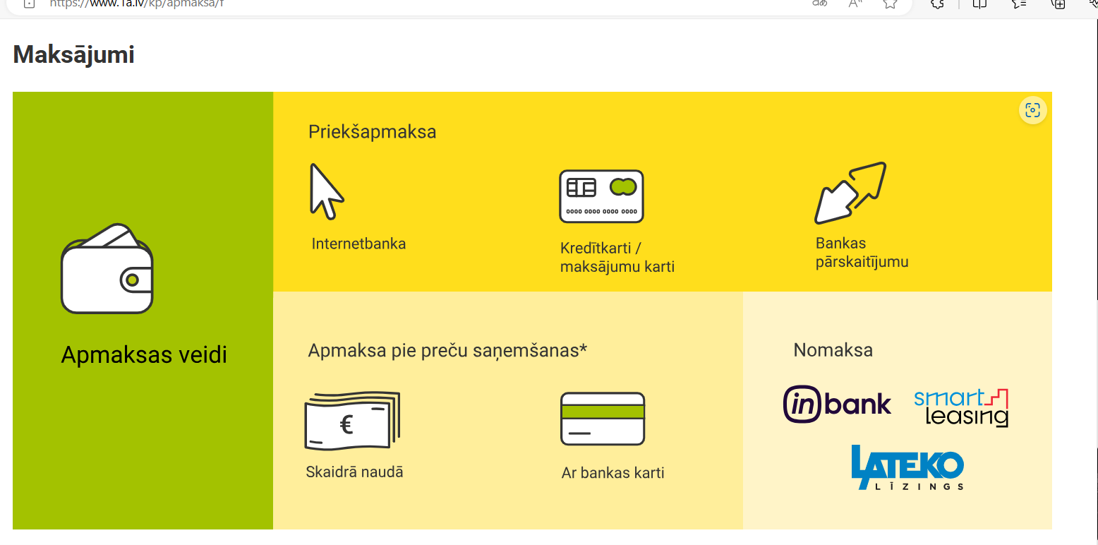
Payments:

Slide 8
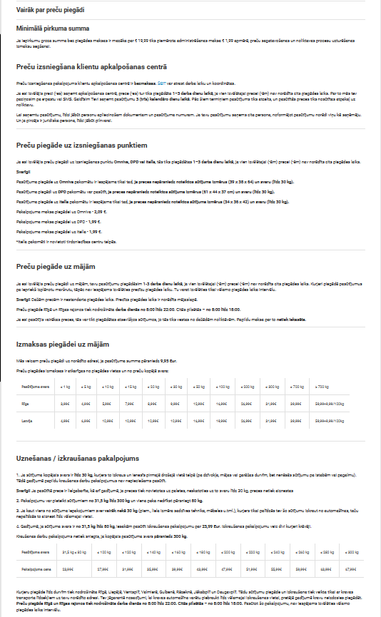
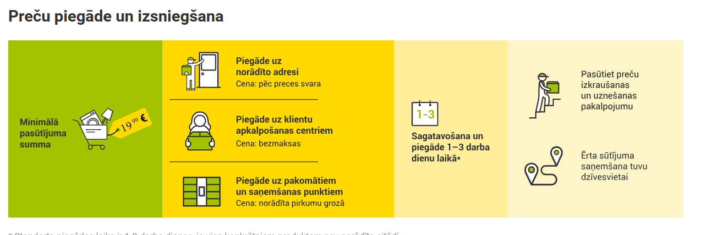
Shipping & Customer Service:

Slide 9


