Slide 1


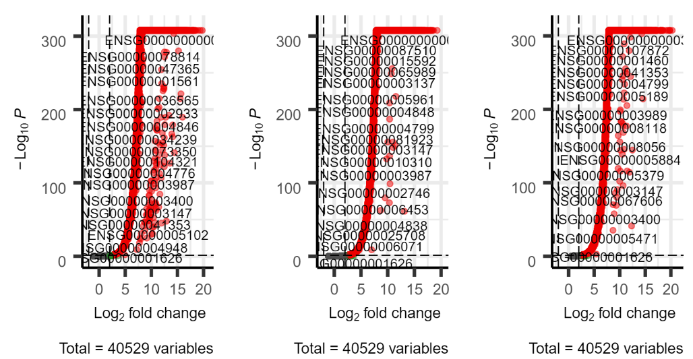
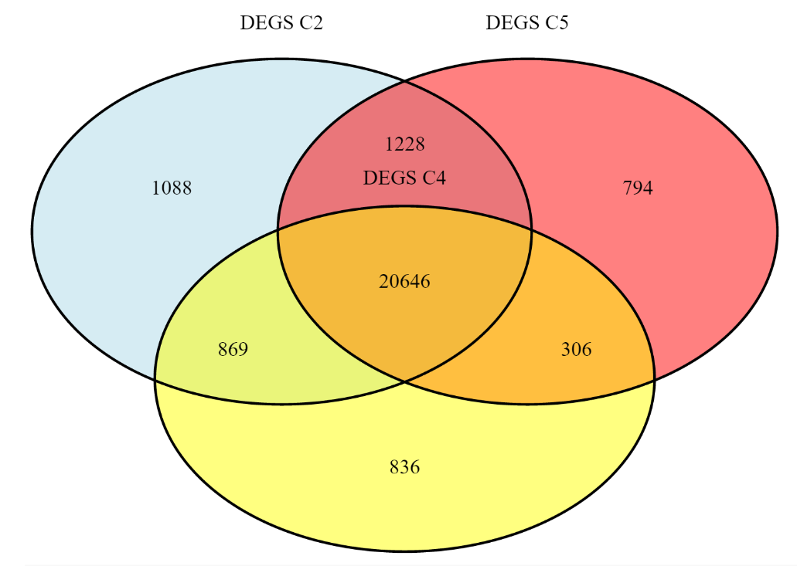
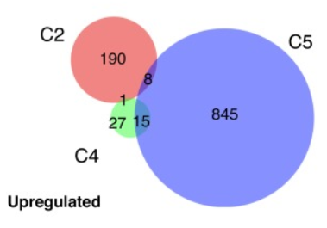
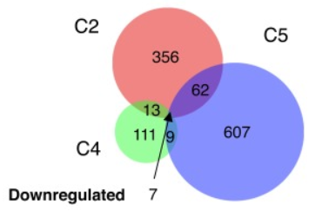
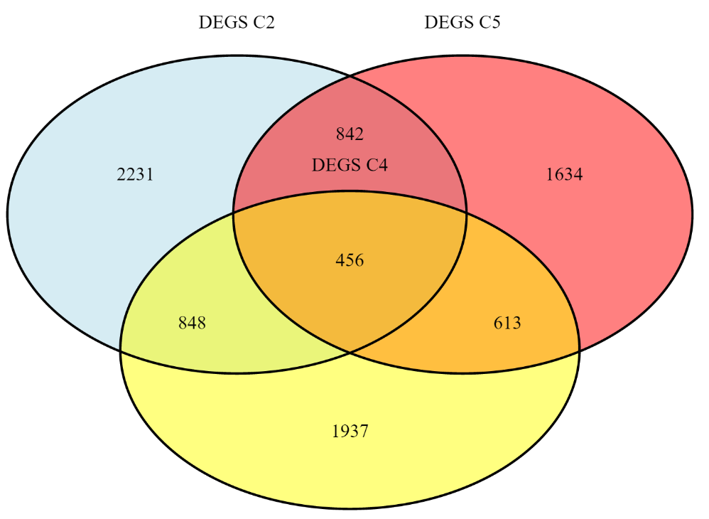
INSERT LOGO HERE
Reduced CYFIP1 in Human Neural Progenitors Results in Dysregulation of Schizophrenia and Epilepsy Gene Networks
Marije Hibma, 380607, BFV2 | Hanzehogeschool, Groningen
w
Introduction
Results
Materials & Methods
dfdfdgfgdgdfgdfg
Before the results could be generated. The data had to be processed.
For this project Rstudio was used to process the data and make the plots. The data used was that which was provided on PubMed.
Goal of this project
The goal of this project was to recreate some of the figures and volcano plots from a research of choice. In my case I chose to recreate the Venn diagrams found in the research paper. What this is supposed to show is that only a small part of the genes are similarly dysregulated in response to CYFIP1 knockdown across all three of the NPC lines that were evaluated (up- vs downregulated). The diagrams from the research paper can be seen below (images 1 & 2).
Conclusion
The results of the project did not come out the way it was intended to be. This was due to the fact that the DSeq2 was not done properly. So as for the conclusion it is hard to write one.
Image 1: Upregulated Image 2: Downregulated
.
Notes:
You can add your presentation notes here. This presentation template for research posters is fully editable so text, graphics and content can be updated to fit your own research needs.
Download more poster presentation templates from FPPT.com

