Slide 1

Design Patterns
Filter/Criteria Pattern
DavID SCHEERS & Marijn van den Heuvel
1 Feb 2016

Slide 2
What is the Filter/Criteria Pattern?
Filter pattern or Criteria pattern is a design pattern that enables to filter a set of objects, using different criteria, chaining them through logical operations. This type of design pattern comes under structural pattern as this pattern is combining multiple criteria to obtain single criteria.

Slide 3
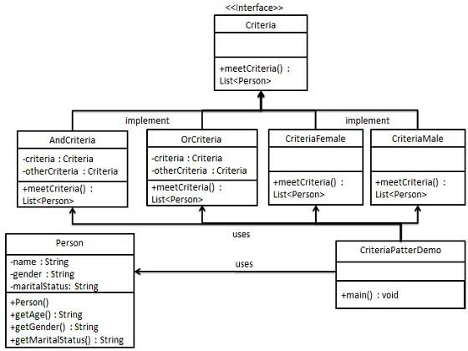
How is the Filter/Criteria Pattern created?

Slide 4
Implementation example
We're going to create a Person object, Criteria interface and concrete classes implementing this interface to filter list of Person objects. CriteriaPatternDemo, our demo class uses Criteria objects to filter List of Person objects based on various criteria and their combinations.

Slide 5
Implementation example
Step 1: Create a class on which criteria is to be applied. (Class Person)
Step 2: Create an interface for criteria. (Interface Criteria)
Step 3: Create concrete classes implementing the criteria interface. (Class CriteriaMale, Class CriteriaFemale, Class CriteriaSingle, Class CriteriaMarried)
Step 4: Create concrete classes implementing the criteria interface to use as comparator. (Class AndCriteria, Class OrCriteria)
Step 5: Use the different criteria & their combination. (Class CriteriaPatternDemo)

Slide 6

ANY Questions?

