Slide 1

The Observer pattern

Slide 2
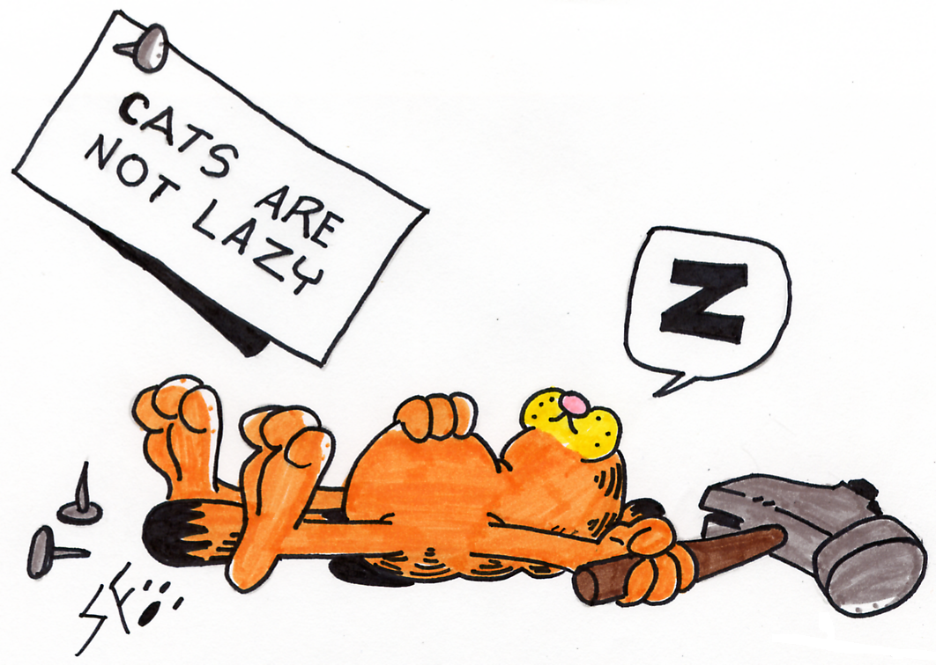
The problem
You own a shop
AND you are lazy as hell!
Every week you have new promotions
So, you have to change the price of your products
You change them in the products database
But:
Your register also needs the updates
You want your webshop to be up to date all the time
Can you find the solution?

Slide 3
Possible solution
Stop changing the prices!
You can stay lazy, because you don’t have to update anything
Force the register and your webshop to update its data, you only have to do this once every week… It’s just a little extra work you have to do…

Slide 4

There is a better solution
Let your webshop and your register update itself!

Slide 5
The observer pattern
Also know as the publisher/subscriber-pattern
Behavioral pattern
GoF definition:
Define a one-to-many dependecy between objects so that when one object changes state, all its dependents are notified and updated automatically.
Objects can have 2 roles:
Observer (view)
Observable (model)

Slide 6
The Basic Idea

Slide 7
How to make a class an Observer?
Let the observing class(es) implement the interface Observer
public class MyShopRegister implements Observer
This functional interface has only one method you have to implement
void update(Observable observable, Object object)
The update-method gets called everytime your Observable changes
So implement this method that your Observer updates his own state with the most recent data from your observable

Slide 8
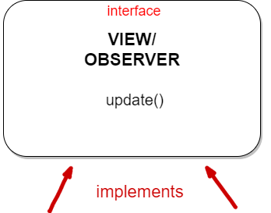
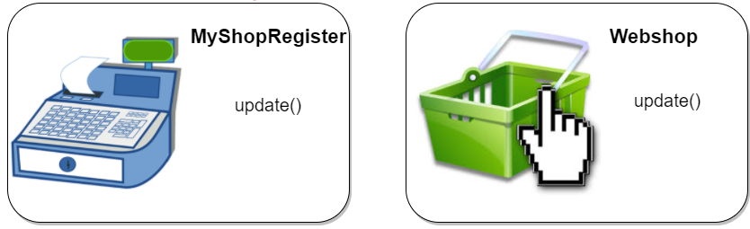

Slide 9
How to make a class an Observable?
Let your class extend the class Observable
public class MyShop extends Observable
This class has some useful methods
addObserver(Observer observer)
deleteObserver(Observer observer)
hasChanged()
…
The most important methods are
addObserver(Observer observer): adds a new observer to this object
notifyObserver() or notifyObserver(Object o): notifies all the observers
setChanged(): sets the state of this Observable to changed

Slide 10
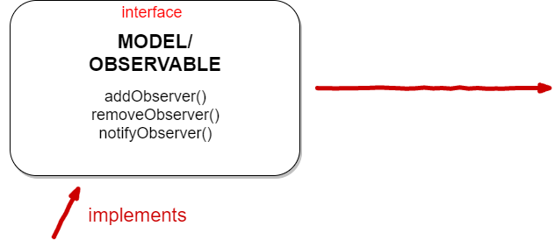
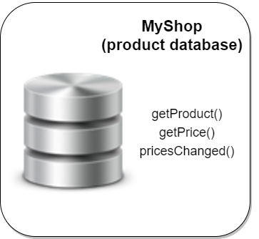

Slide 11
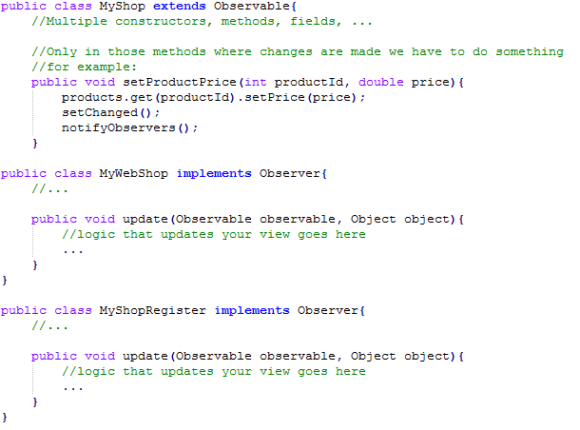
Shop example

Slide 12

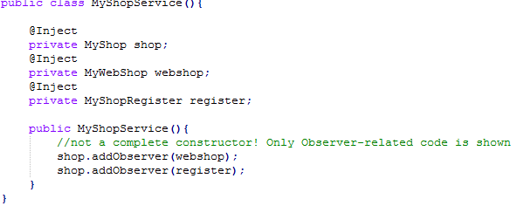
But… don’t forget to do this!

