Slide 1
The Singleton Pattern

Slide 2
Creational Pattern
Design patterns that deal with object creation mechanisms.
Create objects in a manner suitable to the situation.
Basic form of object creation could result in design problems or added complexity to the design.
Creational design patterns solve this problem by somehow controlling this object creation.
Singleton Pattern is an example of a creational pattern.

Slide 3

What is the Singleton Pattern?

Slide 4
What is the Singleton Pattern?
Ensures a class only has one instance.
Providing a global point of access to it.
America’s President Office is a real life example of a Singleton.
Constitution specifies the means by which a president is elected.
Limits the term of office.
Defines the order of succession.
"The President of the United States" is a global point of access that identifies the person in the office.

Slide 5

Why use Singleton?

Slide 6
Why use Singleton
Only one instance of an object needed, available to number of other classes.
Popular usage of Singletons:
Providing a registry
Thread pools
Caching
Driver objects
Logging, providing one single access point to applications log file

Slide 7
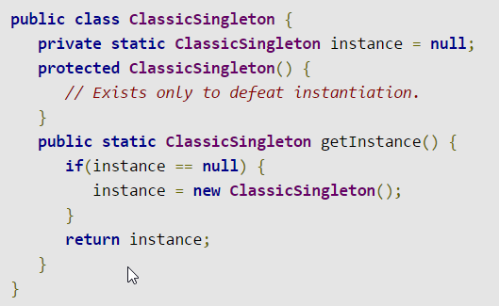
Classic Singleton example

Slide 8
Classic Singleton example
Static reference to lone Singleton instance.
Returns reference from getInstance().
Lazy instantiation.
Singleton instance not created until getInstance() called.
Ensures singletons only created when necessary.

Slide 9

Anti pattern?

Slide 10
Anti pattern?
Assumption of one instance often broken during project’s lifetime.
Code structure requires heavy refactoring if assumption is broken.
Often difficulties testing when using Singleton, especially in agile world.
Difficult to use with multi-threading.
Decrease in performance.

