Slide 1

HTTP & DNS
Cegekaschool
Kevin Smet, Kevin Billen
15/02/2017

Slide 2


Slide 3


Slide 4
hypertext transfer protocol

Slide 5
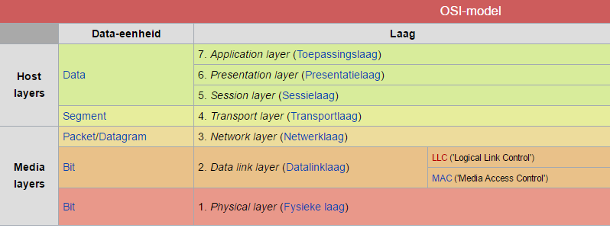

Slide 6
HTTP overzicht
HTTP: hypertext transfer protocol
Applicationlayer protocol of the www-application
According to client/server model
client: browser that does requests and receives web objects and shows them.
server: Web server that sends those obejects on demand
HTTP 1.0
HTTP 1.1
HTTP 2.0
HTTP request
PC running
Explorer
HTTP response
Server
running
Apache Web
server
HTTP request
HTTP response
Mac running
Navigator

Slide 7

Go Little Billy

Slide 8
Structure
Blackboard

Slide 9
Methods & response codes
Title
explenation

Slide 10
Correction
Blackboard

Slide 11
HTTP - Methods
GET
By default done by all browsers
Only to fetch data from a web server
POST
Send data to a web server
PUT
Send data to a web server
Idempotent!
DELETE
Execute a delete operation at the web server
Idempotent!

Slide 12
HTTP – response codes
Most common error codes
HTTP code | Brief explenation
200 | OK
204 | No content returned (~ HTTP 200)
400 | Bad request
405 | Method not allowed
407 | Proxy authentication required
500 | Internal server error

Slide 13
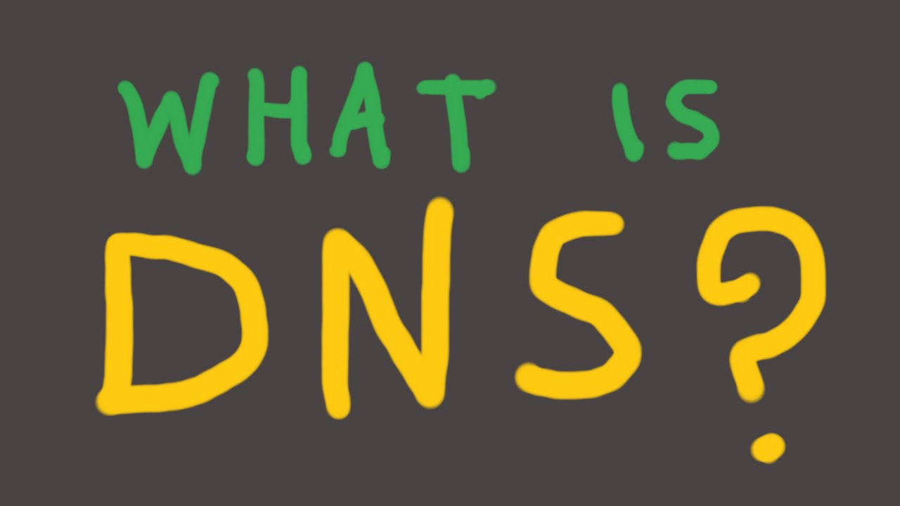

Slide 14

Wat is DNS?
DNS = Domain Name System

Slide 15
What is DNS?
DNS is a translation system to go from an url to a IP – adres or the other way around.
You can compare DNS with the equivalent of a phonebook.
When you type in an url, your computer can’t do anything with it. It can only handle IP-adresses to find some info on the network.

Slide 16
What happens when you put an url into your browser?
When for example, you type in your browser www.example.com
Your browser is going to put a dot in the end extra
So in the case from the example, in your browser it says www.example.com.
This dot represents the ROOT of the domain system.

Slide 17
What is the meaning of the ROOT?
The root make sure, that your computer go and search for the IP-adress that is linked to the url you asked for in your browser?
So whenever you type in an url, your computer is sending a request to the local DNS server to ask if he knows the IP-adres for a specific url?
This server is going to have a look in his cache if he knows the IP-adres. When he does, it returns the adres and DNS is not being activated.
In this case, our local DNS server doesn’t know the IP-adres.

Slide 18


Slide 19


Slide 20
Now What?
When your local DNS server doesn’t know the IP-adres, we’ll have to find it elsewhere.
This search can happen on two different ways.
You can search on an iterative way or on a recursive way.
But more on the way of searching later on.

Slide 21
Now what?
First is your local DNS server going to ask the Top Level Domain server, if he knows the IP-adres.
The Root DNS – server knows where to find the Top Level Domain -servers. These servers have got the (.com,.be,.org,…) information on an IP-adres.
When they don’t find the IP-adres is their cache, we’ll have to find another server who maybe knows the IP-adres.
In our example, the Top level domain-server doesn’t know the IP-adres.

Slide 23
Now what?
Since the Top Level Domain-server doesn’t know the IP-adres, we have to look somewhere else for the correct IP-adres.
The Top Level Domain-server is giving the location of the authorative name servers.
These servers are responsible for the (example.com, …) domain.
These servers on their turn are going to look for the IP-adres in their cache.

Slide 25
Now what?
The Root servers can give you the adress of the authorative name servers.
What are the root servers?

Slide 26
Root servers
When you want to register an url, you have to register them with The Registrar.
These are massive databases of the different url with their respective IP-adres.
The registrar also updates the Authorative Domain servers, so they know to wich root domain server they have to go.
When they can’t resolve the url in the root domain server, the url doesn’t exists.

Slide 27
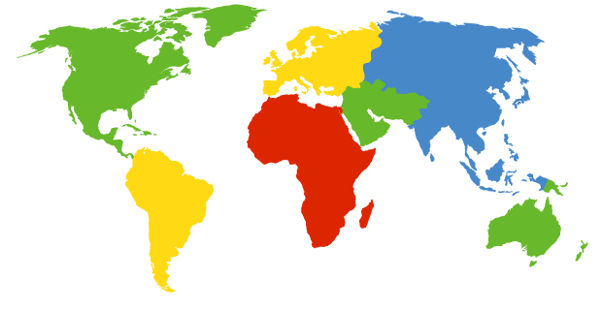
DNS: Root name servers
Laatste kans als eerdere resolving pogingen niets opleverden
Heeft de gegevens van de authoritative name servers
a Verisign, Dulles, VA
c Cogent, Herndon, VA (also Los Angeles)
d U Maryland College Park, MD
g US DoD Vienna, VA
h ARL Aberdeen, MD
j Verisign, ( 11 locations)
k RIPE London (also Amsterdam, Frankfurt)
i Autonomica, Stockholm (plus 3 other locations)
m WIDE Tokyo
e NASA Mt View, CA
f Internet Software C. Palo Alto, CA (and 17 other locations)
13 root name servers wereldwijd
www.roots-servers.org
b USC-ISI Marina del Rey, CA
l ICANN Los Angeles, CA

Slide 28
Now we know what the IP-adress is of a URL
As previous mentionned, you can do this search on two different ways.
You can search on an iterative way and on a recursive way.

Slide 29
The Iterative way
We first contact our local DNS – server.
This server contacts the Root DNS server. When the Root DNSserver doesn’t know the IP – adres, it gives the adres of the Top Level domain server.
Then our local DNS server contacts the Top level Domain server.
When the Top level Domain server, doesn’t know the IP-adres, it gives the adres of the Authorative name-server to the local DNS – server.
The local DNS server contacts the Authorative Name –server.
In the Iterative way, the local DNS server does all the work.

Slide 30
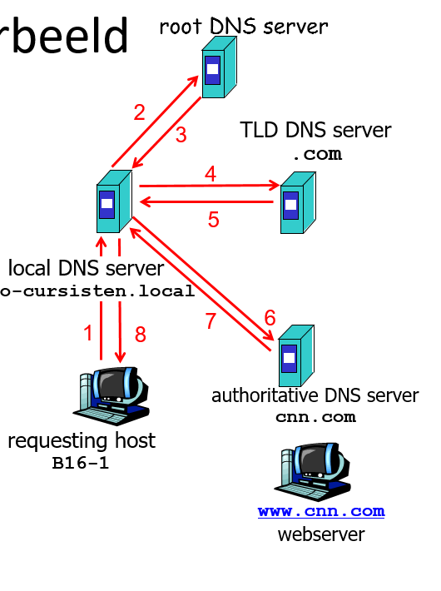

Slide 31
Recursive way
We first contact our local DNS-server.
This server contacts the Root DNS server. When the Root DNS server doesn’t know the IP-adres.
The Root DNS server asks the Top level domain server if he knows the IP-adres.
When the Top level Domain server doesn’t know the IP –adres, it asks the Authorative Name-server for the IP-adres.
When the Authorative Name-server sends the IP-adres, it has to send it back the way it was asked.

Slide 32
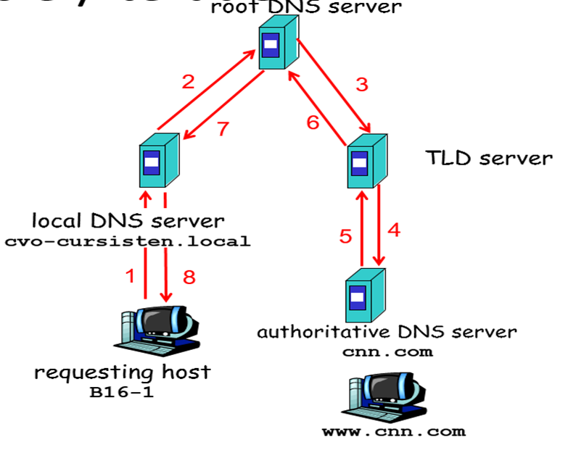

Slide 33
Recursive way vs iterative way
The recursive way of searching causes a higher workload on servers.
It puts all the work with the contacted server.
The iterative way of searching causes a higher workload on the local server.
It puts all the work with the original server.

Slide 34
Summary
So DNS translates the url into an IP-adres or vice versa.
For the queries DNS uses UDP.
DNS is a not centralised structure :
*To avoid single point of failure
*High volumes of trafic
* maintaining a huge database

Slide 35
Summary
The following website are good to review about DNS :
*https://mxtoolbox.com/SuperTool.aspx?action=mx%3a&run=toolpage#
*https://www.youtube.com/watch?v=72snZctFFtA&feature=youtu.be
*https://www.dnsbelgium.be/nl/domeinnaam
Why only 13 Root servers?
Because DNS uses UDP. The memory usage of UDP is only capable of having 13 IP-adresses at the same time.

Slide 36

Also questions about the dates of little Billy.

