Slide 1
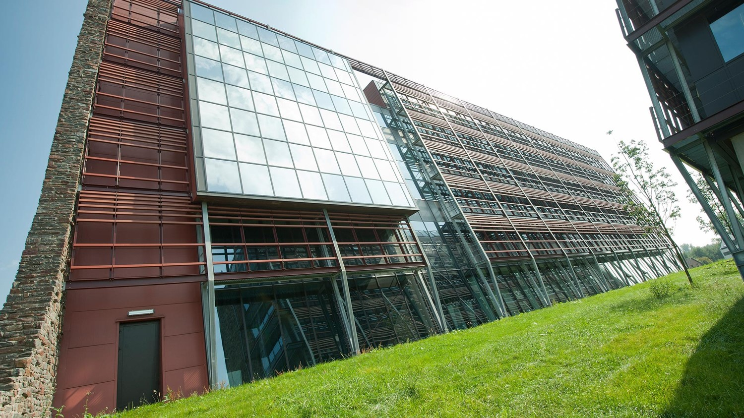
Firewall
How to protect your computer/network?
Thomas Vanausloos, Steven Excelmans
16 February 2017

Slide 2
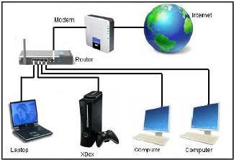
Network – possible security flaws

Slide 3
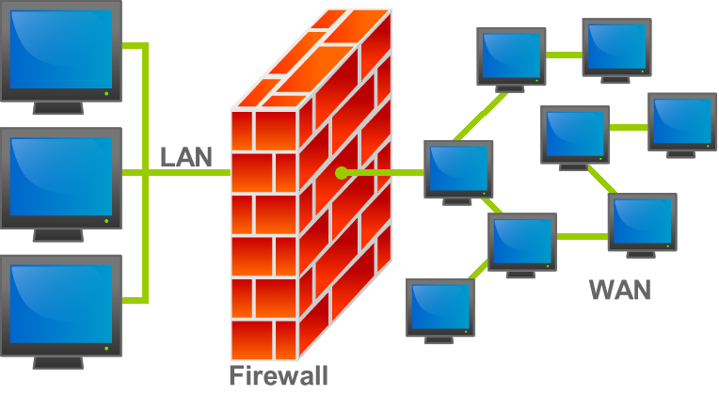
What is a firewall?
A firewall is a system (software and/or hardware) that can prevent unwanted actions or abuse coming into your computer or network.
Unwanted actions:
Denial/Service attacks
Spam
Spyware
Virus
…

Slide 4
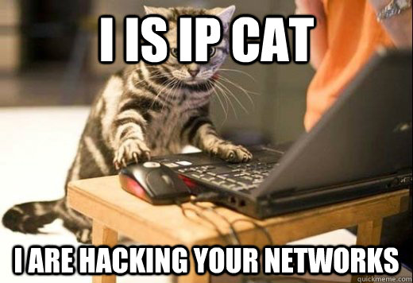
Typical dangers
Hackers will exploit open ports of your computer/server to get in.
Hackers can use programs to open ports for them.
Once they have access to an open port they have free access to your files…

Slide 5
Why use a firewall?
You can compare a firewall to a physical firewall used in buildings: those firewalls prevent the spread of fire for a prescribed period of time … a firewall for computers will slow down hackers or abusers by governing the data traffic into the network/computer.

Slide 6
Firewall types
There are two different ways of screening incoming data traffic:
Packet filtering firewall (network layer)
Stateless firewall
Statefull firewall
Application layer firewall (application layer)
OSI-model
 | data unit | layer
Host layers | Data | 7. Application layer
 |  | 6. Presentation layer
 |  | 5. Session layer
 | Segment | 4. Transport layer
Media layers | Packet/Datagram | 3. Network layer
 | Bit | 2. Data link layer
 | Bit | 1. Physical layer

Slide 7
Packet filtering firewall
Handles traffic on the network layer from OSI model.
Based on some rules the firewall determines if an IP package will be blocked or not. It takes the destination port and the IP address of origin into account.
Only takes IP header of data package into account, not the payload!
+ | -
Fast & simple | Less protection against viruses, spam, …

Slide 8

Three possible setups of Packet filtering firewalls:
1) Bastion Host
Used to protect simple networks (that don’t provide services to the outside world !)

Slide 9
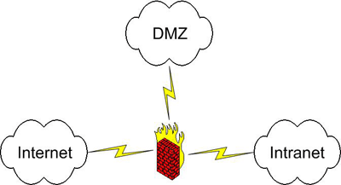
Three possible setups of Packet filtering firewalls:
2) Screened Subnet
A DMZ (Demilitarized Zone) is created and separated from both the Internet and the trusted network by the firewall.
If the DMZ gets compromised the attacker still doesn’t have access to the private subnet!
Services to the outside world are placed in the DMZ (mail server for ex).

Slide 10
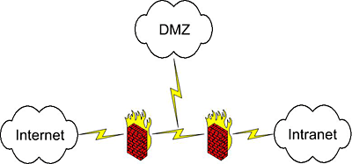
Three possible setups of Packet filtering firewalls:
2) Dual Firewall
More expensive then the Screened Subnet.
The services in the DMZ have gained some protection by adding a firewall.
Both firewalls are usually from different vendors (different to attack)!

Slide 11
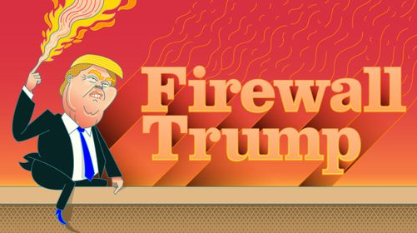
The United States of … stateless or statefull?
Stateless firewalls treat package by package, the firewall doesn’t save any information on the connections running over the firewall in the meanwhile. This has a lot of limitations …
Statefull firewalls however do save information from connections, therefore the firewall is capable of making a better difference between packaged that are allowed and packages that aren’t allowed.
Hence most recent firewalls are statefull.
No more Trump on your PC?
https://www.firewalltrump.com/

Slide 12
Application layer firewall
Handles traffic on the application layer from the OSI model.
Usually based on more rules then a packet filtering firewall because an application layer has rules for each supported protocol.
More complex because of the fact that it treats every protocol on it’s own.
Usually implemented by the use of proxy’s.
Found on each computer on the network.
+ | -
Better protection against viruses, spam, … | Complex & takes more resources

Slide 13
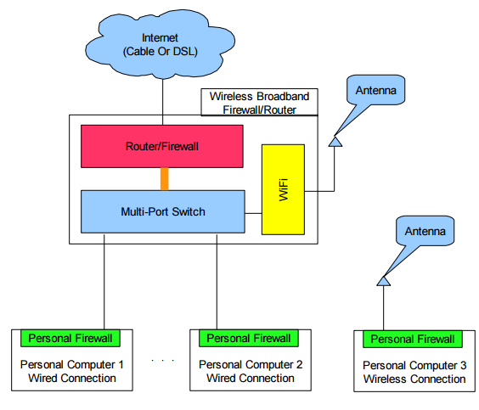
Application layer firewall

Slide 14

Questions?

