Slide 1
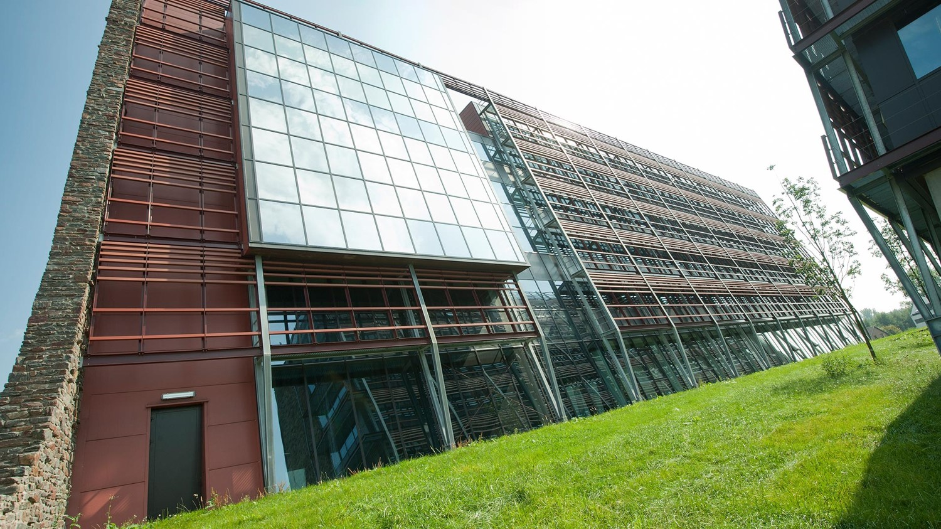
Networks
LAN / VLAN / WAN
Jens Devriendt & Sanne vermeiren

Slide 2
Table of contents
1. LAN
2. LAN Address
3. LAN or IP
4. VLAN
5. WAN

Slide 4
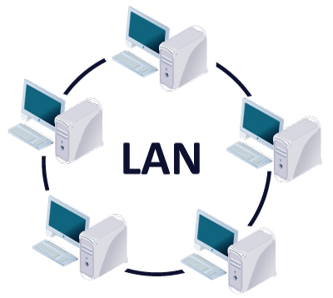
LAN
Local Area Network

Slide 5
LAN
Network of computer and other hardware
Local area
Connected directly or through other medium
Direct data communication
Companies
Schools
Home -> connecting all hardware

Slide 6
LAN
Connection:
Ethernet
Wifi

Slide 7
LAN
External communication
Gateway
Ethernet : point-to-point configuration (STAR)
each connection uses a separate Ethernet protocol to avoid conflicts

Slide 8




LAN
A
switch
D
C
B

Slide 9
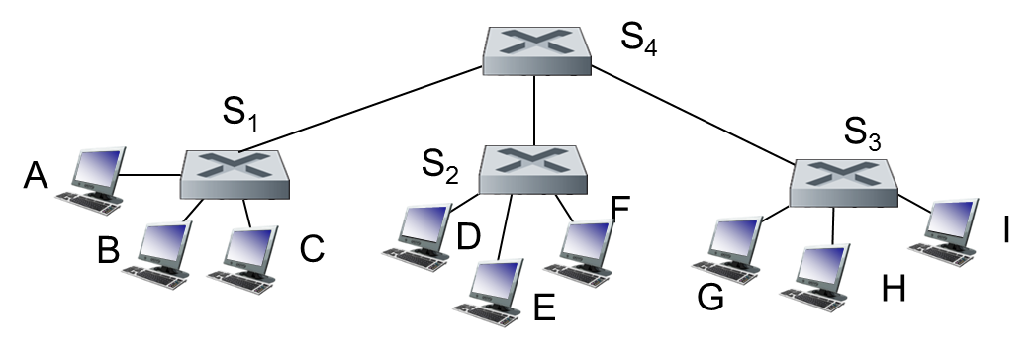
LAN
Switches can be coupled

Slide 10
LAN
Switch
Each host has its own connection to the switch
Switch has a buffer that catches the packages
Switch can send packages from A to B and from C to D simultaneously without conflicts

Slide 11
LAN address
adapter

Slide 12
LAN address
MAC address = LAN address = Ethernet address = Physical address
Used to send a frame from one physical interface to another physical interface (if both interfaces are connected)

Slide 13
LAN or IP
LAN | IP
32 bit | 48 bit
Unique (national security number) | Post address
Transferable → you can transfer the LAN card from one network to another → Same address at work as at home | Not transferable Dependent on subnet you’re connected to Different address at work than at home

Slide 14
VLAN
Virtual Local Area Network
Acts like a LAN
Not coupled via physical hardware
Can be more geographical spread

Slide 15
WAN
Wide Area Network
Can be spread over continents
Collection of hosts (machines used for running userprograms)
Your own pc can be a host!
Connected via communication subnet (owned by telecom provider)
Subnet: send information from host to host

Slide 16
WAN
Two main components:
Transmission lines & Switching elements
1. Transmission lines
→ moving bits between hosts
→ copper – fiber – radio
2. Switches
→ Router
→ Data arrive on incoming line – Switch element chooses the outgoing line to pass on the data

Slide 17
Questions

