Slide 1
IP addresses

Slide 2
Example
You are on vacation and you want to send a postcard to your parents
What do you do to make sure the card arrives?
What are the different parts of an address?
Street
Number
Zip code
City
(Country)

Slide 3
How does this work in a computer network?
In a computer network each computer sends messages to other computers
How do they make sure that the message arrives on the right computer?
Computers also have an address
MAC-address (unique identification of your network interface card)
Used for communication inside the same subnet
IP-address
Used for identification of computers on different subnets/networks
Notes:
MAC stands for Media Access Control, are most often assigned by the manufacturer and stored in its hardware
IP stands for Internet Protocol

Slide 4

What is an IP-address
Sequence of ones and zeroes (32 bits for IPv4)
11000000101010000000000000000001
This notation is not readable for humans, so we can convert this to a decimal notation
Split it up in 4 octets (bytes)
11000000.10101000.00000000.00000001
Convert each byte to its decimal notation
Value between 0 and 255
Decimal notation: 192.168.0.1

Slide 5
Different parts of an IP-address
Network identification
This identifies the network of your computer
Host identification
This identifies the computer inside the network

Slide 6
Discover the network identification in you IP-address
Example: What is the network address of 10.165.32.5?
What do you need to filter the network address from your IP?
Subnet mask: 255.255.0.0
How do you do this filtering?
Convert the decimal notation to binary notation
Calculate the network address using a logical AND
00001010.10100101.00010000.000000101
11111111.11111111.00000000.000000000
00001010.10100101.00000000.000000000
Convert back to decimal notation
10.165.0.0

Slide 7
What is a valid subnet mask?
Is 255.16.0.0 valid?
NO!
Subnet mask is a sequence of ones followed by a sequence of zeroes
The ones identify the network address
The zeroes identify the host address
Possible notation
Dotted notation 192.168.0.1 subnet mask 255.255.0.0
Prefix notation 192.168.0.1/16

Slide 8
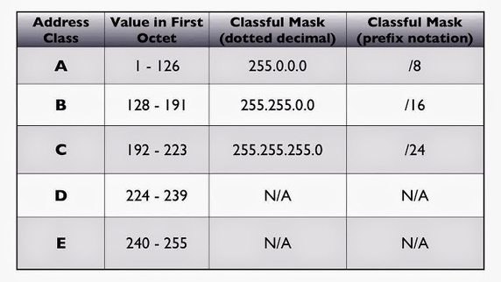
Different classes in IP-addresses (ClassFull)

Slide 9
Private ranges in IP addresses
Addresses that are not routable on the internet
Result: These addresses can be reused in different networks
Has anyone ever tried to look at his/her/its IP-address at home?
Mostly it’s something like 192.168.0.x
This applies for the most of us, maybe not for Roel… ☺
Class A: range: 10.0.0.0 – 10.255.255.255
Class B: range: 172.16.0.0 – 172.31.255.255
Class C: range: 192.168.0.0 – 192.168.255.255
How can multiple hosts have the same IP address?
Ask the group that will present NAT!

Slide 10
Special addresses
Linklocal loopback address: 127.0.0.1
The same as typing localhost in your browser
Localhost:8080 == 127.0.0.1:8080
Broadcast address
IP-address with all ones in the host address
Used to send broadcast messages on a network
192.168.255.255

Slide 11
IP Address exhaustion
IP addresses are limited
If a company has too many hosts to fit inside of a class C address, they get a class B address. Probably they don’t have this many hosts
A lot of IP addresses are/were wasted
Solution: ClassLess
No fixed size classes
If a company only needs 7 hosts, they will only get 7 addresses
This is where subnet masks like 255.255.255.128 come in
More possible networks with the same amount of IP addresses

Slide 12
IPv6
Still the number of IP addresses is very limited in our digital world
With the rise of smartphones and IoT (or even IoE) we need a lot more IP addresses
IPv6 is a new notation with a bigger range
128 bits, so a lot of ones and zeroes!
Notation: divided in 8 groups of 4 hexadecimal digits (0-F)
16 bits per group
1234:5678:9ABC:DEF0:1234:5678:9ABC:DEF0
Fixed length network and host part: 64 bits each (4 groups)
Can also be subnetted

Slide 13
Subnets?
You can divide your network into different smaller sub networks
Why?
Security
Separating logical groups of hosts
Computers
Printers
Servers
…
How?
Broaden the network address and change your subnet masks
You can calculate this, but we’ll leave this out of scope
https://www.pluralsight.com/blog/it-ops/simplify-routing-how-to-organize-your-network-into-smaller-subnets

Slide 14

