Slide 1
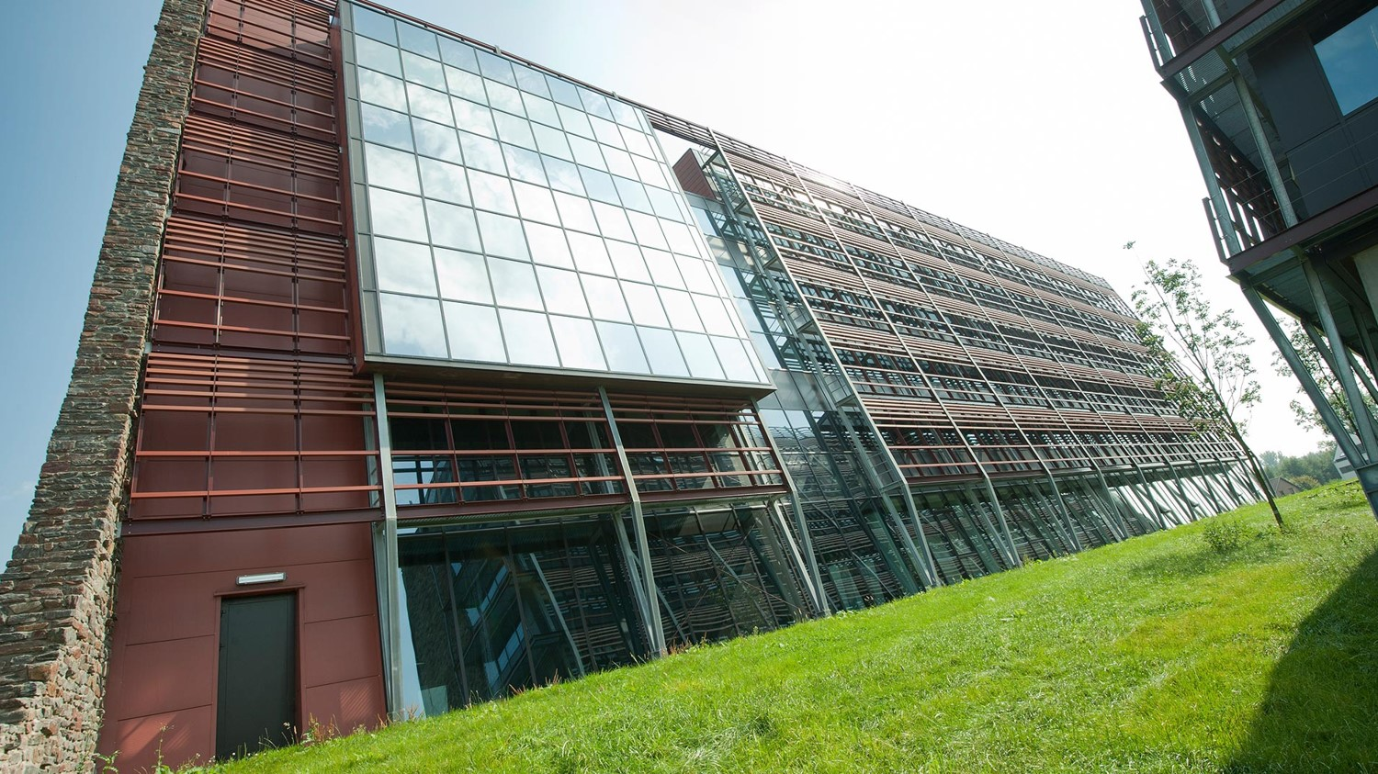
Networking
OSI Model
Stijn Liekens & Marijn van den Heuvel
15 Feb 2016

Slide 2
What is a model?
A model is a conceptual scheme that characterizes and standardizes the communication functions of a telecommunication or computing system without regard to their underlying internal structure and technology. Its goal is the interoperability of different communication systems with standard protocols. The model partitions a communication system into abstraction layers.
e.g. DoD Model, OSI Model

Slide 3
OSI Model
Layer |  | Protocol data unit (PDU) | Function
Host layers | 7. Application | Data | High-level APIs, including resource sharing, remote file access
 | 6. Presentation |  | Translation of data between a networking service and an application; including character encoding, data compression and encryption/decryption
 | 5. Session |  | Managing communication sessions, i.e. continuous exchange of information in the form of multiple back-and-forth transmissions between two nodes
 | 4. Transport | Segment (TCP) / Datagram (UDP) | Reliable transmission of data segments between points on a network, including segmentation, acknowledgement and multiplexing
Media layers | 3. Network | Packet | Structuring and managing a multi-node network, including addressing,routing and traffic control
 | 2. Data link | Frame | Reliable transmission of data frames between two nodes connected by a physical layer
 | 1. Physical | Bit | Transmission and reception of raw bit streams over a physical medium
Notes:
OSI: Open Systems Interconnection
Bottom-up: Please Do Not Throw Salami Pizza Away
Top-to-Bottom: All People Seem To Need Date Processing

Slide 4
7. Application layer
The application layer interacts directly with an application (e.g. the browser). The application itself isn’t part of the application layer.
Example protocols: HTTP, FTP, SMTP, …
Notes:
HTTP: Hyper Text Transfer Protocol
FTP: File Transfer Protocol
SMTP: Simple Mail Transfer Protocol
SNMP: Simple Network Management Protocol (Network Discovery)
LDAP: Lightweight Directory Access Protocol
BGP: Border Gateway Protocol (Exchange routing information over remote networks)

Slide 5
6. Presentation layer
This layer provides independence from data representation (e.g., encryption) by translating between application and network formats. The presentation layer transforms data into the form that the application accepts.
Example protocols: SSL, TLS, …
Notes:
SSL: Secure Sockets Layer
TLS: Transport Layer Security

Slide 6
5. Session layer
The session layer controls the dialogues (connections) between computers. It establishes, manages and terminates the connections between the local and remote application. It provides for full-duplex, half-duplex, or simplex operations. This layer is responsible for the graceful close of sessions.
Notes:
Full-duplex: both parties can communicate with each other simultaneously (e.g. telephone) ,
Half-duplex: both parties can communicate with each other, but not simultaneously (e.g. walkie-talkie).
Simplex: Only one party can communicate with the other party not the other way around (e.g. TV).
→ Sockets: a representation of an endpoint in the networking software.

Slide 7
4. Transport layer
The transport layer controls the reliability of a given link through flow control, segmentation/desegmentation, and error control.
e.g. TCP, UDP
Notes:
TCP: Transfer Control Protocol
UDP: User Datagram Protocol
Firewall = Layer 7 + Layer 4 + Layer 3

Slide 8
3. Network layer
This layer provides the means to transfer data sequences (packets) over a network using some sort of “address”.
e.g. IP
Notes:
IP: Internet Protocol
ICMP: Internet Control Message Protocol (e.g. ping, tracert)
IGMP: Internet Group Message Protocol (used for multicasting)
OSPF: Open Shortest Path First
RIP: Routing Information Protocol
Appliances that use layer 3: Routers

Slide 9
2. Datalink layer
This layer is usually split into 2 separate layers:
Media Access Control Layer: responsible for controlling how devices in a network gain access to a medium and permission to transmit it.
Logical Link Control: responsible for identifying Network layer protocols and then encapsulating them and controls error checking and frame synchronization.
Notes:
Example for MAC layer = 802.3 - Ethernet, 802.11 – WiFi
Example for LLC layer = PPP (Point-to-Point Protocol)
Appliances that use layer 2: switch

Slide 10
1. Physical layer
This layer describes the carrier (and its properties) over which you send the data.
e.g.:, Layout of pins, cable specs, radio frequencies, …
Notes:
Appliances that use layer1: Hubs, Repeaters, …
Pinning Ethernet 10/100:
1: White-Green: Tx
2: Green: Tx
3: White-Orange: Rx
4: Blue
5: White-Blue
6: Orange: Rx
7: White-Brown
8: Brown

Slide 11

Notes:
https://www.youtube.com/watch?v=-6Uoku-M6oY

