Slide 1
What is SSL/TLS ?
Secure Sockets Layer (SSL)
Transport Layer Security (TLS)
Notes:
SSL: Secure Sockets Layer
standard security protocol for establishing an encrypted link between a server and a client
Since 1994 (netscape)

Slide 2
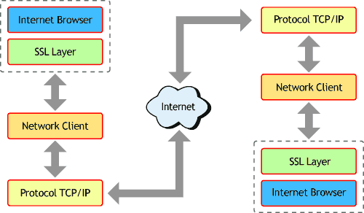
Where is SSL?
Notes:
SSL v1, v2, v3 --> SSL v4 = TLS v1.
We actually use TLS nowadays, but we still call it SSL.
SSL acts as a secret agent which will exchange message secretly between two parties of sender and receiver without knowing others and keeping it safe.
--> privacy + data integrity

Slide 3
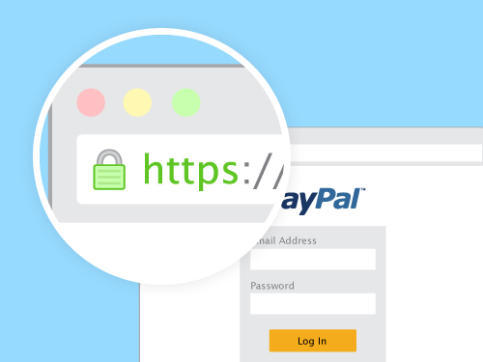


Usage:

Slide 4


Certificates
Notes:
Explain authentication → certificates. We’re communicating secure, but are we talking to whom we think we’re talkink to?
Certificates have to be signed by trusted Certificate Authority (CA);
Bind a public key to an identity
Your browser comes preloaded with a list of trusted CAs.

Slide 5
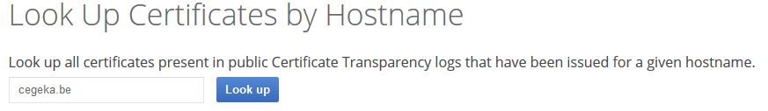
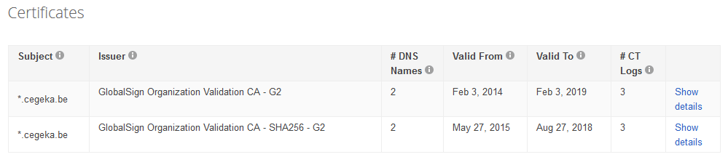
Certificate Transparency

Slide 6
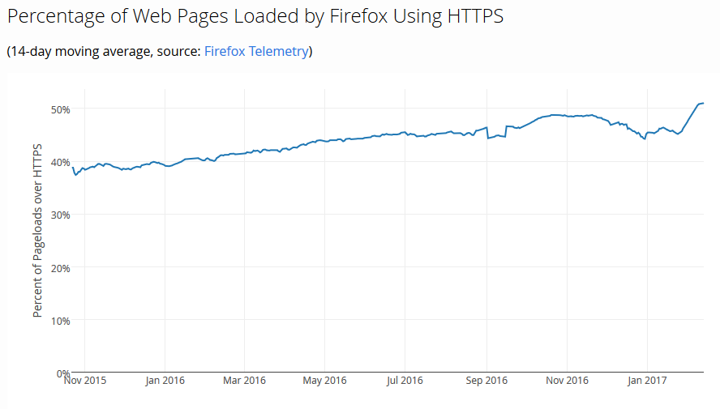
Let's Encrypt Growth

Slide 7
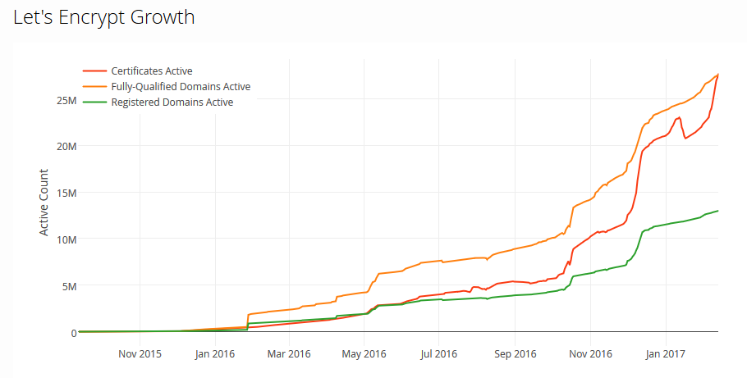
Let's Encrypt Growth

Slide 8
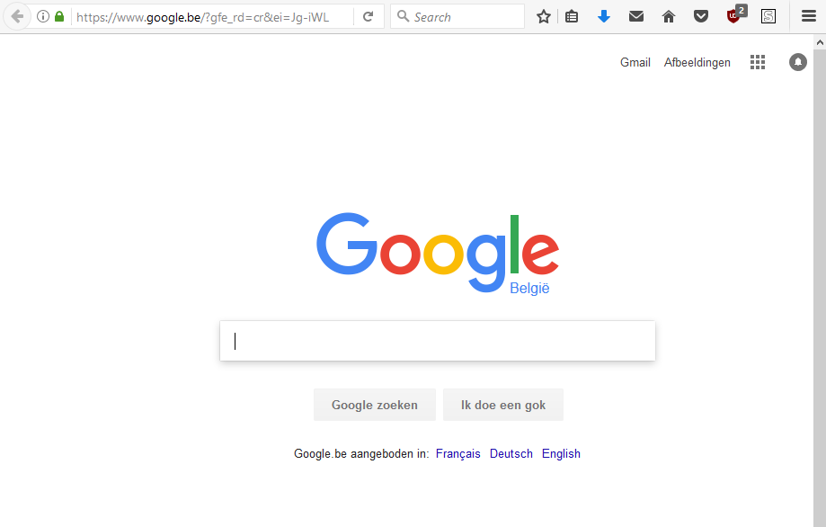


Basic request
Server
Notes:
explain SSL working through https explenation:
when surfing to a website, your request must pass through many different networks – any of which could be used to potentially eavesdrop or tamper with your connection. When you're sending sensitive information over the connection, like credit card data or passwords, you don't want somebody else is able to read or alter that information. --> httpS (s= secure)

Slide 9
Encryption
TLS: Hybrid cryptographic system
1) Symmetric key cryptography
2) Public key cryptography
➔ Client and server can generate keys over an insecure channel and use them afterwards to communicate securely
Notes:
This is where Encryption (TLS/SSL) comes in. we can agree upon a key to encrypt all are messages → only people with key can read (decrypt) them. = Symmetric
But how do we agree upon a key, over an insecure channel ?
=> Pubic key encryption

Slide 10
An example
Alice and Bob want to communicate securely
In order to create a “shared secret” they need:
Private key Alice: 6
Private key Bob: 15
A base number: 5
A large prime number: 23

Slide 11
An example
Alice sends to Bob: 5⁶ mod 23 = 8
Bob sends to Allice: 5¹⁵ mod 23 = 19
Alice computes: 19⁶ mod 23 = 2
Bob computes: 8¹⁵ mod 23 = 2
Shared secret (2) between Alice and Bob

Slide 12
Public key encryption only needed once per session
After generating shared secret, they can use symmetric key encryption
➔ Much more efficient

Slide 13

MITM attack
Notes:
attacker secretly relays and possibly alters the communication between two parties who believe they are directly communicating with each other

Slide 14
SSH
Secure Sockets Shell
provides administrators with a secure way to access a remote computer
Also uses public Key cryptography

