Slide 1
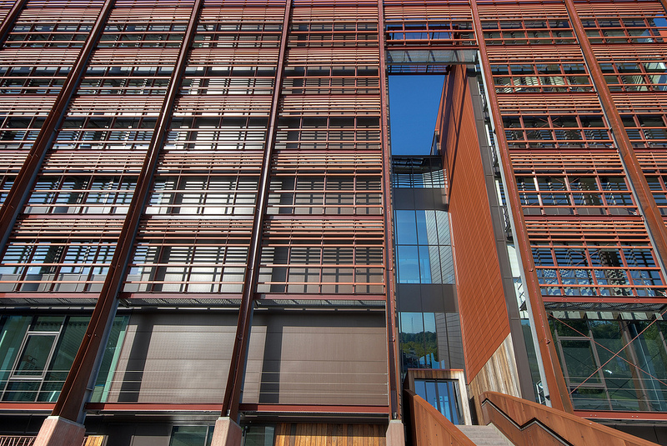
Networking
Virtual Private Network (VPN)

Slide 2
What is VPN?
A technology that creates a network that is physically public, but virtually private.
VPNs typically require remote users of the network to be authenticated, and often secure data with encryption technologies to prevent disclosure of private information to unauthorized parties.

Slide 3
Private Network
First there was Private Network
Completely isolated network is established.
It creates its own TCP\IP internet .
Leased lines .
Isolated from the world
Costs more to maintain

Slide 4


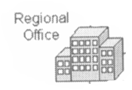


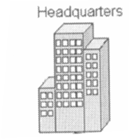
Leased lines
Leased lines
Leased lines
Leased lines

Slide 5
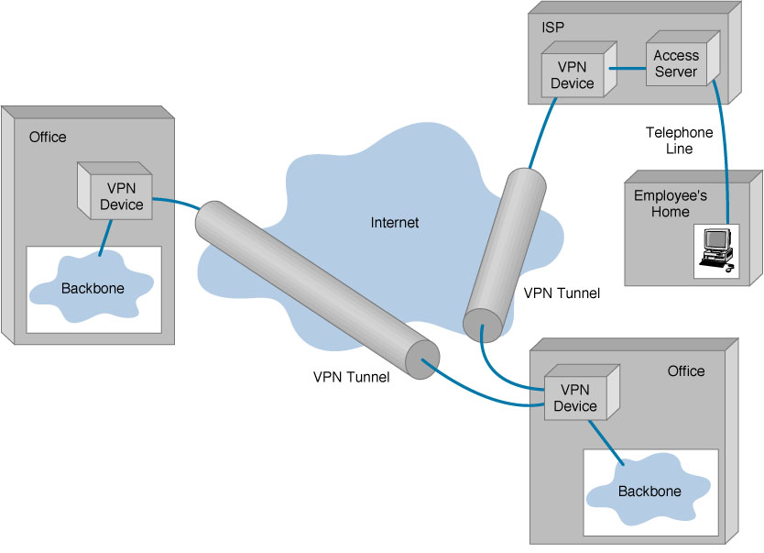
Basic Architecture of VPN

Slide 6
Characteristics of the VPN
Tunneling Communication
Data Encryption
User Authentication
Encapsulation
Firewall

Slide 7
Tunneling
VPN is a technology based on the idea of tunneling.
The outer packet protects the contents from public view and ensures the packet moves in a ‘virtual tunnel’.

Slide 8
Types of Tunneling
Voluntary tunneling:
VPN client manages connection setup:
Connects with ISP
Creates the tunnel to VPN server
Compulsory Tunneling:
Carrier network provider manages VPN connection setup:
VPN connections are set up in just one step.
Brokers the VPN connection between that client and a VPN server immediately.

Slide 9
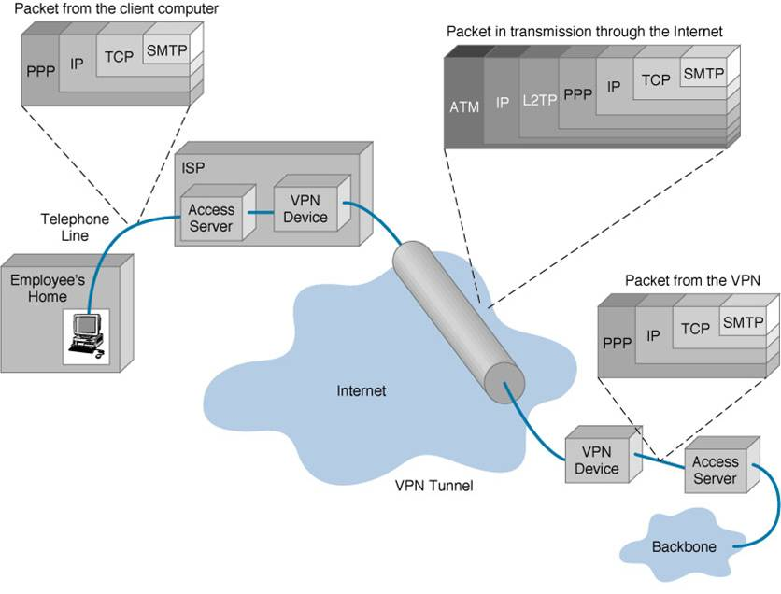

Slide 10
Tunneling
Packets are constructed in a specific VPN protocol and encapsulated within some other base or carrier protocol.
Transmission is between VPN client and server.
De-encapsulation happens on the receiving side.
allows senders to encapsulate their data in IP packets that hide the routing and switching infrastructure of the Internet.
to ensure data security against unwanted viewers, or hackers.

Slide 11
Encryption
Encryption is the process of encoding data so that only a computer with the right decoder will be able to read and use it.
The VPN client at each end of the tunnel encrypts the data entering the tunnel and decrypts it at the other end.

Slide 12
Encryption
Two types of encryption:
Symmetric-key encryption.
Uses same cryptographic key for both encryption and decryption.
Public-key encryption.
Uses a public and private key. The public key can be used by anyone for encrypting, the private key can only be used by the receiver for decrypting.

Slide 13
Encryption (Authentication)
Authentication process determines if the sender is the authorized person and if the data has been redirected or corrupted .

Slide 14
Firewall
Firewall provides network security and business continuity .
It prevents attacks, and secures your data communications with multiple parallel Virtual Private Network (VPN) connections.
There are two approaches to using a firewall with a VPN server:
VPN server in front of the firewall.
VPN server behind the firewall.

Slide 15
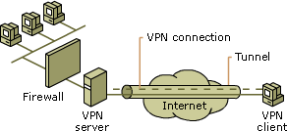
VPN server in front of the firewall

Slide 16
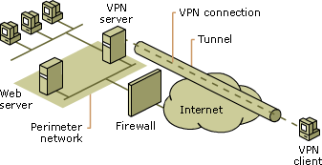
VPN server behind the firewall

Slide 17
Encapsulation
Packets in one of several VPN protocols are encapsulated within Internet Protocol (IP) packets
For data encapsulation, VPN relies on either of the following protocols like GRE , IPSec, L2F,PPTP and L2TP .
In which L2PT and PPTP can be viewed as competitors.
IPsec combines the best of previous two.

Slide 18
Types of VPNs
Remote access VPN:
Allows individual users to establish secure connections with a remote computer network.
Intranet VPN:
Intranet VPNs link corporate headquarters, remote offices, and branch offices over a shared infrastructure using dedicated connections.
Extranet VPN:
Extranet VPNs link customers, suppliers, partners, or communities of interest to a corporate intranet over a shared infrastructure using dedicated connections.

Slide 19
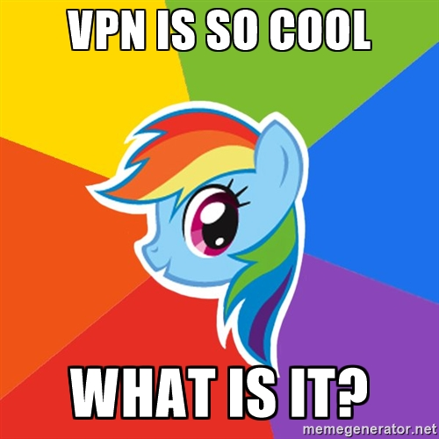
VPN advantages and disadvantages
Advantages:
Security
Reliability
Cost saving

Slide 20
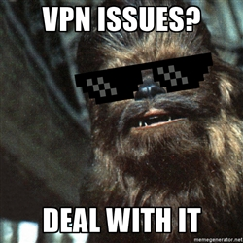
Disadvantages
Requires detailed understanding.

Slide 21

Disadvantages
Reliability and performance not under direct control.

Slide 22



Questions

