Slide 1
Programming Experiments With Python And Pygame #2
 | Course Code | Course Name | Credits
 | V.ITD215 | Programming Experiments | 2
Prepared by Mariko Tagawa, JICA volunteer

Slide 2
Course schedule
Week | Class | Title | Goal of the class or Tasks
1
 | 1 | Introduction to Pygame and Its Capabilities | Understand what Pygame is and its role in graphical programming. Learn how to install and set up the Pygame library in Python. Run and analyze a simple Pygame program to create a blank window.
2 | 2 | Chapter 1 - Create a Custom Calculator | Review Python basics Printing Comments Variables Operators
 | 3 | Chapter 1 - Create a Custom Calculator Lab 1: Custom Calculators | Lab1: Create a Custom Calculator Create a program to calculate your target time for completing a full marathon
3 | 4 | Chapter 3 - Quiz Games and If Statements | Review Python basics Basic Comparisons Indentation Using And/Or Boolean Variables Else and Else If Text Comparisons
 | 5 | Chapter 3 - Quiz Games and If Statements Lab 3: Create a Quiz | Lab 3: Create a Quiz Refer to a Sample Quiz and create your own Quiz Use if, elif, else

Slide 3
Course schedule
Week | Class | Title | Goal of the class or Tasks
4 | 6 | Chapter 4: Random Numbers and Loops | Review Python basics For Loop while Loops Random Numbers
 | 7 | Chapter 4: Random Numbers and Loops Lab 4: Game | Lab 4: Create a Game Refer to a Sample game and create your own game. Use loop, if
5 | 8 | Chapter 5: Introduction to Graphics | Learn how to draw basic shapes like rectangles, polygons, and text using Pygame.
 | 9 | Introduction to Animation | Understand the basics of animation using Python and Pygame.
6 | 10 | Lab 5: Create a Picture | Lab5: Create a Picture You must use multiple colors. You must use multiple types of graphic functions (circles, rectangles, lines, etc.) You must use a while or for loop to create a repeating pattern.
 | 11 | Lab 8: Animation | Lab8: Animation Modify the prior Create-a-Picture lab5 or start a new one. Animate the image.

Slide 4
Course schedule
Week | Class | Title | Goal of the class or Tasks
7 | 12 | Chapter 10: Controlling an object with the mouse and keyboard | Learn how to control an object with the mouse or keyboard on the screen. Files: move_mouse.py, move_keyboard.py Exercise7: Modify sample programs.
 | 13 | Chapter 11: Bitmapped Graphics and Sound | Learn how to use bitmapped graphics (images) to your games. Learn how to add sound to your games. Exercise8. Use images and sound.
8, 9 | 14,15 ,16 | Lab: Designing Your Own Animation/Game Presentations and Showcase | Use the knowledge from previous classes to create your own animation or game. Present your completed animation or game to the class.

Slide 5
Week 1, Class 2: Chapter 1: Create a Custom Calculator
Goals/Tasks:
Review Python basics
Printing
Comments
Variables
Operators
Create a Custom Calculator
Exercise2: write a code using print.
Homework: Review today's class content

Slide 6
Chapter 1: Create a Custom Calculator
Online Course: http://programarcadegames.com/index.php?chapter=python_as_calculator&lang=en#section_1
Review Python basics syntax
Printing
Escape Codes
Comments
Assignment Operators
Variables
Operators
Exercise2: write a code using “print”.
Homework Quiz: http://programarcadegames.com/quiz/quiz.php?file=python_as_calculator&lang=en

Slide 7
Exercise 2:
Task: Write a python code to print out the following information.
Store your first name into first_name variable.
Store your last name into last_name variable.
Store your age into my_age variable.
Print out:
Save the file to class2_<Your name>_exe2.py
Upload the file to the Teams Files. https://mustedumn.sharepoint.com/:f:/r/sites/I101/Shared%20Documents/General?csf=1&web=1&e=l750AH
Hello, my name is <your first name> <your last name>
I am < your age> years old.

Slide 8
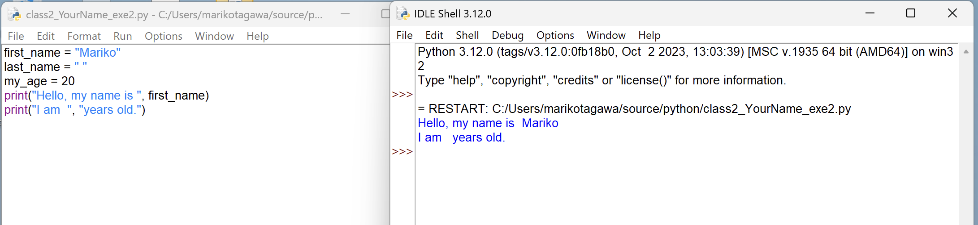
Exercise 2:
Hint:
first_name = "Mariko"
last_name = " "
my_age = 20
print("Hello, my name is ", first_name)
print("I am ", "years old.")

Slide 9
Exercise 2:
Sample Answer script
# class2_SampleScript_exe2.py
# Store your first name into first_name variable.
first_name = "Mariko"
# Store your last name into last_name variable.
last_name = "Tagawa"
# Store your age into my_age variable.
my_age = 20
#Print out:
print("Hello, my name is ", first_name, last_name)
print("I am", my_age, "years old.")

Slide 10
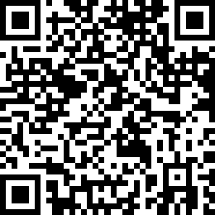
Attendance Check 2
Please submit the following form at the end of the class. This is today's attendance check.
https://forms.gle/aKjWFCuZrXdWzYpY6

Slide 11
Week2, Class3: Lab1: Create a Custom Calculator
Goals/Tasks:
Lab1: Create a Custom Calculator
Calculate your target time for completing a full marathon

Slide 12
Chapter 1: Create a Custom Calculator LAB1
Lab1:
Create a program to calculate your target time for completing a full marathon
https://youtu.be/JK5ht5_m6Mk?si=H-25xC_awz5Yb5UO
http://programarcadegames.com/index.php?chapter=lab_calculator&lang=en
Save the file to calculator_lab1_<your name>.py
Upload the file to the Teams Files.
https://mustedumn.sharepoint.com/:f:/r/sites/I101/Shared%20Documents/General?csf=1&web=1&e=l750AH

Slide 13
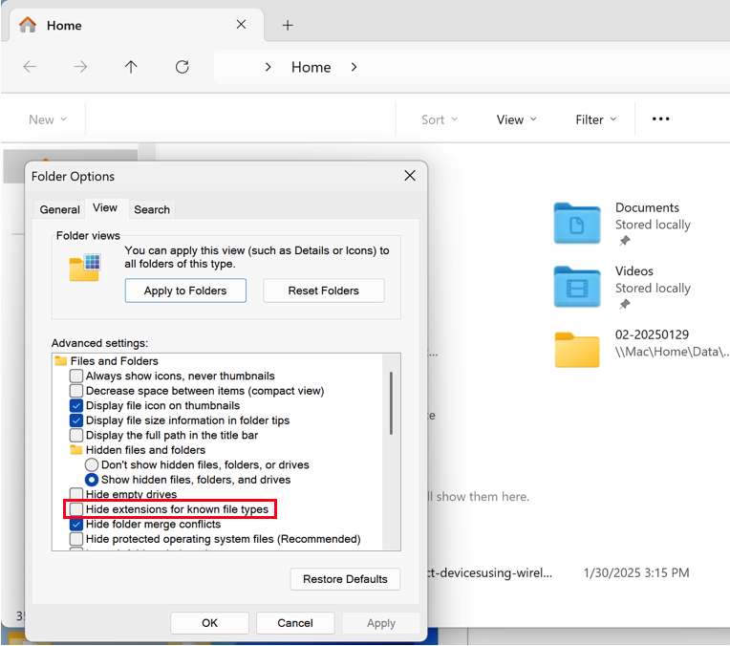
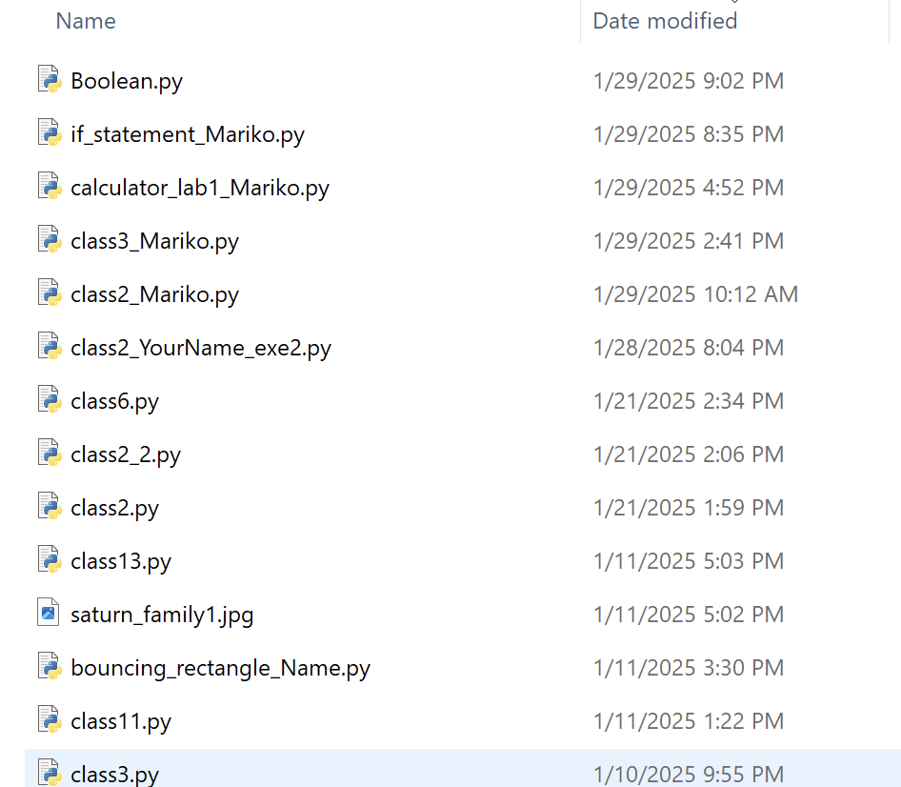
Chapter 1: Create a Custom Calculator
In your Windows’ file explore, “Option” – “View”, uncheck “Hide extensions for known file types.”
You can recognize python program has .py extension.

Slide 14


Chapter 1: Create a Custom Calculator Sample file: class3_sample.py
A program can use Python to calculate the mileage(*) of a car that drove 294 miles on 10.5 gallons of gas. https://www.youtube.com/watch?v=JK5ht5_m6Mk&ab_channel=ProfessorCraven
m = 294
g = 10.5
m2 = m / g
print(m2)
How much miles can drive per 1 gallon gas?
# Get data from user
milesDriven = input("Enter miles driven:")
milesDriven = float(milesDriven)
gallonsUsed = input("Enter gallons used:")
gallonsUsed = float(gallonsUsed)
# Do calculations
mpg = milesDriven / gallonsUsed
#Print result
print("Your mgp:", mpg)
294 miles drive
10.5 gallons of gas
(*) How many miles (kilometers) a car can travel per gallon (liter) of gasoline.

Slide 15
Lab1:
Task: Create a program to calculate your target time for completing a full marathon (42.195 km).
Input:
How many minutes does it take you to run 1 km?
(ex: 7)
Calculate:
How many minutes will take to complete 42.195 km.
Convert the minutes to hours + minutes.
Output:
Your estimated goal time is___ hours and ___ minutes.

Slide 16



How many minutes does it take for you to run 1 km?
Lab1:
I will run 1km = 7 min
Start
1km
2km
3km
7 min
14 min
21 min
Goal
Your estimated goal time is__4_ hours and _55__ minutes.
42.195 km

Slide 17
Lab1:
Hint:
# Get data from user
min_per_km = input("How many minutes does it take you to run 1 km?” )
min_per_km = float(min_per_km )
# Do calculations
# How many minutes will take to complete 42.195 km.
# Convert the minutes to hours + minutes.
goal_hours =
goal_minutes =
#Print result
print( "Your estimated goal time is” , goal_hours, "hours and", goal_minutes, "minutes.” )

Slide 18
(option) Lab1-2: If you finish Lab1, please do Lab1-2.
Task: Write a Python program that Calculate Total Restaurant Bill with Tip
Scenario:
You went to a restaurant and had dinner. Now, you need to calculate the total bill, including a tip.
Write a Python program that:
Asks the user to input the dinner price.
Asks the user to input the tip percentage they want to leave.
Calculates the total bill by adding the tip amount to the dinner price.
Prints the total amount the user needs to pay.
Save the file to calculator_lab1-2_<your name>.py

Slide 19




Lab1-2:
No Hint
How much you should pay for the dinner with tip
+
=
Dinner is xxx ₮
Tip is xxx % of dinner
Total bill

Slide 20
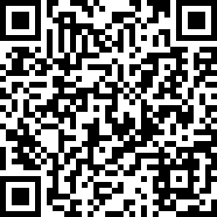
Attendance Check 3
Please submit the following form at the end of the class. This is today's attendance check.
https://forms.gle/ZEDwFn8T2Dmc4LTr9

