Slide 1
Programming Experiments With Python And Pygame #1
 | Course Code | Course Name | Credits
 | V.ITD215 | Programming Experiments | 2
Prepared by Mariko Tagawa, JICA volunteer

Slide 2
What is this class about?
Learn by exercises:
Practice programming by writing lots of code and completing fun exercises.
Create with Python and Pygame:
Use Python and Pygame to make graphics, animations, and simple games.
Solve Problems:
Learn how to think logically and solve challenges step by step.
Have Fun with Programming:
Turn your ideas into cool programs and games you can share with others!

Slide 3
What’s Pygame?
Pygame is a tool (a python library) that helps you create games and cool graphical programs using Python.
It lets you:
Draw pictures and shapes.
Make animations and moving objects.
Add sounds and music to your projects.
Video:
https://youtu.be/K9lzrqMP9sE

Slide 4
Course schedule
Week | Class | Title | Goal of the class or Tasks
1
 | 1 | Introduction to Pygame and Its Capabilities | Understand what Pygame is and its role in graphical programming. Learn how to install and set up the Pygame library in Python. Run and analyze a simple Pygame program to create a blank window.
2 | 2 | Chapter 1 - Create a Custom Calculator | Review Python basics Printing Comments Variables Operators
 | 3 | Chapter 1 - Create a Custom Calculator Lab 1: Custom Calculators | Lab1: Create a Custom Calculator Create a program to calculate your target time for completing a full marathon
3 | 4 | Chapter 3 - Quiz Games and If Statements | Review Python basics Basic Comparisons Indentation Using And/Or Boolean Variables Else and Else If Text Comparisons
 | 5 | Chapter 3 - Quiz Games and If Statements Lab 3: Create a Quiz | Lab 3: Create a Quiz Refer to a Sample Quiz and create your own Quiz Use if, elif, else

Slide 5
Course schedule
Week | Class | Title | Goal of the class or Tasks
4 | 6 | Chapter 4: Random Numbers and Loops | Review Python basics For Loop while Loops Random Numbers
 | 7 | Chapter 4: Random Numbers and Loops Lab 4: Game | Lab 4: Create a Game Refer to a Sample game and create your own game. Use loop, if
5 | 8 | Chapter 5: Introduction to Graphics | Learn how to draw basic shapes like rectangles, polygons, and text using Pygame.
 | 9 | Introduction to Animation | Understand the basics of animation using Python and Pygame.
6 | 10 | Lab 5: Create a Picture | Lab5: Create a Picture You must use multiple colors. You must use multiple types of graphic functions (circles, rectangles, lines, etc.) You must use a while or for loop to create a repeating pattern.
 | 11 | Lab 8: Animation | Lab8: Animation Modify the prior Create-a-Picture lab5 or start a new one. Animate the image.

Slide 6
Course schedule
Week | Class | Title | Goal of the class or Tasks
7 | 12 | Chapter 10: Controlling an object with the mouse and keyboard | Learn how to control an object with the mouse or keyboard on the screen. Files: move_mouse.py, move_keyboard.py Exercise7: Modify sample programs.
 | 13 | Chapter 11: Bitmapped Graphics and Sound | Learn how to use bitmapped graphics (images) to your games. Learn how to add sound to your games. Exercise8. Use images and sound.
8, 9 | 14,15 ,16 | Lab: Designing Your Own Animation/Game Presentations and Showcase | Use the knowledge from previous classes to create your own animation or game. Present your completed animation or game to the class.

Slide 7
Class environment
OS: Windows
Programming tools:
Anaconda
Anaconda Prompt
IDLE – under the Anaconda
Backup
Your google drive
Submit your reports, assignments
Teams – “Программчлалын туршилт I” – General – Files – “2025xxxx_Students”

Slide 8
Online Couse, Documentations
Online Course: Program Arcade Games With Python And Pygame
Home:
http://programarcadegames.com/index.php
Video:
https://youtube.com/playlist?list=PL1D91F4E6E79E73E1&si=MvHx9PHppoIKR5Gj
Python Tutorial site
https://www.w3schools.com/python/default.asp
Pygame Documentation
https://www.pygame.org/docs/
Color Picker
https://www.webfx.com/web-design/color-picker/
https://htmlcolorcodes.com/color-picker/

Slide 9
Week 1, Class 1: Introduction to Pygame
Goals/Tasks:
Understand what Pygame is and its role in graphical programming.
Learn how to install and set up the Pygame library in Python.
Run and analyze a simple Pygame program to create a blank window.

Slide 10
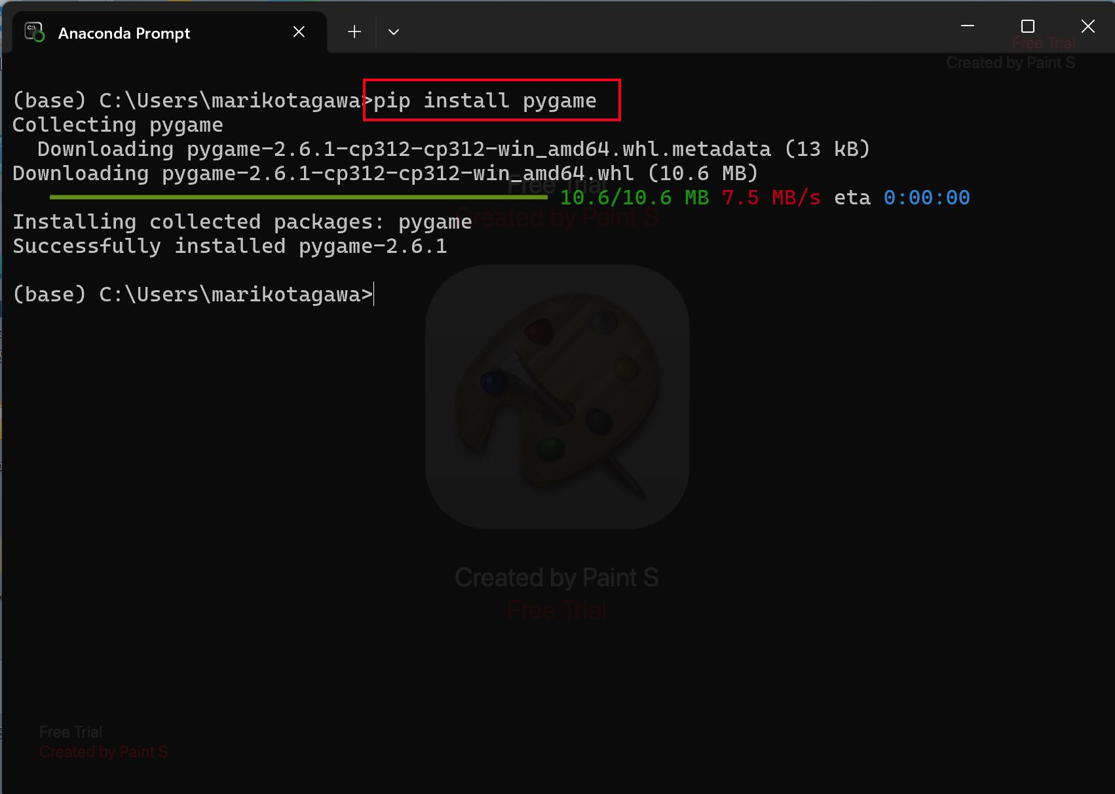
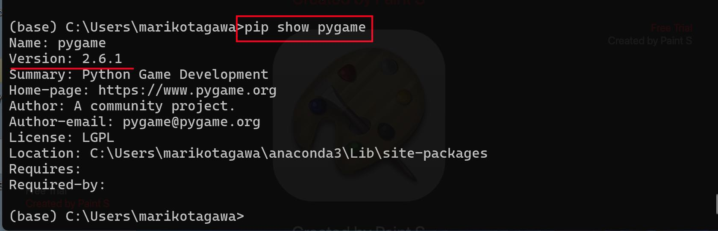
Installing pygame library
Open Anaconda Prompt.
Run the following command to install pygame.
Run the command to check the installation.
pip install pygame
pip show pygame

Slide 11
Sample1 : Opening a Window
file name: pygame_base_template.py
Video: https://youtu.be/vRB_983kUMc

Slide 12
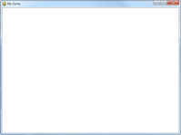
Sample1 : Opening a Window file name: pygame_base_template.py
This opens a blank pygame window. It is a good template to use when starting a new program.

Slide 13
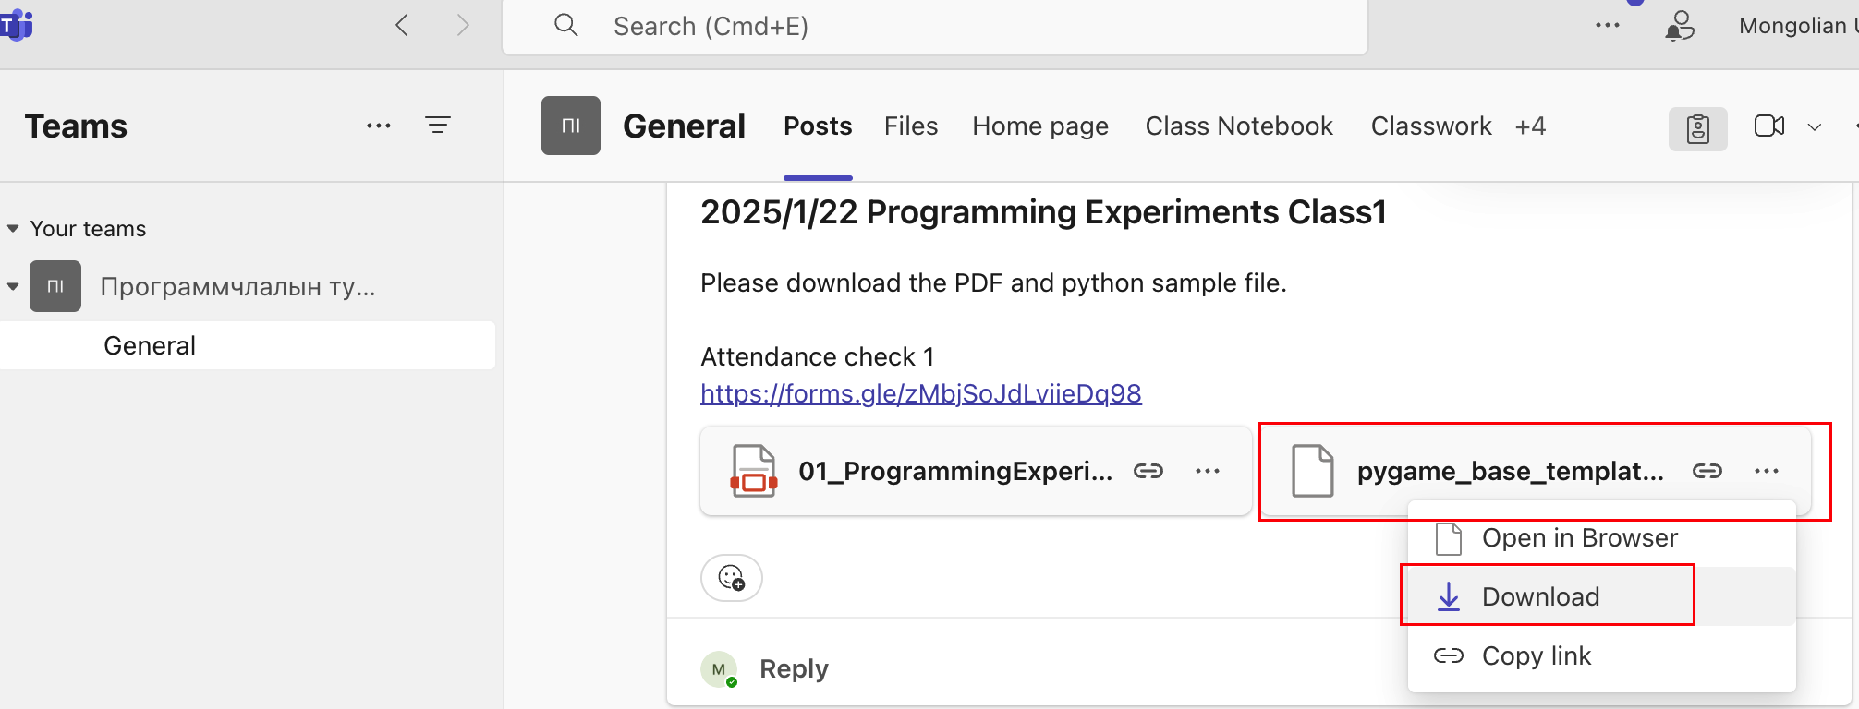
Download the sample program
Download pygame_base_template.py from Teams on your PC.

Slide 14
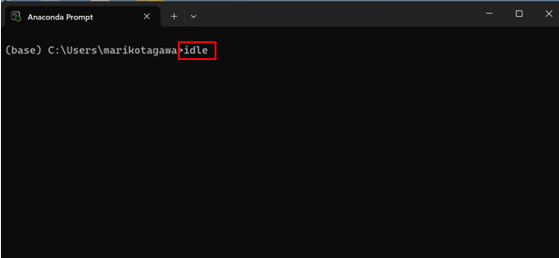
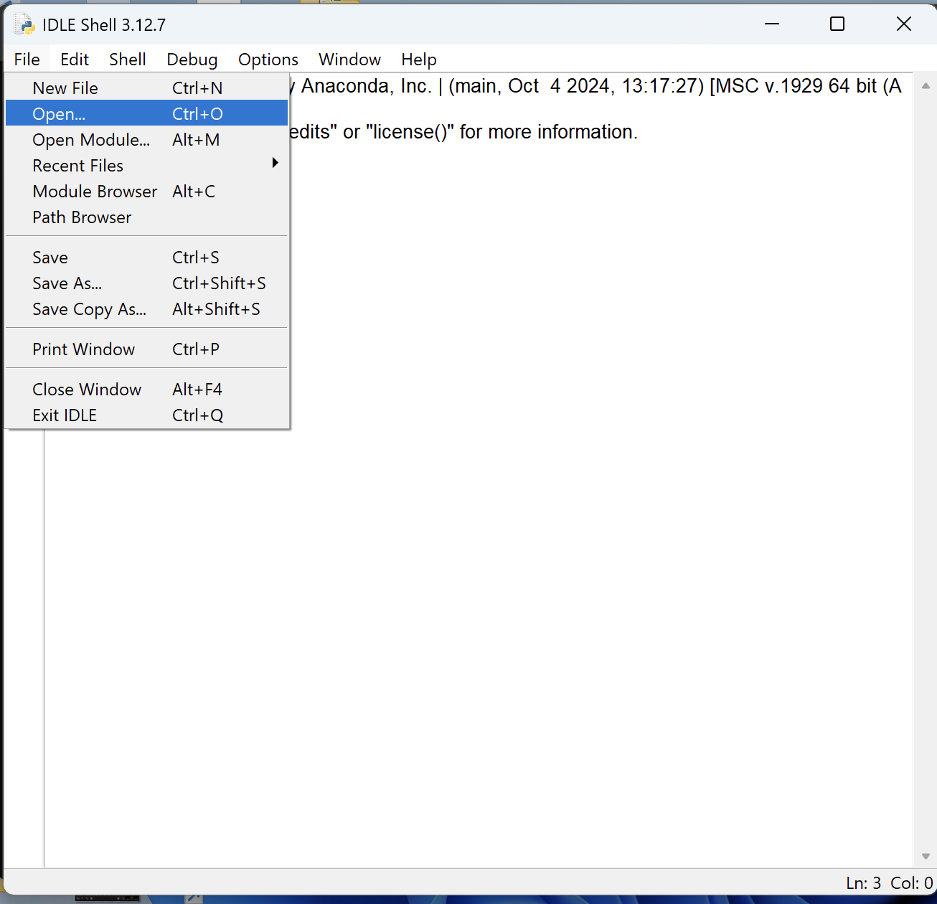
Sample1 : Opening a Window file name: pygame_base_template.py
Open Anaconda Prompt.
Type “ldle” in the Anaconda Prompt.
File - Open - pygame_base_template.py
Rename the sample program. File – SaveAs- pygame_base_template_<your name>.py
Run (F5)
White window appears.

Slide 15
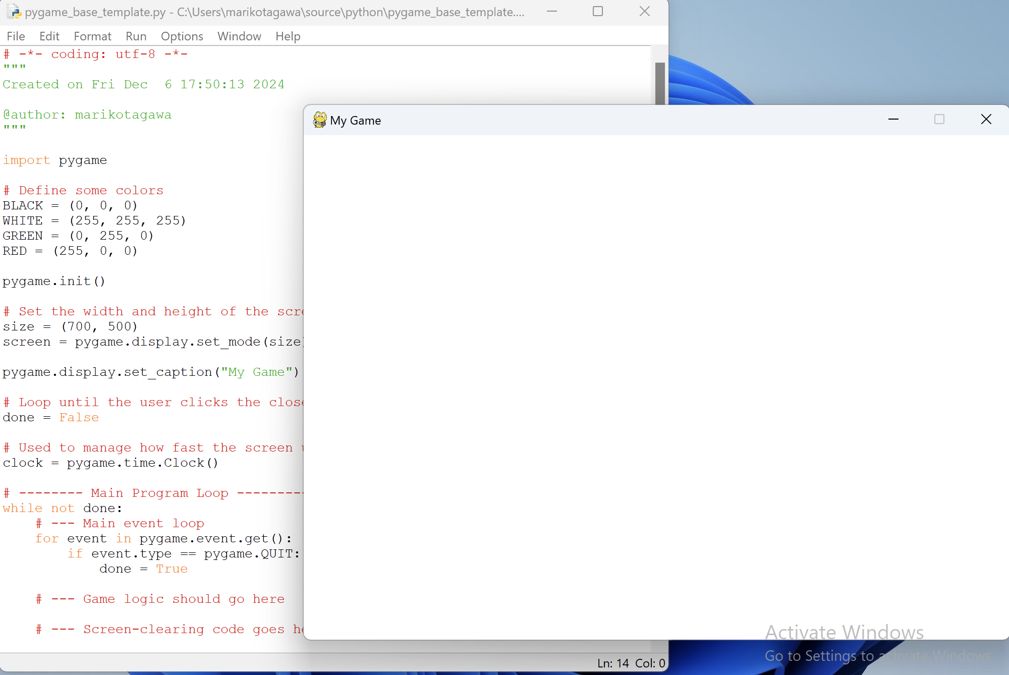
Sample1 : Opening a Window file name: pygame_base_template.py
Run (Press F5)
White window appears.
Click “x” and close the window.

Slide 16
Sample1 : Opening a Window file name: pygame_base_template.py
import pygame
# Define some colors
BLACK = (0, 0, 0)
WHITE = (255, 255, 255)
GREEN = (0, 255, 0)
RED = (255, 0, 0)
pygame.init()
# Set the width and height of the screen [width, height]
size = (700, 500)
screen = pygame.display.set_mode(size)
pygame.display.set_caption("My Game")
# Loop until the user clicks the close button.
done = False
# Used to manage how fast the screen updates
clock = pygame.time.Clock()
import pygame
Define colors
Initialize pygame library
Set the screen size
Display a window
Window Title
Loop control. Loop will continue until done = True
Screen update speed
How fast the game runs.

Slide 17
Sample1 : Opening a Window file name: pygame_base_template.py
# -------- Main Program Loop -----------
while not done:
# --- Main event loop
for event in pygame.event.get():
if event.type == pygame.QUIT:
done = True
# --- Game logic should go here
# --- Screen-clearing code goes here
# Here, we clear the screen to white. Don't put other drawing commands
# above this, or they will be erased with this command.
# If you want a background image, replace this clear with blit'ing the
# background image.
screen.fill(WHITE)
# --- Drawing code should go here
# --- Go ahead and update the screen with what we've drawn.
pygame.display.flip()
# --- Limit to 10 frames per second
clock.tick(10)
# Close the window and quit.
pygame.quit()
Loop
If user click close -> done = Ture -> Exit loop
Screen background color
Update screen
How fast the game run. In this case, 10 frames per second
Quite Pygame
This code is outside of the loop

Slide 18
Exercise 1:
Task: Modify pygame_base_template.py
Change the Window title to any title you want.
Create a new color definition, such as PINK.
Check the color code in https://www.webfx.com/web-design/color-picker/
Change the Window Color to the new color.
Change the Window size such as (Width=900, Hight=700)
Save the file to pygame_base_template_<Your name>_exe1.py
Upload the file to the Teams Files. https://mustedumn.sharepoint.com/:f:/r/sites/I101/Shared%20Documents/General?csf=1&web=1&e=l750AH

Slide 19
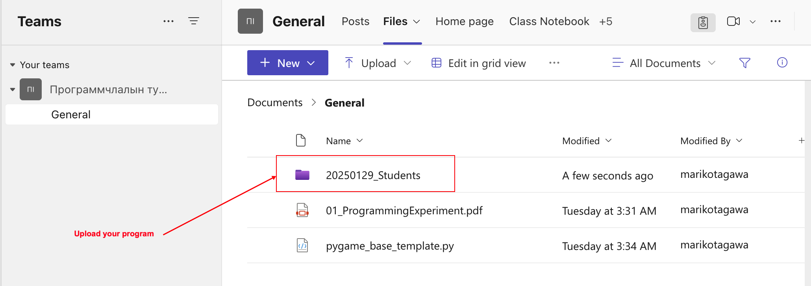
Exercise 1:
Task: Modify pygame_base_template.py
5. Save the file to pygame_base_template_<Your name>_exe1.py
6. Upload the file to the Teams Files. https://mustedumn.sharepoint.com/:f:/r/sites/I101/Shared%20Documents/General?csf=1&web=1&e=l750AH

