Slide 1
Programming Experiments With Python And Pygame #3
 | Course Code | Course Name | Credits
 | V.ITD215 | Programming Experiments | 2
Prepared by Mariko Tagawa, JICA volunteer

Slide 2
Course schedule
Week | Class | Title | Goal of the class or Tasks
1
 | 1 | Introduction to Pygame and Its Capabilities | Understand what Pygame is and its role in graphical programming. Learn how to install and set up the Pygame library in Python. Run and analyze a simple Pygame program to create a blank window.
2 | 2 | Chapter 1 - Create a Custom Calculator | Review Python basics Printing Comments Variables Operators
 | 3 | Chapter 1 - Create a Custom Calculator Lab 1: Custom Calculators | Lab1: Create a Custom Calculator Create a program to calculate your target time for completing a full marathon
3 | 4 | Chapter 3 - Quiz Games and If Statements | Review Python basics Basic Comparisons Indentation Using And/Or Boolean Variables Else and Else If Text Comparisons
 | 5 | Chapter 3 - Quiz Games and If Statements Lab 3: Create a Quiz | Lab 3: Create a Quiz Refer to a Sample Quiz and create your own Quiz Use if, elif, else

Slide 3
Course schedule
Week | Class | Title | Goal of the class or Tasks
4 | 6 | Chapter 4: Random Numbers and Loops | Review Python basics For Loop while Loops Random Numbers
 | 7 | Chapter 4: Random Numbers and Loops Lab 4: Game | Lab 4: Create a Game Refer to a Sample game and create your own game. Use loop, if
5 | 8 | Chapter 5: Introduction to Graphics | Learn how to draw basic shapes like rectangles, polygons, and text using Pygame.
 | 9 | Introduction to Animation | Understand the basics of animation using Python and Pygame.
6 | 10 | Lab 5: Create a Picture | Lab5: Create a Picture You must use multiple colors. You must use multiple types of graphic functions (circles, rectangles, lines, etc.) You must use a while or for loop to create a repeating pattern.
 | 11 | Lab 8: Animation | Lab8: Animation Modify the prior Create-a-Picture lab5 or start a new one. Animate the image.

Slide 4
Course schedule
Week | Class | Title | Goal of the class or Tasks
7 | 12 | Chapter 10: Controlling an object with the mouse and keyboard | Learn how to control an object with the mouse or keyboard on the screen. Files: move_mouse.py, move_keyboard.py Exercise7: Modify sample programs.
 | 13 | Chapter 11: Bitmapped Graphics and Sound | Learn how to use bitmapped graphics (images) to your games. Learn how to add sound to your games. Exercise8. Use images and sound.
8, 9 | 14,15 ,16 | Lab: Designing Your Own Animation/Game Presentations and Showcase | Use the knowledge from previous classes to create your own animation or game. Present your completed animation or game to the class.

Slide 5
Online Couse, Documentations
Online Course: Program Arcade Games With Python And Pygame
Home:
http://programarcadegames.com/index.php
Video:
https://youtube.com/playlist?list=PL1D91F4E6E79E73E1&si=MvHx9PHppoIKR5Gj
Python Tutorial site
https://www.w3schools.com/python/default.asp
Pygame Documentation
https://www.pygame.org/docs/
Color Picker
https://www.webfx.com/web-design/color-picker/
https://htmlcolorcodes.com/color-picker/

Slide 6
Sample answer program for Lab1
Exercise2: class2_SampleProgram_exe2.py
Lab1: calculator_lab1_SampleProgram.py
Lab1-2: calculator_lab1-2_SampleProgram.py
What is an f-string in Python?
In Python, f-strings (f” ”) are a way to format and insert variables directly into a string, making it easier to print meaningful messages.
It allows us to insert variables directly inside the string.
{hours} and {minutes} inside the string
{hours} is replaced by the value stored in the hours variable.
{minutes} is replaced by the value stored in the minutes variable.
print(f"Your estimated goal time is {hours} hours and {minutes} minutes.")
print("Your estimated goal time is", hours, "hours and", minutes, "minutes.")

Slide 7
Week 2, Class 4: Chapter 3: Quiz Games and If Statements
Goals/Tasks:
Review Python basics
Basic Comparisons
Indentation
Using And/Or
Boolean Variables
If, Else If and Else
Exercise3: write a code using if, elif, else
Homework: Review today's class content

Slide 8
Chapter 3: If Statements
Online Course: http://programarcadegames.com/index.php?chapter=conditional_statements&lang=en#section_3
Understand the Basics of Conditional Logic
Basic Comparisons
Indentation
Using And/Or
Boolean Variables
Else and Else If
Text Comparisons
Exercise3: write a code using if, elif, else
Homework Quiz: http://programarcadegames.com/quiz/quiz.php?file=if_statements&lang=en

Slide 9
Exercise 3-1: filename: exe3-1_SampleProgram_tbf.py
Task: This sample program is something wrong.
Run the sample program and input 40. It’s expected to print out "Өө, та зам дээр өндөг хуурч болно!". But it doesn't. Please modify the script and fix the issue.
Once fix the issue, save the program to exe3-1_<Your name>.py
Upload the file to the Teams Folder.
Before uploading your program, please run it and confirm it works.
# sample program : exe3-1_SampleProgram_tbf.py # This program is not perfect. Please improve the code temperature = int(input("What is the temperature in Celsius? "))
if temperature > 25:
print("Гадаа халуун байна")
elif temperature > 35:
print("Өө, та зам дээр өндөг хуурч болно!")
elif temperature < 10:
print("Гадаа хүйтэн байна")
else:
print("Гадаа сайхан байна")
print("Done")

Slide 10




Exercise 3-1: filename: exe3-1_SampleProgram_tbf.py
Hint:
What is the temperature in Celsius?
It’s 40
Гадаа халуун байна
You should say,
“Өө, та зам дээр өндөг хуурч болно!"

Slide 11
Exercise 3-2: filename: exe3-2_SampleProgram_tbf.py
Task: This sample program is not perfect.
The sample program asks for the user's name and checks if it matches ”Mariko". However, it is case-sensitive, meaning ”mariko" or ”MARIKO" will not work.
Modify the sample program so that it recognizes the name ”Mariko" regardless of how the user types it (e.g., ”Mariko", ”mariko", ”MARIKO", ”mariKO").
Save the program to exe3-2_<Your name>.py
Upload the file to the Teams Folder.
Before uploading your program, please run it and confirm it works.
# Sample File exe3-2_SampleProgram_tbf.py
# This program is not perfect. Please improve the code
userName = input("What is your name? ")
if userName == ”Mariko":
print("You have a NICE name!!")
else:
print("Your name is OK.")

Slide 12



Exercise 3-2: filename: exe3-2_SampleProgram_tbf.py
Hint:
What is your name?
Mariko
You have a NICE name!!
What is your name?
mariko
Your name is OK

Slide 13
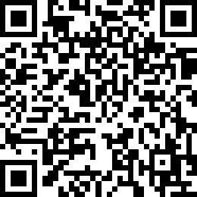
Attendance Check 4
Please submit the following form at the end of the class. This is today's attendance check.
https://forms.gle/XdcGSiW5KeyUWtsk6

Slide 14
Sample answer program for exercise3 / Good Program.
Exercise3-1: exe3-1_SampleProgram.py
Exercise3-2 : exe3-2_SampleProgram.py
What Makes a Good Program?
Short: Think of an effective and good algorithm to write short and simple code.
Easy to Read: Use clear variable names and proper indentation.
(ex) total_score, first_name, kirometers_driven,
Bug-Free: Test your code well to prevent errors.
Well-Organized: Add comments.
Reusable: Write code that can be easily modified or reused.
Notes:
# Calculate the area of a rectangle (repeated code)
width1 = 5
height1 = 10
area1 = width1 * height1
print(f"Area of rectangle 1: {area1}")
width2 = 7
height2 = 4
area2 = width2 * height2
print(f"Area of rectangle 2: {area2}")
❌ Problem:
The same formula (width * height) is repeated.
If we need to change the logic, we must update it multiple times.
--------------
# Define a reusable function to calculate the area
def calculate_area(width, height):
return width * height
# Call the function multiple times
print(f"Area of rectangle 1: {calculate_area(5, 10)}")
print(f"Area of rectangle 2: {calculate_area(7, 4)}")
this better
The calculate_area() function can be used multiple times.
If we need to change the formula, we only update it once inside the function.
The code is shorter, cleaner, and easier to maintain.

Slide 15
Week 3, Class 5: Lab3: Create a Quiz
Goals/Tasks:
Lab3: Create a Quiz
Create your own quiz program

Slide 16
Lab 3-1:
Task: Write a Python program to calculate the bus fare based on the age.
Instructions:
Ask the user to input their age. Make sure to handle the input as a number.
Use an if-elif-else structure to determine the bus fare based on the age entered.
Print the appropriate bus fare or a message indicating the fare is free for passengers under 6.
Save the file to class5_lab3_<Your name>.py
Upload the file to the Teams Files. https://mustedumn.sharepoint.com/:f:/r/sites/I101/Shared%20Documents/General?csf=1&web=1&e=l750AH

Slide 17
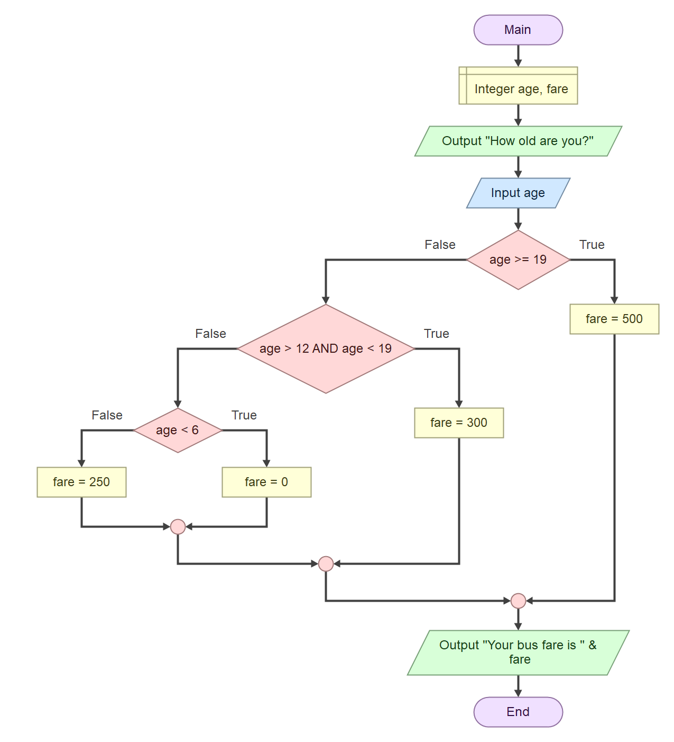
Lab 3-1:
Task: Write a Python program to calculate the bus fare based on the age.
Input:
How old are you? (ex 15)
Calculate:
Adult (19 and older): The fare is 500 ₮.
Student (ages 13–18): The fare is 300 ₮.
Child (ages 6–12): The fare is 250 ₮.
Under 6: The fare is free.
Output:
Your bus fare is 300 ₮

Slide 18





Lab 3-1:
Hint:
How old are you?
15
Your bus fare is 300 ₮
How old are you?
20
Your bus fare is 500 ₮
How old are you?
5
Your bus fare is Free

Slide 19
Lab 3-2:
Task: Refer to the Sample Quiz and create your own Quiz.
http://programarcadegames.com/index.php?chapter=lab_create_a_quiz&lang=en
Create a quiz program with five or more questions.
A number as the answer (e.g., "What is 1 + 1?").
A text answer (e.g., "What is Harry Potter's last name?").
A multiple-choice selection (e.g., "Which option is correct? A, B, or C?").
Requirements:
Input : For text answers, make sure your program accepts variations. For example, A and a is OK.
Feedback: Let the user know if their answer is correct or incorrect.
Score Tracking: Keep track of how many questions the user gets right.
Final Score: At the end, calculate and display the user's percentage score.
Save your program as class5_lab3-2_<your name>.py
Upload the file to the Teams Files.
https://mustedumn.sharepoint.com/:f:/r/sites/I101/Shared%20Documents/General?csf=1&web=1&e=l750AH

Slide 20
Lab 3-2:
Task: Refer to the Sample Quiz and create your own Quiz.
http://programarcadegames.com/index.php?chapter=lab_create_a_quiz&lang=en
Sample.
Quiz time!
How many books are there in the Harry Potter series? 7
Correct!
What is 3*(2-1)? 3
Correct!
What is 3*2-1? 5
Correct!
:
Congratulations, you got 4 answers right. Your score is 40%!

Slide 21
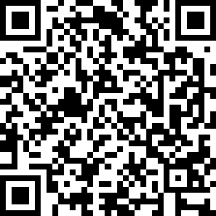
Attendance Check 5
Please submit the following form at the end of the class. This is today's attendance check.
https://forms.gle/JA73gowjYm4Wn7hP8
If you can’t access to the google form, please come to me.
Otherwise, you will be checked as “Not-Attended”.

Slide 22
(Option) Lab 3-3:
Task: Write a Python program to calculate a movie ticket price. The price depends on age and the day of the week. Special discounts apply on certain days.
Ticket Pricing Rules:
Standard Pricing:
Adult (19-64 years): 1,200₮
Senior (65+ years): 800₮
Teen (13-18 years): 900₮
Child (6-12 years): 600₮
Kids under 6: Free
Discount Days:
Wednesday (Discount Day): Everyone gets 20% off the standard price.
Weekend (Saturday & Sunday): Adult price increases to 1,500₮ due to high demand.
Special Holiday Discount (e.g., National Holiday): All tickets are 50% off.
Special Holiday Discount applies to all tickets, and other discounts (e.g., Wednesday discount or weekend pricing) will not be applied.

Slide 23
(Option) Lab 3-3:
Instruction:
Ask for the user's age.
Ask for the day of the week.
Ask if today is a special holiday.
Calculate and display the ticket price.
Save the file to class5_lab3-3_<Your name>.py
Upload the file to the Teams Folder.

Slide 24


Lab 3-3:
Hint:
Enter your age:
16
Enter the day of the week:
Wednesday
Is today a special holiday?
No
Your movie ticket price is 720₮

