Slide 1
Programming Experiments With Python And Pygame #5
 | Course Code | Course Name | Credits
 | V.ITD215 | Programming Experiments | 2
Prepared by Mariko Tagawa, JICA volunteer

Slide 2
Course schedule
Week | Class | Title | Goal of the class or Tasks
1
 | 1 | Introduction to Pygame and Its Capabilities | Understand what Pygame is and its role in graphical programming. Learn how to install and set up the Pygame library in Python. Run and analyze a simple Pygame program to create a blank window.
2 | 2 | Chapter 1 - Create a Custom Calculator | Review Python basics Printing Comments Variables Operators
 | 3 | Chapter 1 - Create a Custom Calculator Lab 1: Custom Calculators | Lab1: Create a Custom Calculator Create a program to calculate your target time for completing a full marathon
3 | 4 | Chapter 3 - Quiz Games and If Statements | Review Python basics Basic Comparisons Indentation Using And/Or Boolean Variables Else and Else If Text Comparisons
 | 5 | Chapter 3 - Quiz Games and If Statements Lab 3: Create a Quiz | Lab 3: Create a Quiz Refer to a Sample Quiz and create your own Quiz Use if, elif, else

Slide 3
Course schedule
Week | Class | Title | Goal of the class or Tasks
4 | 6 | Chapter 4: Random Numbers and Loops | Review Python basics For Loop while Loops Random Numbers
 | 7 | Chapter 4: Random Numbers and Loops Lab 4: Game | Lab 4: Create a Game Refer to a Sample game and create your own game. Use loop, if
5 | 8 | Chapter 5: Introduction to Graphics | Learn how to draw basic shapes like rectangles, polygons, and text using Pygame.
 | 9 | Introduction to Animation | Understand the basics of animation using Python and Pygame.
6 | 10 | Lab 5: Create a Picture | Lab5: Create a Picture You must use multiple colors. You must use multiple types of graphic functions (circles, rectangles, lines, etc.) You must use a while or for loop to create a repeating pattern.
 | 11 | Lab 8: Animation | Lab8: Animation Modify the prior Create-a-Picture lab5 or start a new one. Animate the image.

Slide 4
Course schedule
Week | Class | Title | Goal of the class or Tasks
7 | 12 | Chapter 10: Controlling an object with the mouse and keyboard | Learn how to control an object with the mouse or keyboard on the screen. Files: move_mouse.py, move_keyboard.py Exercise7: Modify sample programs.
 | 13 | Chapter 11: Bitmapped Graphics and Sound | Learn how to use bitmapped graphics (images) to your games. Learn how to add sound to your games. Exercise8. Use images and sound.
8, 9 | 14,15 ,16 | Lab: Designing Your Own Animation/Game Presentations and Showcase | Use the knowledge from previous classes to create your own animation or game. Present your completed animation or game to the class.

Slide 5
Class environment
OS: Windows
Programming tools:
Anaconda
Anaconda Prompt
IDLE
Backup
Your google drive
Submit your reports, assignments
Teams – “Программчлалын туршилт I” – General – Files – “2025xxxx_Students”

Slide 6
Online Couse, Documentations
Online Course: Program Arcade Games With Python And Pygame
Home:
http://programarcadegames.com/index.php
Video:
https://youtube.com/playlist?list=PL1D91F4E6E79E73E1&si=MvHx9PHppoIKR5Gj
Python Tutorial site
https://www.w3schools.com/python/default.asp
Pygame Documentation
https://www.pygame.org/docs/
Color Picker
https://www.webfx.com/web-design/color-picker/
https://htmlcolorcodes.com/color-picker/

Slide 7
Week 4, Class 8 (2025/02/19): Introduction to Graphics
Goals/Tasks:
Learn how to draw basic shapes like rectangles, polygons, and text using Pygame.
File: simple_graphics_demo.py.
2. Exercise5: Modify the sample code.
3. Homework Quiz: Review today's class content

Slide 8
Drawing rectangles, polygons, text etc.
file name: simple_graphics_demo.py
Online Page: http://programarcadegames.com/index.php?chapter=introduction_to_graphics&lang=en#section_5
Homework Quiz:
http://programarcadegames.com/quiz/quiz.php?file=graphics&lang=en

Slide 9
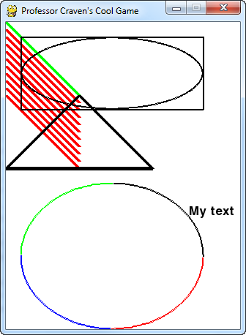
Drawing rectangles, polygons, text etc. file name: simple_graphics_demo.py
This file demonstrates setting up a window and drawing rectangles, polygons, text, and other basic shapes.
Open Anaconda Prompt.
Type “ldle” in the Anaconda Prompt.
File - Open - simple_graphics_demo.py
File – SaveAs- simple_graphics_demo_<your name>.py
Run
A window with rectangles, polygons, and other shapes appears.

Slide 10
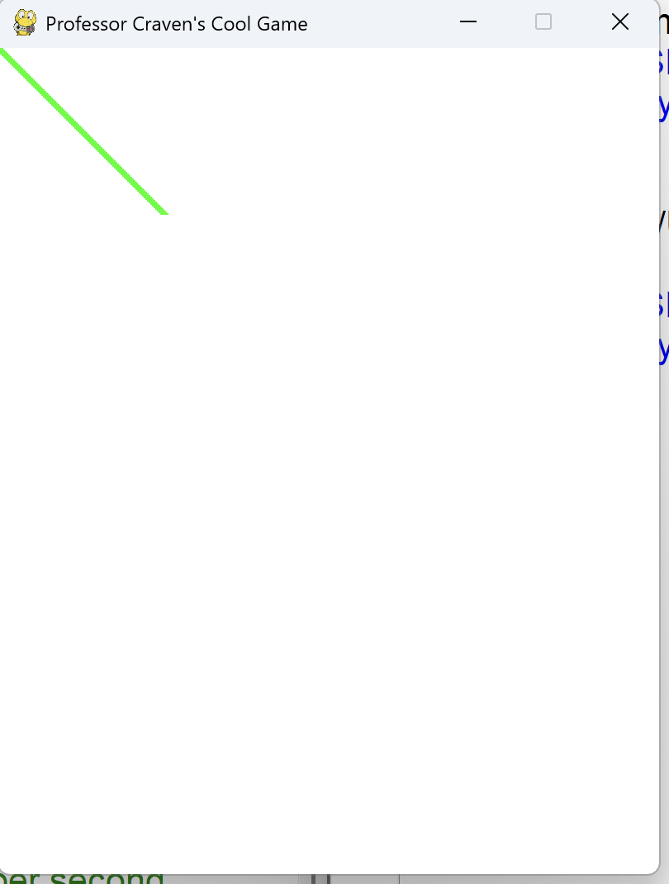
Drawing rectangles, polygons, text etc. file name: simple_graphics_demo.py
# Line 41
# Draw on the screen a line from (0,0) to (100,100)
# 5 pixels wide.
pygame.draw.line(screen, GREEN, [0, 0], [100, 100], 5)
pygame.draw.line():
Draws a straight line.
Parameters:
screen: The game window, where the line will be drawn.
GREEN: The color of the line, defined as an RGB value, e.g., (0, 255, 0) for green.
[0, 0]: The starting point of the line, specified as (x, y) coordinates. This is the top-left corner of the screen.
[100, 100]: The ending point of the line, specified as (x, y) coordinates.
5: The width of the line in pixels.
It draws a green line from the top-left corner (0, 0) to the point (100, 100) on the screen, with a thickness of 5 pixels.

Slide 11
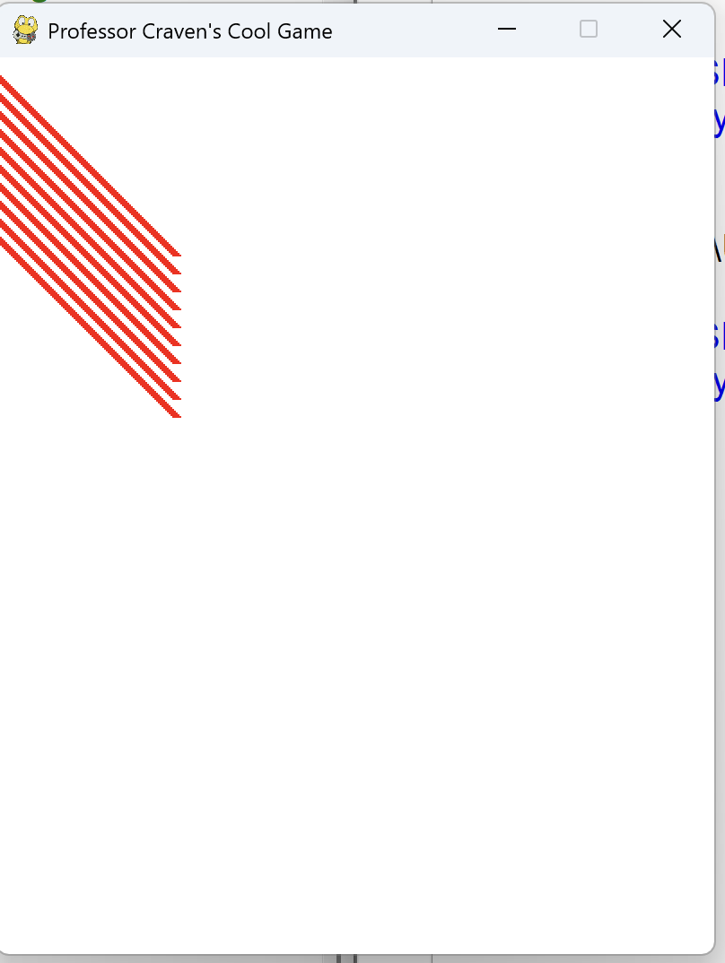
Drawing rectangles, polygons, text etc. file name: simple_graphics_demo.py
#line 45
for y_offset in range(0, 100, 10):
pygame.draw.line(screen, RED, [0, 10 + y_offset], [100, 110 + y_offset], 5)
This is a for loop that repeat 10 times, 0, 10, 20, 30, ..., 90. This code draws 10 red lines on the screen.
pygame.draw.line()
Draws a line on the screen with the following parameters:
RED: The color of the line (e.g., (255, 0, 0) for red).
Starting point ([0, 10 + y_offset]):
The x-coordinate is always 0 (left edge of the screen).
The y-coordinate starts at 10 and increases with each loop (10 + y_offset).
Ending point ([100, 110 + y_offset]):
The x-coordinate is always 100.
The y-coordinate starts at 110 and increases with each loop (110 + y_offset).
The thickness of the line is 5 pixels.

Slide 12
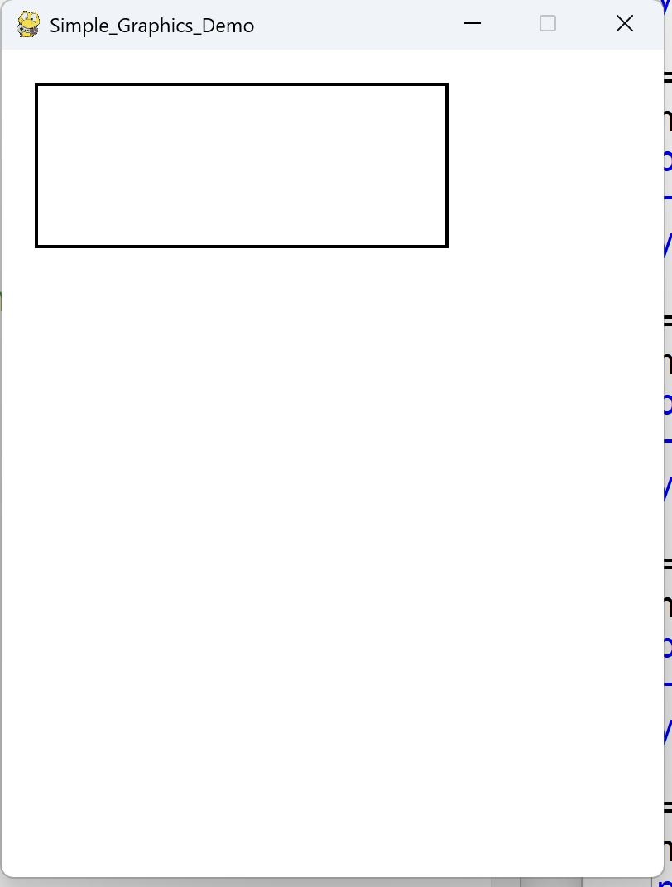
Drawing rectangles, polygons, text etc. file name: simple_graphics_demo.py
#line 50
# Draw a rectangle
pygame.draw.rect(screen, BLACK, [20, 20, 250, 100], 2)
pygame.draw.rect()
This code draws a rectangle on the screen with the following parameters:
screen: Where to draw.
BLACK: Color of the rectangle.
[20, 20, 250, 100]:
(20, 20): Starting point (top-left corner).
250: Width.
100: Height.
2: Line thickness (2 pixels).

Slide 13
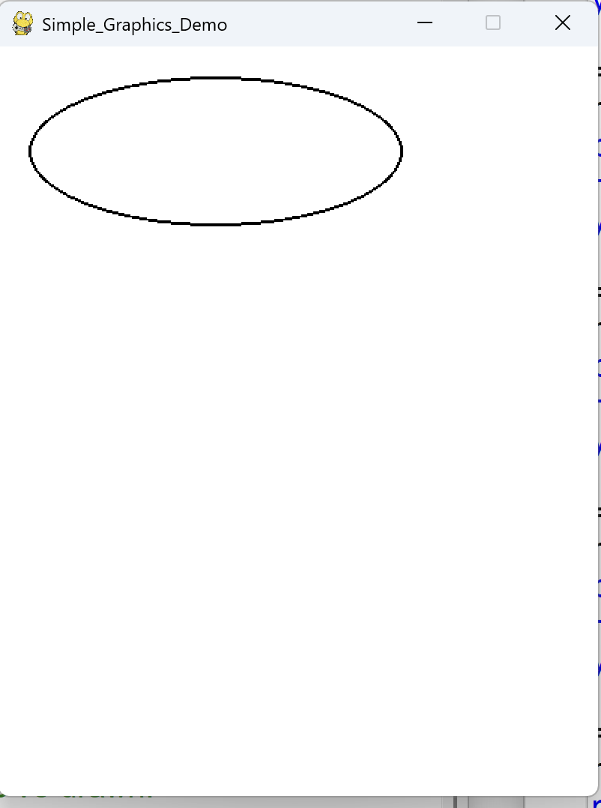
Drawing rectangles, polygons, text etc. file name: simple_graphics_demo.py
#line 53
# Draw an ellipse, using a rectangle as the outside boundaries
pygame.draw.ellipse(screen, BLACK, [20, 20, 250, 100], 2)
pygame.draw.ellipse()
This code draws an ellipse (oval) inside a rectangle shape.
with the following parameters:
screen: Where to draw.
BLACK: Color of the ellipse.
[20, 20, 250, 100]:
(20, 20): Starting point (top-left corner).
250: Width.
100: Height.
2: Line thickness (2 pixels).

Slide 14
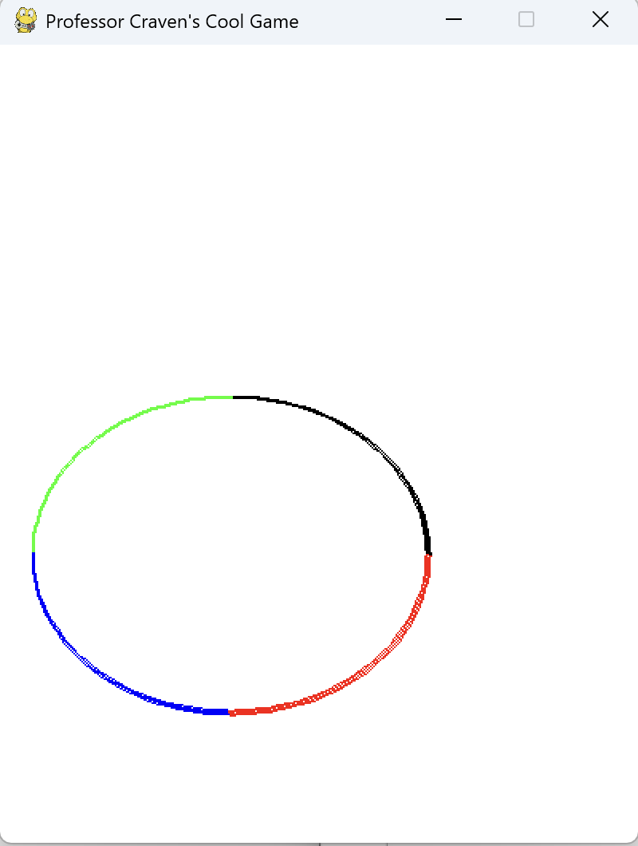
Drawing rectangles, polygons, text etc. file name: simple_graphics_demo.py
#Line 57
# Draw an arc as part of an ellipse.
# Use radians to determine what angle to draw.
pygame.draw.arc(screen, BLACK, [20, 220, 250, 200], 0, PI / 2, 2)
pygame.draw.arc(screen, GREEN, [20, 220, 250, 200], PI / 2, PI, 2)
pygame.draw.arc(screen, BLUE, [20, 220, 250, 200], PI, 3 * PI / 2, 2)
pygame.draw.arc(screen, RED, [20, 220, 250, 200], 3 * PI / 2, 2 * PI, 2)
pygame.draw.arc():
Draws an arc (a curved line).
screen:
The screen where the arc will be drawn.
BLACK: The color of the arc.
[20, 220, 250, 200]:
The rectangle area where the arc is drawn:
(20, 220) is the top-left corner of the rectangle.
250 is the width, and 200 is the height.
0, PI / 2 : The arc starts at 0 radians (right side) and ends at 90 degrees (PI/2 radians, top side).
2: The thickness of the arc's line, in pixels.
The other Arcs:
GREEN arc from 90° (top) to 180° (left).
BLUE arc from 180° (left) to 270° (bottom).
RED arc from 270° (bottom) back to 360° (right).

Slide 15
Drawing rectangles, polygons, text etc. file name: simple_graphics_demo.py
#Line 57
# Draw an arc as part of an ellipse.
# Use radians to determine what angle to draw.
pygame.draw.arc(screen, BLACK, [20, 220, 250, 200], 0, PI / 2, 2)
pygame.draw.arc(screen, GREEN, [20, 220, 250, 200], PI / 2, PI, 2)
pygame.draw.arc(screen, BLUE, [20, 220, 250, 200], PI, 3 * PI / 2, 2)
pygame.draw.arc(screen, RED, [20, 220, 250, 200], 3 * PI / 2, 2 * PI, 2)
8. Angles in radians:
0 radians → Starts from the right side.
PI / 2 radians (1.57) → Moves to the top (90°).
PI radians (3.14) → Moves to the left (180°).
3 * PI / 2 radians (4.71) → Moves to the bottom (270°).
2 * PI radians (6.28) → Full circle back to the right (360°).

Slide 16
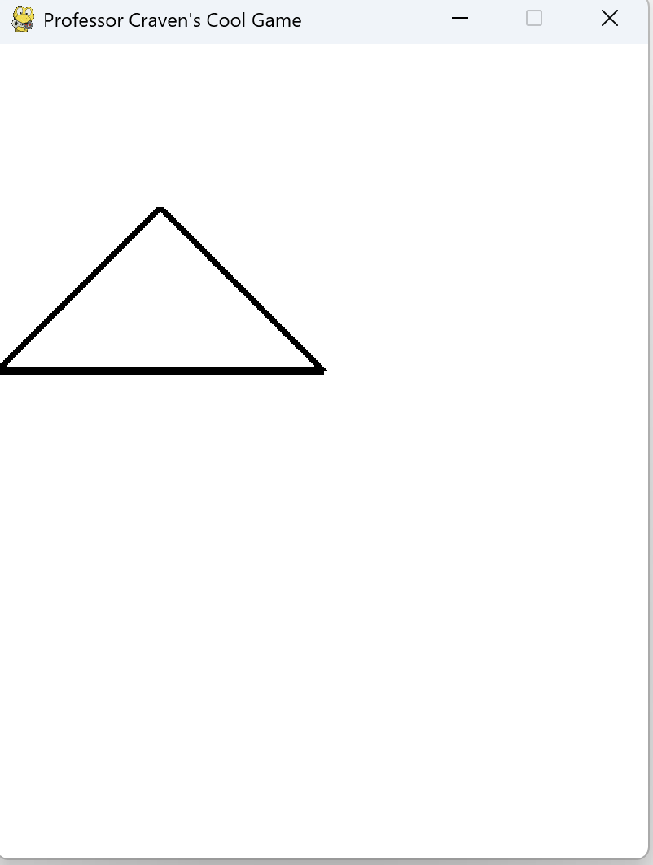
Drawing rectangles, polygons, text etc. file name: simple_graphics_demo.py
#Line 63
# This draws a triangle using the polygon command
pygame.draw.polygon(screen, BLACK, [[100, 100], [0, 200], [200, 200]], 5)
This code draws a polygon (a shape with straight sides) on the screen. In this case, it draws a triangle because there are 3 points.
pygame.draw.polygon():
Draw a polygon on the screen.
screen: The window where the polygon will be drawn.
BLACK: The color of the polygon's outline
[[100, 100], [0, 200], [200, 200]]:
A list of points (x, y) for the corners of the shape:
(100, 100) → The first point.
(0, 200) → The second point.
(200, 200) → The third point.
The width (thickness) of the polygon's outline in pixels.

Slide 17
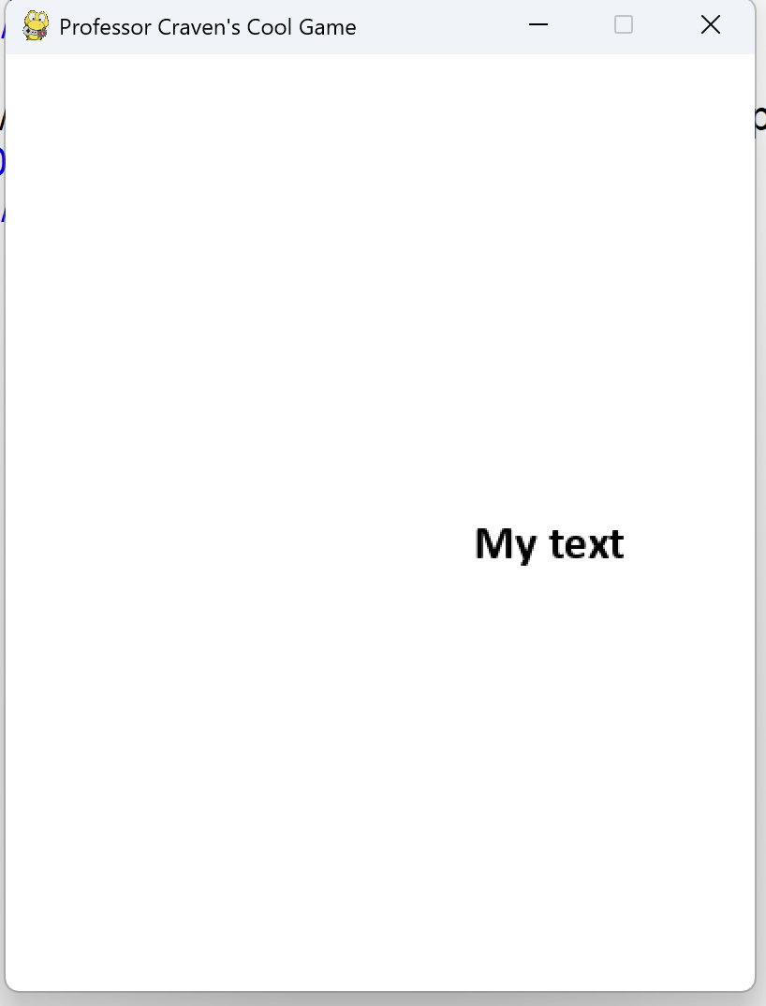
Drawing rectangles, polygons, text etc. file name: simple_graphics_demo.py
#Line 66
font = pygame.font.SysFont('Calibri', 25, True, False)
text = font.render("My text", True, BLACK)
screen.blit(text, [250, 250])
This code displays the text "My text" on the screen at the position [250, 250].
font = pygame.font.SysFont('Calibri', 25, True, False)
pygame.font.SysFont → Creates a font.
'Calibri' → The name of the font.
25 → The size of the text (25 pixels high).
True → Makes the text bold.
False → The text is not italic.

Slide 18
Drawing rectangles, polygons, text etc. file name: simple_graphics_demo.py
#Line 66
font = pygame.font.SysFont('Calibri', 25, True, False)
text = font.render("My text", True, BLACK)
screen.blit(text, [250, 250])
text = font.render("My text", True, BLACK)
font.render → Draws the text.
"My text" → The text that will be displayed.
True → Makes the text smooth (anti-aliased).
BLACK → The color of the text.
screen.blit(text, [250, 250])
screen.blit → Puts the text on the screen.
text → The text you created.
[250, 250] → The position of the text on the screen (x=250, y=250).

Slide 19
Drawing rectangles, polygons, text etc. file name: simple_graphics_demo.py
#Line 66
font = pygame.font.SysFont('Calibri', 25, True, False)
text = font.render("My text", True, BLACK)
screen.blit(text, [250, 250])
text = font.render("My text", True, BLACK)
font.render → Draws the text.
"My text" → The text that will be displayed.
True → Makes the text smooth (anti-aliased).
BLACK → The color of the text.
screen.blit(text, [250, 250])
screen.blit → Puts the text on the screen.
text → The text you created.
[250, 250] → The position of the text on the screen (x=250, y=250).

Slide 20
Exercise 5-1: Basic Exercises
Task: Modify the sample program: simple_graphics_demo_<your name>.py.
Change the Window Title
Change the title to: “My First Pygame Program” or any title you like.
Change the Background Color
Change the background color to BLUE or any other color from the defined colors.
Color Picker : https://www.webfx.com/web-design/color-picker/
Add More Lines
Draw another line in RED from (50, 50) to (200, 200).
Change Text Content
Change the text to display your name or a short message like:“Hello, Pygame!”.
Save the file to class8_<Your name>_exe5-1.py
Upload the file to the Teams Folder.

Slide 21
Exercise 5-2: Challenging Exercises
Task: Modify the sample program: simple_graphics_demo_<your name>.py.
Draw Another Shape
Add a line of code to draw a blue circle with a radius of 50 pixels at position (300, 100).
2. Modify the Rectangle
Make it larger or move it to a different position on the screen.
3. Display Multiple Lines of Text
Add another line of text below the existing one with a different color and size, for example: “Welcome to My Game!” in RED, size 30.
4. New Colors
Define a new color (e.g., PURPLE) and use it to draw a new shape.
Color Picker : https://www.webfx.com/web-design/color-picker/
Save the file to class8_<Your name>_exe5-2.py
Upload the file to the Teams Folder.

Slide 22
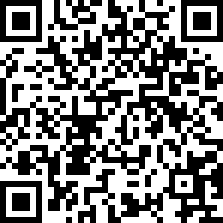
Attendance Check 8
Please submit the following form at the end of the class. This is today's attendance check.
https://forms.gle/49xAmPMvqnUJXRCm9

