Slide 1
Programming Experiments With Python And Pygame #6
 | Course Code | Course Name | Credits
 | V.ITD215 | Programming Experiments | 2
Prepared by Mariko Tagawa, JICA volunteer

Slide 2
Course schedule
Week | Class | Title | Goal of the class or Tasks
1
 | 1 | Introduction to Pygame and Its Capabilities | Understand what Pygame is and its role in graphical programming. Learn how to install and set up the Pygame library in Python. Run and analyze a simple Pygame program to create a blank window.
2 | 2 | Chapter 1 - Create a Custom Calculator | Review Python basics Printing Comments Variables Operators
 | 3 | Chapter 1 - Create a Custom Calculator Lab 1: Custom Calculators | Lab1: Create a Custom Calculator Create a program to calculate your target time for completing a full marathon
3 | 4 | Chapter 3 - Quiz Games and If Statements | Review Python basics Basic Comparisons Indentation Using And/Or Boolean Variables Else and Else If Text Comparisons
 | 5 | Chapter 3 - Quiz Games and If Statements Lab 3: Create a Quiz | Lab 3: Create a Quiz Refer to a Sample Quiz and create your own Quiz Use if, elif, else

Slide 3
Course schedule
Week | Class | Title | Goal of the class or Tasks
4 | 6 | Chapter 4: Random Numbers and Loops | Review Python basics For Loop while Loops Random Numbers
 | 7 | Chapter 4: Random Numbers and Loops Lab 4: Game | Lab 4: Create a Game Refer to a Sample game and create your own game. Use loop, if
5 | 8 | Chapter 5: Introduction to Graphics | Learn how to draw basic shapes like rectangles, polygons, and text using Pygame.
 | 9 | Introduction to Animation | Understand the basics of animation using Python and Pygame.
6 | 10 | Lab 5: Create a Picture | Lab5: Create a Picture You must use multiple colors. You must use multiple types of graphic functions (circles, rectangles, lines, etc.) You must use a while or for loop to create a repeating pattern.
 | 11 | Lab 8: Animation | Lab8: Animation Modify the prior Create-a-Picture lab5 or start a new one. Animate the image.

Slide 4
Course schedule
Week | Class | Title | Goal of the class or Tasks
7 | 12 | Chapter 10: Controlling an object with the mouse and keyboard | Learn how to control an object with the mouse or keyboard on the screen. Files: move_mouse.py, move_keyboard.py Exercise7: Modify sample programs.
 | 13 | Chapter 11: Bitmapped Graphics and Sound | Learn how to use bitmapped graphics (images) to your games. Learn how to add sound to your games. Exercise8. Use images and sound.
8, 9 | 14,15 ,16 | Lab: Designing Your Own Animation/Game Presentations and Showcase | Use the knowledge from previous classes to create your own animation or game. Present your completed animation or game to the class.

Slide 5
Class environment
OS: Windows
Programming tools:
Anaconda
Anaconda Prompt
IDLE
Backup
Your google drive
Submit your reports, assignments
Teams – “Программчлалын туршилт I” – General – Files – “2025xxxx_Students”

Slide 6
Online Couse, Documentations
Online Course: Program Arcade Games With Python And Pygame
Home:
http://programarcadegames.com/index.php
Video:
https://youtube.com/playlist?list=PL1D91F4E6E79E73E1&si=MvHx9PHppoIKR5Gj
Python Tutorial site
https://www.w3schools.com/python/default.asp
Pygame Documentation
https://www.pygame.org/docs/
Color Picker
https://www.webfx.com/web-design/color-picker/
https://htmlcolorcodes.com/color-picker/

Slide 7
Week 5, Class 9 (2025/02/21): Introduction to Animation
Goals/Tasks:
Understand the basics of animation using Python and Pygame.
bouncing_rectangle.py
animating_snow.py
Exercise6.
Homework Quiz: Review today's class content

Slide 8
8.1 The Bouncing Rectangle
Online Course:
http://programarcadegames.com/index.php?chapter=introduction_to_animation&lang=en#section_8
Video : https://youtu.be/-GmKoaX2iMs?si=pNctjL1ZmnN5QJPX
Homework Quiz
http://programarcadegames.com/quiz/quiz.php?file=animation&lang=en

Slide 9
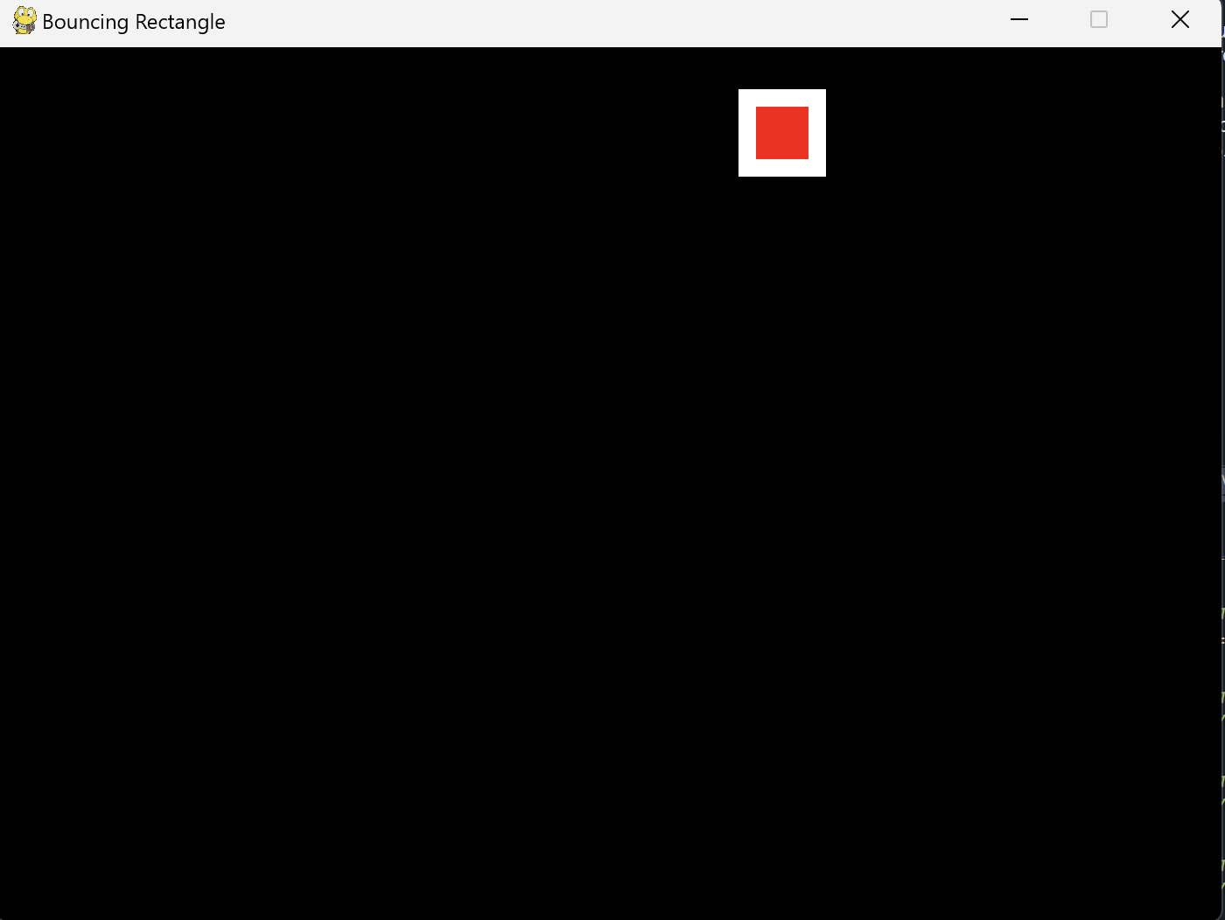
8.1 The Bouncing Rectangle
This program shows how to use Python and Pygame to make a rectangle bounce on the screen.
Open Anaconda Prompt.
Type “ldle” in the Anaconda Prompt.
Open - bouncing_rectangle.py
Run
A window with a rectangle appears. The rectangle bounces in the screen.
Close the window.

Slide 10
8.1 The Bouncing Rectangle
Open Anaconda Prompt.
Type “ldle” in the Anaconda Prompt.
Open - pygame_base_template.py
File – SaveAs - pygame_base_<Your name>.py
Video: https://youtu.be/-GmKoaX2iMs?si=wmgAlpzr3p8awiHh
Start modify the template.

Slide 11
8.2 Animating Snow
Online Course:
http://programarcadegames.com/index.php?chapter=introduction_to_animation&lang=en#section_8
Video: https://youtu.be/Gkhz3FuhGoI
Homework Quiz
http://programarcadegames.com/quiz/quiz.php?file=animation&lang=en

Slide 12
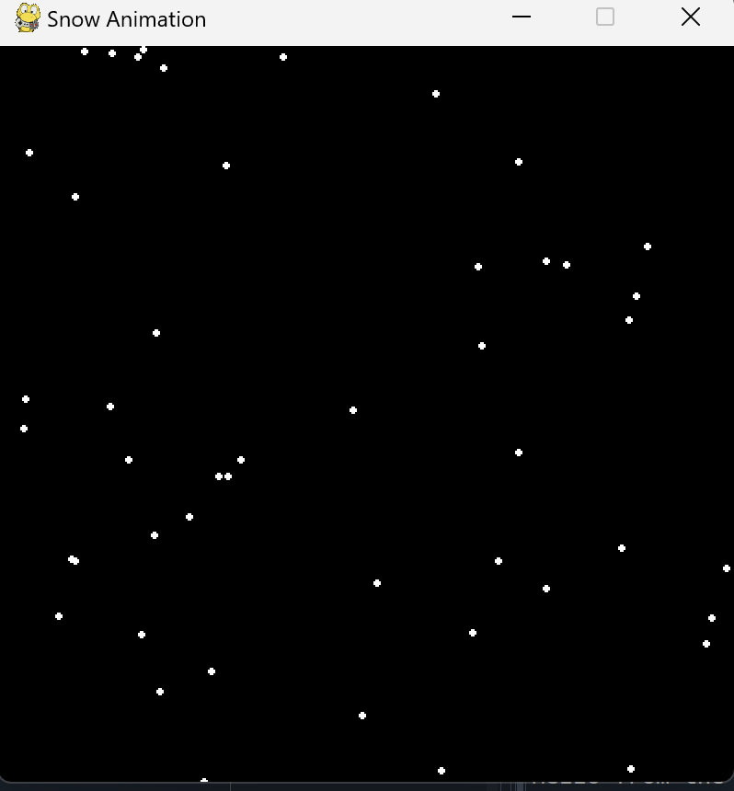
8.2 Animating Snow
This program shows how to use a list to animate and track many objects, like snowflakes.
Open Anaconda Prompt.
Type “ldle” in the Anaconda Prompt.
File - Open - animating_snow.py
Run
A window with snowflakes appears.
Close the window.

Slide 13
8.2 Animating Snow
Open Anaconda Prompt.
Type “ldle” in the Anaconda Prompt.
Open - pygame_base_template.py
File – SaveAs - pygame_base_<your name>.py
Video : https://youtu.be/Gkhz3FuhGoI
Start modify the template.

Slide 14
Exercise 6-1: Modify bouncing_rectangle.py
Exercise: Modify the code of bouncing_rectangle.py to change the rectangle's speed, color, or behavior.
Change the move speed.
Change the rectangles’ size.
Change the rectangles’ color.
Change other parameters.
Test the modified program
Save the file to class9_<Your name>_exe6-1.py
Upload the file to the Teams Folder.

Slide 15
Exercise 6-2: Modify animating_snow.py
Exercise: Modify the code of animating_snow.py to change the appearance or behavior of the snowflakes.
Change the snowflakes’ size
Change the downward move speed
Change other parameters.
Test the modified program.
Save the file to class9_<Your name>_exe6-2.py
Upload the file to the Teams Folder.

Slide 16
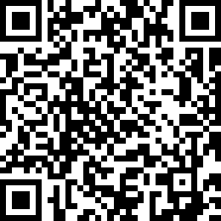
Attendance Check 9
Please submit the following form at the end of the class. This is today's attendance check.
https://forms.gle/Ew6r5AADo2x7iZwX9

