Slide 1
Programming Experiments With Python And Pygame #8
 | Course Code | Course Name | Credits
 | V.ITD215 | Programming Experiments | 2
Prepared by Mariko Tagawa, JICA volunteer

Slide 2
Course schedule
Week | Class | Title | Goal of the class or Tasks
1
 | 1 | Introduction to Pygame and Its Capabilities | Understand what Pygame is and its role in graphical programming. Learn how to install and set up the Pygame library in Python. Run and analyze a simple Pygame program to create a blank window.
2 | 2 | Chapter 1 - Create a Custom Calculator | Review Python basics Printing Comments Variables Operators
 | 3 | Chapter 1 - Create a Custom Calculator Lab 1: Custom Calculators | Lab1: Create a Custom Calculator Create a program to calculate your target time for completing a full marathon
3 | 4 | Chapter 3 - Quiz Games and If Statements | Review Python basics Basic Comparisons Indentation Using And/Or Boolean Variables Else and Else If Text Comparisons
 | 5 | Chapter 3 - Quiz Games and If Statements Lab 3: Create a Quiz | Lab 3: Create a Quiz Refer to a Sample Quiz and create your own Quiz Use if, elif, else

Slide 3
Course schedule
Week | Class | Title | Goal of the class or Tasks
4 | 6 | Chapter 4: Random Numbers and Loops | Review Python basics For Loop while Loops Random Numbers
 | 7 | Chapter 4: Random Numbers and Loops Lab 4: Game | Lab 4: Create a Game Refer to a Sample game and create your own game. Use loop, if
5 | 8 | Chapter 5: Introduction to Graphics | Learn how to draw basic shapes like rectangles, polygons, and text using Pygame.
 | 9 | Introduction to Animation | Understand the basics of animation using Python and Pygame.
6 | 10 | Lab 5: Create a Picture | Lab5: Create a Picture You must use multiple colors. You must use multiple types of graphic functions (circles, rectangles, lines, etc.) You must use a while or for loop to create a repeating pattern.
 | 11 | Lab 8: Animation | Lab8: Animation Modify the prior Create-a-Picture lab5 or start a new one. Animate the image.

Slide 4
Course schedule
Week | Class | Title | Goal of the class or Tasks
7 | 12 | Chapter 10: Controlling an object with the mouse and keyboard | Learn how to control an object with the mouse or keyboard on the screen. Files: move_mouse.py, move_keyboard.py Exercise7: Modify sample programs.
 | 13 | Chapter 11: Bitmapped Graphics and Sound | Learn how to use bitmapped graphics (images) to your games. Learn how to add sound to your games. Exercise8. Use images and sound.
8, 9 | 14,15 ,16 | Lab: Designing Your Own Animation/Game Presentations and Showcase | Use the knowledge from previous classes to create your own animation or game. Present your completed animation or game to the class.

Slide 5
Online Couse, Documentations
Online Course: Program Arcade Games With Python And Pygame
Home:
http://programarcadegames.com/index.php
Video:
https://youtube.com/playlist?list=PL1D91F4E6E79E73E1&si=MvHx9PHppoIKR5Gj
Python Tutorial site
https://www.w3schools.com/python/default.asp
Pygame Documentation
https://www.pygame.org/docs/
Color Picker
https://www.webfx.com/web-design/color-picker/
https://htmlcolorcodes.com/color-picker/

Slide 6
Week 7, Class 12 (2025/03/12): Controlling an object with the mouse and keyboard
Goals/Tasks:
Learn how to control an object with the mouse or keyboard on the screen using Python and Pygame.
Exercise7.
Homework Quiz: Review today's class content.

Slide 7
Controlling an object with the mouse
Online Course:
http://programarcadegames.com/index.php?chapter=controllers_and_graphics&lang=en#section_10
Video :
https://youtu.be/OP4PR9C6pBc?si=MDjI02QFR3eB6SNU
https://youtu.be/LKOyJSc6Z1c?si=Pry2yB9TXC8JcsN7
Homework Quiz
http://programarcadegames.com/quiz/quiz.php?file=controllers&lang=en

Slide 8
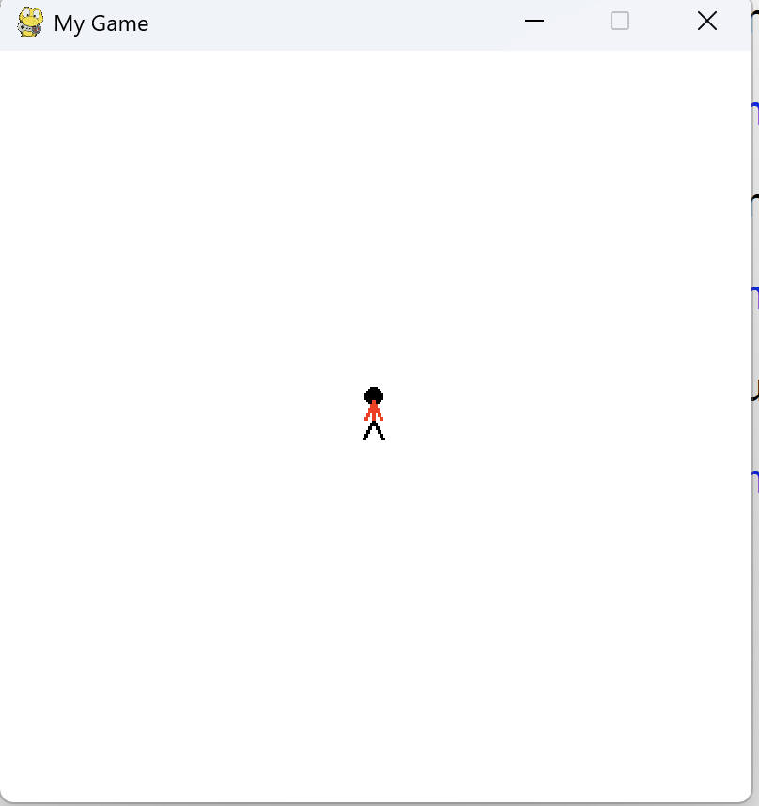
Controlling an object with the mouse
This program shows how to move an object with the mouse.
Open Anaconda Prompt.
Type “ldle” in the Anaconda Prompt.
File - Open - move_mouse.py
Run
A small guy appears on the screen. With your mouse movement, it moves.
Close the window.

Slide 9
First, let‘s review Python’s ‘function’.
Function in Python
A function in Python is a reusable block of code that performs a specific task.
Defining a Function
A function is defined using the def keyword:
def hello(name):
#This function prints a greeting message
print(f"Hello, {name}!")
# Calling the function
hello("Alice") # Output: Hello, Alice!

Slide 10
Controlling an object with the mouse
First, let‘s review Python’s ‘function’.
Function:
def draw_stick_figure(screen, x, y):
# Head
pygame.draw.ellipse(screen, BLACK, [1 + x, y, 10, 10], 0)
# Legs
pygame.draw.line(screen, BLACK, [5 + x, 17 + y], [10 + x, 27 + y], 2)
pygame.draw.line(screen, BLACK, [5 + x, 17 + y], [x, 27 + y], 2)
# Body
pygame.draw.line(screen, RED, [5 + x, 17 + y], [5 + x, 7 + y], 2)
# Arms
pygame.draw.line(screen, RED, [5 + x, 7 + y], [9 + x, 17 + y], 2)
pygame.draw.line(screen, RED, [5 + x, 7 + y], [1 + x, 17 + y], 2)
Call function:
draw_stick_figure(screen, 0, 0)

Slide 11
Controlling an object with the mouse
Open Anaconda Prompt.
Type “ldle” in the Anaconda Prompt.
Open - pygame_base_template.py
File – SaveAs - pygame_base_<your name>.py
Video : https://youtu.be/OP4PR9C6pBc?si=MDjI02QFR3eB6SNU
Start modify the template.

Slide 12
Controlling an object with the keyboard
This program shows how to move an object with the keyboard.
Open Anaconda Prompt.
Type “ldle” in the Anaconda Prompt.
File - Open - move_keyboard.py
Run
A small guy appears on the screen.
Press the key, ↑, ↓, →, ← on the keyboard, he moves up, down, left, or right accordingly.
Close the window.

Slide 13
Controlling an object with the keyboard
Open Anaconda Prompt.
Type “ldle” in the Anaconda Prompt.
Open - pygame_base_template.py
File – SaveAs - pygame_base_<your name>.py
Video :https://youtu.be/LKOyJSc6Z1c?si=Pry2yB9TXC8JcsN7
Start modify the template.

Slide 14
Exercise 7: Modify move_mouse.py and / or move_keyboard.py
Exercise: Modify the code of move_mouse.py and / or move_keyboard.py.
Create your own object.
Control the object with mouse or keyboard.
Test the modified program well.
Save the file to class12_<Your name>_exe7.py
Upload the file to the Teams Folder.

Slide 15
Exercise 7: Modify move_mouse.py and / or move_keyboard.py
Hints: Create your function to draw an object.
Sample function:
def draw_snowman(screen, x, y):
# Draw a circle for the head
pygame.draw.ellipse(screen, WHITE, [35 + x, y, 25, 25])
# Draw the middle snowman circle
pygame.draw.ellipse(screen, WHITE, [23 + x, 20 + y, 50, 50])
# Draw the bottom snowman circle
pygame.draw.ellipse(screen, WHITE, [x, 65 + y, 100, 100])

Slide 16
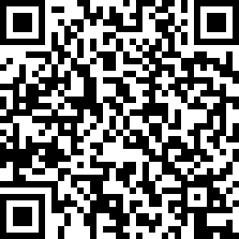
Attendance Check 12
Please submit the following form at the end of the class. This is today's attendance check.
https://forms.gle/JQ126CcGG25siUsTA

