Slide 1
Fundamentals of Algorithms
 | Course Code | Course Name | Credits
 | V.ITD203 | Fundamentals of Algorithms | 1
Prepared by Mariko Tagawa, JICA volunteer

Slide 2
What’s Algorithm? What is the Difference Between Algorithm and Program? Let’s see the Video of Introduction to Algorithm. https://youtu.be/tm5oUTciK8g?si=RZZiEnkwz3KIFGWN
Notes:
An algorithm is a step-by-step set of instructions or a procedure designed to perform a specific task or solve a problem. It is the foundation of computer science and programming and can be applied in various fields like mathematics, data analysis, and everyday tasks.
Key Features of an Algorithm:
Input: It takes zero or more inputs.
Output: It produces at least one output (result).
Definiteness: Each step must be clear and unambiguous.
Finiteness: An algorithm must always terminate after a finite number of steps.
Effectiveness: Each step must be basic enough to be performed, in principle, by a human using pen and paper.
Examples of Algorithms:
Real-life example: A recipe for cooking a dish is an algorithm, as it provides specific steps to follow.
Programming example: Finding the largest number in a list or sorting a set of numbers.
Why Are Algorithms Important?
They serve as a blueprint for solving problems.
They help in optimizing performance in computer programs.
Algorithms are independent of programming languages, focusing only on logic and steps.
Programming is the process of writing, testing, debugging, and maintaining the code that instructs a computer or device on how to perform specific tasks. It involves using a programming language to create a set of instructions (a program) that a computer can execute.
Key Concepts in Programming:
Code:
The written instructions in a specific programming language (e.g., Python, Java, C++).
Logic:
The structured flow of operations to achieve a desired outcome.
Programming Languages:
Tools used to write code (e.g., Python, JavaScript, Java).
Each language has its syntax (rules) and is designed for specific purposes.
Compilation/Interpretation:
The process of converting human-readable code into machine language (binary) so the computer can understand and execute it.
Why Is Programming Important?
Automation: Automates repetitive tasks to save time and effort.
Problem Solving: Helps in building solutions for complex problems.
Applications: Enables the development of software, apps, games, websites, and more.
Learning and Innovation: Programming powers innovations in AI, robotics, IoT, and other technologies.
Real-World Examples of Programming:
Creating a mobile app to track fitness.
Writing code to analyze large datasets in scientific research.
Automating tasks like sending emails or generating reports.
If you're teaching programming, starting with basic concepts like logic and syntax and progressing toward practical examples is a great way to engage students

Slide 3
What’s Algorithms? What’s Programming?
Learn Algorithm
First
Algorithms
A step-by-step procedure to solve a problem or perform a task
Programming
Writing instructions in a programming language to implement algorithms
Problem / Task
Solution
Any programming language needs Algorithms
Programming languages
C
C++
C#
Python
Java
Java Script
VB
VBA
Ruby
Perl
Cobol
Fortran
More and more

Slide 4
Course schedule
 | Title | Goal of the class or Tasks
1 | Introduction to Algorithms and Tools | Learn the basics of algorithms, install Flowgorithm, and explore (*) SPOJ for algorithm practice. Create the first program in Flowgorithm. (*) SPOJ is an online platform designed for programmers to practice and improve their coding and problem-solving skills.
2 | Building Basic Algorithms with Flowgorithm | Task Names: Create algorithms to solve geometric and numeric problems such as perimeter, sums, cubes, and areas. Finding the sum of two numbers. Calculating the perimeter of a triangle. Calculating the cube of a number. Computing the area of a rectangle.
3 | Customizing Functions in Algorithms | Task Names: Implement and explore custom functions to enhance algorithm capabilities. Writing a simple custom function (Function 1). Writing a second custom function (Function 2).
3 | Exploring Numeric Operations Through Algorithms | Task Names: Design algorithms to extract digits and analyze 2-digit and 3-digit numbers. Extracting the last digit of a number. Identifying the decimal place digit in a number. Working with 2-digit and 3-digit numbers.
4

Slide 5
Course Schedule
 | Title | Goal of the class or Tasks
4 | Time and Date Conversions Using Algorithms | Task Names: Develop algorithms to manipulate and convert time-based values like minutes, seconds, hours, and days. Convert minutes and seconds. Convert hours, minutes, and seconds. Calculate total seconds from time formats. Convert days and hours. Convert years and months.
5 | Learn how to use "if" symbol to compare numbers in an algorithm. | Task Names: Create algorithms to determine maximums, minimums, and compute specific sums. Determine the maximum of two numbers. Determine the minimum of two numbers. Find the maximum of three numbers. Find the minimum of four numbers.
6 | Learning "Loop" for Repeating Actions. | Task Names: Create algorithms that perform repeated calculations. Print "IOI" 3 times on the screen. Print "IOI" the number of times given by the user. Compute the sum of 1 to N using a loop. Compute n! (factorial of N) using a loop. Use a "for" loop to calculate total running distance for a week. Use a “while” loop to calculate total running distance for a month.
5

Slide 6
Course Schedule
 | Title | Goal of the class or Tasks
7, 8 | Design Your Own Algorithm | Students will design and implement your own algorithm using Flowgorithm. Be creative! You can create a quiz, game, calculation tool, or any scenario-based algorithm.
6

Slide 7
Class 1: Introduction to Algorithms: Understanding the Basics
Goals/Tasks:
Understand what’s algorithms in programming.
Install and get acquainted with the Flowgorithm tool for visualizing algorithms.
Create an account on SPOJ (https://www.spoj.com/), an online platform for algorithm practice and coding challenges.
Create the first Program in Flowgorithm
(*) SPOJ is an online platform designed for programmers to practice and improve their coding and problem-solving skills.

Slide 8
Class environment
OS: Windows
Flowchart tools:
Flowgorithm https://www.flowgorithm.org
Question examples:
SPOJ (Sphere Online Judge) https://www.spoj.com/RGB7
Backup
Your google drive
Submit your reports, assignments
Teams - Алгоритмын үндэс – General – Files – 20250xxx_Students

Slide 9
Алгоритмын төрлүүд
Шугаман : Алгоритмын бүх үйлдлүүд зөвхөн нэг удаа биелэдэг.
Салаалсан : Ямар нэгэн хувьсагчийн утгаас хамаарч 2 үйлдлийн аль нэгийг хийдэг.
Давталттай : Өгөгдлийн утгаас хамааран нэг үйлдэл нэг болон түүнээс олон удаа давтагддаг алгоритмыг хэлнэ.
Хольмог : Дээрх төрлүүд холилдсон алгоритмыг хэлнэ.

Slide 10
Types of Algorithms
Sequential （順次）: All operations of the algorithm are executed only once.
Branched （分岐） : Depending on the value of a variable, one of two actions is performed.
Iterative /Loop （繰り返し） : An algorithm in which a single action is repeated one or more times depending on the value of the data.
Mixed Flowchart: An algorithm that combines the above types.
10

Slide 11
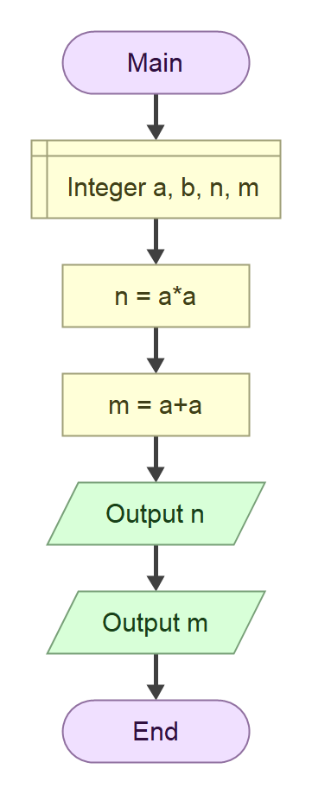
Шугаман алгоритм
Жишээ:
Хэрэглэгчийн өгсөн 2 тооны квадрат болон нийлбэрийг ол.

Slide 12
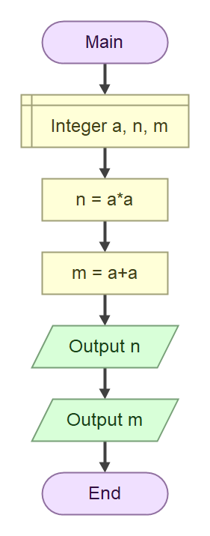
Sequential Algorithm
Example:
Calculate the squares and the sum of two numbers entered by the user.

Slide 13
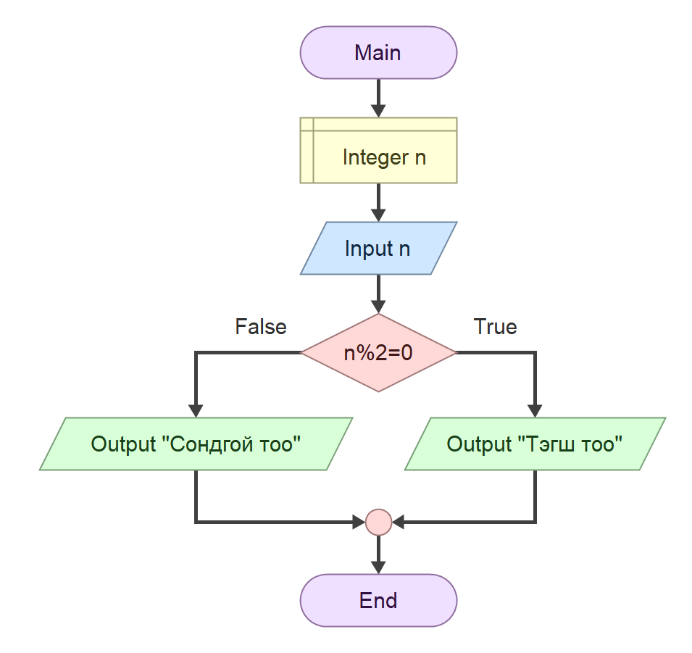
Салаалсан алгоритм
Жишээ:
Хэрэглэгчийн оруулсан тоо тэгш, сондгой эсэхийг шалгаж, “Тэгш тоо” эсвэл “Сондгой тоо” гэж хэвлэ.

Slide 14
Branched Algorithm
Example:
Check whether the number entered by the user is even or odd, and print "Even Number" or "Odd Number" accordingly.

Slide 15
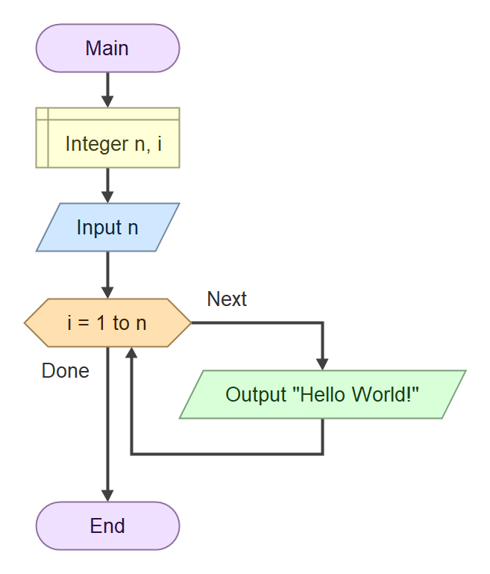
Давталттай алгоритм
Жишээ 1:
Хэрэглэгчийн өгсөн тоогоор “Hello World” гэж хэвлэ.

Slide 16
Iterative (Loop) Algorithm
Example 1:
Print "Hello World" based on the number provided by the user.

Slide 17
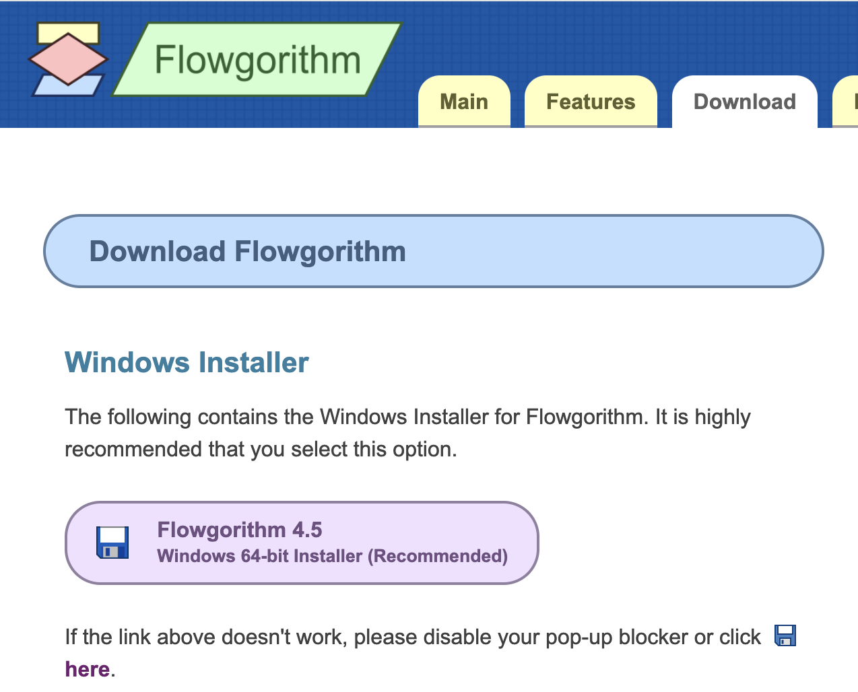
Install Flowgorithm tool for visualizing algorithms
Flowgorithm is a user-friendly application designed for creating and visualizing algorithms using flowcharts. It is primarily aimed at beginners who are learning the fundamentals of programming and algorithm design. The tool allows users to understand the logic of programming without the complexity of learning syntax for a specific programming language.
Go to the link and download the file. https://www.flowgorithm.org/download/
Notes:
Flowgorithm is a user-friendly application designed for creating and visualizing algorithms using flowcharts. It is primarily aimed at beginners who are learning the fundamentals of programming and algorithm design. The tool allows users to understand the logic of programming without the complexity of learning syntax for a specific programming language.
Key Features of Flowgorithm:
Flowchart-Based Design:
Users can create algorithms visually using flowcharts, which represent the logic and flow of the program.
Language-Independent:
The focus is on the logic and structure of algorithms, not on any specific programming language.
Step-by-Step Execution:
Flowgorithm can execute the flowchart step-by-step, allowing users to see how the algorithm works in real time.
Code Generation:
It can translate the flowchart into code in various programming languages such as Python, C++, Java, and more.
Debugging Support:
Built-in tools to help identify and fix logical errors in the flowchart.
Interactive Learning:
Suitable for teaching programming logic to beginners in a classroom or self-learning environment.
Free and Easy to Use:
Flowgorithm is free to download and use, making it accessible to students and educators.
Why Use Flowgorithm?
It simplifies the process of understanding algorithmic logic.
Reduces the barrier to entry for programming by eliminating syntax-related challenges.
Encourages logical thinking and problem-solving skills.
Who Can Benefit?
Students learning the basics of algorithms and programming.
Educators who want a visual teaching tool.
Beginners who want to understand program flow before diving into coding.
If you're teaching algorithms, Flowgorithm can be a great tool to incorporate into your lessons to make abstract concepts more tangible and interactive. Let me know if you'd like more information on how to use it!

Slide 18
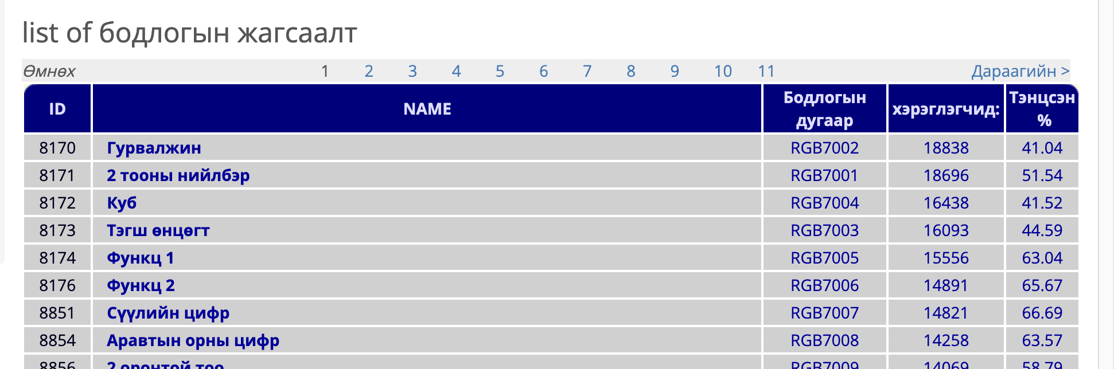
Create account on SPOJ, online platform for algorithm practice and coding challenges.
SPOJ (Sphere Online Judge) is an online platform designed for programmers to practice and improve their coding and problem-solving skills. It offers a vast collection of algorithmic problems that range from beginner to advanced levels, making it a popular choice among competitive programmers and coding enthusiasts.
Go to https://www.spoj.com/RGB7/ and sign-up
Notes:
Flowgorithm is a user-friendly application designed for creating and visualizing algorithms using flowcharts. It is primarily aimed at beginners who are learning the fundamentals of programming and algorithm design. The tool allows users to understand the logic of programming without the complexity of learning syntax for a specific programming language.
Key Features of Flowgorithm:
Flowchart-Based Design:
Users can create algorithms visually using flowcharts, which represent the logic and flow of the program.
Language-Independent:
The focus is on the logic and structure of algorithms, not on any specific programming language.
Step-by-Step Execution:
Flowgorithm can execute the flowchart step-by-step, allowing users to see how the algorithm works in real time.
Code Generation:
It can translate the flowchart into code in various programming languages such as Python, C++, Java, and more.
Debugging Support:
Built-in tools to help identify and fix logical errors in the flowchart.
Interactive Learning:
Suitable for teaching programming logic to beginners in a classroom or self-learning environment.
Free and Easy to Use:
Flowgorithm is free to download and use, making it accessible to students and educators.
Why Use Flowgorithm?
It simplifies the process of understanding algorithmic logic.
Reduces the barrier to entry for programming by eliminating syntax-related challenges.
Encourages logical thinking and problem-solving skills.
Who Can Benefit?
Students learning the basics of algorithms and programming.
Educators who want a visual teaching tool.
Beginners who want to understand program flow before diving into coding.
If you're teaching algorithms, Flowgorithm can be a great tool to incorporate into your lessons to make abstract concepts more tangible and interactive. Let me know if you'd like more information on how to use it!

Slide 19
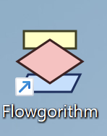
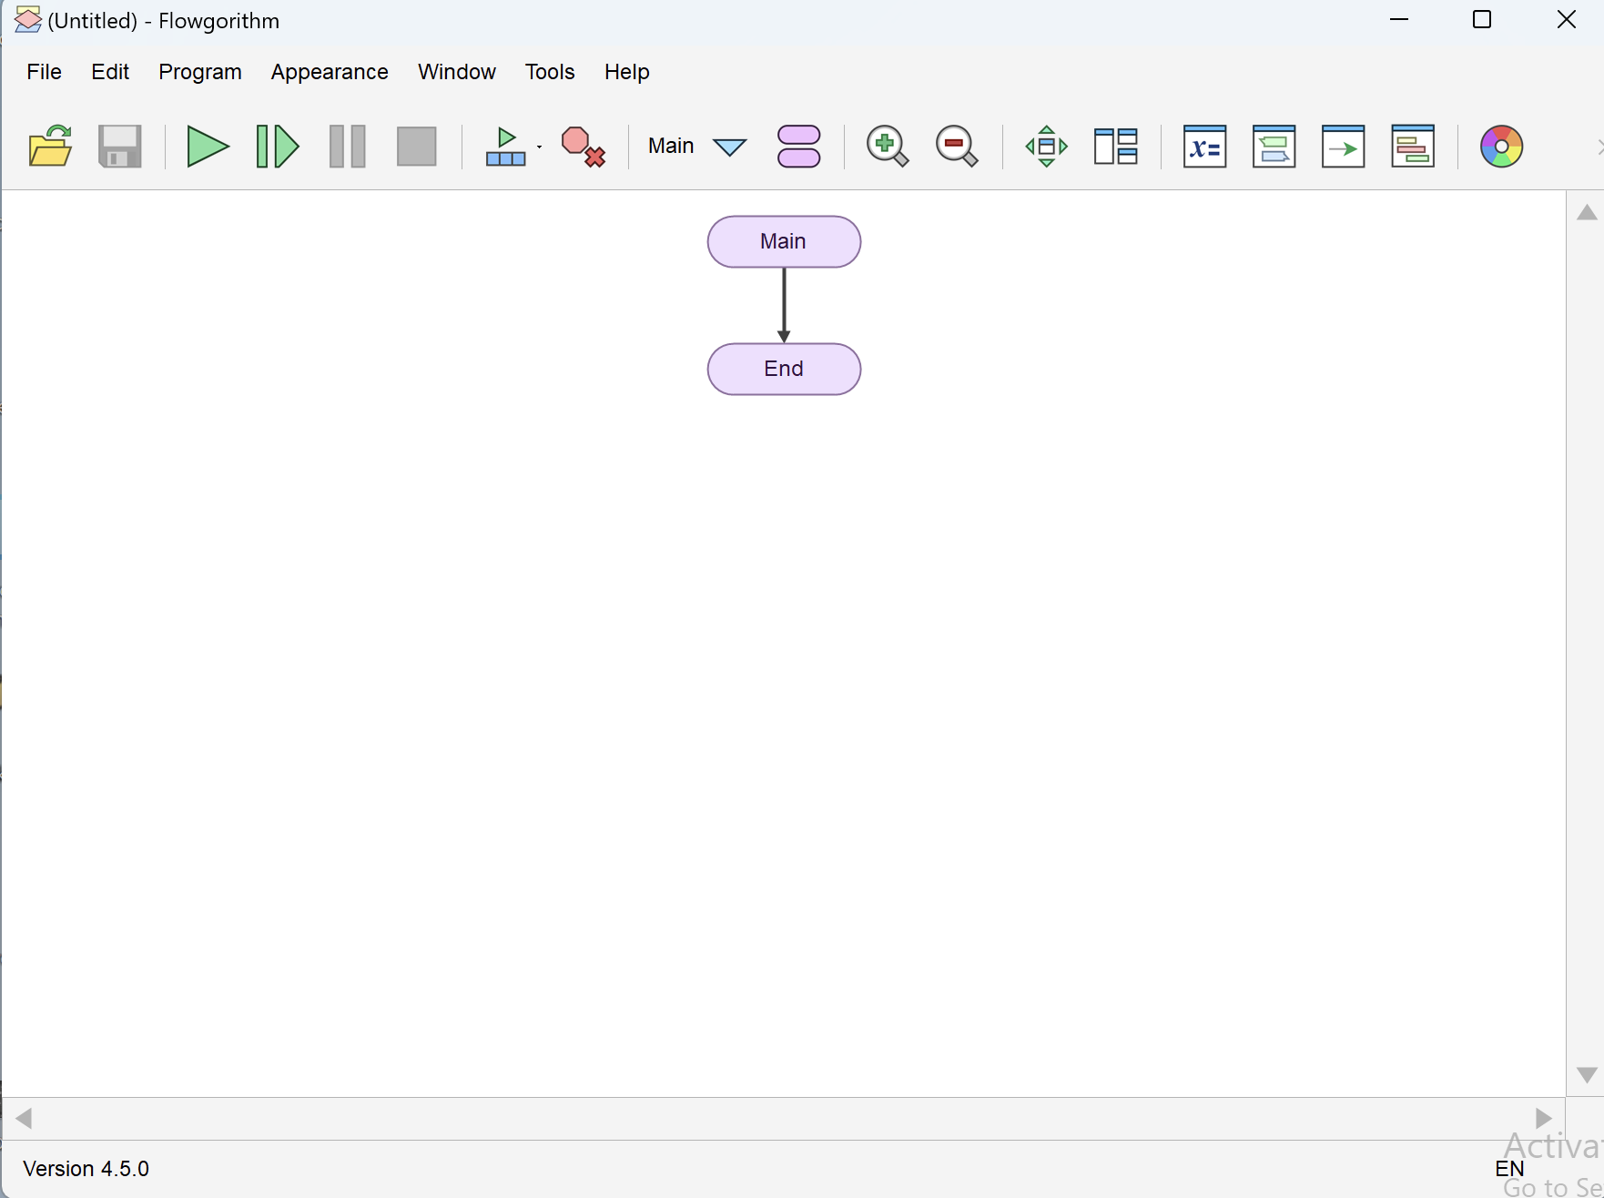
Get acquainted with the Flowgorithm tool
Start Flowgorithm.
Manual: https://www.flowgorithm.org/documentation/
Video: https://youtu.be/wmd_qu94Mx4?si=0B4uValHAcrUovzj

Slide 20
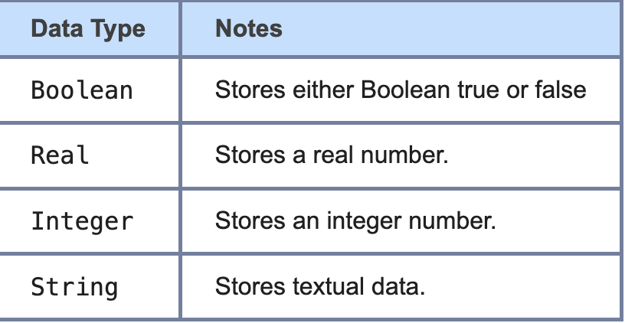
Get acquainted with the Flowgorithm tool
Data Types:
https://www.flowgorithm.org/documentation/language/types.html

Slide 21
Get acquainted with the Flowgorithm tool
Identifiers and Keywords:
https://www.flowgorithm.org/documentation/language/keywords.html
Naming Rules:
They must start with a letter.
After the first letter, the identifier can contain additional letters or numbers.
Spaces are not allowed.
They cannot be key words or words already defined by Flowgorithm.

Slide 22
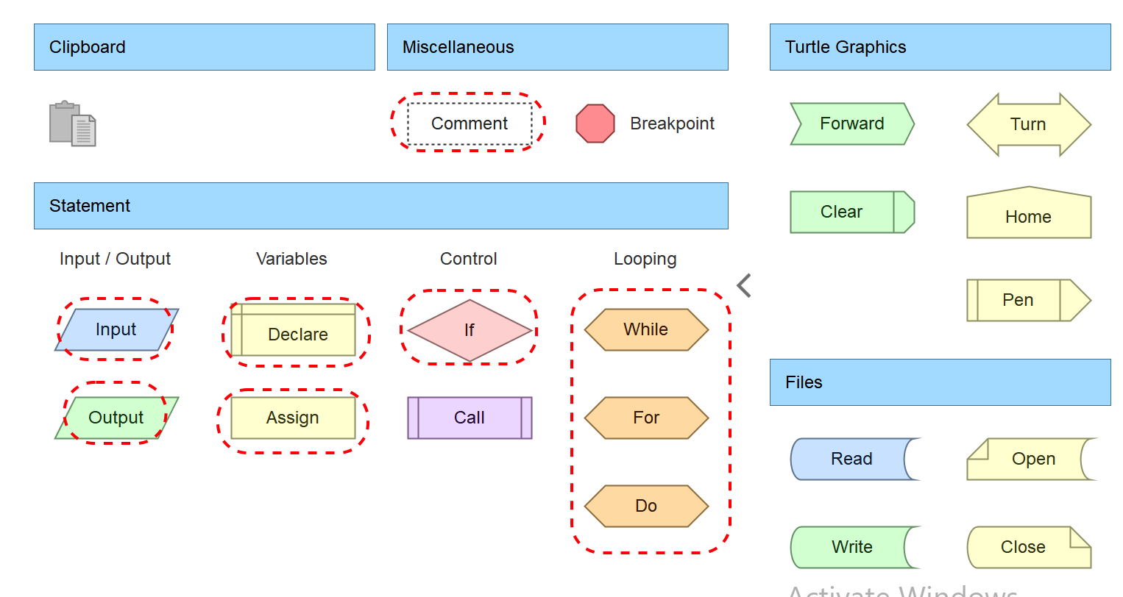
Get acquainted with the Flowgorithm tool
Basic Shapes
Input **
Output **
Declare **
Assign **
If **
While **
For **
Do **
Comment **

Slide 23
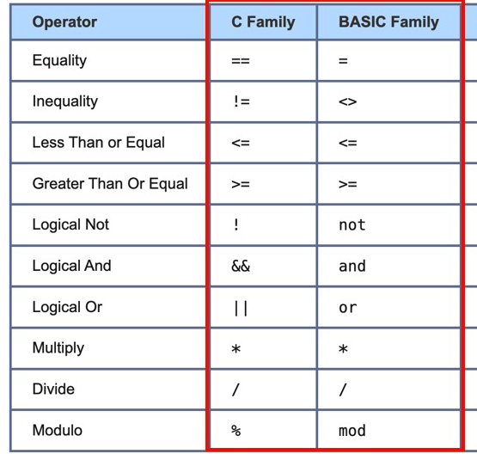
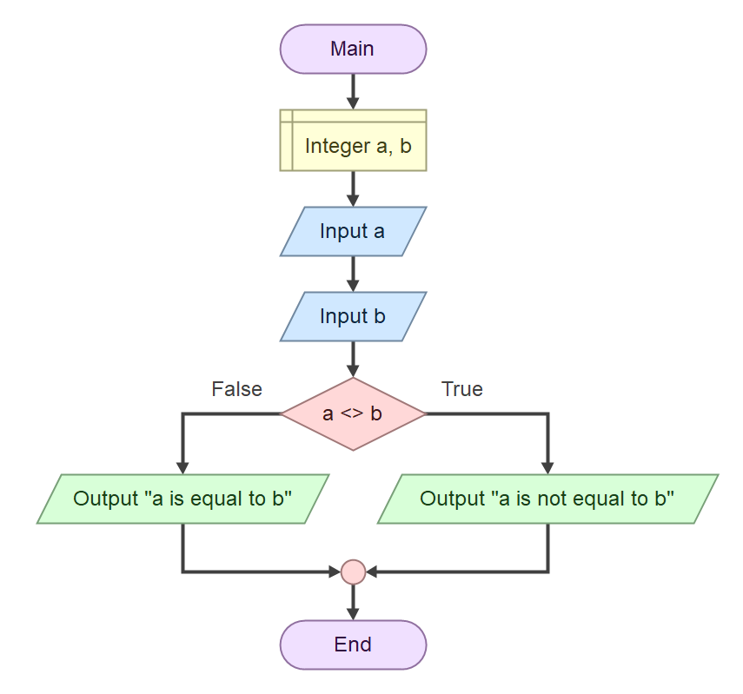
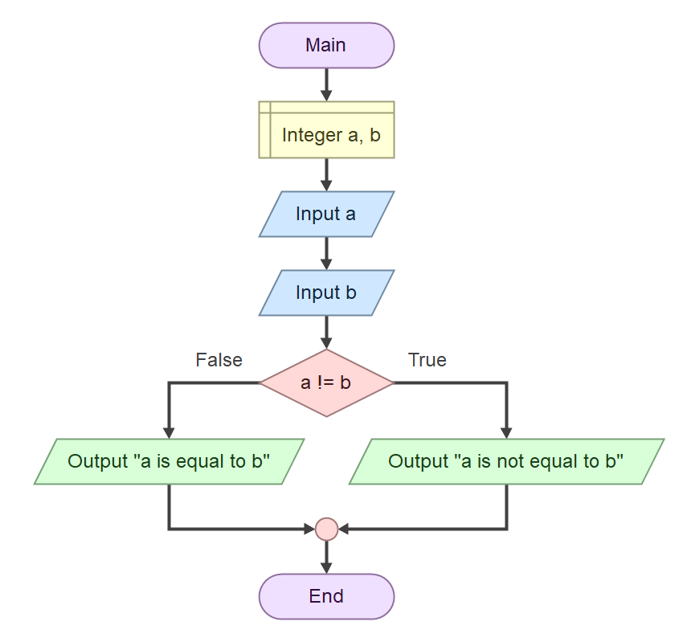
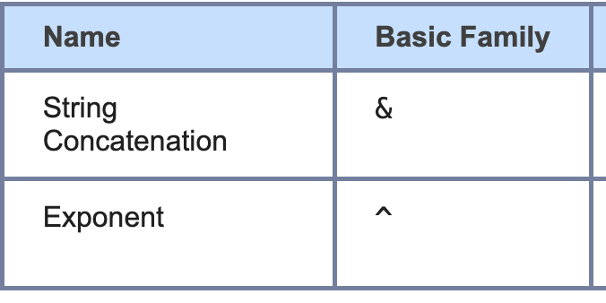
Get acquainted with the Flowgorithm tool
Operators
https://www.flowgorithm.org/documentation/language/operators.html
In Flowgorithm, you can use both types of operators.
Notes:
演算子 概要 比較や論理演算子などに使用される表記は、プログラミング言語によって大きく異なります。Flowgorithmは、数学で使用される記号（Unicode値を使用）だけでなく、2つの主要なプログラミング言語ファミリーの記号もサポートしています。「BASICファミリー」は英語のキーワードと演算子を使用します。一方、「Cファミリー」（C、Java、C#を含む）は、より記号的な表現を採用しています。
数学と2つの主要な言語ファミリーがサポートされているため、冗長な演算子も存在します。Flowgorithmでは、この冗長な演算子を同じものとして扱い、どのセットを使っても（または全てを使っても）構いません。これにより、生徒は後に学ぶ予定のプログラミング言語に合った演算子を使用することができます。

Slide 24
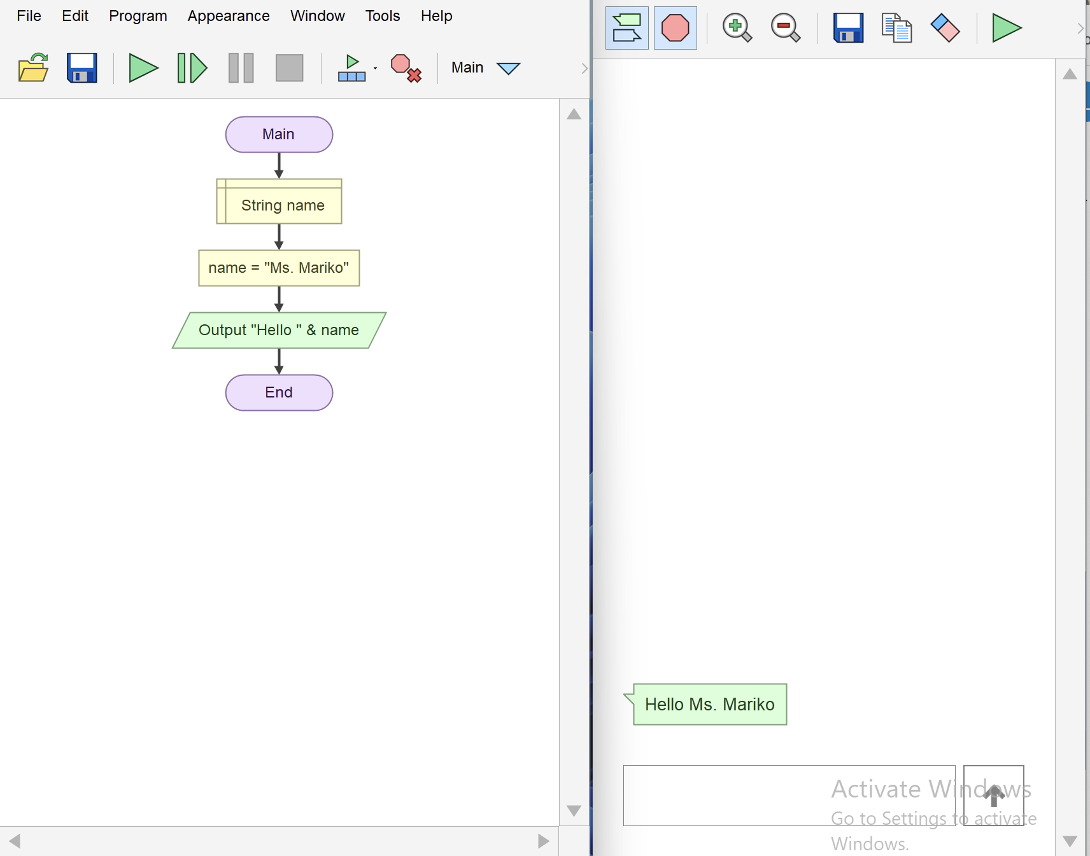
First Program in Flowgorithm
Video: https://youtu.be/u1O_Ml1qX1M?si=I1uUL-P8JjRBWPTv

Slide 25
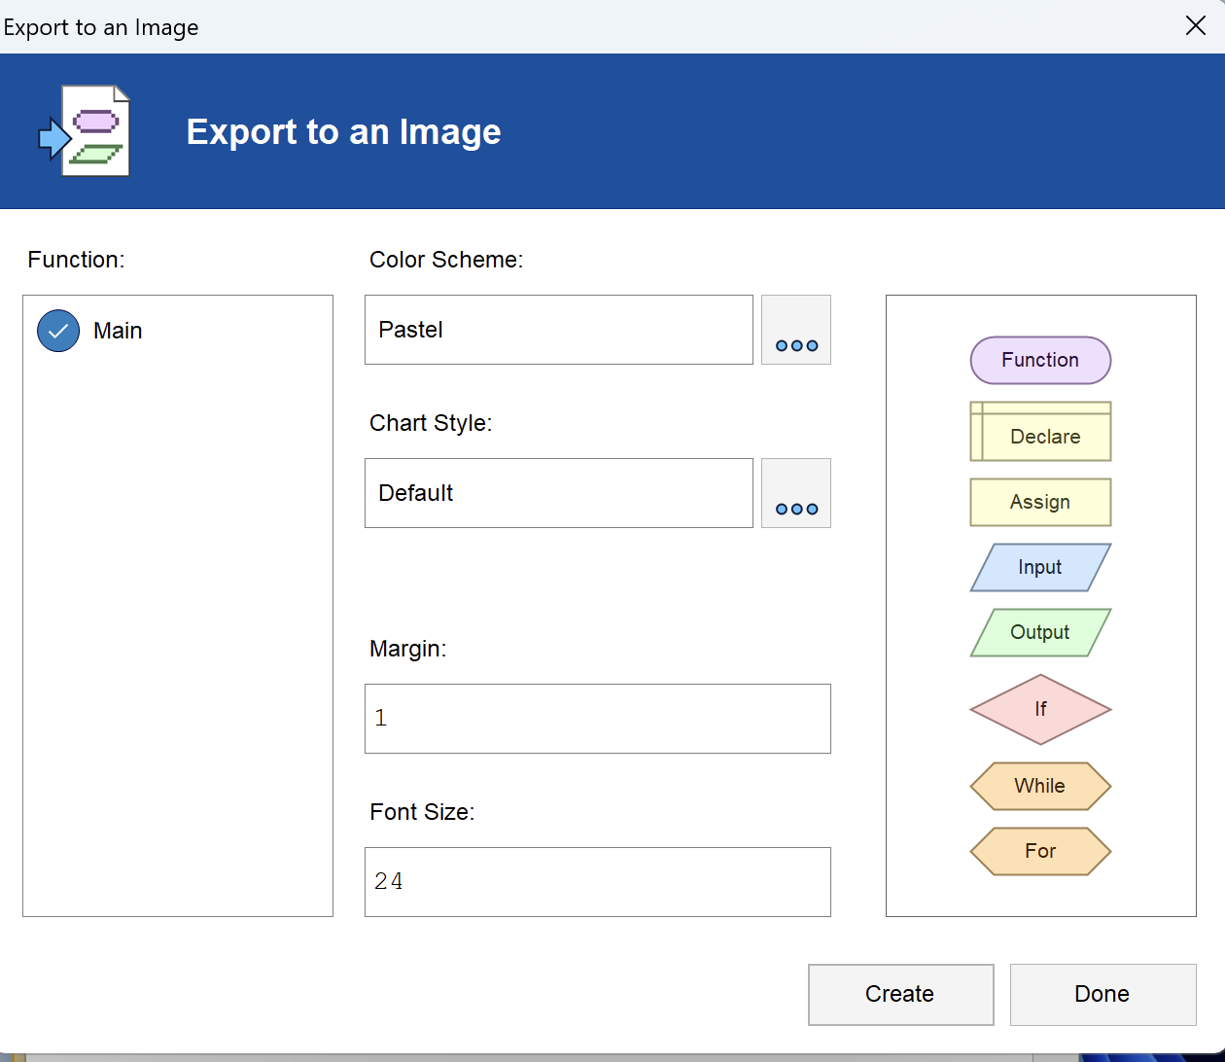
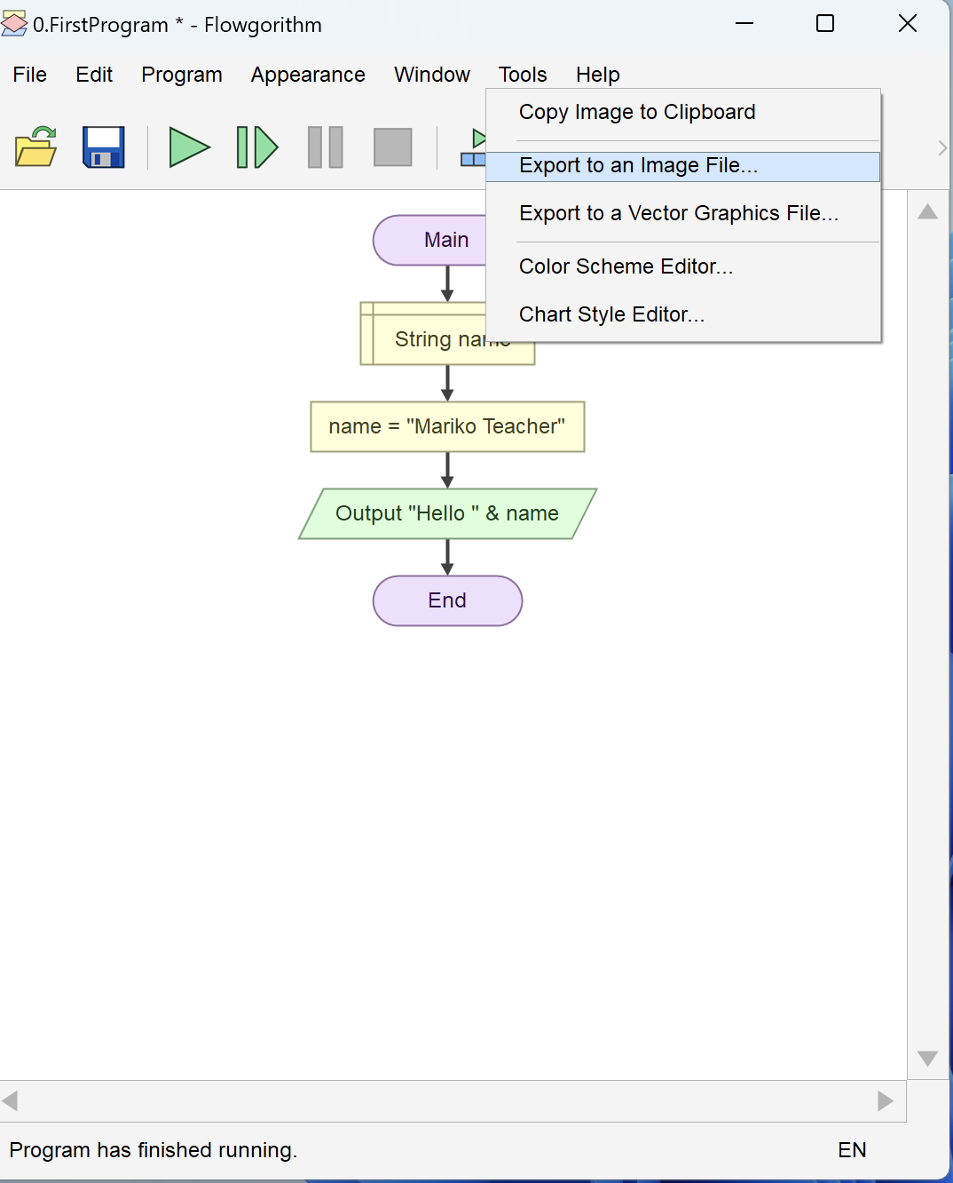
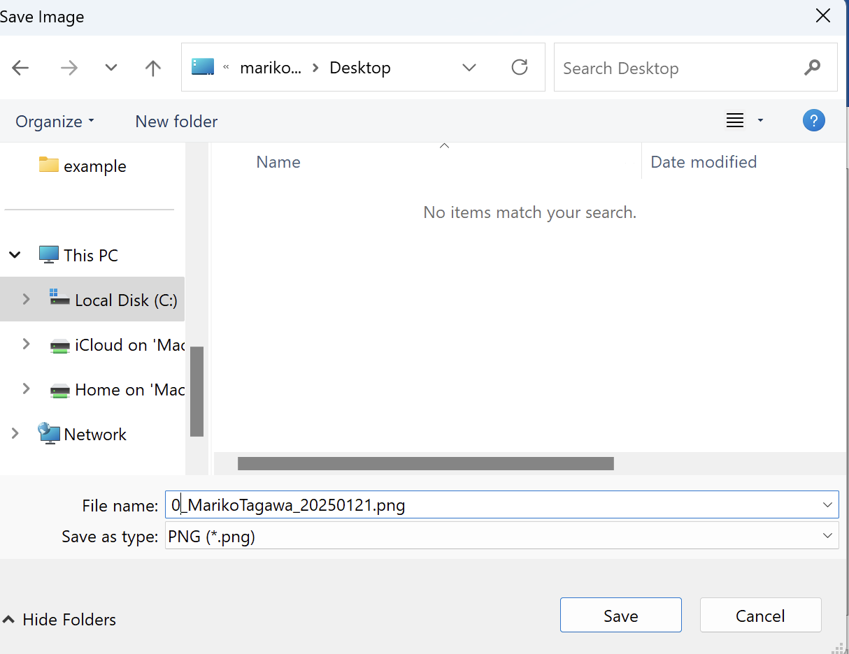
Exercise 1
Store your name in the variable “name”.
Print out “Hello < your name>.
Save your algorithm as <Your Name>_20250203.
Tools – Export to an Image File as <Your Name>_20250203.png.
Upload the Image file to the Teams folder.
File Name : <Your Name>_<2025MMDD>

Slide 26
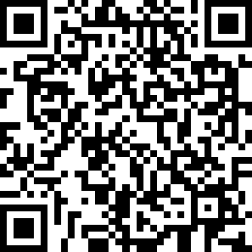
Attendance Check1
Please submit the following form at the end of the class. This is today's attendance check.
https://forms.gle/RQmYSnNMKkhu56Jt9

Slide 27
Class 2: Building Basic Algorithms with Flowgorithm
Goals/Tasks:
Create algorithms to solve geometric and numeric problems.
Finding the sum of two numbers.
Calculating the perimeter of a triangle
Calculating the cube of a number.
Computing the area of a rectangle.
SPOJ: https://www.spoj.com/RGB7/problems/main/sort=0,start=0

Slide 28
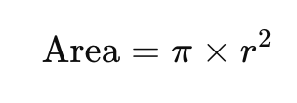
Example1: Flowgorithm Area of a Circle
pi refers to the mathematical constant, which is approximately 3.14159…...
Video: https://youtu.be/mHCiQJTZsww?si=DTxeIMNqr01-WsET
Calculate area of a circle.
Input
Radius of the circle.
Output
The Area of the circle.
r
Function | Description
ToFixed(r, i) | Convert real number r to a string with i digits after the decimal point. This function is useful for currency.
ToInteger(n) | Convert a string to an integer
ToReal(n) | Convert a string to an real
ToString(n) | Convert a number to a string

Slide 29
Example2: Flowgorithm Area of a Circle
Video: https://youtu.be/X1OE4ZL8co0?si=5b3V25Guj0cU4p9b
Calculate area of a triangle.
Input
Base and Hight of the triangle.
Output
The Area of the triangle.
Hight
Base
Area = (Base x Hight ) / 2

Slide 30
Execise: 1. RGB7001 - Sum of 2 Numbers
SPOJ: https://www.spoj.com/RGB7/problems/RGB7001/
Find the sum of the given integers.
Input
Two integers separated by a space are provided on a single line.
Output
The sum of the two integers.
Example
Input: 12, 23
Output: 35
Save your algorithm as <Your Name>_ RGB7001.
Tools – Export to an Image File as <Your Name>_ RGB7001.png.
Upload the Image file to the Teams folder.

Slide 31
Execise: 2. RGB7002 - Triangle
SPOJ: https://www.spoj.com/RGB7/problems/RGB7002/
Find the perimeter of the given triangle.
Input
The sides of the triangle are provided as integers separated by spaces on a single line.
Output
The perimeter of the triangle.
Example
Input: 3 4 5
Output:12
Save your algorithm as <Your Name>_ RGB7002.
Tools – Export to an Image File as <Your Name>_ RGB7002.png.
Upload the Image file to the Teams folder.
5
3
4
Notes:
RGB7002 - 三角形
与えられた三角形の周囲長を求める。
入力 三角形の辺が整数で、スペースで区切られて1行に与えられる。
出力 三角形の周囲長。

Slide 32
Execise: 3, RGB7003 - Rectangle
SPOJ: https://www.spoj.com/RGB7/problems/RGB7003/
Find the area and perimeter of the given rectangle.
Input
The length and width of the rectangle are provided as integers, separated by a space, on a single line.
Output
Print the area and perimeter of the rectangle, separated by a space, on a single line.
Example
Input: 6 4
Output: 24 20
Save your algorithm as <Your Name>_ RGB7003.
Tools – Export to an Image File as <Your Name>_ RGB7003.png.
Upload the Image file to the Teams folder.
6
4
Notes:
Perimeter = total length of the four sides ４角形＝quadrilateral

Slide 33
Execise: 4. RGB7004 - Cube
SPOJ: https://www.spoj.com/RGB7/problems/RGB7004/
Find the volume and total surface area of the given cube.
Input
The side length of the cube is given as an integer on a single line.
Output
Print the volume and the total surface area of the cube, separated by a space, on a single line.
Example
Input: 5
Output: 125 150
Save your algorithm as <Your Name>_ RGB7004.
Tools – Export to an Image File as <Your Name>_ RGB7004.png.
Upload the Image file to the Teams folder.
5

Slide 34
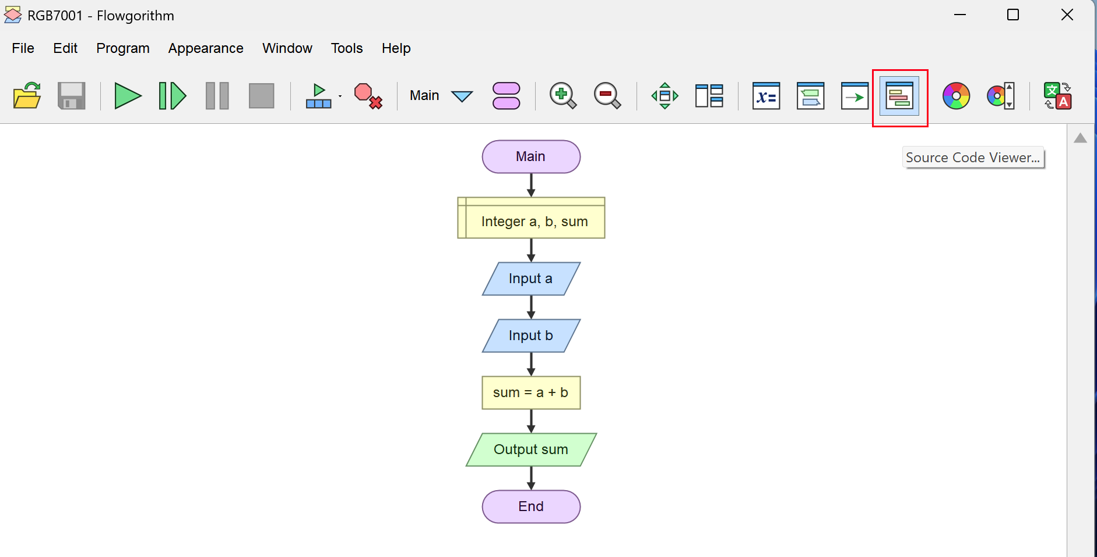
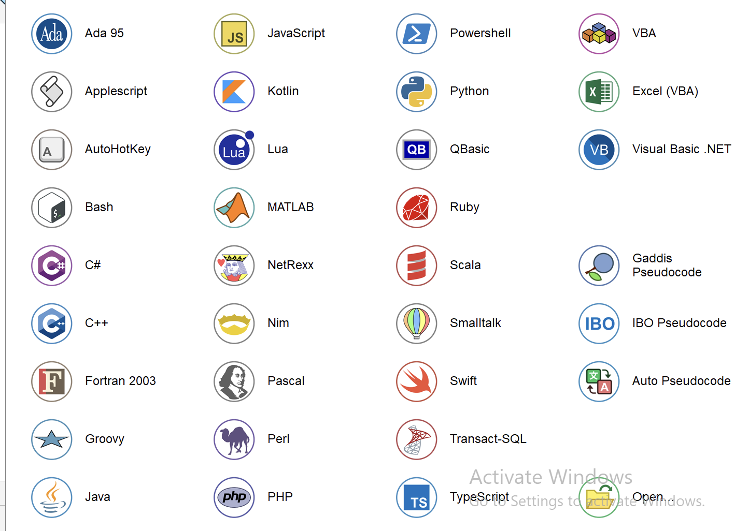
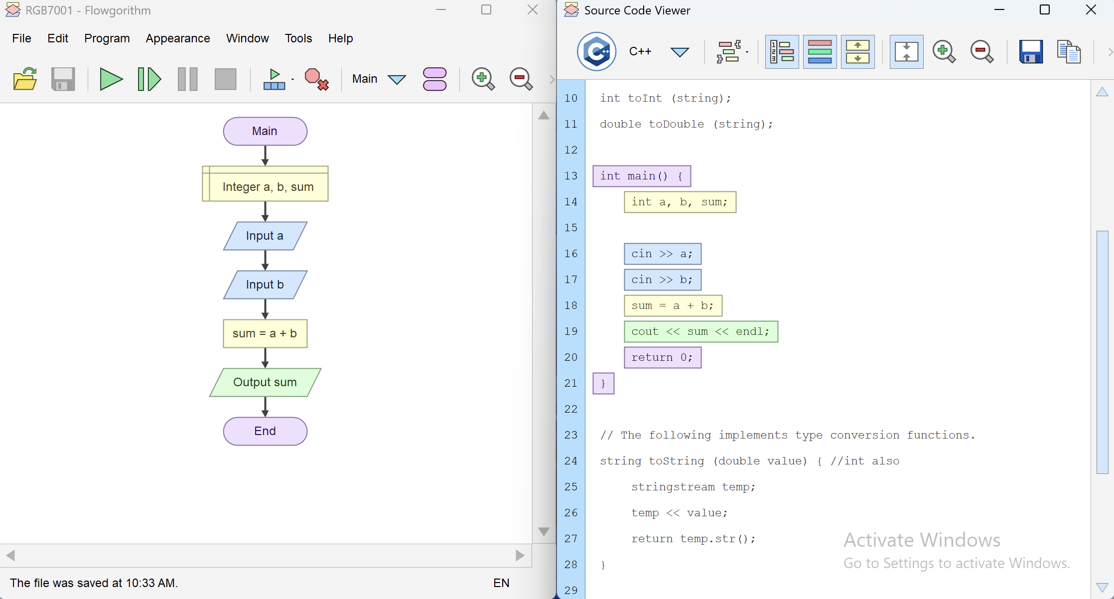
Option: The Source Code Viewer
Programming language is not the scope in this class. But if you want to try, please try!
Source Code Viewer
Supported programming languages
Copy Source Code

Slide 35
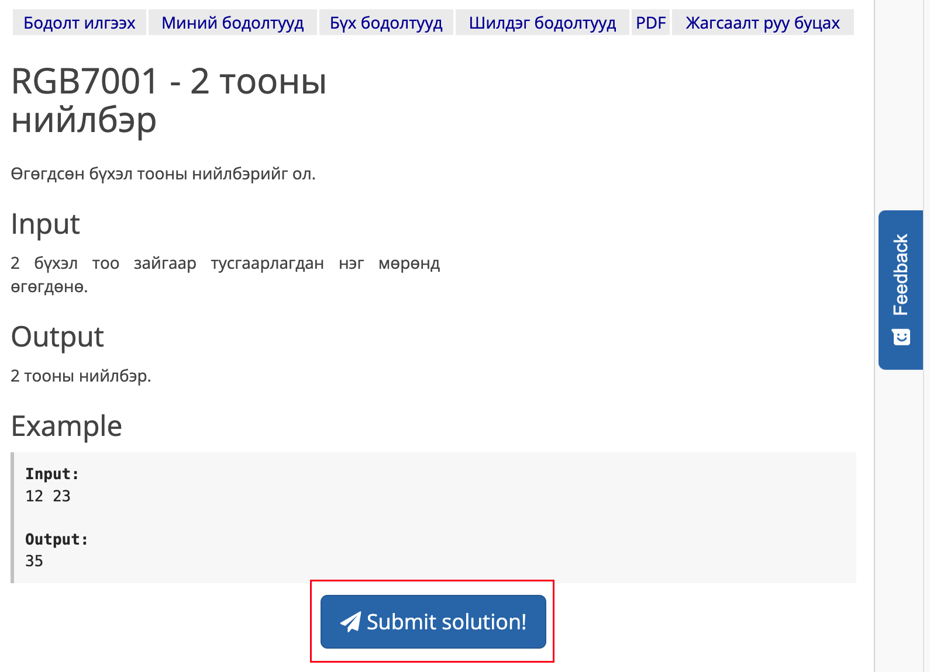
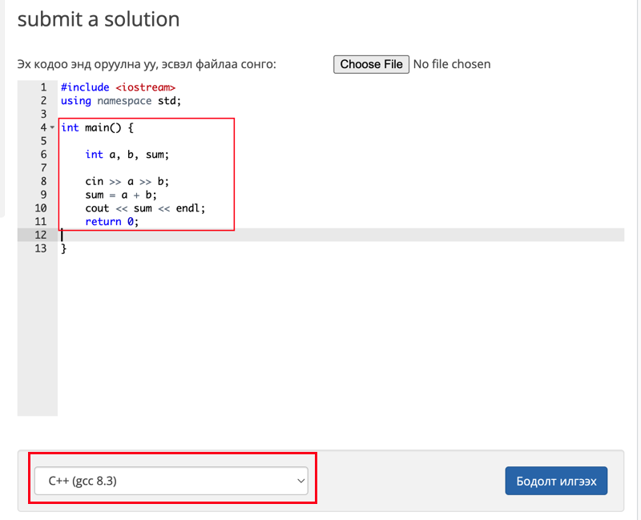
Option: The Source Code Viewer
Submit your code and see if it passes or not pass.

Slide 36
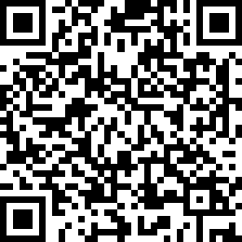
Attendance Check 2
Please submit the following form at the end of the class. This is today's attendance check.
https://forms.gle/DfwqCF8n4JRD2Uxx7
If you can’t access to the google form, Please come to me. Otherwise, you will be checked as “Not-Attended”.

Slide 37
Class 3: Customizing Functions in Algorithms
Goals/Tasks:
Writing functions.
Extracting digits.
Writing a simple custom function (Function 1).
Writing a second custom function (Function 2).
Extracting the last digit of a number.
Identifying the decimal place digit in a number.
Working with 2-digit and 3-digit numbers.
SPOJ: https://www.spoj.com/RGB7/problems/main/sort=0,start=0

Slide 38
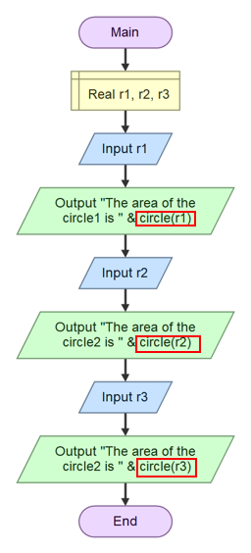
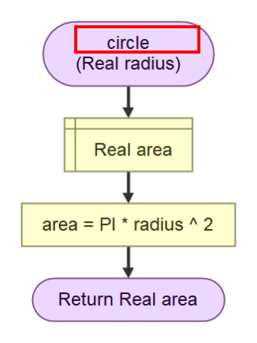
Function
In Flowgorithm, a function is a reusable block of code within a flowchart that performs a specific task.
Function

Slide 39
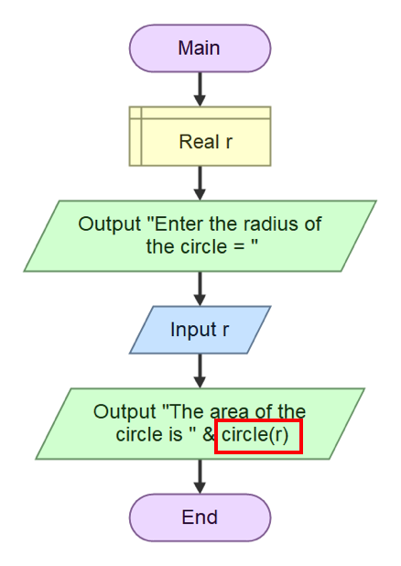
Function
Video: https://youtu.be/5L7Xr2fJzNc?si=uhso_J5XGvWEcJS6
Function name: circle
Argument: r
Output: area
pi refers to the mathematical constant, which is approximately 3.14159
Calculating the area of a circle:

Slide 40
Execise: 5. RGB7005 - Function 1
SPOJ: https://www.spoj.com/RGB7/problems/RGB7005/
The function is defined as: y = 3x - 5
Input
The value of x is given as an integer.
Output
The value of y.
Example
Input:1
Output:-2
Save your algorithm as <Your Name>_ RGB7005.
Tools – Export to an Image File as <Your Name>_ RGB7005.png.
Upload the Image file to the Teams folder.

Slide 41
Execise: 6. RGB7006 - Function 2
SPOJ: https://www.spoj.com/RGB7/problems/RGB7006/
The function is defined as: y=_{4x}²_{- 3x + 5}
Input
x is an integer of type Int.
Output
The value of y.
Example
Input: -2
Output: 27
Save your algorithm as <Your Name>_ RGB7006.
Tools – Export to an Image File as <Your Name>_ RGB7006.png.
Upload the Image file to the Teams folder.

Slide 42
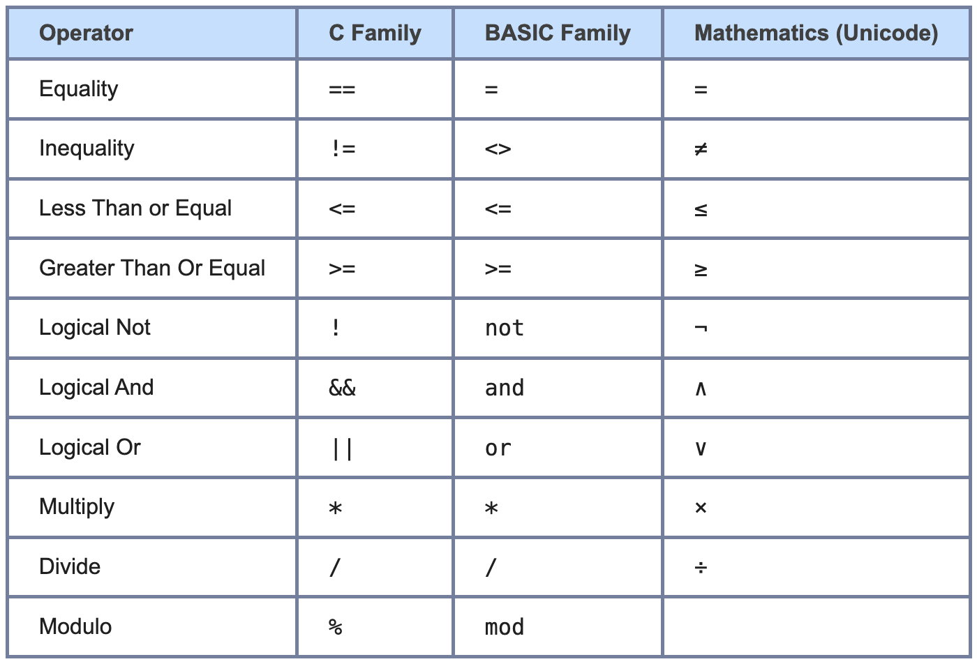
Operators in flowgorithm
http://www.flowgorithm.org/documentation/language/operators.html

Slide 43
Execise: 7. RGB7007 - Last Digit
SPOJ: https://www.spoj.com/RGB7/problems/RGB7007/
Find the last digit of the given number.
Input
An integer of type Int is provided.
Output
The last digit.
Example
Input: 476
Output: 6
Save your algorithm as <Your Name>_ RGB7007.
Tools – Export to an Image File as <Your Name>_ RGB7007.png.
Upload the Image file to the Teams folder.
Hint: Use Operator “%”

Slide 44
Execise: 8. RGB7008 - Tens Digit
SPOJ: https://www.spoj.com/RGB7/problems/RGB7008/
Find the tens digit of the given number.
Input
An integer of type Int is provided.
Output
The tens digit.
Example
Input: 423
Output: 2
Save your algorithm as <Your Name>_ RGB7008.
Tools – Export to an Image File as <Your Name>_ RGB7008.png.
Upload the Image file to the Teams folder.
Hint: Use Operator “/”, “%”

Slide 45
Execise: 9. RGB7009 - 2-Digit Number
SPOJ: https://www.spoj.com/RGB7/problems/RGB7009/
Find the product of the digits of the given 2-digit number.
Input
A 2-digit number is provided.
Output
The product of the tens digit and the units digit.
Example
Input: 27
Output: 14
Save your algorithm as <Your Name>_ RGB7009.
Tools – Export to an Image File as <Your Name>_ RGB7009.png.
Upload the Image file to the Teams folder.
Hint: Use Operator “/”, “%”
Notes:
与えられた2桁の数字の各桁の積を求めなさい。 Output: 十の位の数字と一の位の数字の積。

Slide 46
Execise: 10. RGB7010 - 3-Digit Number
SPOJ: https://www.spoj.com/RGB7/problems/RGB7010/
Find the sum of the digits of the given 3-digit number.
Input
A 3-digit positive number is provided.
Output
The sum of its digits.
Example
Input: 123
Output: 6
Save your algorithm as <Your Name>_ RGB7010.
Tools – Export to an Image File as <Your Name>_ RGB7010.png.
Upload the Image file to the Teams folder.
Hint: Use Operator “/”, “%”

Slide 47
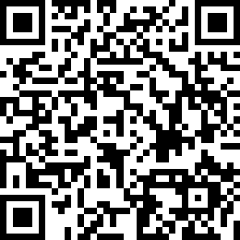
Attendance Check3
Please submit the following form at the end of the class. This is today's attendance check.
https://forms.gle/cvSzk2GN57JsgKNg6

Slide 48
Class 4: Time and Date Conversions Using Algorithms
Goals/Tasks:
Develop algorithms to manipulate and convert time-based values like minutes, seconds, hours, and days.
Convert minutes and seconds.
Convert hours, minutes, and seconds.
Calculate total seconds from time formats.
Convert days and hours.
Convert years and months.
SPOJ: https://www.spoj.com/RGB7/problems/main/sort=0,start=0

Slide 49
Execise: 11. RGB7011 - Minutes and Seconds
SPOJ: https://www.spoj.com/RGB7/problems/RGB7011/
Convert the given seconds into minutes and seconds.
Input The number of seconds is provided as an integer (Int).
Output Print the minutes and seconds, separated by a space.
Example
Input: 200
Output: 3 20
Save your algorithm as <Your Name>_ RGB7011.
Export to an Image File as <Your Name>_ RGB7011.png.
Upload the Image file to the Teams folder.

Slide 50
Execise: 12. RGB7012 - Hours, Minutes, and Seconds
SPOJ: https://www.spoj.com/RGB7/problems/RGB7012/
Convert the given seconds into hours, minutes, and seconds.
Input
The number of seconds is provided as an integer (Int).
Output
Print the hours, minutes, and seconds, separated by a single space. If there are no hours or minutes, output 0 for those fields.
Example
Input: 3612
Output: 1 0 12
Save your algorithm as <Your Name>_ RGB7012.
Export to an Image File as <Your Name>_ RGB7012.png.
Upload the Image file to the Teams folder.

Slide 51
Execise: 13. RGB7013 - Minutes and Seconds -> Seconds
SPOJ: https://www.spoj.com/RGB7/problems/RGB7013/
Convert the given minutes and seconds into total seconds.
Input
Minutes and seconds are provided as integers (Int) separated by a space.
Output
The total seconds.
Example
Input: 3 4
Output: 184
Save your algorithm as <Your Name>_ RGB7013.
Export to an Image File as <Your Name>_ RGB7013.png.
Upload the Image file to the Teams folder.

Slide 52
Execise: 14. RGB7014 - Hours, Minutes, and Seconds -> Seconds
SPOJ: https://www.spoj.com/RGB7/problems/RGB7014/
Convert the given hours, minutes, and seconds into total seconds.
Input
Hours, minutes, and seconds are provided as integers (Int) separated by spaces on a single line.
Output
The total seconds.
Example
Input: 1 2 3
Output: 3723
Save your algorithm as <Your Name>_ RGB7014.
Export to an Image File as <Your Name>_ RGB7014.png.
Upload the Image file to the Teams folder.

Slide 53
Execise: 15. RGB7015 - Days and Hours
SPOJ: https://www.spoj.com/RGB7/problems/RGB7015/
Convert the given hours into days and hours.
Input
The number of hours is provided as an integer (Int).
Output
Print the days and hours, separated by a space, on a single line.
Example
Input: 44
Output: 1 20
Save your algorithm as <Your Name>_ RGB7015.
Export to an Image File as <Your Name>_ RGB7015.png.
Upload the Image file to the Teams folder.

Slide 54
Execise: 16. RGB7016 - Days and Hours -> Hours
SPOJ: https://www.spoj.com/RGB7/problems/RGB7016/
Convert the given days and hours into total hours.
Input
Days and hours are provided as integers (Int) separated by a space.
Output
The total hours.
Example
Input: 2 5
Output: 53
Save your algorithm as <Your Name>_ RGB7016.
Export to an Image File as <Your Name>_ RGB7016.png.
Upload the Image file to the Teams folder.

Slide 55
Execise: 17. RGB7017 - Years and Months
SPOJ: https://www.spoj.com/RGB7/problems/RGB7017/
Convert the given number of months into years and months.
Input
The number of months is provided as an integer (Int).
Output
Print the years and remaining months, separated by a space, on a single line.
Example
Input: 27
Output: 2 3
Save your algorithm as <Your Name>_ RGB7017.
Export to an Image File as <Your Name>_ RGB7017.png.
Upload the Image file to the Teams folder.

Slide 56
Execise: 18. RGB7018 - Years and Months -> Months
SPOJ: https://www.spoj.com/RGB7/problems/RGB7018/
Convert the given years and months into total months.
Input
Years and months are provided as integers (Int) separated by a space on a single line.
Output
Print the total number of months.
Example
Input: 2 7
Output: 31
Save your algorithm as <Your Name>_ RGB7018.
Export to an Image File as <Your Name>_ RGB7018.png.
Upload the Image file to the Teams folder.

Slide 57
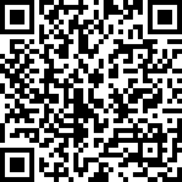
Attendance Check4
Please submit the following form at the end of the class. This is today's attendance check.
https://forms.gle/FSdKfv3fW2ocH3bd7

Slide 58
Class 5: Learning "If" to Compare Numbers
Goals:
Learn how to use "if" symbol to compare numbers in an algorithm.
Create algorithms to find the biggest and smallest numbers.
Find the bigger number between two numbers.
Find the smaller number between two numbers.
Find the biggest number among three numbers.
Find the smallest number among four numbers.
Execise5-1: Temperature-Based Weather Description.
Execise5-2: Calculate the bus fare based on the age.
SPOJ: https://www.spoj.com/RGB7/problems/main/sort=0,start=0

Slide 59
Class 5: Learning "If" to Compare Numbers
Video : https://youtu.be/Qr39lkxXbhE?si=xSma5YS7-K0bqX5F
Start Flowgorithm on your computer.

Slide 60
Execise: 19. RGB7101 - Maximum of Two Numbers
SPOJ: https://www.spoj.com/RGB7/problems/RGB7101/
Find the greater of the given two integers.
Input
Two integers of type Int are provided on a single line, separated by a space.
Output
The larger number.
Example
Input: 16 14
Output: 16
Save your algorithm as <Your Name>_ RGB7101.
Export to an Image File as <Your Name>_ RGB7101.png.
Upload the Image file to the Teams folder.

Slide 61
Execise: 20. RGB7102 - Minimum of Two Numbers
SPOJ: https://www.spoj.com/RGB7/problems/RGB7102/
Find the smaller of the given two numbers.
Input
Two numbers of type Int are provided on a single line, separated by a space.
Output
The smaller number.
Example
Input: 9 6
Output: 6
Save your algorithm as <Your Name>_ RGB7102.
Export to an Image File as <Your Name>_ RGB7102.png.
Upload the Image file to the Teams folder.

Slide 62
Execise: 21. RGB7103 - Maximum of Three Numbers
SPOJ: https://www.spoj.com/RGB7/problems/RGB7103/
Find the largest of the given three numbers.
Input
Three numbers of type Int are provided on a single line, separated by spaces.
Output
The largest number.
Example
Input: 1 3 2
Output: 3
Save your algorithm as <Your Name>_ RGB7103.
Export to an Image File as <Your Name>_ RGB7103.png.
Upload the Image file to the Teams folder.

Slide 63
Execise: 22. RGB7104 - Minimum of Four Numbers
SPOJ: https://www.spoj.com/RGB7/problems/RGB7104/
Find the smallest of the given four numbers.
Input
Four integers of type Int are provided on a single line, separated by spaces.
Output
The smallest number.
Example
Input: 3 2 1 4
Output: 1
Save your algorithm as <Your Name>_ RGB7104.
Export to an Image File as <Your Name>_ RGB7104.png.
Upload the Image file to the Teams folder.

Slide 64
Exercise: 5-1: Temperature-Based Weather Description
Task:
Create an algorithm using Flowgorithm ”if” symbol that does the following:
Asks the user: "What is the temperature in Celsius?”
Based on the input temperature, display the appropriate message:
If the temperature is greater than 35°C, output: "Oh, you could fry eggs on the pavement! ”
If the temperature is greater than 25°C, output: "It is hot outside."
If the temperature is less than 10°C, output: "It is cold outside."
Otherwise, output: "It is okay outside.”
Input: A single integer representing the temperature in Celsius.
Output: A message describing the weather condition.

Slide 65
Exercise: 5-1: Temperature-Based Weather Description
Hint:
What is the temperature in Celsius?
40
Oh, you could fry eggs on the pavement!
What is the temperature in Celsius?
30
It is hot outside

Slide 66
Exercise: 5-1: Temperature-Based Weather Description
Example 1:
Input: 30
Output: It is hot outside.
Example 2:
Input: 40
Output: Oh, you could fry eggs on the pavement!.
Example 3:
Input: 5
Output: It is cold outside.
Example 4:
Input: 20
Output: It is okay outside.
Please test your algorithm well.
Save your algorithm as <Your Name>_ exe5-1.
Export to an Image File as <Your Name>_ exe5-1.png.
Upload the Image file to the Teams folder.

Slide 67
Exercise: 5-2: Calculate the bus fare based on the age
Task:
Create an algorithm to calculate the bus fare based on the age.
Ask the user to input their age.
Based on the input age, calculate the bus fare and output it.
Calculate:
Adult (19 and older): The fare is 500 ₮.
Student (ages 13–18): The fare is 300 ₮.
Child (ages 6–12): The fare is 250 ₮.
Under 6: The fare is free.
Input: A single integer, passenger’s age.
Output: The bus fare.

Slide 68





Exercise: 5-2: Calculate the bus fare based on the age
Hint:
How old are you?
15
Your bus fare is 300 MNT
How old are you?
20
Your bus fare is 500 MNT
How old are you?
5
Your bus fare is Free

Slide 69
Exercise: 5-2: Calculate the bus fare based on the age
Example 1:
Input: 15
Output: 300 MNT
Example 2:
Input: 20
Output: 500 MNT
Example 3:
Input: 5
Output: The fare is free
Please test your algorithm well.
Save your algorithm as <Your Name>_ exe5-2.
Export to an Image File as <Your Name>_ exe5-2.png.
Upload the Image file to the Teams folder.

Slide 70
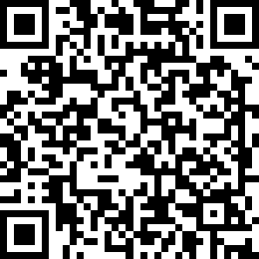
Attendance Check5
Please submit the following form at the end of the class. This is today's attendance check.
https://forms.gle/HTMXHfz61StvmTh29

Slide 71
Class 6: Learning "Loop" for Repeating Actions.
Goals:
Learn how to use the "loop" symbols (for, while, do ) to repeat actions in an algorithm. Create algorithms that perform repeated calculations automatically.
Print "IOI" 3 times on the screen.
Print "IOI" the number of times given by the user.
Compute the sum of 1 to N using a loop.
Compute n! (factorial of N) using a loop.
Use a "for" loop to calculate total running distance for a week.
Use a “while” loop to calculate total running distance for a month.
SPOJ: https://www.spoj.com/RGB7/problems/main/sort=0,start=0

Slide 72
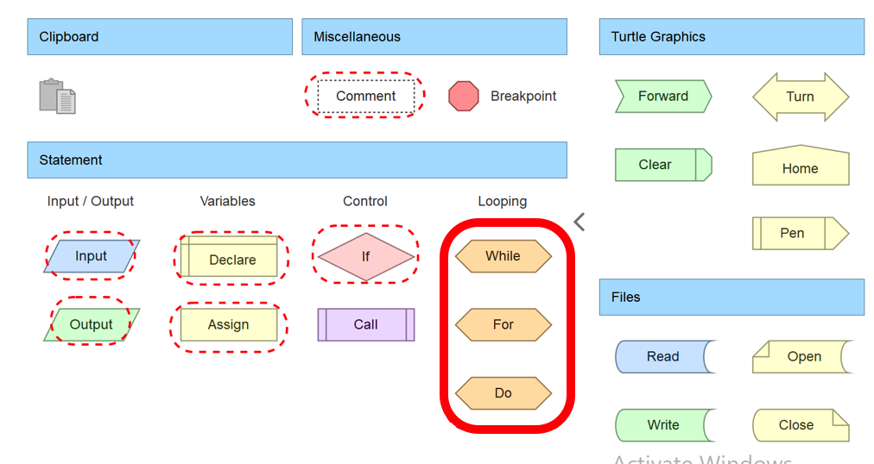
Class 6: Learning ”loop" to Repeat Actions.
Video of “for” loop : https://youtu.be/akYXMwjroJw?si=NcOCzqW3h2HPs3zE
Video of “while” loop: https://youtu.be/j5GEhz2IqXg?si=uk5Fsm4_hhoBdNlV

Slide 73
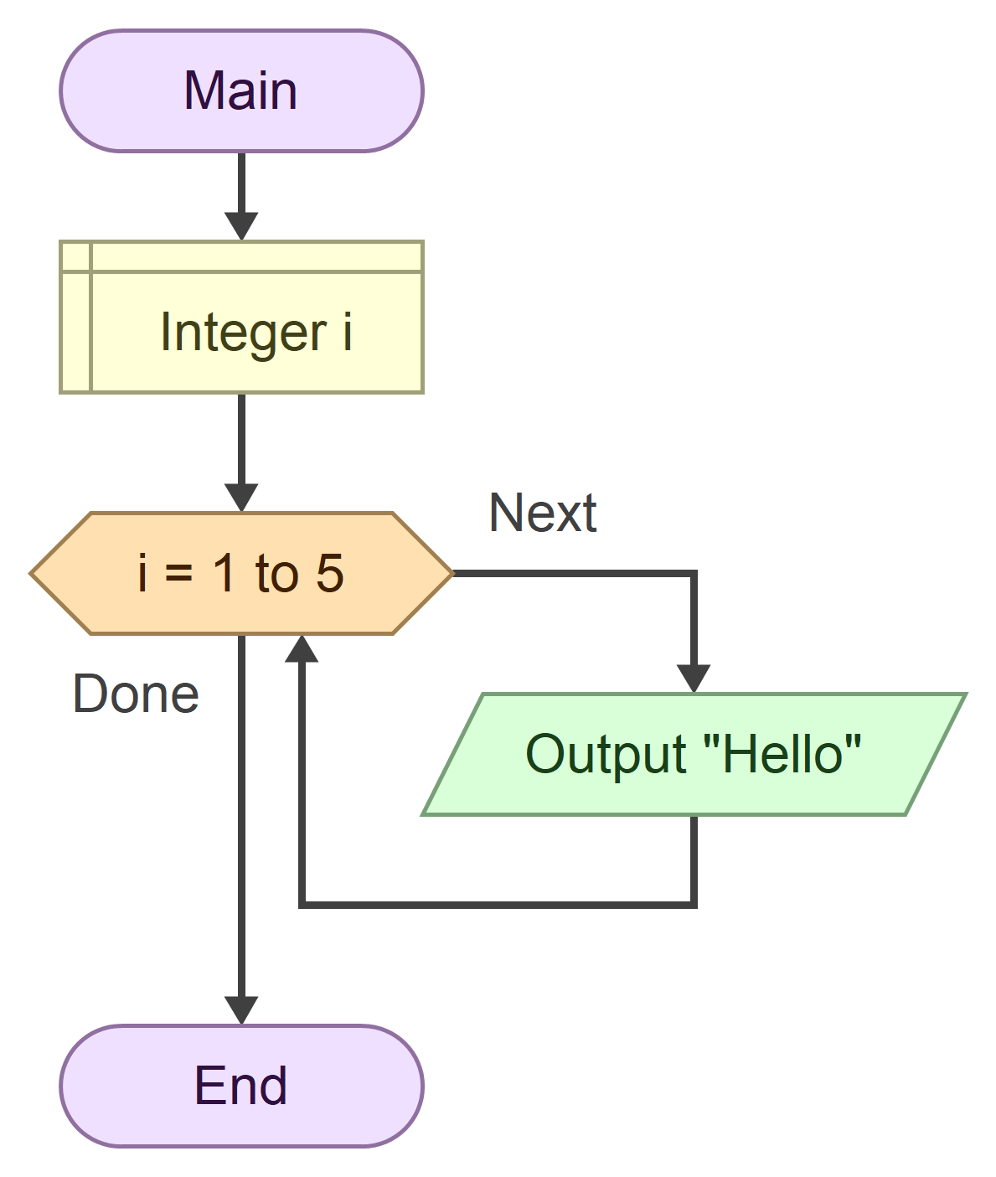
3 types of loop
For loop - Repeat a Fixed Number of Times
Use when you know how many times to repeat.
Runs a specific number of times.
Example:
"Print 'Hello' 5 times”

Slide 74
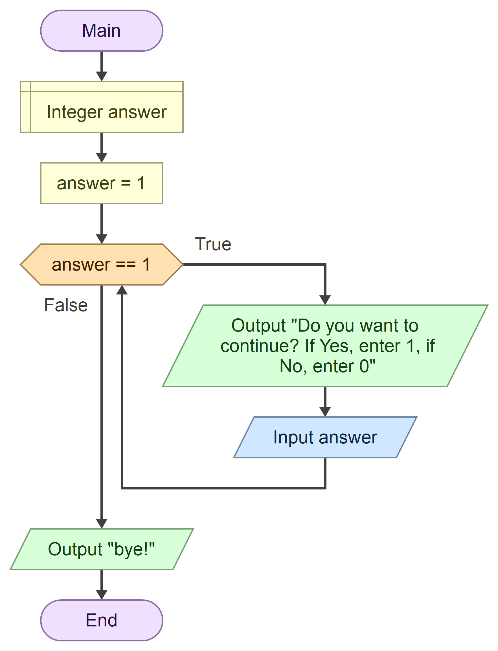
3 types of loop
While Loop – Repeat Until a Condition is False
Use when you don't know how many times to repeat
Checks the condition before running the loop
Example:
"Keep asking if user wants to continue or exit”

Slide 75
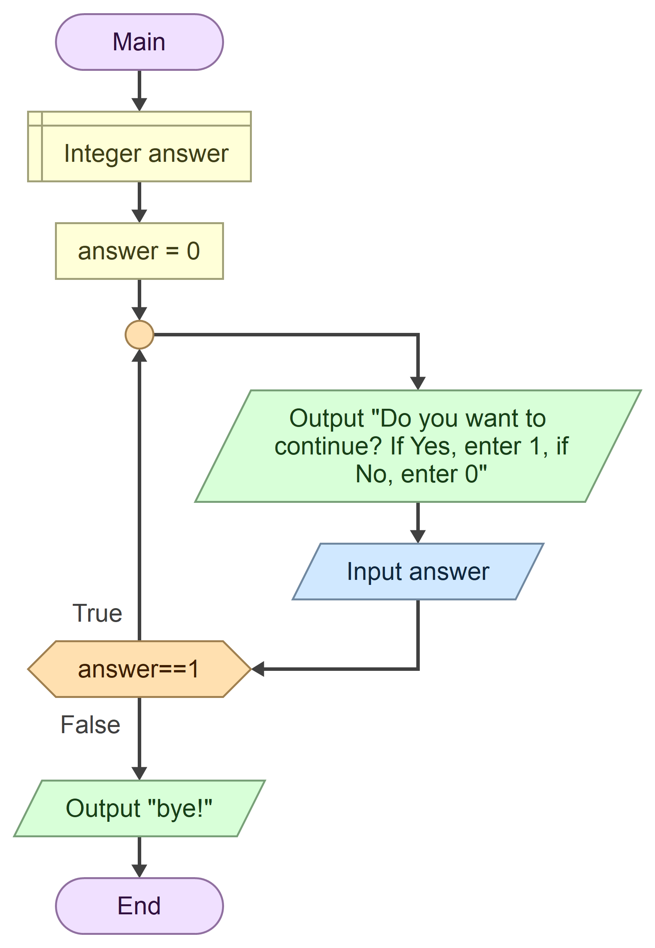
3 types of loop
Do Loop – Always Runs at Least Once
Runs the loop first, then checks the condition
Always executes at least once
Example:
" Keep asking if user wants to continue or exit"

Slide 76
Execise: 23. RGB7202 - IOI 3 times
SPOJ: https://www.spoj.com/RGB7/problems/RGB7202/
Print “IOI” 3 times on the screen.
Input
No input
Output
Print the word “IOI” for 3times
Example
Input: N/A
Output:
IOI IOI IOI
Save your algorithm as <Your Name>_ RGB7202.
Export to an Image File as <Your Name>_ RGB7202.png.
Upload the Image file to the Teams folder.

Slide 77
Execise: 24. RGB7203 - IOI n times
SPOJ: https://www.spoj.com/RGB7/problems/RGB7203/
Print “IOI” for the given number of times.
Input
A positive integer number is given
Output
Print the word “IOI” for the given number on each line.
Example
Input: 4
Output:
IOI IOI IOI
IOI
Save your algorithm as <Your Name>_ RGB7203.
Export to an Image File as <Your Name>_ RGB7203.png.
Upload the Image file to the Teams folder.

Slide 78
Execise: 25. RGB7204 - sum of numbers from 1
SPOJ: https://www.spoj.com/RGB7/problems/RGB7204/
Calculate the sum of numbers starting from 1 and repeating until the given number.
Input
A positive integer number is given
Output
The sum of the numbers from 1 to n
Example
Input: 5
Output: 15
1+2+3+4+5 = 15
Save your algorithm as <Your Name>_ RGB7204.
Export to an Image File as <Your Name>_ RGB7204.png.
Upload the Image file to the Teams folder.

Slide 79
Execise: 26. RGB7205 - sum of numbers from 1
SPOJ: https://www.spoj.com/RGB7/problems/RGB7205/
Calculate n! (n factorial) using a loop.
Input
A positive integer number is given
Output
Factorial of the given number.
Example
Input: 5
Output: 120
1 * 2 * 3 * 4* 5 = 120
Save your algorithm as <Your Name>_ RGB7205.
Export to an Image File as <Your Name>_ RGB7205.png.
Upload the Image file to the Teams folder.
Factorial (n!) is a mathematical function that represents the product of all positive integers from 1 to n.

Slide 80
Exercise 6-1: Calculate Total Running Distance for a Week.
Task: Create an algorithm using “for” loop to calculate Total Running Distance for a Week.
Scenario:
You're tracking your running distance for a week.
Uses a for loop to ask the user to input the number of km they ran each day for 7 days.
Calculates the total running distance for the week.
Output the total distance after exiting the loop.
Please test your algorithm well.
Save your algorithm as <Your Name>_ exe6-1.
Export to an Image File as <Your Name>_ exe6-1.png.
Upload the Image file to the Teams folder.

Slide 81
Exercise 6-1: Calculate Total Running Distance for a Week.
Instructions:
Use a for loop to repeat the input for 7 days.
Each day, ask the user:
How many kilometers did you run today?
Add the kilometers for each day to a variable that keeps track of the total distance.
After the loop ends, display the total running distance for the week.

Slide 82


Exercise 6-1: Calculate Total Running Distance for a Week.
Day 1: How many kilometers did you run today?
5
Day 2: How many kilometers did you run today?
7
Day 3: How many kilometers did you run today?
6
Day 4: How many kilometers did you run today?
8
Day 5: How many kilometers did you run today?
10
Day 6: How many kilometers did you run today?
3
Day 7: How many kilometers did you run today?
4
Total running distance for the week: 43 km

Slide 83
Exercise 6-2: Calculate run distance until a target goal is reached.
Task:
Create an algorithm using “while” loop to calculate Total Running Distance until a target goal is reached.
Scenario:
You are training for a running challenge and have set a total distance goal for the month. Each day, you record how many kilometers you ran.
Please test your algorithm well.
Save your algorithm as <Your Name>_ exe6-2.
Export to an Image File as <Your Name>_ exe6-2.png.
Upload the Image file to the Teams folder.

Slide 84
Exercise 6-2: Calculate run distance until a target goal is reached.
Instructions:
Ask the user to input their target running distance for the month.
Uses a while loop to keep asking the user to enter the distance they ran each day.
Continues looping until the total distance reaches the target goal or 30 days have passed.
If the goal is reached before 30 days, output a congratulatory message.
If 30 days pass without reaching the goal, output a message showing the total distance.

Slide 85
Exercise 6-2: Calculate run distance until a target goal is reached.
Sample: If the user meets the target before 30 days, exit the loop.
Enter your target running distance for the month (in km): 100
Enter the distance you ran today (in km): 5
Total so far: 5.00 km in 1 days.
Enter the distance you ran today (in km): 8
Total so far: 13.00 km in 2 days.
...
...
Enter the distance you ran today (in km): 7
Total so far: 102.00 km in 20 days.
Congratulations! You reached your goal of 100 km in 20 days!
TargetDistance = 100
DailyRun = 5
TotalDistance = 5
DayCount = 1
DailyRun = 8
TotalDistance = 13
DayCount = 2
DailyRun = 7
TotalDistance = 102
DayCount = 20

Slide 86
Exercise 6-2: Calculate run distance until a target goal is reached.
Sample: If the user reaches day 30 without meeting the target, quite the loop.
Enter your target running distance for the month (in km): 100
Enter the distance you ran today (in km): 5
Total so far: 5.00 km in 1 days.
...
Enter the distance you ran today (in km): 6
Total so far: 75.00 km in 30 days.
You reached the end of the month. You ran a total of 75.00 km.
TargetDistance
= 100
DailyRun = 5
TotalDistance = 5
DayCount = 1
DailyRun = 6
TotalDistance = 75
DayCount = 30

Slide 87
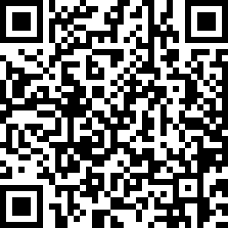
Attendance Check 6
Please submit the following form at the end of the class. This is today's attendance check.
https://forms.gle/wE82JQyNFJayVGFFA

Slide 88
Spare

Slide 89
Mid-Term Assignment: Create Your Own Algorithm
Goals/Tasks:
You will design and implement your own algorithm using Flowgorithm.
Be creative! You can create a quiz, game, calculation tool, or any scenario-based algorithm.
Instructions:
Think of a Scenario
Plan Your Algorithm
Implement in Flowgorithm
Test Your Algorithm
Upload Your Work
Submit the check form. https://forms.gle/GyhfQd6Ldvwbh2MaA

Slide 90
Mid-Term Assignment: Create Your Own Algorithm
Instructions:
Think of a Scenario
Example: A math quiz, a guessing game, a calculator, or any interactive program.
Plan Your Algorithm
Determine inputs and outputs
Use loops (for, while, do) if needed.
Use conditions (if) to make decisions.
Use functions to make the algorithm simple.
Implement in Flowgorithm
Design a flowchart of your logic.
Ensure the algorithm runs correctly.
Test Your Algorithm
Try different inputs to check if it works as expected.
Submit Your Work
Provide a brief explanation of your algorithm.
Include screenshots or a Flowgorithm file.

