Slide 1
Сүлжээний үндэс (Network Basics)
Class code: KCS414
Year Offering: 2025, 2nd Term
Target Grade Level: 4th Grade
Japanese Course Title: ネットワーク入門1,2
Created by Mariko Tagawa (marikotagawa@mail.com), JICA volunteer

Slide 2
TABLE OF CONTENTS 1
Course Overview
Course Plan
Course Objectives
Course materials

Slide 3
00
COURSE OVERVIEW

Slide 4
Course materials
Online Course: CISCO Networking Basics Course .
Simulation tool: CISCO Packet Tracer. We do a lot of hands-on exercise.
Textbook: “図解入門: TCP/IP”

Slide 5
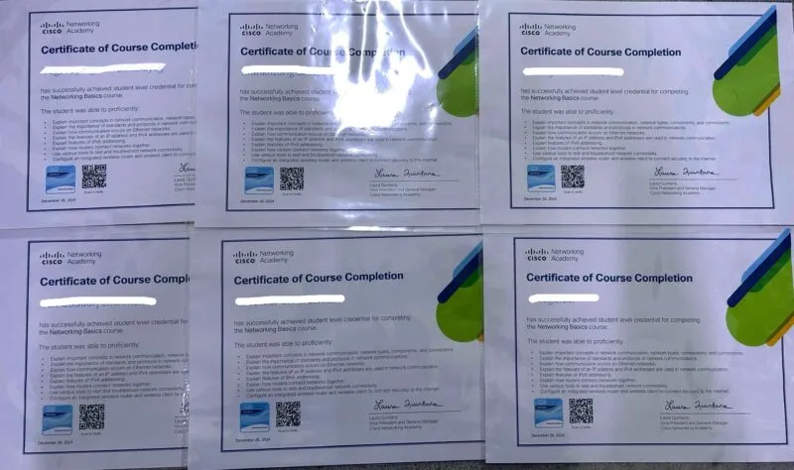
Achievements
CISCO provides the Digital Badge

Slide 6
TABLE OF CONTENTS 2
01
02
03
04
05
06
CISCO Packet Tracer
Communication in a Connected World
Network Components,
Types, and Connections
Build a
Home Network
Communication Principles
07
08
09
The Access Layer
The Internet Protocol
IPv4 and Network Segmentation
中間試験

Slide 7
TABLE OF CONTENTS 2
10
11
12
13
14
15
Dynamic Addressing with DHCP
Gateways to Other Networks
The ARP Process
Routing Between Networks
TCP and UDP
16
17
Application Layer Services
Network Testing Utilities
期末テスト

Slide 8
Course Objectives
Explain important concepts in network communication, network types, components, and connections.
Explain the importance of standards and protocols in network communications.
Explain how communication occurs on Ethernet networks.
Explain the features of an IP address and IPv4 addresses are used in network communication.
Explain features of IPv6 addressing.
Explain how routers connect networks together.
Use various tools to test and troubleshoot network connectivity.
Configure an integrated wireless router and wireless client to connect securely to the internet.
You will be able to perform the following tasks:

Slide 9
コースの目標
ネットワーク通信、ネットワークの種類、構成要素、および接続に関する重要な概念を説明する。
ネットワーク通信における標準とプロトコルの重要性を説明する。
イーサネットネットワーク上で通信がどのように行われるかを説明する。
IPアドレスの特徴と、IPv4アドレスがネットワーク通信でどのように使用されるかを説明する。
ルーターがどのようにしてネットワークを接続するかを説明する。
様々なツールを使用してネットワーク接続をテストおよびトラブルシューティングする。
無線ルーターとコンピュータを設定して、インターネットに安全に接続する方法を学ぶ。
コースを終了すると次のことができるようになります:

Slide 10
Course Plan 1-1
Week | Date 2025 | Class (80min) | Course Title | Course contents
1 | 1/23 | 1 | Course Overview CISCO Packet Traer | Installation of Packet Tracer. Exercise: Using the Packet Tracer.
 |  | 2
2 | 1/30 | 3 | Module 1: Communication in a Connected World | Network Types Data Transmission Bandwidth and Throughput Exercise: 1.1.4packet-tracer-create-realistic-structured-cablinginthe-physical-workspaceand-cabling-devices-ina-rack
 |  | 4
3 | 2/6 | 5 | Module 2: Network Components, Types, and Connections | Clients and Servers Network Components ISP Connectivity Options Exercise: 1.1.6packet-tracer-connect-devicesusing-wireless-technologies
 |  | 6
4 | 2/13 | 7 | Module 4: Build a Home Network Exercise with Packet Tracer | Home Network Basics Network Technologies in the Home Wireless Standards Exercise:Set Up a Home Router using Packet Tracer Exercise: 1.1.8packettracerexploredeviceconfigurationusingthecli
 |  | 8

Slide 11
Course Plan 1-2
Week | Date | Class | Course Title | Course contents
5 | 2/20 | 9 | Module 5: Communication Principles | Communication Protocols Communication Standards Network Communication Models Exercise: 2.0.7packetrtacer-edittoplogies
 |  | 10
6 | 3/6 | 11 | Module 7: The Access Layer | Encapsulation and the Ethernet Frame The Access Layer Exercise: 2.1.1_packet_tracer_create_a_simple_network
 |  | 12
7 | 3/13 | 13 | Module 8: The Internet Protocol | Purpose of an IPv4 Address The IPv4 Address Structure Exercise: 2.1.3packettracermonitoryournetworkusinganetworkcontroll
 |  | 14
8 | 3/20 | 15 | Module 9: IPv4 and Network Segmentation | IPv4 Unicast, Broadcast, and Multicast Types of IPv4 Addresses Network Segmentation Exercise: Router in Cisco Packet Tracer.pkt
 |  | 16

Slide 12
Course Plan 1-3
 | Week | Class | Course Title | Course contents
9 | 3/24~3/28 | 17 | 中間試験
 |  | 18
10 | 4/3 | 19 | Module 11: Dynamic Addressing with DHCP | Static and Dynamic Addressing DHCPv4 Configuration Exercise: Packet Tracer - Configure DHCP on a Wireless Router Exercise: Configuring a DHCP Server and Clients
 |  | 20
11 | 4/10 | 21 | Module 12: Gateways to Other Networks | Network Boundaries Network Address Translation Exercise: Packet Tracer - Examine NAT on a Wireless Router File: 10.2.3-packet-tracer---examine-nat-on-a-wireless-router.pka
 |  | 22
12 | 4/17 | 23 | Module 13: The ARP Process | MAC and IP Broadcast Containment Exercise: Packet Tracer - Identify MAC and IP Addresses file: 13.1.3-packet-tracer-identify-mac-and-ip-addresses.pka
 |  | 24

Slide 13
Course Plan 1-4
Week | Date | Class | Course Title | Course contents
13 | 4/24 | 25 | Module 14: Routing Between Networks | The Need for Routing The Routing Table Create a LAN Exercise: Packet Tracer - Create a LAN file: 14.3.3-packet-tracer-observe-traffic-flow-in-a-routed-network.pka file: 14.3.4-packet-tracer-create-lan.pka
 |  | 26
14 | 5/1 | 27 | Module 15: TCP and UDP | TCP and UDP Port Numbers Exercise: Packet Tracer – TCP and UDP Communications File:14.8.1 Packet Tracer - TCP and UDP Communications.pka
 |  | 28
15 | 5/8 | 29 | Module 16: Application Layer Services | The Client Server Relationship DNS, HTTP, FTP, Telnet, Email Exercise: Packet Tracer-Use FTP, Telnet and SSH File:16.5.3-packet-tracer---use-ftp-services.pka File: 16.6.4-packet-tracer---use-telnet-and-ssh.pka
 |  | 30
16 | 5/15 | 31 | Module 17: Network Testing Utilities | Troubleshooting Commands Exercise: Packet Tracer - Packet Tracer - Use the ping Command File: 17.1.3-packet-tracer---use-the-ipconfig-command.pka File: 17.1.6-packet-tracer---use-the-ping-command.pka File: 13 The Cisco Troubleshooting Methodology_20241209.pkt
 |  | 32

Slide 14
Course Plan 1-5
 | Week | Class | Course Title | Course contents
17 | 5/19~ 5/30 | 33 | 期末試験 | End of term test
 |  | 34
Spare |  |  |  | Exercise:2.1.5-packet-tracer-manage-and-configure-your-network-using-a-network-controller Exercise: Packet Tracer - 13 The Cisco Troubleshooting Methodology_20241209.pkt

Slide 15
授業の進め方
2
4
1
3
5
Quiz、確認テストの提出で出席をチェックする。
Quiz、確認テストの点数は成績に含めない。
授業の最後に質問やディスカッション
今日の授業で勉強したことについて質問やフリートーク (5分)
今日の学習目標
今日の授業が終わった時に習得しておくべきこと (1-2分)
Quizで確認
授業の途中にQuizで理解を確認 （5-10分)
6
今日の授業について
今日の授業の内容の説明 （1-2分）
授業
主にOnline CourseとPacket Tracerを使って学習 （100-120分)
確認テスト
今日の授業で勉強したことをテストで確認
(10-15分)

