Slide 1
Programming Experiments With Python And Pygame #7
 | Course Code | Course Name | Credits
 | V.ITD215 | Programming Experiments | 2
Prepared by Mariko Tagawa, JICA volunteer

Slide 2
Course schedule
Week | Class | Title | Goal of the class or Tasks
1
 | 1 | Introduction to Pygame and Its Capabilities | Understand what Pygame is and its role in graphical programming. Learn how to install and set up the Pygame library in Python. Run and analyze a simple Pygame program to create a blank window.
2 | 2 | Chapter 1 - Create a Custom Calculator | Review Python basics Printing Comments Variables Operators
 | 3 | Chapter 1 - Create a Custom Calculator Lab 1: Custom Calculators | Lab1: Create a Custom Calculator Create a program to calculate your target time for completing a full marathon
3 | 4 | Chapter 3 - Quiz Games and If Statements | Review Python basics Basic Comparisons Indentation Using And/Or Boolean Variables Else and Else If Text Comparisons
 | 5 | Chapter 3 - Quiz Games and If Statements Lab 3: Create a Quiz | Lab 3: Create a Quiz Refer to a Sample Quiz and create your own Quiz Use if, elif, else

Slide 3
Course schedule
Week | Class | Title | Goal of the class or Tasks
4 | 6 | Chapter 4: Random Numbers and Loops | Review Python basics For Loop while Loops Random Numbers
 | 7 | Chapter 4: Random Numbers and Loops Lab 4: Game | Lab 4: Create a Game Refer to a Sample game and create your own game. Use loop, if
5 | 8 | Chapter 5: Introduction to Graphics | Learn how to draw basic shapes like rectangles, polygons, and text using Pygame.
 | 9 | Introduction to Animation | Understand the basics of animation using Python and Pygame.
6 | 10 | Lab 5: Create a Picture | Lab5: Create a Picture You must use multiple colors. You must use multiple types of graphic functions (circles, rectangles, lines, etc.) You must use a while or for loop to create a repeating pattern.
 | 11 | Lab 8: Animation | Lab8: Animation Modify the prior Create-a-Picture lab5 or start a new one. Animate the image.

Slide 4
Course schedule
Week | Class | Title | Goal of the class or Tasks
7 | 12 | Chapter 10: Controlling an object with the mouse and keyboard | Learn how to control an object with the mouse or keyboard on the screen. Files: move_mouse.py, move_keyboard.py Exercise7: Modify sample programs.
 | 13 | Chapter 11: Bitmapped Graphics and Sound | Learn how to use bitmapped graphics (images) to your games. Learn how to add sound to your games. Exercise8. Use images and sound.
8, 9 | 14,15 ,16 | Lab: Designing Your Own Animation/Game Presentations and Showcase | Use the knowledge from previous classes to create your own animation or game. Present your completed animation or game to the class.

Slide 5
Week 6, Class 10: (2025/02/26): Lab 5: Create a Picture
Goals/Tasks:
Lab5: Create a Picture
You must use multiple colors.
You must use multiple types of graphic functions (circles, rectangles, lines, etc.)
You must use a while or for loop to create a repeating pattern.

Slide 6
Lab 5:
Task: Draw a pretty picture.
Refer to the online course: http://programarcadegames.com/index.php?chapter=lab_create_a_picture&lang=en
You must use multiple colors.
You must use multiple types of graphic functions (circles, rectangles, lines, etc.)
You must use a while or for loop to create a repeating pattern.
Use templates if you need.
pygame_base_template.py
simple_graphics_demo.py
Save your program as lab5_<your name>.py
Upload the file to the Teams Folder

Slide 7
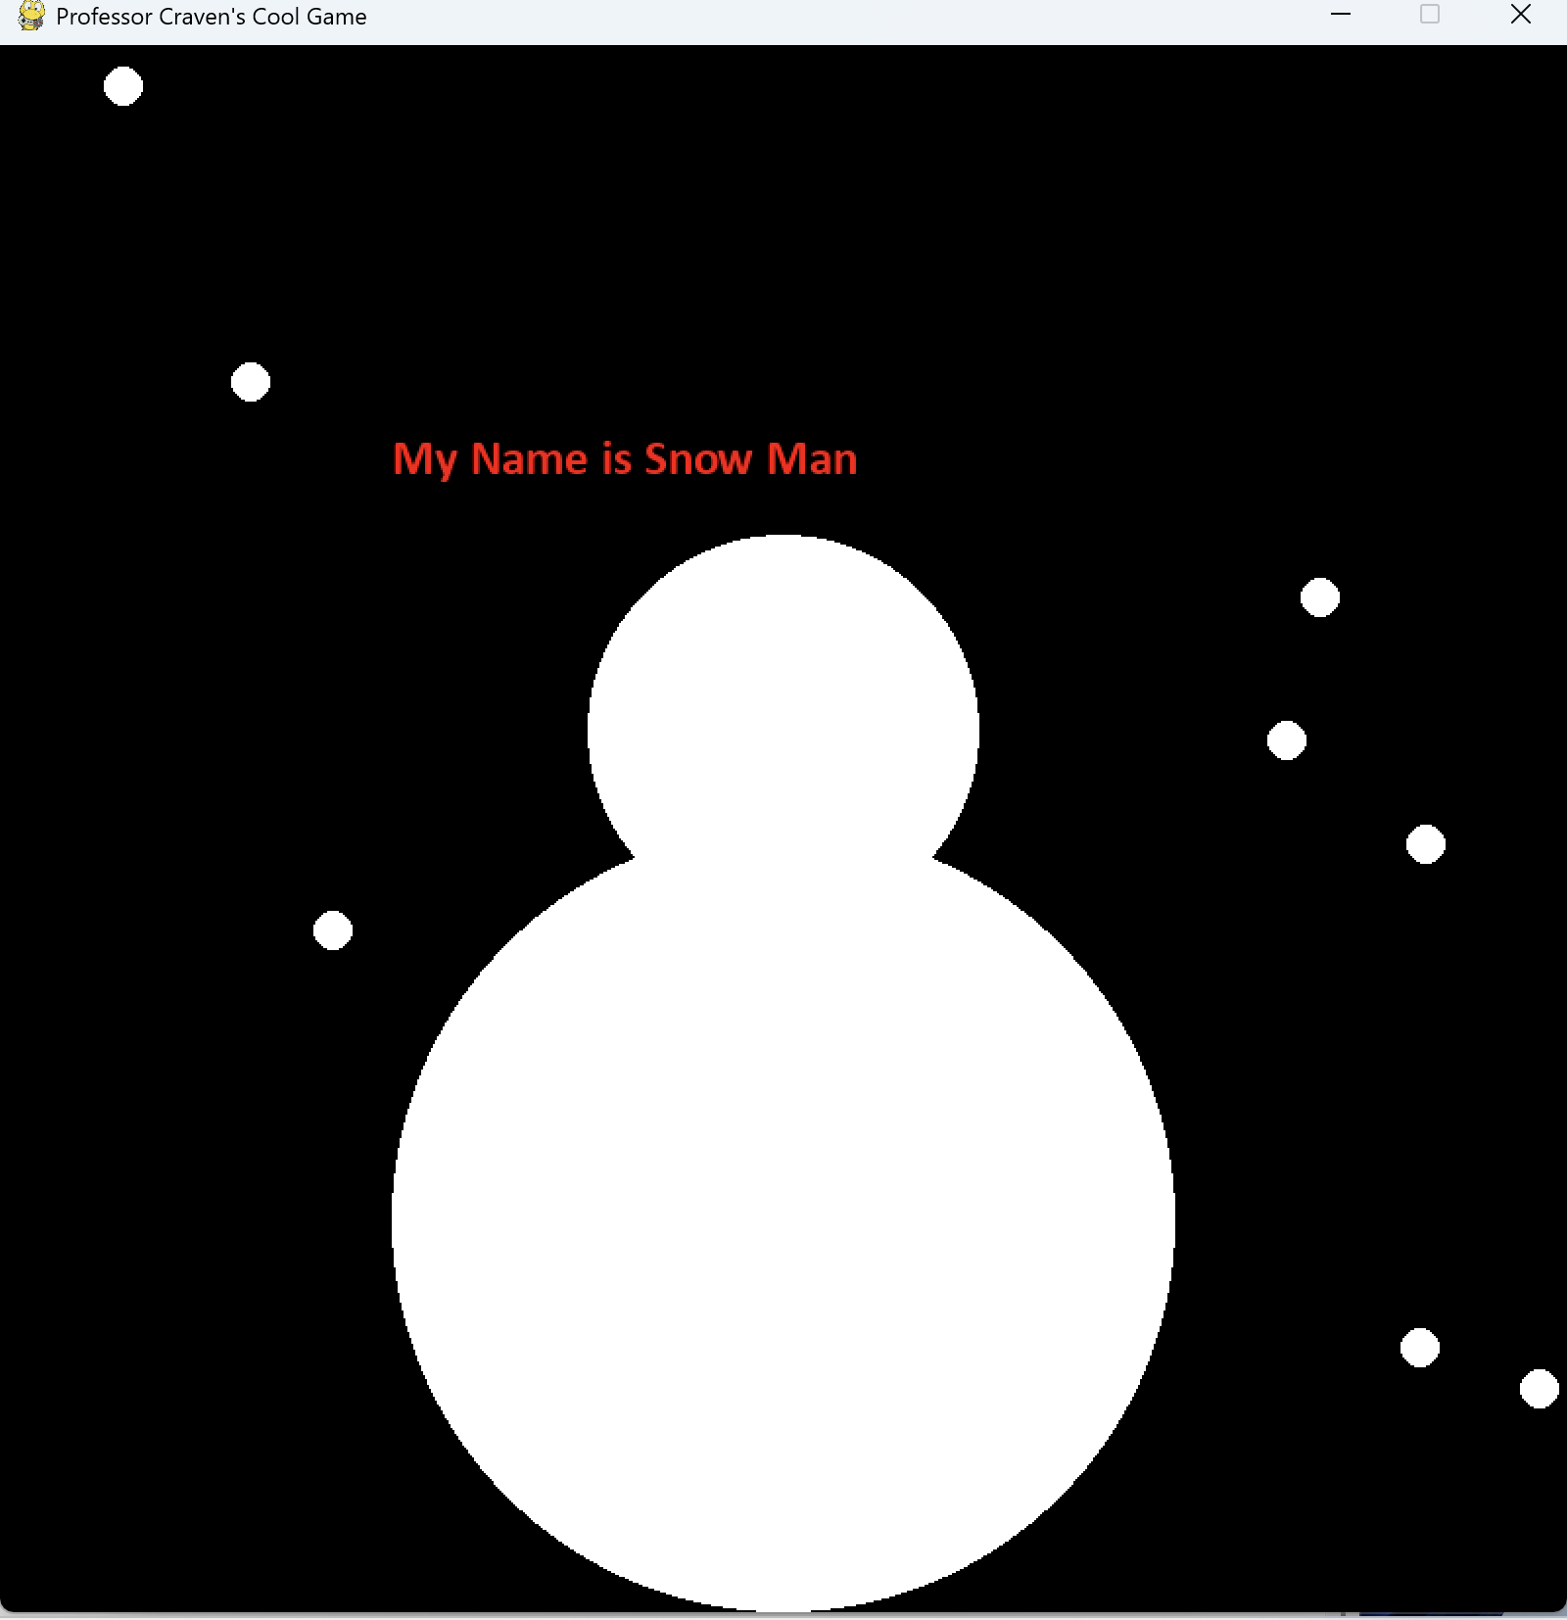
Lab 5:
Hints:
Start with template files.
pygame_base_template.py
simple_graphics_demo.py
2. This is an example to draw a snowman and snowflake using pygame.draw.circle.
# Draw 2 circles and make a snowman
pygame.draw.circle(screen, WHITE, [400, 600], 200)
pygame.draw.circle(screen, WHITE, [400, 350], 100)
# Draw snowflake
for i in range(10):
x = random.randrange(0,800)
y = random.randrange(0,800)
pygame.draw.circle(screen, WHITE, [x, y], 10)

Slide 8
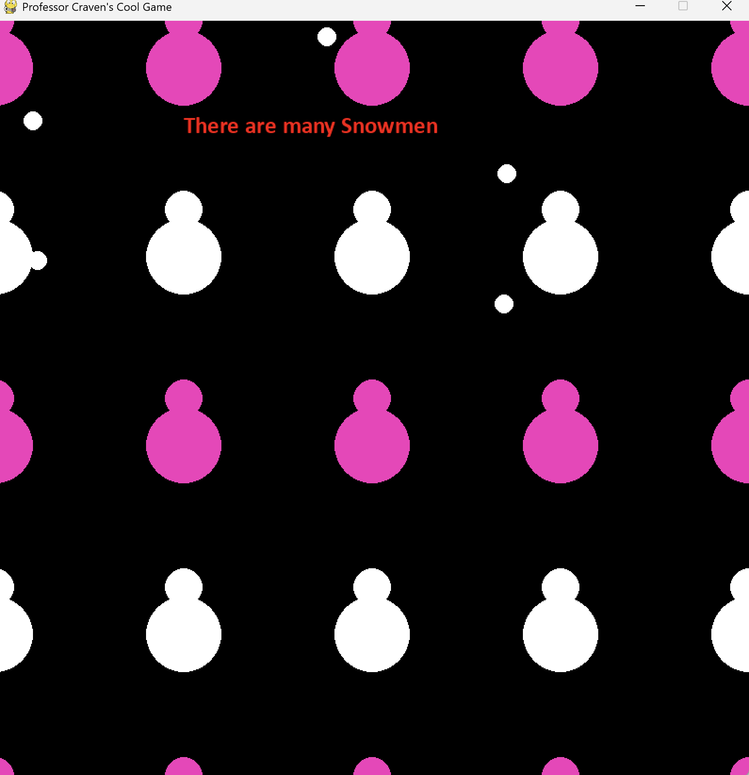
Lab 5:
Hints:
Start with template files.
pygame_base_template.py
simple_graphics_demo.py
2. This is an example to draw many snowmen
using pygame.draw.circle.
# Draw 2 circles and make a snowman
for i in range(5):
for j in range(5):
if j %2:
color = WHITE
else:
color = PINK
pygame.draw.circle(screen, color, [i*200, j*200], 20)
pygame.draw.circle(screen, color, [i*200, j*200+50], 40)

Slide 9
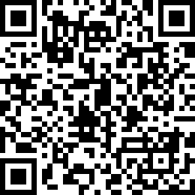
Attendance Check 10
Please submit the following form at the end of the class. This is today's attendance check.
https://forms.gle/ESYNVNNSaTsr6xJa8

Slide 10
Week 6, Class 11 (2025/02/28): Lab 8: Animation
Goals/Tasks:
Lab8: Animation
Modify the prior Create-a-Picture lab5 or start a new one.
Animate the image.

Slide 11
Lab 8:
Task: Write a program to create an Animation
Refer to the online course: http://programarcadegames.com/index.php?chapter=lab_animation&lang=en
Modify the prior Create-a-Picture lab5 or start a new one.
Animate the image. Try one or more of the following:
Move an item across the screen.
Move an item back and forth.
Move up/down/diagonally.
Move in circles.
Have a person wave his/her arms.
Create a stoplight that changes colors.
Save your program as lab8_<your name>.py
Upload the file to the Teams Folder

Slide 12
Lab 8:
Hints:
Start with template files.
pygame_base_template.py
simple_graphics_demo.py
animating_snow.py
2. This is an example to animate snowmen
# x-change increases in the while loop by 5
x_change += 5
for i in range(5):
for j in range(5):
if j %2:
color = WHITE
else:
color = PINK
pygame.draw.circle(screen, color, [i*200 + x_change, j*200], 20)
pygame.draw.circle(screen, color, [i*200 + x_change, j*200+50], 40)
#when the most righ snowman reached the right-side edge, initialize x_change
if i == 3 and (i*200 + x_change) > 800:
x_change = 0

Slide 13
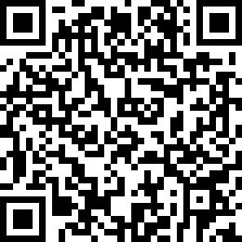
Attendance Check 11
Please submit the following form at the end of the class. This is today's attendance check.
https://forms.gle/6y3PpTJore1m2Lcw8

