Slide 1
Programming Experiments With Python And Pygame #9
 | Course Code | Course Name | Credits
 | V.ITD215 | Programming Experiments | 2
Prepared by Mariko Tagawa, JICA volunteer

Slide 2
Course schedule
Week | Class | Title | Goal of the class or Tasks
1
 | 1 | Introduction to Pygame and Its Capabilities | Understand what Pygame is and its role in graphical programming. Learn how to install and set up the Pygame library in Python. Run and analyze a simple Pygame program to create a blank window.
2 | 2 | Chapter 1 - Create a Custom Calculator | Review Python basics Printing Comments Variables Operators
 | 3 | Chapter 1 - Create a Custom Calculator Lab 1: Custom Calculators | Lab1: Create a Custom Calculator Create a program to calculate your target time for completing a full marathon
3 | 4 | Chapter 3 - Quiz Games and If Statements | Review Python basics Basic Comparisons Indentation Using And/Or Boolean Variables Else and Else If Text Comparisons
 | 5 | Chapter 3 - Quiz Games and If Statements Lab 3: Create a Quiz | Lab 3: Create a Quiz Refer to a Sample Quiz and create your own Quiz Use if, elif, else

Slide 3
Course schedule
Week | Class | Title | Goal of the class or Tasks
4 | 6 | Chapter 4: Random Numbers and Loops | Review Python basics For Loop while Loops Random Numbers
 | 7 | Chapter 4: Random Numbers and Loops Lab 4: Game | Lab 4: Create a Game Refer to a Sample game and create your own game. Use loop, if
5 | 8 | Chapter 5: Introduction to Graphics | Learn how to draw basic shapes like rectangles, polygons, and text using Pygame.
 | 9 | Introduction to Animation | Understand the basics of animation using Python and Pygame.
6 | 10 | Lab 5: Create a Picture | Lab5: Create a Picture You must use multiple colors. You must use multiple types of graphic functions (circles, rectangles, lines, etc.) You must use a while or for loop to create a repeating pattern.
 | 11 | Lab 8: Animation | Lab8: Animation Modify the prior Create-a-Picture lab5 or start a new one. Animate the image.

Slide 4
Course schedule
Week | Class | Title | Goal of the class or Tasks
7 | 12 | Chapter 10: Controlling an object with the mouse and keyboard | Learn how to control an object with the mouse or keyboard on the screen. Files: move_mouse.py, move_keyboard.py Exercise7: Modify sample programs.
 | 13 | Chapter 11: Bitmapped Graphics and Sound | Learn how to use bitmapped graphics (images) to your games. Learn how to add sound to your games. Exercise8: Use images and sound.
8, 9 | 14,15 ,16 | Lab: Designing Your Own Animation/Game Presentations and Showcase | Use the knowledge from previous classes to create your own animation or game. Present your completed animation or game to the class.

Slide 5
Week 7, Class 13 (2025/03/14): Bitmapped Graphics and Sound
Goals/Tasks:
Learn how to use bitmapped graphics (images) to your games.
Learn how to add sound to your games.
Exercise8. Use images and sound.
Homework Quiz: Review today's class content

Slide 6
Bitmapped Graphics and Sound
Online Course:
http://programarcadegames.com/index.php?chapter=bitmapped_graphics_and_sound&lang=en#section_11
Homework Quiz
http://programarcadegames.com/quiz/quiz.php?file=bitmapped_graphics&lang=en

Slide 7

Create a project folder
In this class, we use multiple files, python source file, image files and sound file.
These files should be stored in a folder.
Create a folder on your computer, named “Project1” or any name is OK.
Store the 5 files.
Project1 | bitmapped_graphics.py pygame_base_template.py laser5.ogg playerShip1_orange.png saturn_family1.jpg

Slide 8
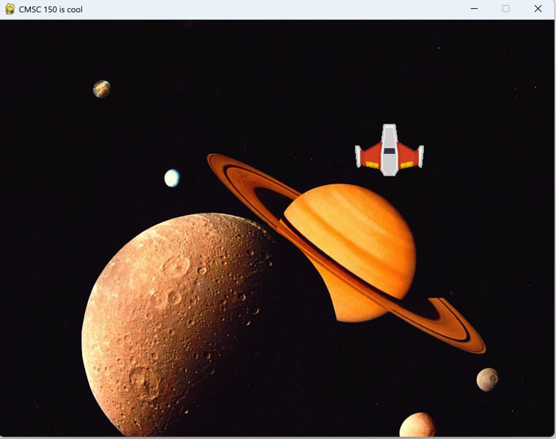
Bitmapped Graphics and Sound
This program shows how to set a background image and .use an image in the program.
Open Anaconda Prompt.
Type “ldle” in the Anaconda Prompt.
File - Open - bitmapped_graphics.py
Run
A spaceship appears in the windows with a Saturn image in the background. The spaceship moves with your mouse.
Close the window.

Slide 9
Bitmapped Graphics
Open Anaconda Prompt.
Type “ldle” in the Anaconda Prompt.
Open - pygame_base_template.py
File – SaveAs - pygame_base_<your name>.py
Video :https://youtu.be/4YqIKncMJNs?si=C6BIqPq8j6WF9DuZ (2’30” ~)
Video : https://youtu.be/ONAK8VZIcI4 (1’15” ~)
Free Image sites:
https://pixabay.com/
https://www.istockphoto.com/
https://opengameart.org/

Slide 10
Sound
Video : https://youtu.be/_6c4o41BIms?si=vs5yh1WbzJPErBv4
When using images or sounds, please be mindful of copyright.
Free Images site:
https://pixabay.com/
https://www.istockphoto.com/
https://opengameart.org/

Slide 11
Exercise 8: Modify bitmapped_graphics.py
Exercise: Modify the code of bitmapped_graphics.py.
Download free images and sounds from the internet.
Please be careful their copyright.
(ex) https://opengameart.org/
Set background image, draw an image, and add sound in your program.
Test the modified program well.
Save the file to class13_<Your name>_exe8.py
Upload the file to the Teams Folder.

Slide 12
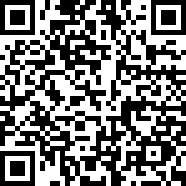
Attendance Check 13
Please submit the following form at the end of the class. This is today's attendance check.
https://forms.gle/paSNeJnvKN6gL7SZ6

Slide 13
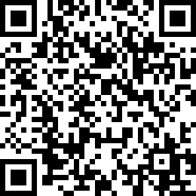
2025/3/19 Attendance Check 14
Please submit the following form at the end of the class. This is today's attendance check.
https://forms.gle/MHRRD8V1XsvV1yNm8

Slide 14
Сорил-1/ тоглоом хийж хураалгах /
Сорил-1/ тоглоом хийж хураалгах /
3-р сарын 26-нд оюутан бүр хийсэн тоглоомоо хураалгана.
3-р сарын 28-нд хийсэн ажлын тайлан /тоглоом/ тавина.
Mid-Term Assignment Design Sheet
https://forms.gle/SUjvhY5HGbuxNw5w7

Slide 15
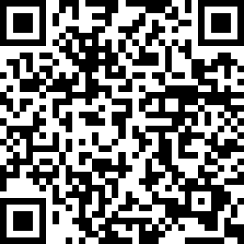
Сорил-1/ тоглоом хийж хураалгах /
Сорил-1/ тоглоом хийж хураалгах /
3-р сарын 26-нд оюутан бүр хийсэн тоглоомоо хураалгана.
3-р сарын 28-нд хийсэн ажлын тайлан /тоглоом/ тавина.
Mid-Term Project Design Sheet
https://forms.gle/SUjvhY5HGbuxNw5w7

Slide 16
Python & Pygame Videos
Python Pygame tutorials!
https://youtube.com/playlist?list=PLsFyHm8kJsx1g191CspASSTHuLDEXZRH9&si=FQeqeXrxncrdAuac
Program Arcade Games
https://youtube.com/playlist?list=PL1D91F4E6E79E73E1&si=Kuq7xMuohRIAGcCL
The ultimate introduction to Pygame
https://youtu.be/AY9MnQ4x3zk?si=I9bOyPmaf2EjyJEy
Learn Pygame!
https://youtube.com/playlist?list=PLEqFPUEr9bX805YzIiUx_6uXtB--FQJCb&si=uGhWVkjjhNYOGOF3

Slide 17
Python & Pygame Videos
Learn Pygame!
https://youtube.com/playlist?list=PLEqFPUEr9bX805YzIiUx_6uXtB--FQJCb&si=uGhWVkjjhNYOGOF3
Example code and programs
http://programarcadegames.com/index.php?chapter=example_code
Add a video in your program
https://youtu.be/Xu8SLkvFq8I?si=N4VOAY6cvWhnffS3

Slide 18
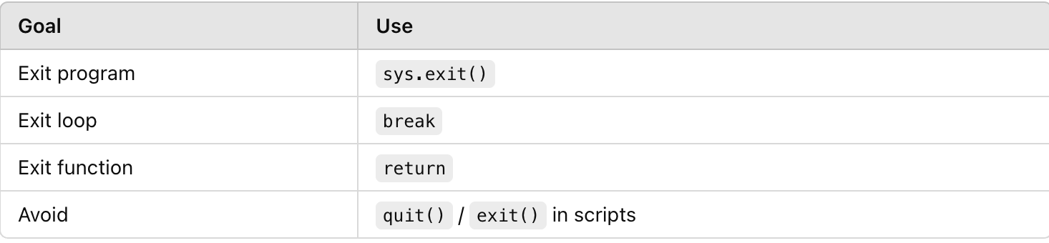
❌ Avoid using quit() or exit() in scripts
quit() and exit() are for interactive use only (like in the Python shell).
They are not recommended in real programs—they may not work as expected in some environments (like IDLE or editors).

