Slide 1
Programming Experiments With Python And Pygame #10
 | Course Code | Course Name | Credits
 | V.ITD215 | Programming Experiments | 2
Prepared by Mariko Tagawa, JICA volunteer

Slide 2
Course schedule
Week | Class | Title | Goal of the class or Tasks
1
 | 1 | Introduction to Pygame and Its Capabilities | Understand what Pygame is and its role in graphical programming. Learn how to install and set up the Pygame library in Python. Run and analyze a simple Pygame program to create a blank window.
2 | 2 | Chapter 1 - Create a Custom Calculator | Review Python basics Printing Comments Variables Operators
 | 3 | Chapter 1 - Create a Custom Calculator Lab 1: Custom Calculators | Lab1: Create a Custom Calculator Create a program to calculate your target time for completing a full marathon
3 | 4 | Chapter 3 - Quiz Games and If Statements | Review Python basics Basic Comparisons Indentation Using And/Or Boolean Variables Else and Else If Text Comparisons
 | 5 | Chapter 3 - Quiz Games and If Statements Lab 3: Create a Quiz | Lab 3: Create a Quiz Refer to a Sample Quiz and create your own Quiz Use if, elif, else

Slide 3
Course schedule
Week | Class | Title | Goal of the class or Tasks
4 | 6 | Chapter 4: Random Numbers and Loops | Review Python basics For Loop while Loops Random Numbers
 | 7 | Chapter 4: Random Numbers and Loops Lab 4: Game | Lab 4: Create a Game Refer to a Sample game and create your own game. Use loop, if
5 | 8 | Chapter 5: Introduction to Graphics | Learn how to draw basic shapes like rectangles, polygons, and text using Pygame.
 | 9 | Introduction to Animation | Understand the basics of animation using Python and Pygame.
6 | 10 | Lab 5: Create a Picture | Lab5: Create a Picture You must use multiple colors. You must use multiple types of graphic functions (circles, rectangles, lines, etc.) You must use a while or for loop to create a repeating pattern.
 | 11 | Lab 8: Animation | Lab8: Animation Modify the prior Create-a-Picture lab5 or start a new one. Animate the image.

Slide 4
Course schedule
Week | Class | Title | Goal of the class or Tasks
7 | 12 | Chapter 10: Controlling an object with the mouse and keyboard | Learn how to control an object with the mouse or keyboard on the screen. Files: move_mouse.py, move_keyboard.py Exercise7: Modify sample programs.
 | 13 | Chapter 11: Bitmapped Graphics and Sound | Learn how to use bitmapped graphics (images) to your games. Learn how to add sound to your games. Exercise8: Use images and sound.
8, 9 | 14,15 ,16 | Lab: Designing Your Own Animation/Game Presentations and Showcase | Use the knowledge from previous classes to create your own animation or game. Present your completed animation or game to the class.

Slide 5
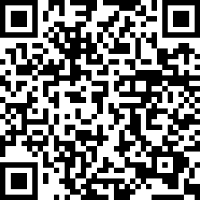
Сорил-1/ тоглоом хийж хураалгах /
Сорил-1/ тоглоом хийж хураалгах /
3-р сарын 26-нд оюутан бүр хийсэн тоглоомоо хураалгана.
3-р сарын 28-нд хийсэн ажлын тайлан /тоглоом/ тавина.
Mid-Term Project Design Sheet
https://forms.gle/SUjvhY5HGbuxNw5w7

Slide 6
1. What Makes a Good Program?
Short & Simple
Think of an efficient algorithm and write concise code.
Easy to Read
Use clear, descriptive variable names. (e.g., total_score, first_name, kilometers_driven)
Follow proper indentation.
Bug-Free
Test your code thoroughly to prevent errors.
Well-Organized
Add helpful comments
Reusable
Write code that can be reused or easily modified for other projects.

Slide 7
2. Important Concepts Not Fully Covered in Class
These are essential in real-world programming!
Keep learning 😊
Exiting Logic Properly
break → to exit loops
return → to exit functions
sys.exit() → to exit the whole program
Exception Handling
What happens if something goes wrong during runtime?
try:
# code
Except SomeError:
# handle error
Error Handling & Debugging
Think about unexpected input, unexpected operations and others.
Use print statements or debugging tools to find bugs

Slide 8
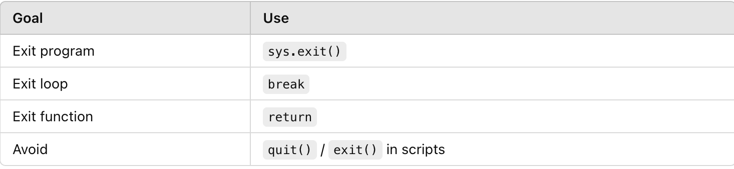
❌ Avoid using quit() or exit() in scripts
quit() and exit() are for interactive use only (like in the Python shell).
They are not recommended in real programs—they may not work as expected in some environments (like IDLE).
8

Slide 9
3. Give a short presentation about your work in front of the class
What your program does – Is it a game? An animation? What’s the goal or purpose?
How to use or play it – Show or explain how users interact with your program.
What features you’re proud of – Highlight any creative or technical features you implemented (e.g., cool graphics, smart code, sounds, animations, etc.).
Any challenges you overcame – Briefly mention anything that was difficult and how you solved it.
(if you want) What you would add or improve next – Ideas for future versions.

Slide 10
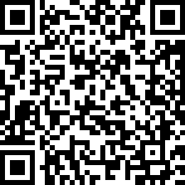
Attendance Check 15
Please submit the following form at the end of the class. This is today's attendance check.
https://forms.gle/8E8VbPX6B5oS5UCK9

